Slide 1
Use Cases for Wireless LAN Sensing
Aug, 2020
Date: 2020-08-xx
Authors:
Name | Affiliation | Address | Phone | Email
Dongguk Lim | LG Electronics | 19, Yangjae-daero 11gil, Seocho-gu, Seoul 137-130, Korea |  | dongguk.lim@lge.com
Insun Jang |  |  |  | insun.jang@lge.com
Sang Kim |  |  |  | sanggook.kim@lge.com
Jeongki Kim |  |  |  | jeongki.kim@lge.com
Jinsoo Choi |  |  |  | js.choi@lge.com

Slide 2
Introduction
Regarding the usage model/use cases, several contributions[1-3] have been discussed in the previous meetings.
In this contribution, we introduce and address the use cases applicable and suitable to WLAN sensing in the home environment.

Slide 3
Home environment
The use of Wireless LAN at home has become common, and, the use of more than one AP at home is getting attention for a stable connection and coverage.
Furthermore, many home appliances(i.e., HAs) are being equipped with the connection capability to the Wireless LAN for various services.
For example, TV, speaker, air conditioner, refrigerator, air cleaner, washing machine, dryer, electric light and etc. can support the connection through WLAN.
Therefore, the various link connection between AP and home appliances can be considered for WLAN sensing as well because these connection can enhance the performance of WLAN sensing.
In this contribution, we consider some use cases for WLAN sensing that utilize the home appliance. Also, regarding suggested use cases, the some requirement and KPIs are take into account.
Basically, we assume the following conditions.
The User does not need to carry a controller/ WLAN device.
The user is continuously monitored by WLAN sensing

Slide 4
Use case #1: Home appliance control
1-1. Control of home appliances by detecting gestures of a user
For example, power on/off, operating mode selection, strength control, channel switching, volume control and etc.
1-2. Control of home appliances by detecting presence or movement of a user
Automatic control happens when presence or movement of a user is detected within some range of each home appliance.
For example, when a user watching TV moves to the bedroom and the situation is detected through WLAN sensing, then the TV is turned off/dimmed or volume-downed automatically.
1-3. Control of home appliances by identifying users
Home appliances can provide user-specific services when identifying users.
For example, when a user sits down in front of TV, TV identifies who the user is by using WLAN sensing and then, provides program list or schedule that the user is interested in.
For another example, when a user comes to the refrigerator, the refrigerator displays customized diet for the identified user on the front screen of the refrigerator or sets a customized dispenser (ex., the water capacity, ice shape or size, etc.) for the identified user.

Slide 5
Use case #2: Surveillance/Monitoring of elder people and/or children
Home appliances are placed at various places in the house, WLAN sensing using the various link connections between AP and those of home appliance(s) can cover the whole house for detecting of the presence in the home.
2-1 Presence or movement detection within home
For example, if there is no one in the house and some movement inside the house is detected by WLAN sensing.
If it is determined as a unusual, for example, starting at the window, this is notified to current home owner or security.
2-2 Monitoring of identified user
Whereabouts of the identified child in the house are not known to a caretaker or identified elder people are staying at home alone, their location and status can be tracked or detected by WLAN sensing.
For example, If it detects some troublesome situations such as fall, bump from the identified child or elder people, it is indicated to the parent or family members.
This can be useful application of WLAN sensing for deployment in elderly care facilities and daycare center.

Slide 6
Use case #3: Medical/health care
WLAN sensing is used to continuously monitor the user’s body movement, for example, abdomen and chest, in real time at the home.
For the WLAN sensing-based vital sign of user, the various link connections between AP/wearable and home appliances are used.
Also, the biometric data measurements include heartbeat and respiration rates are measured by using the WLAN sensing.
This information can be used for monitoring the health of patients/users in a noninvasive and passive manner.
In addition, WLAN sensing is useful to detect the immediate change of vital signs for people in unusual situation.
If an emergency situation(s), for example rapidly reducing or stopping of heart rate, happens, it is indicated to a medical staffs or family members.
This use case primarily targets home deployment for living alone elder people or, however, it is also suitable for deployment in hospital and elderly care facilities.

Slide 7
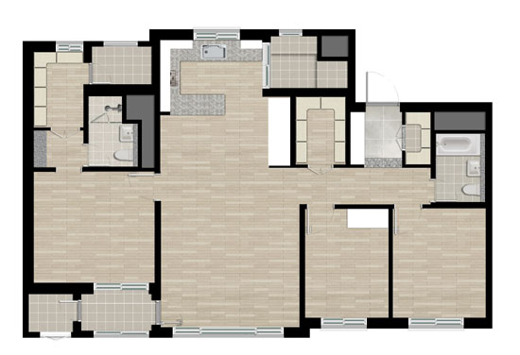
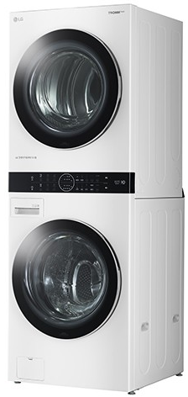
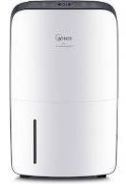
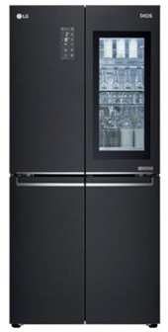
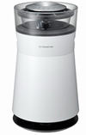
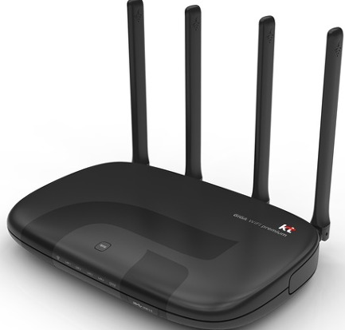
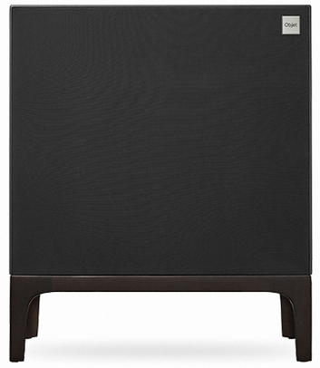
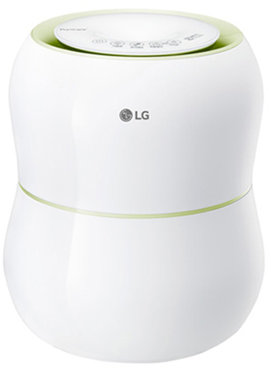
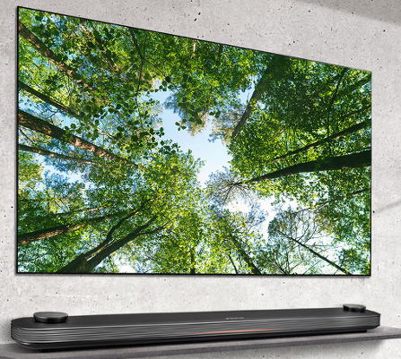
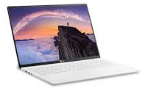
Use cases in home
Example illustration for use cases
When identified user approaching is detected through the WLAN sensing, the screen of the refrigerator turn on and the refrigerator provides the customized services.
When the falling of user is detected by WLAN sensing, it is alerted to others.
User moves from TV to refrigerator
User moves to room
when WLAN sensing detects a user is away from the TV, TV turn off the screen or decrease the volume.
User3
User2
User1
Through the WLAN sensing, presence or movement of user is detected.
When the intrusion is detected by WLAN sensing, it is alerted to others.
Intruder

Slide 8
Operation for use cases
Example for Sensing operation
The home appliances(i.e., STAs) able to support the Wi-Fi are connected to AP in the home.
AP(s) sends the sensing request or sensing measurement frame to home appliances periodically.
After receiving the sensing request or measurement frame from AP, the home appliances send the response frame or feedback the CSI (i.e., channel status information) to AP.
In the first case, the response frame can be replaced with measurement frame or the measurement frame can be transmitted after response frame.
By using the CSI that is measured itself or received from home appliances, AP determines the user’s movement or gestures.
Contrary to the above, the STA(Home appliances) can become the subject to measure the CSI and determine/utilize the information or receive the feedback of CSI from others when it performs the WLAN sensing.
AP/HA
HA/AP
AP/HA
HA/ AP
Sensing Req/Measurement frame
Sensing initiation frame
Sensing Res/feedback frame
Sensing Measurement frame
···
···
···
···
Sensing Measurement frame
Feedback frame

Slide 9
Requirement
Based on the requirements metric in [4]
Use cases | details | Key KPI | Max range (m) | Range Accuracy (m) | Max speed(m/s)/Speed Accuracy | Angular Accuracy (deg) | Target Separation (m) | Security/ Protection | Robustness | Maximum Network Load % | 60GHz Only
Home Appliance Control | Tracking person and motion/ gesture detection | Motion detection | 10 | < 1 |  |  |  | Medium | Medium-High | 1-2 | N
 |  | Gesture Detection | 3* |  |  |  |  | Medium | Medium-High | 5-10 | N
Surveillance/Monitoring of elder people and/or children | Tracking person and presence detection | Detection and localization of person | 10 | 0.2-2 | 3/0. |  | 0.5 | High | High | 10 | N
Medical/health care | measurements of vital signals | Heart/breathing rate | 3 |  | 2/0.1 |  |  | High | High | 10 | N
* : This value was set in considering of TV, but it can be changed depending on the type of Home Appliances.

Slide 10
Summary
The number of home appliances with WLAN connection capability is rapidly increasing.
In this contribution, we addressed the promising possibility of utilizing home appliances in the setting of WLAN sensing and summarized some possible applications :
Home appliance control
Surveillance/Care of elder people and/or children
Medical/health care
As a conclusion, we propose to add the use case of home appliance control into the use case document of 11bf that will be defined.

Slide 11
Reference
[1] 11-19/1725r0, Usage models for WLAN sensing, Rui Du
[2] 11-19/1772r0, Presence and Proximity Detection Using WLAN Sensing, Claudio Silva
[3] 11/1852r0, In-Car-Sensing-a-60GHz-Usage-example, Solomon Trainin
[4] 11-20/936r0, usage-model-document, Assaf Kasher

