Slide 1
Channel Modelling for LC in TGbb: Validation of Ray Tracing Models by Measurements
September 2020
Date: 2020-08-17
Authors:

Slide 2
Abstract
September 2020
This contribution presents a validation of TGbb channel models based on ray tracing based on wideband measurements.

Slide 3
Outline
September 2020
  Introduction
  Ray Tracing Methodology
  Measurement Methodology
  Investigated LC Scenarios
    I. LOS II. NLOS with dominant first-order reflection III. NLOS with higher-order reflections
  Test Environment and Modeling
  Modeling of Tx Front-end
  Modeling of Rx Front-end
  Results
    Channel Frequency Responses
    Channel Impulse Responses (CIRs)
  Mean Square Error (MSE)
Conclusions

Slide 4
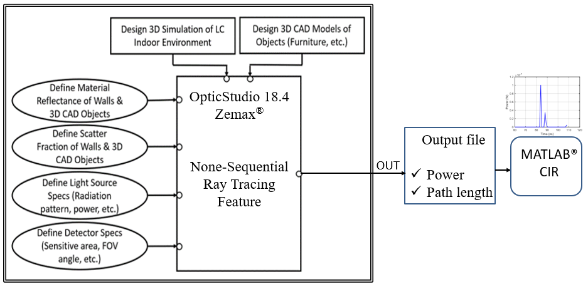
Ray Tracing Methodology
September 2020

Slide 5
Ray Tracing Methodology (2)
September 2020
The Major steps of ray tracing approach can be illustrated as the following:
We first create the 3D simulation model of the test environment under consideration in OpticStudio® and import the CAD models of the objects (i.e., furniture, human beings, etc.).
The coating materials of such CAD objects are then defined in the simulation platform where the wavelength-dependent reflectance as well scatter fraction can be specified.
After that, the light source specifications such as optical power, radiation pattern, orientations, and number of emitted rays are defined.
The specifications of the detector such as the sensitive area, field-of-view (FOV) angle, orientations, and directivity are defined.
The non-sequential ray tracing is performed to generate an output file containing information about the path length and the power of each ray emitted from the light source (Tx) and arrived at the detector (Rx).
By processing this information in MATLAB®, we can construct the CIR by
where N is the number of rays received by the detector and δ(t) is the Dirac delta function. Here, P_{i} and τ_{i} respectively are the power and the propagation delay of the i^{th} ray received by the detector. The channel frequency response can be then computed by the help of Fourier transformation.

Slide 6
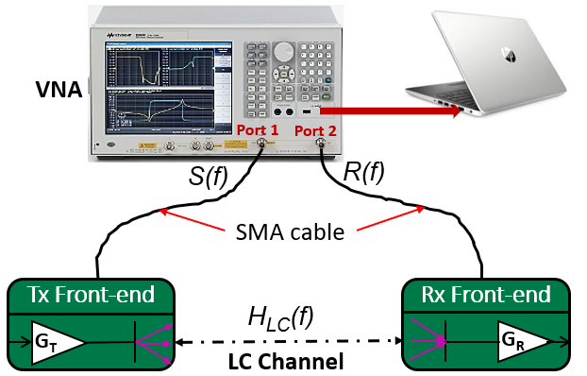
Measurement Methodology
September 2020

Slide 7
Measurement Methodology (2)
September 2020
The channel measurement system is based on frequency sweep technique using a standard Agilent two-port VNA capable of operating between 5 Hz and 3 GHz. The main steps of this approach can be illustrated as the following:
At first, a 0 dB continuous-sinusoidal-signal, swept from 1 MHz to 200 MHz in steps of 200 kHz, is delivered to the optical Tx front-end.
Then, Tx (consisting of multiple LEDs) radiates the signals through the propagation channel and a large amount of transmitted rays will be captured by the PD array of Rx according to the sensitive area and FOV angle of the PD.
The amplitude and phase of the received signal at the port 2 of VNA are compared with the transmitted ones and the corresponding frequency response of the LC system is generated. The resultant frequency response R(f) consists of the response of LC channel H_{LC}(f) and the response of the system H_{sys}(f) including the Tx and the Rx front-ends.
The effect of these front-end responses must be nullified in order to characterize the LC channel. To do this, a LOS calibration at a reference distance, d_{ref} is performed providing the frequency response of the reference LC channel R_{ref}(f).
The calibrated frequency response of the LC channel, is calculated by dividing the received frequency response at any particular distance by the received frequency response at the reference distance. Let S(f) denotes the transmitted signal, the resultant normalized frequency response of the channel is given by
The normalized CIR denoted by h_{N}(t) can be then calculated using the inverse discrete Fourier transformation method.

Slide 8
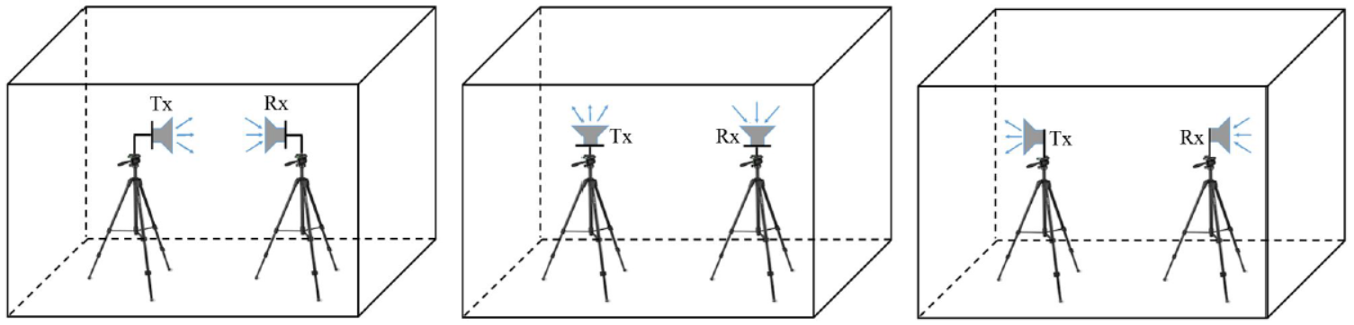
September 2020
Investigated LC Scenarios
LOS
NLOS 1st order reflection
NLOS higher-order reflections
Scenario I: Tx and Rx front-ends are facing each other in order to maintain a LOS link.
Scenario II: Tx and Rx face towards the ceiling. The Rx in this case can capture the rays after the reflection, mostly from the ceiling which represents the first-order reflection.
Scenario III: Tx and Rx face opposite directions. Hence the signaling takes place through the multiple reflections from the surfaces.
Slide 9

Slide 9
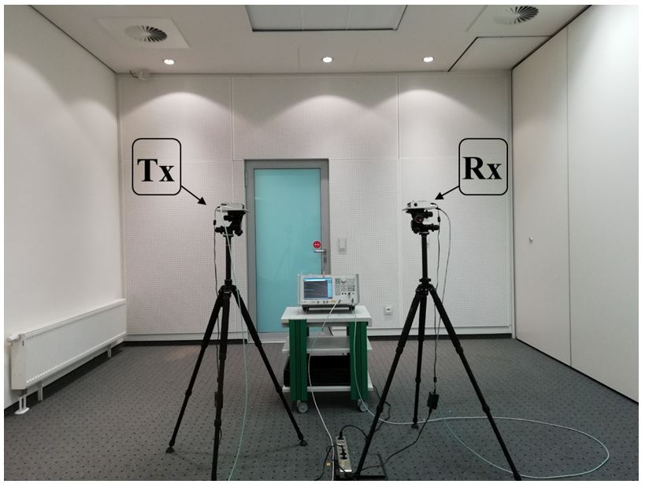
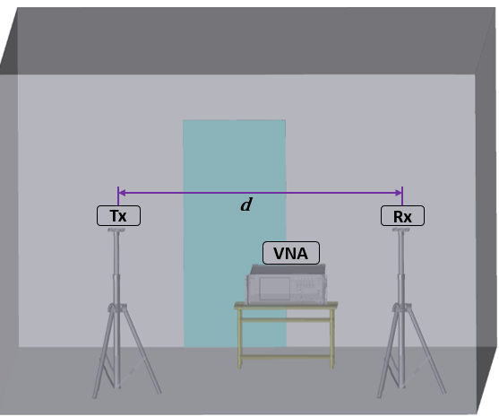
Test Environment and Modeling
September 2020
We performed the measurements in a small meeting room at HHI with a dimension of 5.7 m ×4.5 m × 3 m.
Both Tx and Rx front-ends are deployed on a metal tripod at a height of 1.5 m and with a separation distance of d.
Room environment where measurements carried out
Corresponding simulated scenario

Slide 10
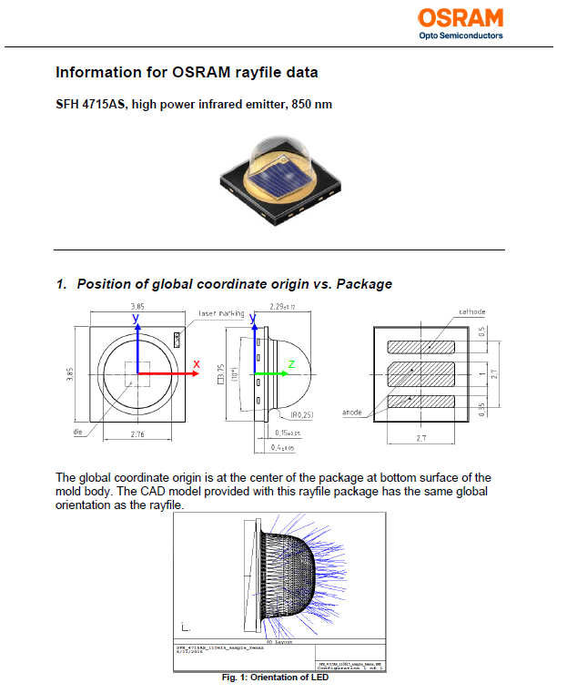
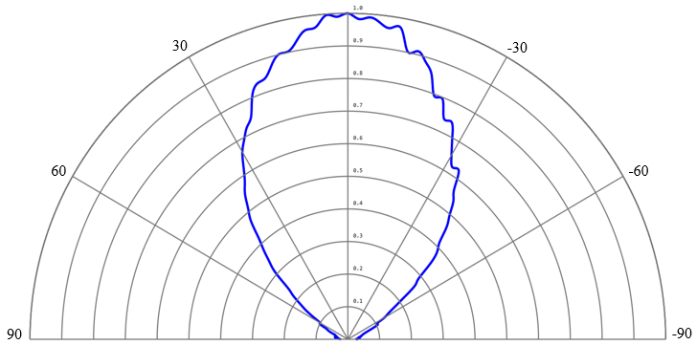
Modeling of Tx Front-end
September 2020
In our set-up, the Tx front-end consists of four OSRAM OSLON SFH-4715AS LEDs which has the centroid wavelength at 850 nm and with the simulated emission pattern given as follows.
Simulated radiation pattern in OpticStudio®

Slide 11
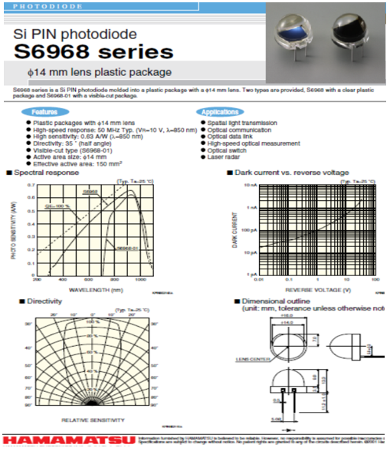
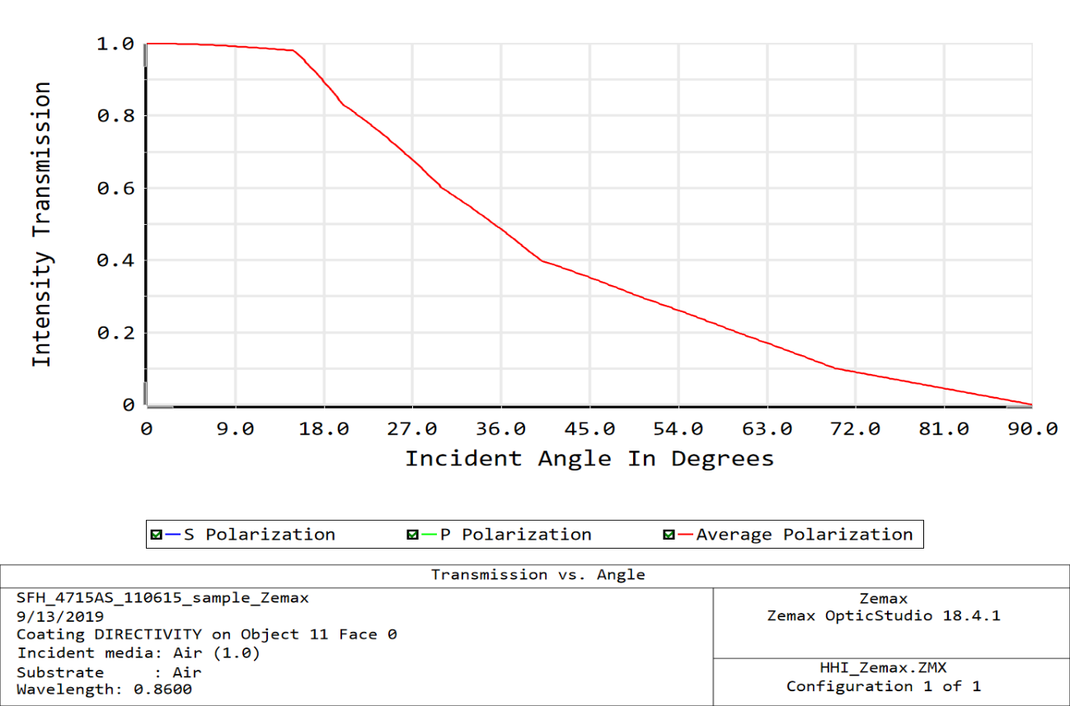
Modeling of Rx Front-end
September 2020
In our set-up, the Rx front-end is equipped with five HAMAMATSU-S6968 PDs with a high sensitivity around 850 nm with a coating and directivity given as follows.
Simulated receiver directivity in OpticStudio®

Slide 12
Simulation Parameters
September 2020
Room Model
Room size Coating materials | 5.7 m ×4.5 m × 3 m Walls: Plaster, Roof: Ceiling, Floor: Pinewood, Tripod: Aluminum
Transmitter Model
Brand Center Wavelength Optical Power Number of LEDs | OSRAM-OSLON-Black-SFH4715AS 850 nm 1.3 W 4
Receiver Model
Brand Active Area Sensitivity at 850 nm Number of Detectors | HAMAMATSU-S6968 Series 150 mm² 0.63 A/W 5
VNA Model
Brand Operating Frequency | Kesight-E5061B-3L5 5 Hz and 3 GHz

Slide 13
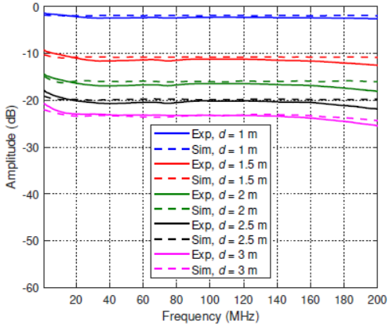
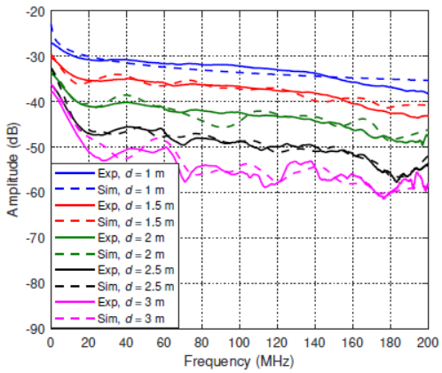
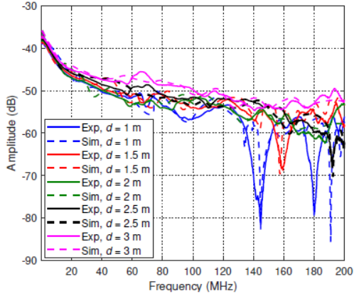
Results (Amplitude Response)
September 2020
Scenario I
Scenario II
Scenario III
Scenario I: The amplitude response is relatively constant over the whole bandwidth. As the distance between Tx and Rx increases from 1 m to 3 m, the DC gain reduces.
Scenario II: As the distance increases, the overlap between Tx radiation and Rx FOV reduces. Thus the possibility of signaling via the first reflection declines and multi-path reflections get more important. As a result, a drop in the amplitude and more ripples are observed due to increasing delays between second- and third-order reflections.
Scenario III: The diffuse signal has a remarkable effect on the amplitude response of the channel. It causes the fast drop below 20 MHz, followed by some ripple and few deep fades which occur always at higher frequencies.

Slide 14
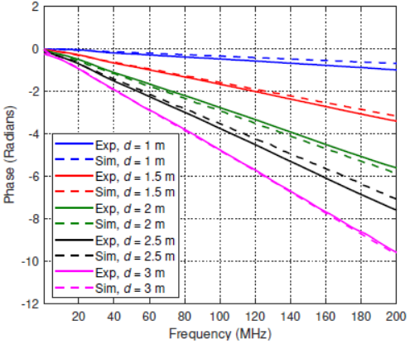
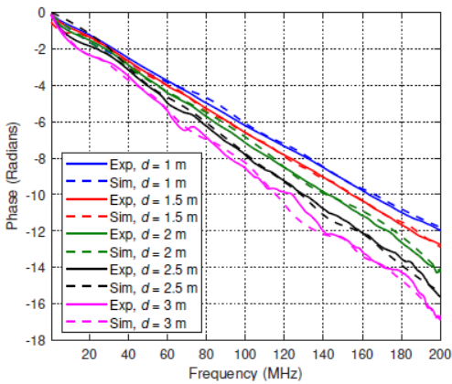
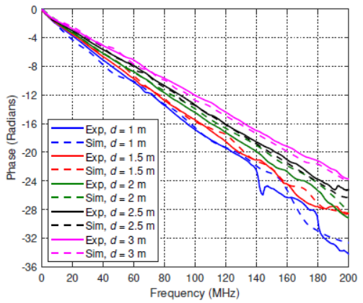
Results (Phase Response)
September 2020
Scenario I
Scenario II
Scenario III
In all scenarios, the phase response has an almost constant slope if there is minor ripple or fading in the amplitude response. The constant slope is due to the delay. In case of ripple and particularly for the fading events, there is a significant variation in the slope of the phase response. It is demonstrated that the amplitude and phase response results from simulation and experiments exhibit very similar behavior having a deviation of only 1-3 dB in amplitude and 1-4 radians in phase.

Slide 15
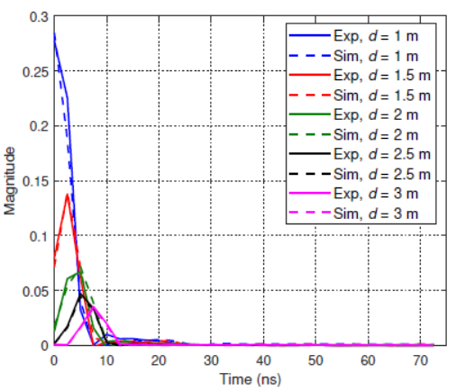
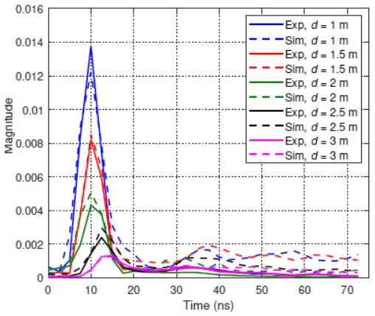
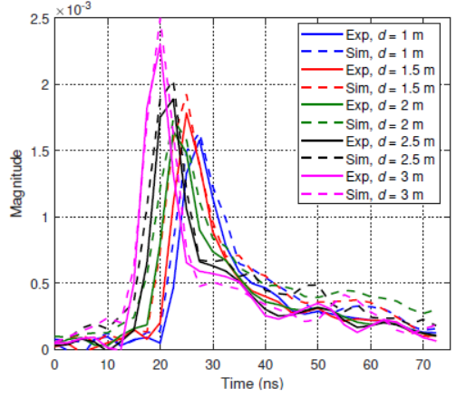
Results (Chanel Impulse Response)
September 2020
Scenario I
Scenario II
Scenario III
Scenario I: Due to strong LOS link, only a single peak is observable.
Scenario II and III: Due to the multiple reflections, the CIR broadens in the time domain and the area under the CIR gets smaller. In all cases, the strongest peak in the CIR is delayed in time as the path length between Tx and Rx increases. The strongest peak of CIRs is observed at the same point in the experimental and simulated data.

Slide 16
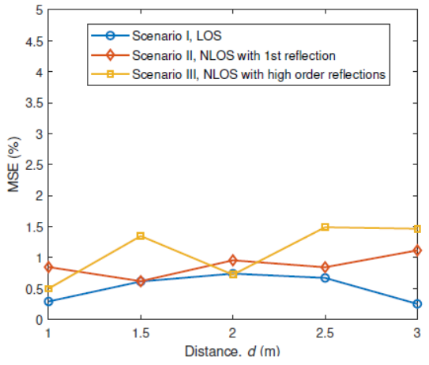
Results (Mean Square Error)
September 2020
We also measured the mean square error (MSE) between the measurements and simulations.
The maximum error are about 0.7%, 1%, and 1.5% respectively for scenario I, scenario II, and scenario III.
We can conclude that the results of simulations and measurements have indicated a very good match in both, frequency and time domains.

Slide 17
Conclusions
September 2020
  This contribution reported on a hands-on validation of the 802.11bb channel modeling methodology based on ray tracing by using wideband measurements.
  We have studied different LC scenarios in an empty room including LOS and two NLOS cases.
  We have taken measurements using state-of-the-art LC frontends using LEDs.
  The scenarios were also modeled in OpticStudio® using non-sequential ray tracing.
  Results of both approaches have indicated a very good match in both, frequency and time domains.
  The channel methodology has been validated, i.e. TGbb can rely on the existing on ray tracing models.

Slide 18
Acknowledgments
September 2020
This contribution was partly supported by the project VisIoN, funded by the European Union’s Horizon 2020 under the Marie Skłodowska-Curie grant agreement number 764461.

