Slide 1
Subcarrier Grouping for EHT
Date: 2020-08-13
Authors:

Slide 2
Introduction
802.11be shall supports that [1]
  Wideband band and noncontiguous spectrum utilization
  Large size RU combination assigned to a single STA.
  Maximum 16 spatial streams
Beamforming feedback overhead is significantly increased, compared to 11ax [2]
In order to reduce feedback overhead, the subcarrier grouping method was adopted in 11ac and 11ax
In this slide, we propose the subcarrier grouping size (Ng) for 802.11be

Slide 3
Recap: Subcarrier grouping
Subcarrier grouping
  Only a single compressed beamforming feedback matrix is reported for each group of N_{g} adjacent subcarriers.
Feedback overhead reduction vs. channel information accuracy
  By using the grouping method, we can reduce the feedback overhead (i.e., total length of CBR frame)
  However, the channel information becomes inaccuracy

Slide 4
Subcarrier grouping size (N_{g}) for EHT
Proposal of N_{g} for EHT
The reason for the proposal
  In most HE SU-MIMO cases, we observed that there was little PER performance difference between Ng=4 and Ng=16
  In most HE MU-MIMO cases, we observed that there was large PER performance difference between Ng=4 and Ng=16
 | SU | MU
VHT | 1, 2, 4
HE | 4, 16
EHT | 16, 32 | 4, 8
Subcarrier spacing for VHT: 312.5 KHz Subcarrier spacing for HE and EHT: 78.125 KHz

Slide 5
Simulation parameters
Parameter | Value
Frame format | HE
Packet size | 4,096 byte
Channel model | B, D
Impairment | Freq. offset: 20 PPM
Channel coding | LDPC
Channel estimation | LS (w/o smoothing)
GI+LTF Size | 4x HE-LTF and 3.2μs GI
Number of transmit antennas (N_{tx}) | 3, 4, 6, 8
Number of receive antennas (N_{rx}) | 1, 2
Number of spatial antennas (N_{ss}) | 1, 2
Number of users | 1, 2, 3, 4
Codebook information | Fine codebook
MCS | 2, 4, 6, 8, 10

Slide 6
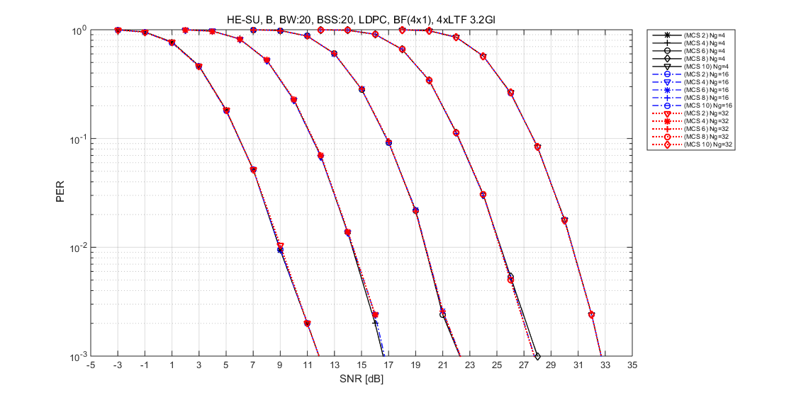
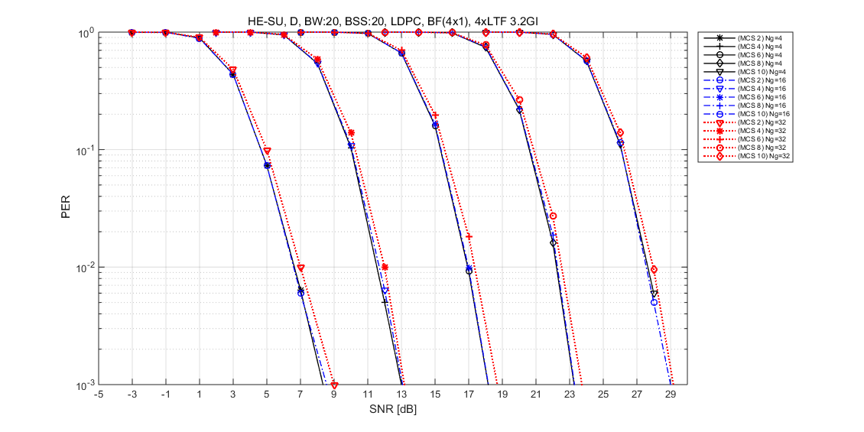
PER for SU-MIMO (4 $×1$)
Channel B
  Performance is almost same for N_{g}=4, N_{g}=16 and N_{g}=32
Channel D
  Compared with N_{g}=4, performance loss for N_{g}=16 is negligible
  Compared with N_{g}=4, performance loss for N_{g}=32 is < 0.5dB at PER=0.1
[Channel B]
[Channel D]

Slide 7
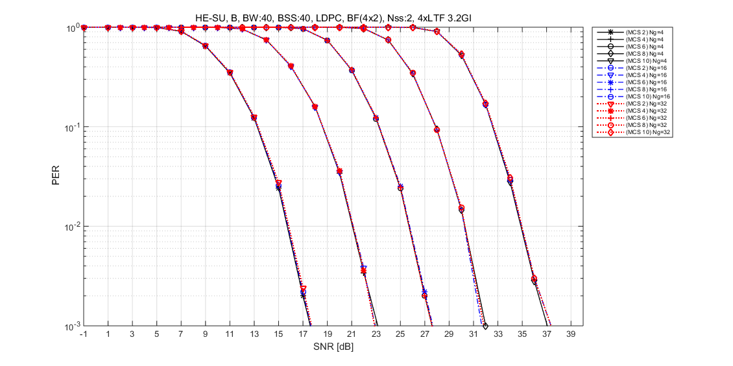
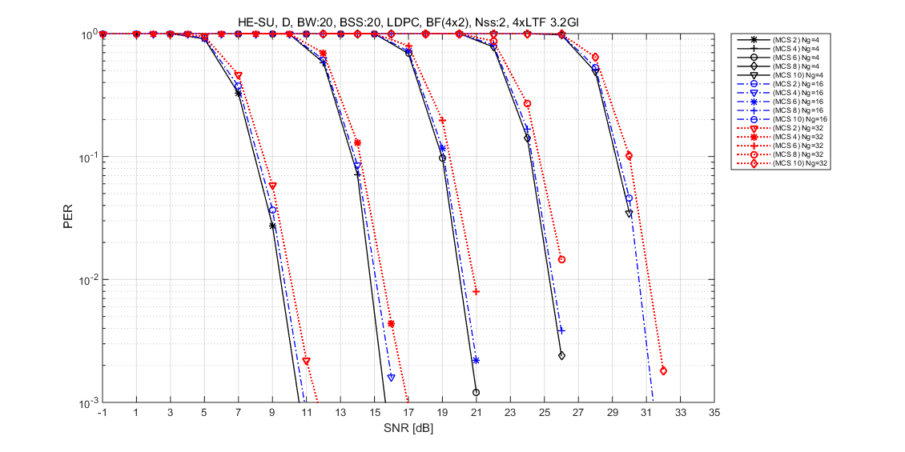
PER for SU-MIMO (4$×2$)
Channel B
  Performance is almost same for N_{g}=4, N_{g}=16 and N_{g}=32
Channel D
  Compared with N_{g}=4, performance loss for N_{g}=16 is negligible
  Compared with N_{g}=4, performance loss for N_{g}=32 is < 1.0dB at PER=0.1
[Channel B]
[Channel D]

Slide 8
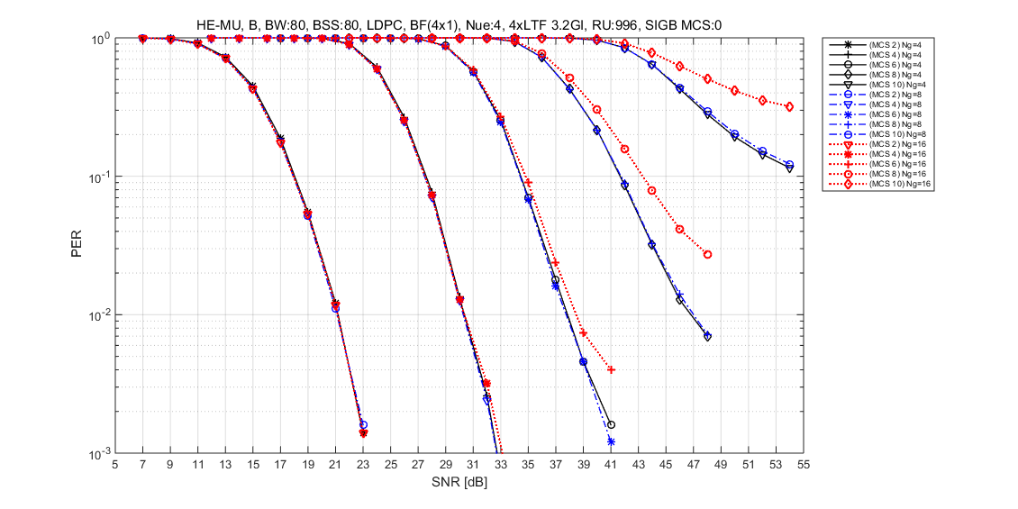
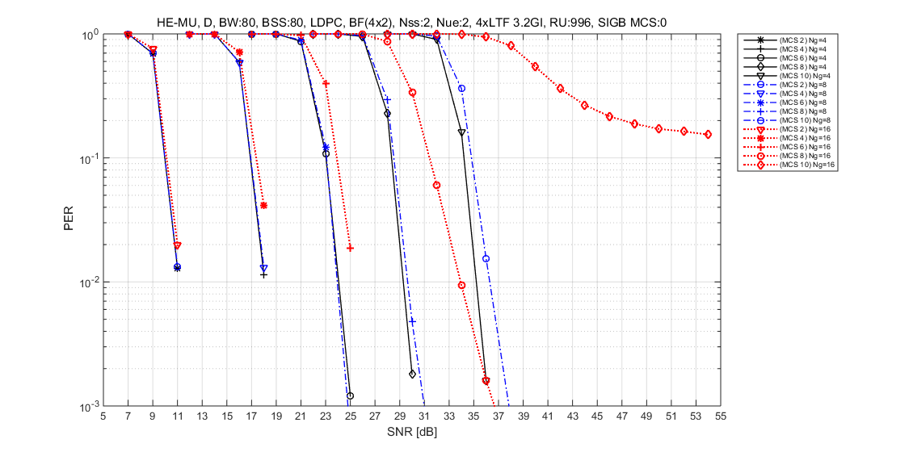
PER for MU-MIMO (4 $×1$)
Channel B
  Performance is almost same for N_{g}=4 and N_{g}=8
Channel D
  Performance loss for N_{g}=16 is significantly large, especially for high MCS
  Performance loss for N_{g}=8 is < 0.5dB at PER=0.1
[Channel B]
[Channel D]

Slide 9
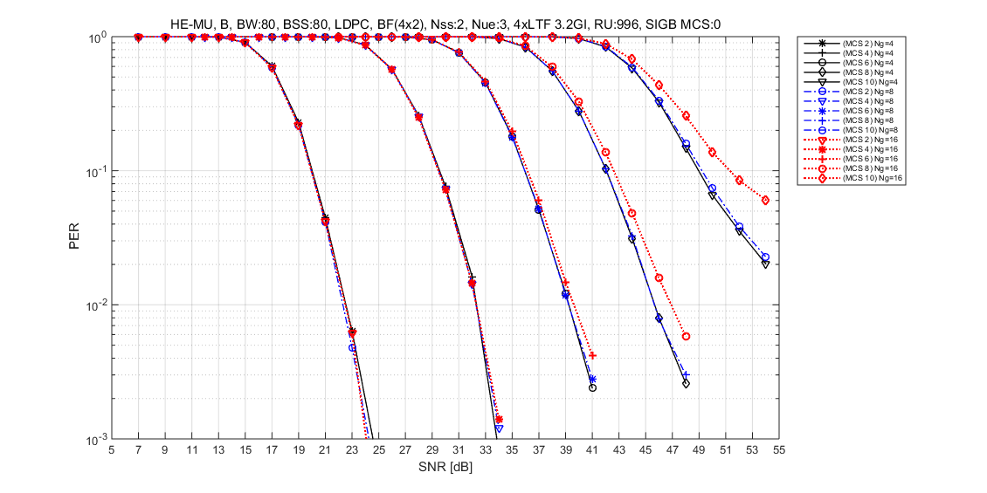
PER for MU-MIMO (4$×2$)
Channel B
  Performance is almost same for N_{g}=4 and N_{g}=8
Channel D
  Performance loss for N_{g}=16 is significantly large, especially for high MCS
  Performance loss for N_{g}=8 is < 0.5dB at PER=0.1
[Channel B]
[Channel D]

Slide 10

Feedback overhead reduction for SU
Feedback overhead reduction is approximately same as the CBR size reduction
  CBR size can be calculated by $16+\left\{N_{a}×(b_{φ}+b_{ψ})/2\right\}×$ $N_{sc}$(bits) [1]
  Assuming 8x2, 40MHz, fine codebook, then
    $N_{a}$ = 26
    $b_{φ}$ = 6, $b_{ψ}$= 4
    $N_{sc}$ = 122, 62, 32, 17 for N_{g} = 4, 8, 16, 32 respectively
N_{g} | 4 | 8 | 16 | 32
CBR size (byte) | 1985 | 1010 | 522 | 278
Reduction compared with N_{g}=4 | 0% | 49% | 74% | 86%

Slide 11
Summary
In this slide, we propose the subcarrier grouping size (Ng) for 802.11be
  Proposal of N_{g} for EHT
 | SU | MU
VHT | 1, 2, 4
HE | 4, 16
EHT | 16, 32 | 4, 8
Subcarrier spacing for VHT: 312.5 KHz Subcarrier spacing for HE and EHT: 78.125 KHz

Slide 12
Reference
[1] 802.11-20/0566r23, Specification Framework for TGbe.
[2] 802.11-19/0828r4, Feedback Overhead Analysis for 16 Spatial Stream MIMO
[3] “IEEE P802.11ax,” Part 11: Wireless LAN Medium Access Control (MAC) and Physical Layer (PHY) specifications. Amendment 1: Enhancements for High Efficiency WLAN, Feb. 2019.

Slide 13
SP #1
Do you agree to add the following to the TGbe SFD ?
  802.11be spec shall support N_{g} = 16, 32 for sounding feedback with SU-MIMO.
  802.11be spec shall support N_{g} = 4, 8 for sounding feedback with MU-MIMO.
  Y / N / Abstain

Slide 14
Appendices

Slide 15
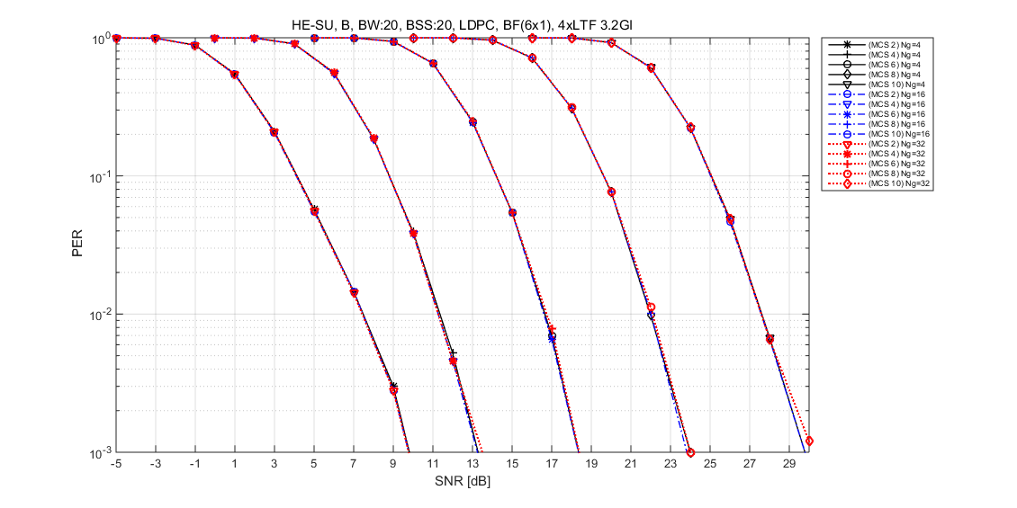
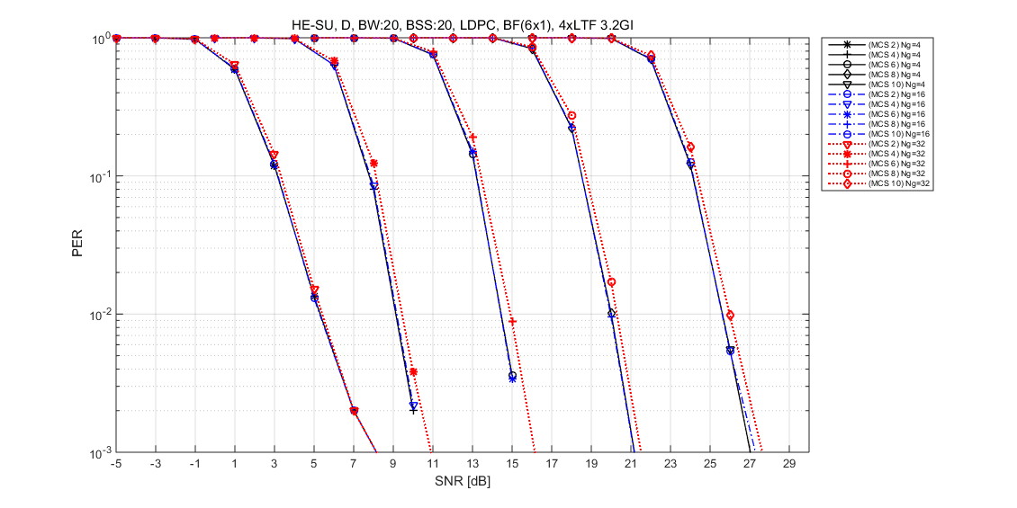
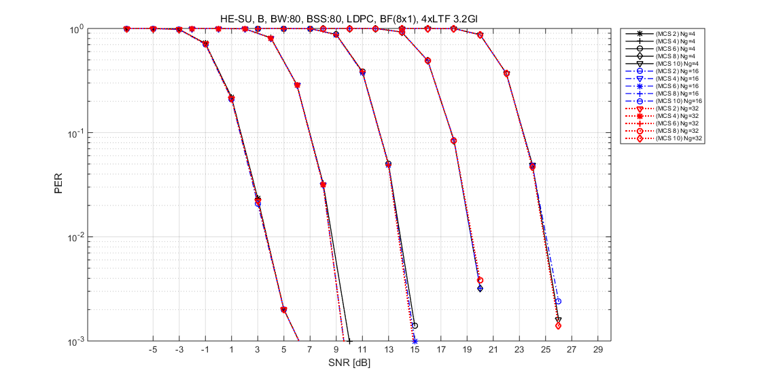
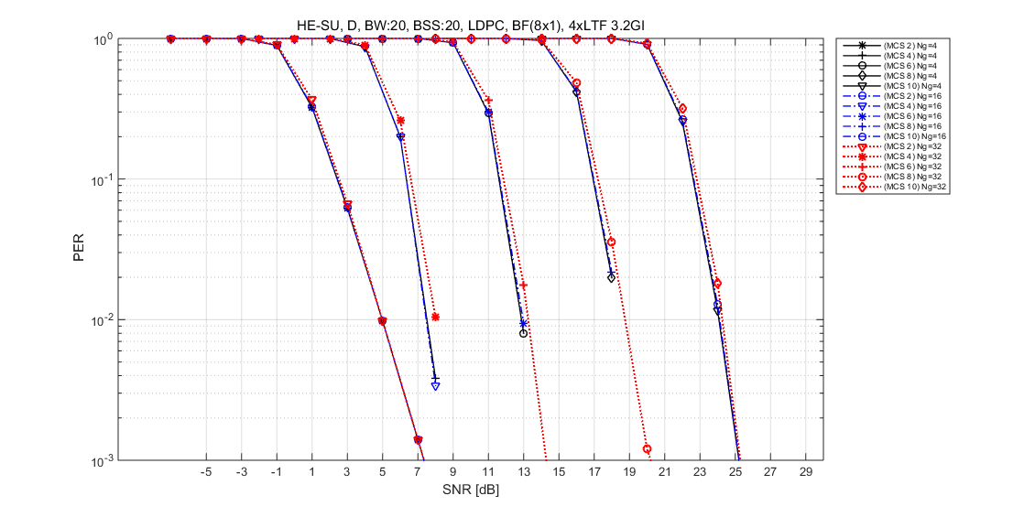
PER for SU-MIMO (6 $×1,$ 8 $×1, Ch.B, Ch.D)$

Slide 16
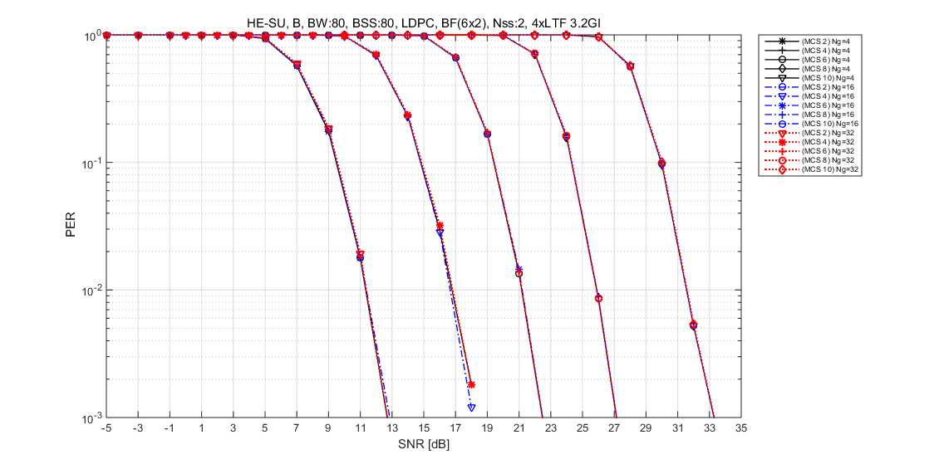
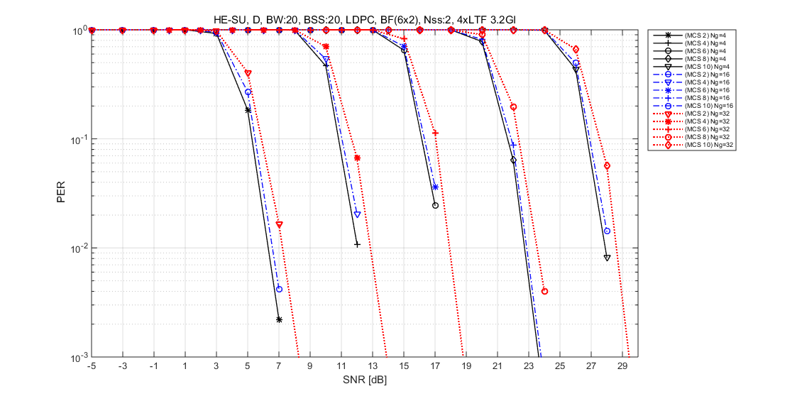
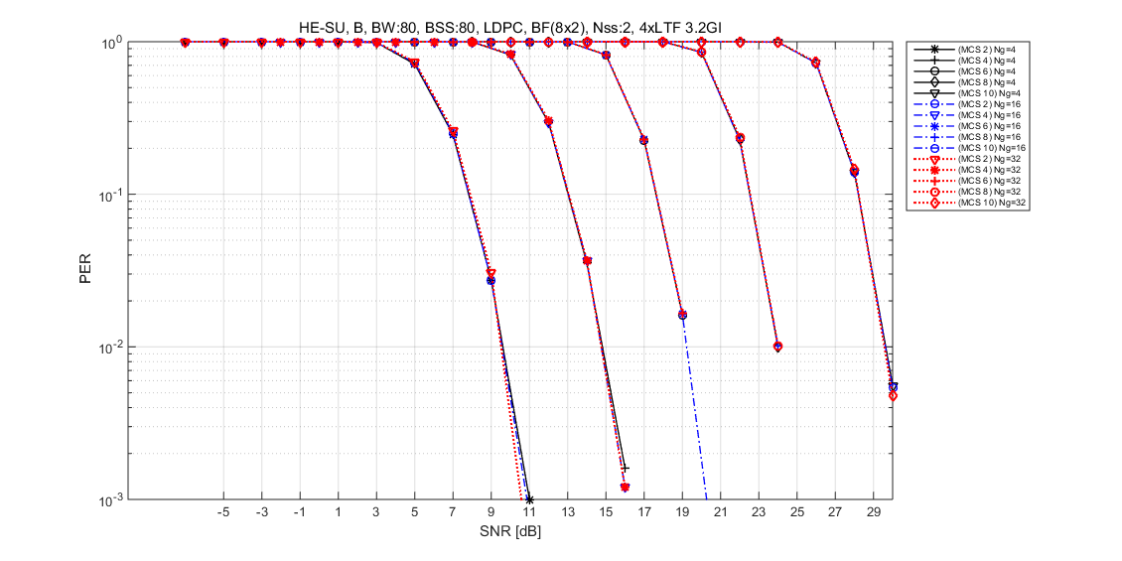
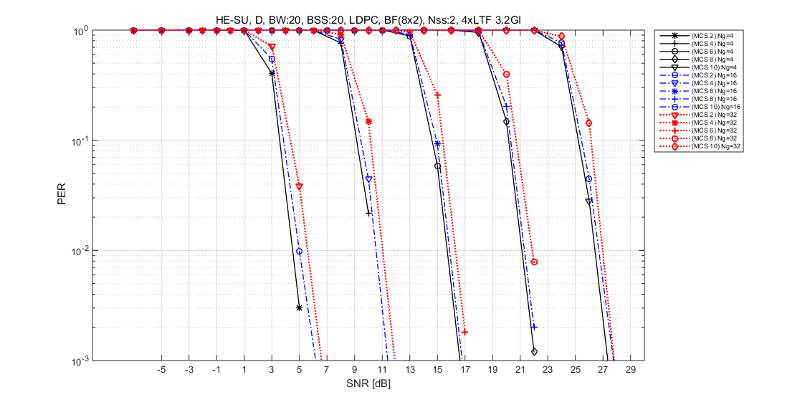
PER for SU-MIMO (6 $×2,$ 8 $×2$, $Ch.B, Ch.D$)

Slide 17
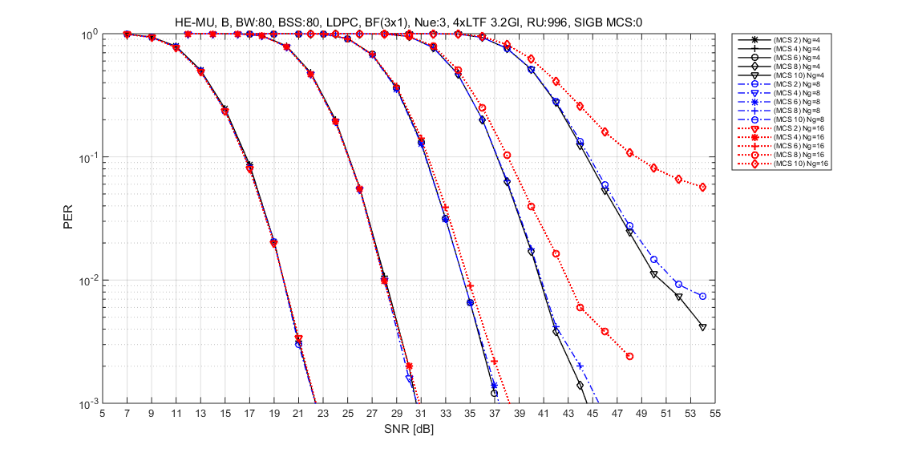
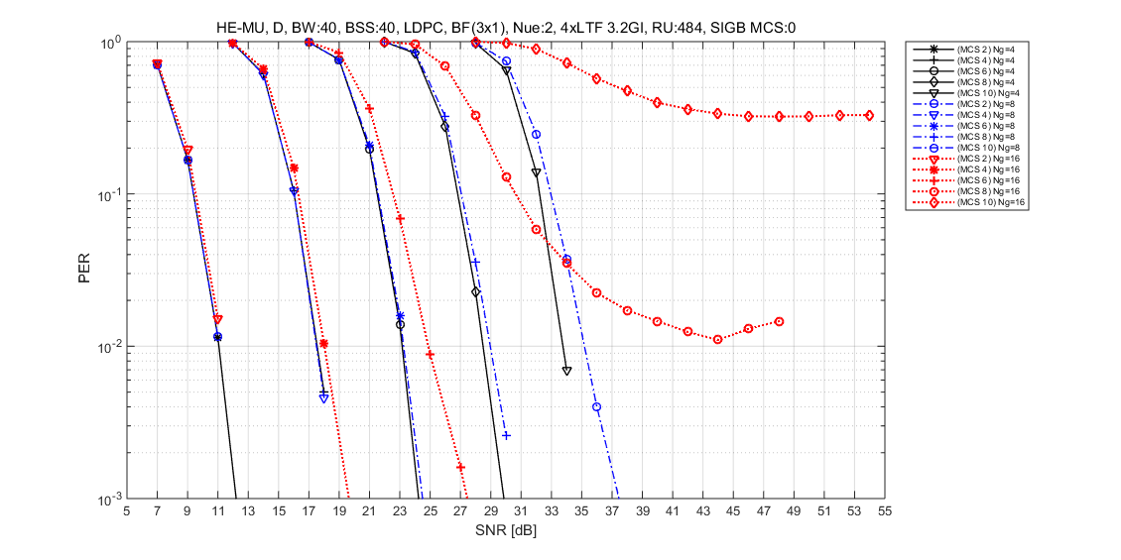
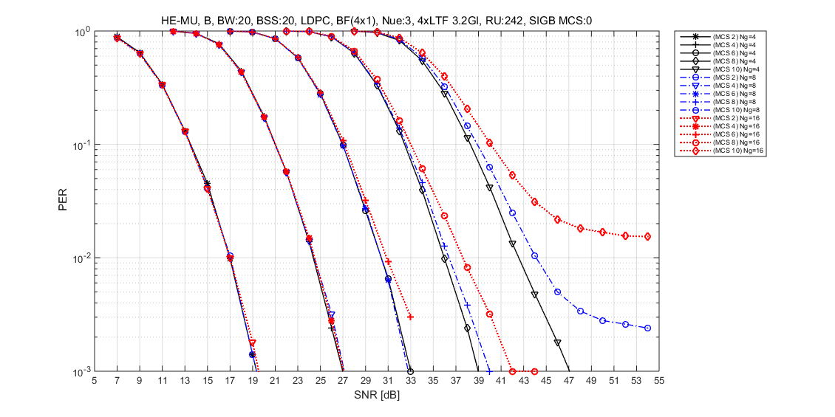
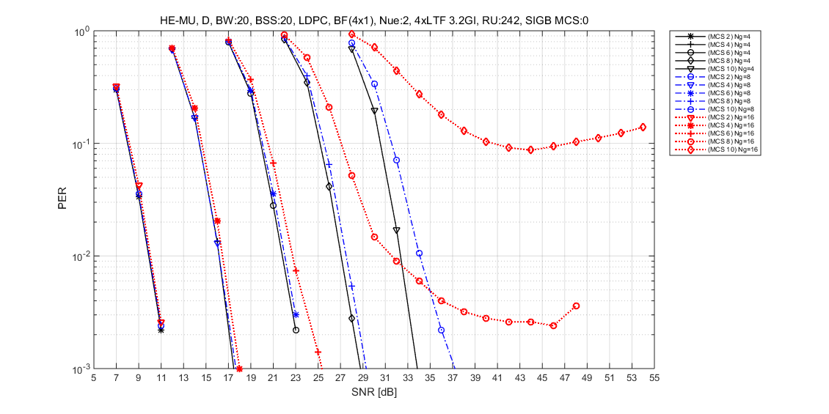
PER for MU-MIMO (3 $×1,$ 4 $×1, Ch.B, Ch.D)$

Slide 18
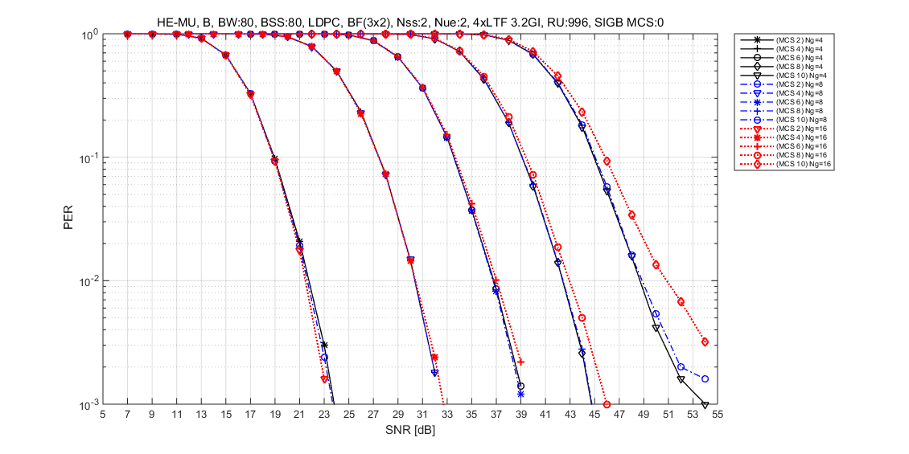
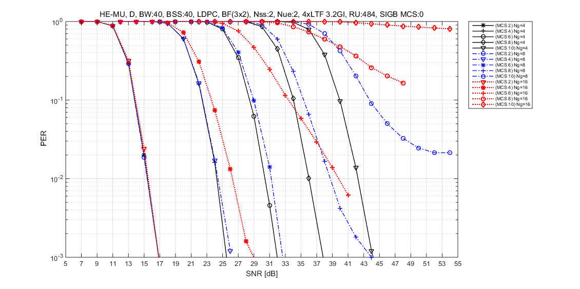
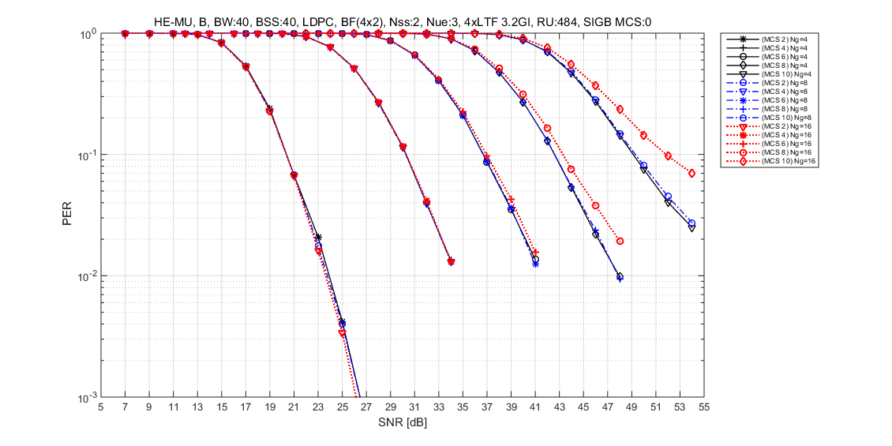
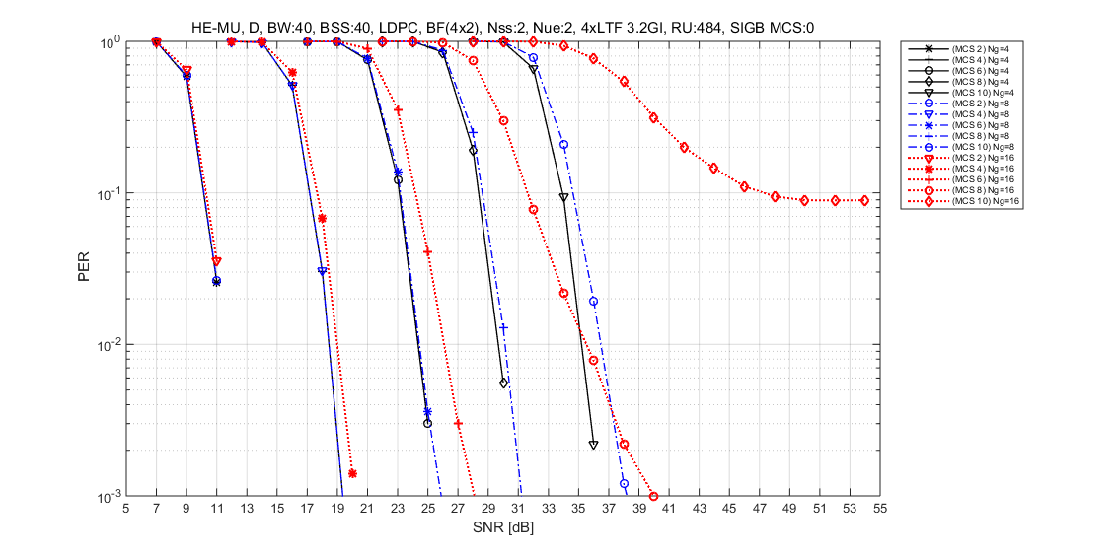
PER for MU-MIMO (3 $×2,$ 4 $×2, Ch.B, Ch.D)$

