Slide 1
STR and non-STR capability indication
Date: 2020-08-13
Authors:
Name | Affiliation | Address | Phone | Email
Yonggang Fang | ZTE (TX) |  |  | yfang@ztetx.com
Zhiqiang Han | ZTE
Bo Sun | ZTE
Liuming Lu | ZTE
Notes:
doc.: IEEE 802.11-yy/xxxxr0
Month Year
John Doe, Some Company
Page 1

Slide 2
Abstract
This contribution discusses STR and non-STR indication and primary channel selection.

Slide 3
Background
Non-STR
  An MLD that is not capable of simultaneous Tx/Rx on multiple links for the given set of links (i.e., it can only do Tx/Tx or Rx/Rx on all links)
STR
  An MLD that is capable of simultaneous Tx/Rx on multiple links for the given set of links.
A MLD that supports multiple links can announce whether it can support transmission on one link concurrent with reception on the other link for each pair of links[1].
In this contribution, we discuss STR and non-STR capability indication and primary channel selection.

Slide 4
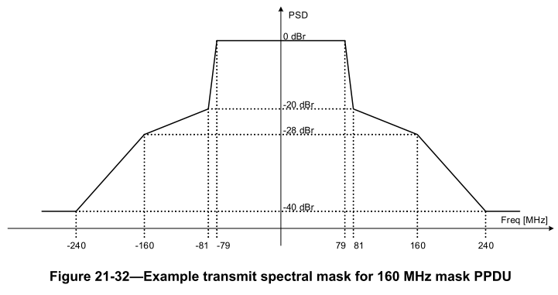
Introduction
The transmission power leakage from one link (link1) to the other link (link2) for a pair of links are not constant even if both the two links are in 5GHz or 6GHz.

Slide 5
STR in Continuous Bandwidth
Interference in Wide Bandwidth
  When link2 supports wider bandwidth such as 320MHz, the transmission on link1 may interfere the reception on a part of link2 while the transmission on link2 may not interfere the reception on link1.
  The interference on the entire bandwidth is not even. The entire bandwidth of link2 could be devided into different parts according to interference level from link1:
    Non-STR part: When the Tx occurs on link1, the Rx is not supported on this part of bandwidth on link2.
    STR-constraint part: When the Tx occurs on link1, the constraint Rx is allowed on this part of bandwidth on link2.
    STR part: When the Tx occurs on link1, the Rx is allowed on this part of bandwidth on link2.
Note: This depends on Tx power, channel BW and spacing, etc. All parts may not exist in a link.
Note: The entire link may be STR, non-STR or STR-constraint.
TX
Non-STR
STR-constraint
STR
Link 1
Link 2

Slide 6
STR in Discontinuous Bandwidth
When link2 supports the discontinuous bandwidth such as 80+80MHz and 160+160MHz, the affect of the interference on two segments are different.
  The interference on each segment of the discontinues bandwidth also depends on the channel space between two segements.
TX
Non-STR
STR
Link 1
Frequency Segment 0
Frequency Segment 1
Link 2

Slide 7
  STR Capability Indication
Unit in Channelization
  The channelization is in the unit of 20MHz in IEEE802.11.
  The transmission of management frames such as Beacon is in 20MHz BW
  The transimission of the preamble is in the unit of 20MHz BW.
  To align with the existing specification, the measurement and capability indication should be in units of 20MHz for ML operation.
Two options for the STR capability indication.
  Option 1 : Non-AP MLD determines the STR capability (STR part, non-STR part or STR-constraint part) and report it to AP MLD.
    Pros: Overhead is low
    Cons: AP MLD cannot obtain the accurate cross link interference
  Option 2 : Non-AP MLD measures the cross link interference level, and report it to AP MLD.
    Pros: AP MLD obtains the accurate cross link interference from non-AP MLD, and easily control the transmission to the non-AP MLD over multi-link.
    Cons: larger overhead comparing to Option 1, OBSS inference is dynamic.

Slide 8
  Primary Channel Selection
An accurate distinction between STR part and non-STR part of the operation bandwidth could allow to efficiently use the channel for improving throughput and reducing delay.
IEEE 802.11 basic operation is based on primary 20MHz channel. So an AP MLD should set up the BSS with a primary 20MHz channel that coincides with STR part.
  Different non-AP MLD may have the different STR part, it's better to select a primary 20MHz channel in common STR part.
  If AP MLD selects a primary 20MHz channel in the non-STR part, the entire link is non-STR.
primary 20 MHz channel
TX
Non-STR
STR
Link 1
Frequency Segment 0
Frequency Segment 1
Link 2

Slide 9
  Transmission Procedure
STR Transmission
  If STR part and non-STR part of the bandwidth can be distinguished, AP MLD or non-AP MLD can use of STR part of the bandwidth to perform STR transmission to improve the throughput and reduce the latency.
primary 20 MHz channel
STR part
with Link1
Data (DL)
BA(UL)
STA2
Non-STR BW with Link1
AP2
Link 2
Data (UL)
BA(DL)
STA1
Link 1
AP1
non-AP MLD
AP MLD

Slide 10
  Summary
The entire bandwidth of one link could be devided into different parts according to interference level from other link, especially in case of wider bandwidth such as 320MHz and discontinuous bandwidth.
To align with the existing specification, the measurement and capability indication should be in units of 20MHz for ML operation.
IEEE 802.11 basic operation is based on primary 20MHz channel. So an AP MLD should set up the BSS with a primary 20MHz channel that coincides with STR part.

Slide 11
  Straw Poll 1
Do you support in the SFD R1 to have a ML capability indication of a pair of multi-links including ?
  The transmission and reception capability of a pair of multi-links may be divided into STR, STR-constraint or STR.
  Note: Not all operation are possible in a pair of multi-links.

Slide 12
  Straw Poll 2
Do you support in the SFD R1 to have the transmission and reception capability indication in units of 20 MHz for a pair of multi-links ?

Slide 13
  Straw Poll 3
Do you support in the SFD R1 an AP MLD should select a primary 20 MHz channel in a STR part in the operation channel bandwidth?

Slide 14
  References
11-20-0566-51-00be-compendium-of-straw-polls-and-potential-changes-to-the-specification-framework-document
11-20-0527-01-00be-multi-link-constraint-signaling
11-20-0809-00-00be-str-capability-report
11-20-0909-00-00be-enhanced-non-str-mld-operation
11-20-0921-01-00be-discussion-about-str-capabilities-indication

Slide 15
Thank you!

