Slide 1
Discussions on PAPR Reduction Methods for DUP Mode
Date: 2020-08-07
Authors:
Name | Affiliation | Address | Phone | Email
Chenchen Liu | Huawei Technologies Co., Ltd | Huawei Base, Bantian, Shenzhen |  | liuchenchen1@huawei.com
Genadiy
Yan Xin
Dandan Liang
Ming Gan

Slide 2
Abstract
In this contribution, we will discuss the possible PAPR Reduction Methods for DUP Mode

Slide 3
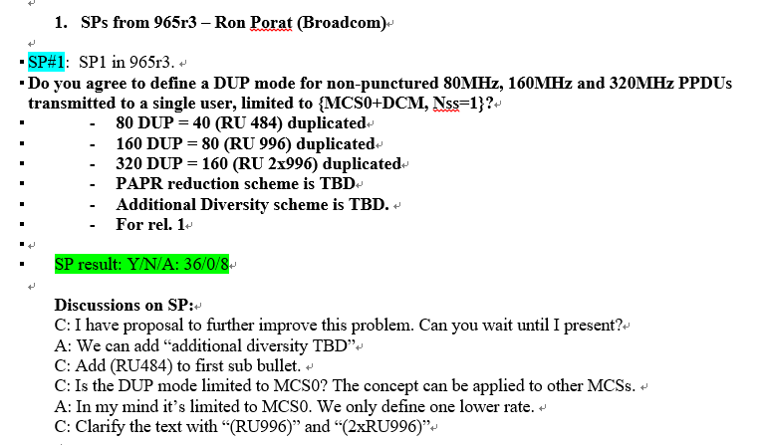
Introduction
To extend the transmission range of the low power indoor Wi-Fi system in 6GHz, the DUP mode is proposed
The following SP on DUP mode has passed

Slide 4
Motivation
The simply duplication in the frequency domain will cause the following problems:
  PAPR increase
  Time diversity loss
Thus, we propose a simple method to reduce the PAPR and make use of the time-domain diversity for DUP mode in this contribution

Slide 5
Proposed DUP mode for reducing PAPR
Option 1:
  Duplicate all the DCM encoded tones
  Negate the odd indexed tones(i.e. multiplied by -1) of the duplicated part
Option2:
  Duplicate all the DCM encoded tones in reverse order
  Negate the even indexed tones(i.e. multiplied by -1) of the duplicated part

Slide 6
Proposed DUP mode for reducing PAPR
Option 3([3]1191):
  Duplicate all the DCM encoded tones
  Negate the data tones(i.e. multiplied by -1) of the lower half of the duplicated part
Option 4 ([2]1135):
  Duplicate all the DCM encoded tones
  Negate the data tones(i.e. multiplied by -1) of the upper half of duplicated part

Slide 7
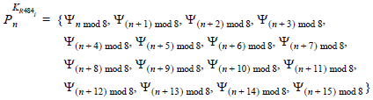
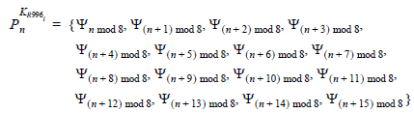

Experiment Setup
BPSK with DCM defined in 11ax is used to create the data tones for lower half bandwidth(RU 484 for 80M DUP, RU996 for 160M DUP, RU 2*996 for 320M DUP)
EHT tone plan is used and the pilot value is set follows the HE(Pilot tone index for RU 484L is [-494 -468 -426 -400 -360 -334 -292 -266 -246 -220 -178 -152 -112], Pilot tone index for RU 996 is [-468 -400 -334 -266 -220 -152 -86 -18 18 86 152 220 266 334 400 468]… )

Slide 8
Experiment Setup
The value for data tones are assumed to be random 1 and -1 values with equal probability after the LDPC tone mapper
Four times up-sampling is used to calculate the PAPR value(i.e. IFFT size=4096 for 80M DUP, IFFT size=4096 for 80M DUP, IFFT size=8192 for 160M DUP, IFFT size=16384 for 160M DUP)
There are 100 data OFDM symbols in each frame, and 10k frames are tested for each bandwidth

Slide 9
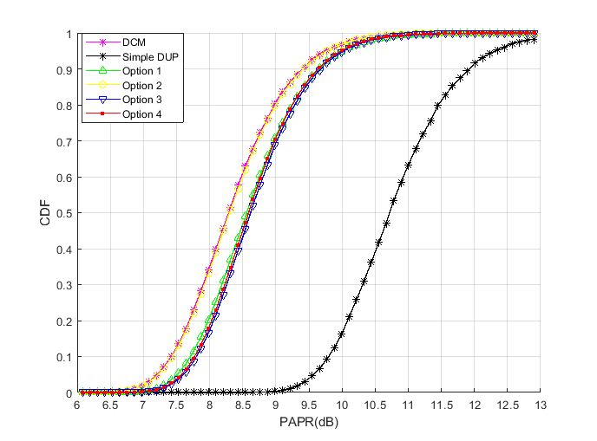
PAPR results for 80M DUP
Scheme | Median PAPR (dB)
DCM | 8.3446
Simple-DUP | 10.7849
Option 1 | 8.6163
Option 2 | 8.3571
Option 3 | 8.6724
Option 4 | 8.6423

Slide 10
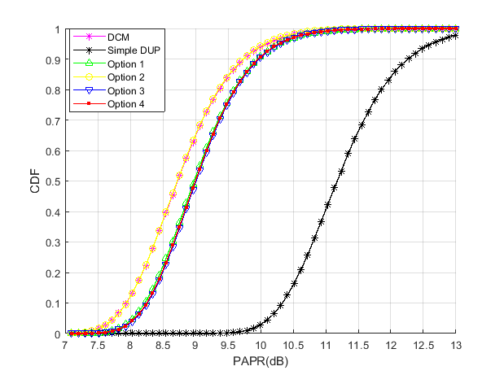
PAPR results for 160M DUP
Scheme | Median PAPR (dB)
DCM | 8.7765
Simple-DUP | 11.2288
Option 1 | 9.0311
Option 2 | 8.7733
Option 3 | 9.0617
Option 4 | 9.0514

Slide 11
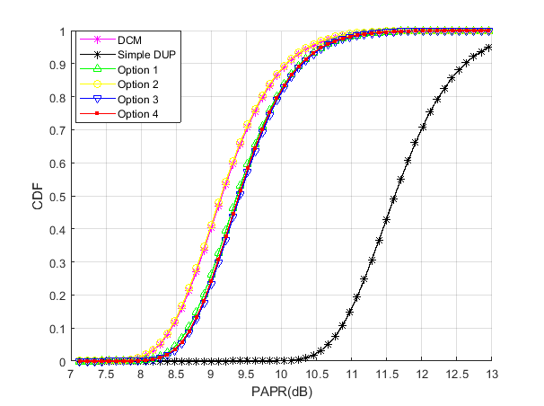
PAPR results for 320M DUP
Scheme | Median PAPR (dB)
DCM | 9.2026
Simple-DUP | 11.6659
Option 1 | 9.4188
Option 2 | 9.1889
Option 3 | 9.4612
Option 4 | 9.4435

Slide 12
References
[1] “6GHz LPI Range Extension,” IEEE 802.11-20/0965r4
[2] “PAPR Issues for EHT ER SU PPDU” IEEE 802.11-20/1135r2
[3] “DUP mode PAPR Reduction ” IEEE 802.11-20/1191r0

Slide 13
SP1
Do you agree to add the following text to the TGbe SFD?
  11be supports the following duplication and phase rotation methods which are applied to the data field of the PPDU transmitted to a single user and limited to {MCS0+DCM, Nss=1}
    For 80MHz PPDU, 484-tone RU is duplicated in reversed order and the even indexed tones corresponding to the duplicated 484-tone RU is multiplied by -1
    For 160MHz PPDU, 996-tone RU is duplicated in reversed order and the even indexed tones corresponding to the duplicated 996-tone RU is multiplied by -1
    For 320MHz PPDU, 2*996-tone RU is duplicated in reversed order and the even indexed tones corresponding to the duplicated 2*996-tone RU is multiplied by -1
    This is for rel. 1
Y/N/A:

Slide 14
SP2
Do you agree to add the following text to the TGbe SFD?
  11be supports the following duplication and phase rotation methods which are applied to the data field of the PPDU transmitted to a single user and limited to {MCS0+DCM, Nss=1}
    For 80MHz PPDU, 484-tone RU is duplicated and the odd indexed tones corresponding to the duplicated 484-tone RU is multiplied by -1
    For 160MHz PPDU, 996-tone RU is duplicated and the odd indexed tones corresponding to the duplicated 996-tone RU is multiplied by -1
    For 320MHz PPDU, 2*996-tone RU is duplicated and the odd indexed tones corresponding to the duplicated 2*996-tone RU is multiplied by -1
    This is for rel. 1
Y/N/A:

