Slide 1
Spectrum Mask Requirement for Punctured Transmission
Date: 2020-10-06
Authors:

Slide 2
Introduction
Multi-RU transmission including preamble puncturing is mandatory in 11be
Recently, ETSI updated its requirement on punctured channel transmission [1]
IEEE 802.11ax spectral mask for punctured case [2] is different from ETSI spectral mask

Slide 3
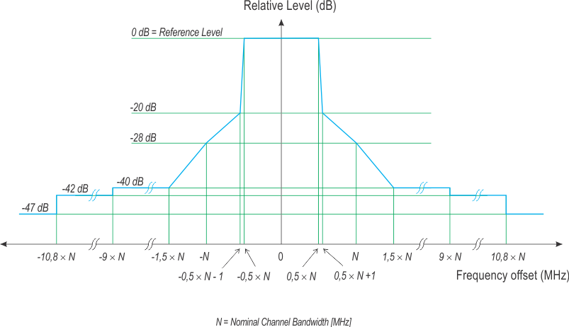
Without Puncturing: ETSI [1]

Slide 4
Without Puncturing: 11ax [2]

Slide 5
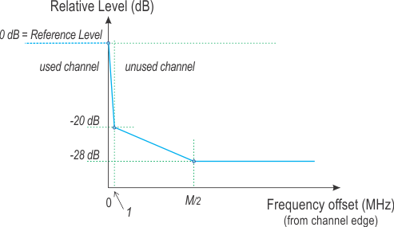
Puncturing Case1: ETSI
When the lowest channel(s) and/or the highest channel(s) of a group of adjacent channels is/are unused
  An additional channel edge mask as in below figure shall be applied at the lower edge of the lowest channel in use and at the higher edge of the highest channel in use. M is the separation in MHz between these 2 channel edges

Slide 6
Puncturing Case1: ETSI
When the lowest channel(s) and/or the highest channel(s) of a group of adjacent channels is/are unused
  An additional channel edge mask as in below figure shall be applied at the lower edge of the lowest channel in use and at the higher edge of the highest channel in use. M is the separation in MHz between these 2 channel edges

Slide 7
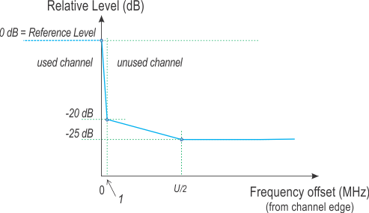
Puncturing Case2: ETSI
When there are two or more unused channels in between used channels and these unused channels are adjacent to each other
  An additional channel edge mask as in below figure shall be applied only at the lowest and highest channel edge of the group of unused adjacent channels. U is the total bandwidth of used channels adjacent to the unused channel(s).

Slide 8
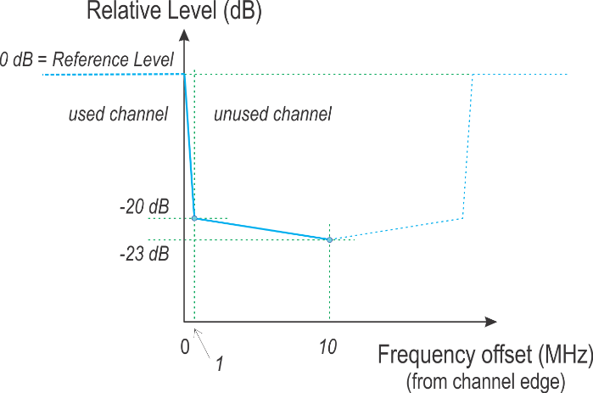
Puncturing Case3: ETSI
When there is only one unused channel in between used channels (all belonging to the group of adjacent channels configured for multi-channel operation)
  An additional mask as in below figure shall be applied at both edges of the unused channel.

Slide 9
Puncturing: 11ax
For preamble puncture, the signal leakage to the preamble punctured channel from the occupied subchannels shall be less than or equal to –20 dBr (dB relative to the maximum spectral density of the signal) starting 0.5 MHz from the boundary of the preamble punctured channel

Slide 10
Puncturing: 11ax
Case 2 and 3

Slide 11
R1: 320 MHz Non-HT DUP (1/3)
Currently, transmit spectral mask for Non-HT DUP is based on 21.3.17.1 (Transmit spectrum mask), which is VHT section

Slide 12
320 MHz Non-HT DUP (2/3)
Since there is no transmit spectral mask defined for 320 MHz mask PPDU in VHT, we need to either define Non-HT DUP 320 MHz mask PPDU in EHT or use EHT 320 MHz mask PPDU for Non-HT DUP
Comparing with 11ac 160 MHz and 11ax 160 MHz spectral mask,
  interim transmit spectral mask 0dBr: 11ac 158 MHz vs. 11ax 159 MHz
  -20 dBr: 11ac 81 MHz vs. 11ax 80.5 MHz
  -28 dBr: 11ac and 11ax 160 MHz
  -40 dBr: 11ac and 11ax 240 MHz

Slide 13
320 MHz Non-HT DUP (3/3)
Single transmit spectral mask option
  interim transmit spectral mask 0dBr: 319 MHz
  -20 dBr: 161 MHz
  -28 dBr: 320 MHz
  -40 dBr: 480 MHz
Separate transmit spectral mask for Non-HT DUP
  interim transmit spectral mask 0dBr: 318 MHz
  -20 dBr: 161 MHz
  -28 dBr: 320 MHz
  -40 dBr: 480 MHz

Slide 14
SP #1
Do you support following requirement in 11be?
  For preamble puncture, the signal leakage to the preamble punctured channel from the occupied subchannels shall be less than or equal to –20 dBr (dB relative to the maximum spectral density of the signal) starting 1 MHz from the boundary of the preamble punctured channel

Slide 15
SP #2
Which option do you support for 320 MHz Non-HT DUP?
  Single transmit spectral mask option
    interim transmit spectral mask 0dBr: 319 MHz
    -20 dBr: 161 MHz
    -28 dBr: 320 MHz
    -40 dBr: 480 MHz
  Separate transmit spectral mask for Non-HT DUP
    interim transmit spectral mask 0dBr: 318 MHz
    -20 dBr: 161 MHz
    -28 dBr: 320 MHz
    -40 dBr: 480 MHz

Slide 16
Reference
[1] ETSI EN 301 893 V2.1.38 (2020-06), 5 GHz RLAN;
Harmonised Standard covering the essential requirements
of article 3.2 of Directive 2014/53/EU
[2] IEEE 802.11ax D6.0

