Slide 1
E-SIG Detection with Different Puncturing Patterns
Date: 2020-08-03
Authors:
Name | Affiliation | Address | Phone | Email
Junghoon Suh | Huawei |  |  | junghoon.suh@huawei.com
Yan Xin |  |  |  | yan.xin@huawei.com
Mengshi Hu |  |  |  | humengshi@huawei.com
Osama Aboul-Magd |  |  |  | osama.aboulmagd@huawei.com

Slide 2
Background
Since 40 MHz content channels are duplicated in each 80 MHz E-SIG, we may achieve combining gains for E-SIG detection in case of no preamble puncturing in the 80 MHz segment
We observed even further gain with additional diversity schemes applied to duplicated 40 MHz content channels
The overhead reduction in E-SIG is an critical goal for our Release 1 progress
  For the case of 6 E-SIG symbols with MCS 5 → 9 E-SIG symbols with MCS 3 → 36 E-SIG symbols with MCS 0 (MCS 0 does not fit with the max number of symbols)
  For the case of 3 E-SIG symbols with MCS 5 → 5 E-SIG symbols with MCS 3 → 24 E-SIG symbols with MCS 0

Slide 3
Scheme 1: DCM applied to 40 MHz Duplicated E-SIG in 80 MHz segment
L-Preamble
/ RL-SIG
U-SIG
E-SIG - 1
L-Preamble
/ RL-SIG
U-SIG
E-SIG - 2
EHT-STF/LTF
and Payload
L-Preamble
/ RL-SIG
U-SIG
E-SIG - 1
with DCM
L-Preamble
/ RL-SIG
U-SIG
E-SIG - 2
with DCM
E-SIG-1 with DCM and E-SIG-2 with DCM are DCM-modulated over the entire content channel
  That is, for the E-SIG-1 with MCS1-DCM case, conj(S_{k}) where S_{k} is a QPSK constellation per subcarrier will be taken for the entire 20MHz content channel

Slide 4
Simulation setting
SISO 80 MHz w/ 40 MHz duplication
Primary 20 and the secondary 20 MHz are separately encoded in the primary 40 MHz / secondary 40 MHz
MCS1~5 for Primary 40 MHz
MCS1~5 with DCM for Secondary 40 MHz
  Each entire content channel is DCM-modulated
Actual channel estimation
BCC and Viterbi decoder
ChanD
Packet size – 10 bytes per content channel

Slide 5
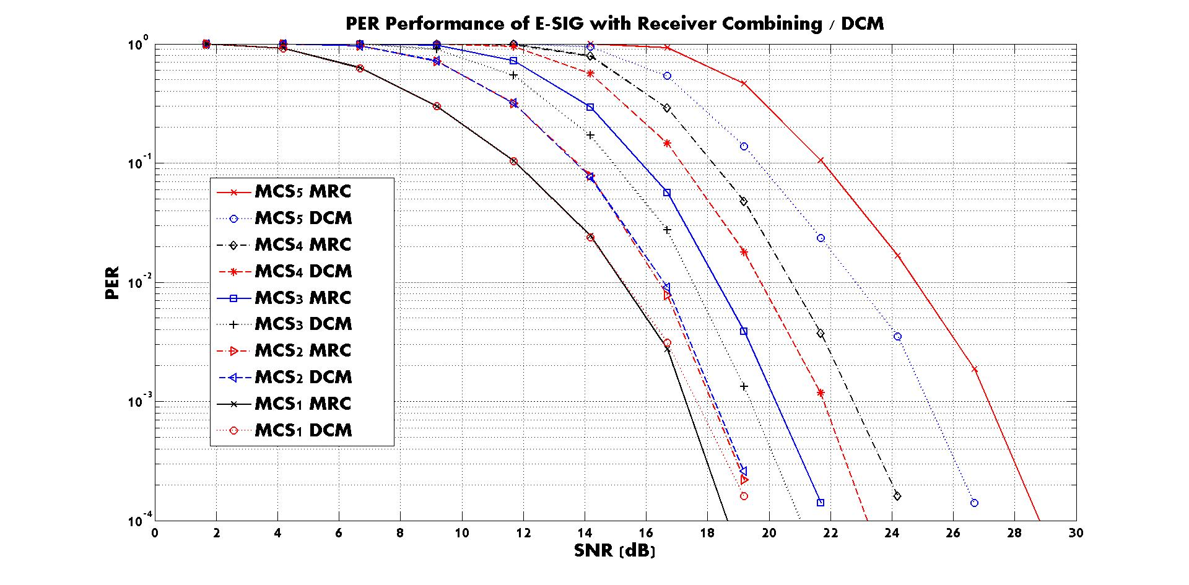
MCS3 with DCM shows about 1 dB gain over MCS3 with simple combining
MCS3 is an important MCS for EHT-SIG in consideration of E-SIG overhead reduction

Slide 6
Scheme 2: 40 MHz Duplicated E-SIG in 80 MHz segment with MCS2/4/5 having different puncturing patterns in each 40 MHz
L-Preamble
/ RL-SIG
U-SIG
E-SIG - 1
with MCS2/4/5
L-Preamble
/ RL-SIG
U-SIG
E-SIG - 2
with MCS2/4/5
EHT-STF/LTF
and Payload
L-Preamble
/ RL-SIG
U-SIG
E-SIG - 1
with MCS2/4/5 - A
L-Preamble
/ RL-SIG
U-SIG
E-SIG - 2
with MCS2/4/5 - A
At the receiver side,
(1) We compute the LLR of E-SIG per content channel ← E-SIG is encoded per content channel
(2) Then, insert the zero bit at the punctured positions according to the Puncturing pattern designated to each content channel
(3) Combine the LLRs of primary 40 MHz with that of the secondary 40 MHz
(4) Run the BCC decoder per content channel based on the combined LLRs in Step 3

Slide 7


Puncturing Patterns for the rate of 3/4 (MCS2/MCS4)
* Puncturing Pattern of BCC code rate 3/4 in the current 802.11
* Puncturing Pattern for MCS2/4-A
X₀
X₁
X₂
X₃
X₄
X₅
X₆
X₇
X₈
Information Bits
X₀
X₁
X₂
X₃
X₄
X₅
X₆
X₇
X₈
A₀
A₁
A₂
A₃
A₄
A₅
A₆
A₇
A₈
Coded Bits
A₀
A₁
A₂
A₃
A₄
A₅
A₆
A₇
A₈
TX
B₀
B₁
B₂
B₃
B₄
B₅
B₆
B₇
B₈
Punctured Bit
B₀
B₁
B₂
B₃
B₄
B₅
B₆
B₇
B₈
A₀
B₀
A₁
B₂
A₃
B₃
A₄
B₅
A₆
B₆
A₇
B₈
Bit Punctured
Data
A₀
B₁
A₂
B₂
A₃
B₄
A₅
B₅
A₆
B₇
A₈
B₈
A₀
A₁
A₂
A₃
A₄
A₅
A₆
A₇
A₈
Inserted Zero Bit
A₀
A₁
A₂
A₃
A₄
A₅
A₆
A₇
A₈
B₀
B₁
B₂
B₃
B₄
B₅
B₆
B₇
B₈
Bit Inserted
Data
B₀
B₁
B₂
B₃
B₄
B₅
B₆
B₇
B₈
RX
Y₀
Y₁
Y₂
Y₃
Y₄
Y₅
Y₆
Y₇
Y₈
Decoded Bits
Y₀
Y₁
Y₂
Y₃
Y₄
Y₅
Y₆
Y₇
Y₈

Slide 8
Puncturing Patterns for the rate of 2/3 (MCS5)
* Puncturing Pattern of BCC code rate 2/3 in the current 802.11
* Puncturing Pattern for the rate 2/3 of MCS5-A
X₀
X₁
X₂
X₃
X₄
X₅
Information Bits
X₀
X₁
X₂
X₃
X₄
X₅
A₀
A₁
A₂
A₃
A₄
A₅
Coded Bits
A₀
A₁
A₂
A₃
A₄
A₅
TX
B₀
B₁
B₂
B₃
B₄
B₅
Punctured Bit
B₀
B₁
B₂
B₃
B₄
B₅
A₀
B₀
A₁
A₂
B₂
A₃
A₄
B₄
A₅
Bit Punctured
Data
A₀
A₁
B₁
A₂
A₃
B₃
A₄
A₅
B₅
A₀
A₁
A₂
A₃
A₄
A₅
Inserted Zero Bit
A₀
A₁
A₂
A₃
A₄
A₅
B₁
B₂
B₃
B₄
B₅
Bit Inserted
Data
B₀
B₁
B₂
B₃
B₄
B₅
B₀
RX
Y₀
Y₁
Y₂
Y₃
Y₄
Y₅
Decoded Bits
Y₀
Y₁
Y₂
Y₃
Y₄
Y₅

Slide 9
Simulation setting
SISO 80 MHz w/ 40 MHz duplication
Primary 20 and the secondary 20 MHz are separately encoded in the primary 40 MHz / secondary 40 MHz
MCS1~5 for Primary 40 MHz
MCS1/2A/3/4A/5A for Secondary 40 MHz
Actual channel estimation
BCC and Viterbi decoder
ChanD
Packet size – 10 bytes per content channel

Slide 10
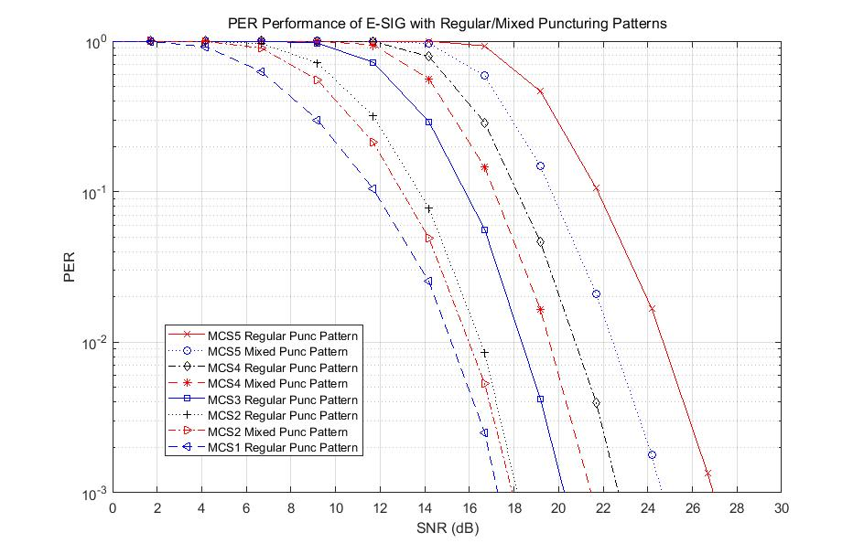
MCS3
MCS2
MCS5
MCS1
MCS4
Mixed Puncturing Pattern: Mixture of Puncturing Pattern between MCS2/4/5 and MCS2A/4A/5A, when combining

Slide 11
Summary
We proposed to apply an additional diversity scheme to the duplicated secondary 40 MHz content channels in each 80 MHz segment
  Additional 1 dB gain is observed for MCS 3 with DCM
  Combining gains boosted by 1~2 dB depending on the MCS with the mixed puncturing patterns
Since MCS3 is likely to be used quite often to reduce the E-SIG overhead, the robust detection of MCS 3 is very important

Slide 12
SP1
For each 80 MHz segment of any EHT-PPDU larger than or equal to 80 MHz BW, do you agree to apply an additional diversity scheme to two content channels in the secondary 40 MHz of E-SIG?

Slide 13
Reference
[1] S. Vermani, et. al., “U-SIG structure and preamble processing”, 802.11-20/0380r0, Mar. 2020
[2] D. Lim, et. al., “Consideration for E-SIG Transmission”, 802.11-20/0020r3, Apr. 2020
[3] S. Vermani, et. al., “Further ideas on EHT preamble design”, 802.11-19/1870r4, Nov. 2019

