Slide 1
TGbb common PHY mode and LC HE PHY mode center frequency discussion
Date: 2020-07-31
Authors:

Slide 2
Abstract
This presentation aims to provide a concept for discussing the centre frequency for the common mode mandatory PHY mode and the LC HE PHY mode as well as the channel selection.

Slide 3
Summary of the problems
In https://mentor.ieee.org/802.11/dcn/20/11-20-1037-00-00bb-experimental-results-for-tgbb-centre-freq-discussion.pptx , we presented the experimental results for TGbb centre frequency discussion.
If the centre frequency is too close to DC, we can’t grow using the existing IEEE 802.11 channelization policies and processes to transmit data efficiently.

Slide 4
Proposal for the common mode mandatory PHY
If the center frequency of the mandatory 20 MHz channel needs to be close to DC, we propose to have a secondary channel (optional) that may accommodate greater channel bandwidth.
E.g.: The mandatory channel may be centered at 12.5 MHz and the secondary channel may be centered at 32.5 MHz.
CH1
CH2
Channel number
12.5
32.5
Frequency (MHz)

Slide 5
Possible concept for the LC HE PHY (1)
2.4 GHz
5 GHz
AP
Dual-band AP and STAs allow simultaneous communications on both 2.4 GHz and 5 GHz.
A STA starts the connection with AP on the mandatory 20 MHz channel CH1 or on CH2 if it has a capability to operate at that frequency; the STA may receive notification from AP about channel selection to transmit data on 5 GHz (e.g., on CH36).
From a WiFi perspective, the channel selection moves from CH36 up to CH64 in the future via Dynamic channel switch.
RF Chain 1
RF Chain 2
CH1
CH36
Wi-Fi Channel
12.5 MHz
32.5 MHz
TGbb centre freq.
12.5 MHz
32.5 MHz
TGbb centre freq.
CH1
CH36
Wi-Fi Channel
RF Chain 1
RF Chain 2
STA
2.4 GHz
5 GHz

Slide 6
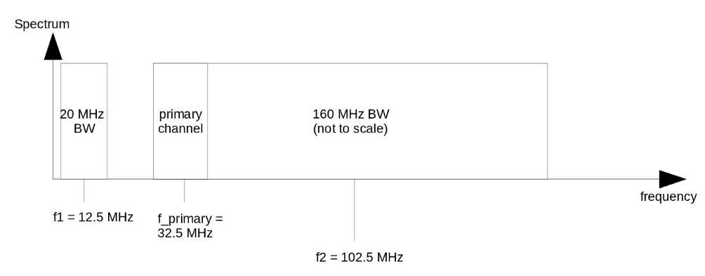
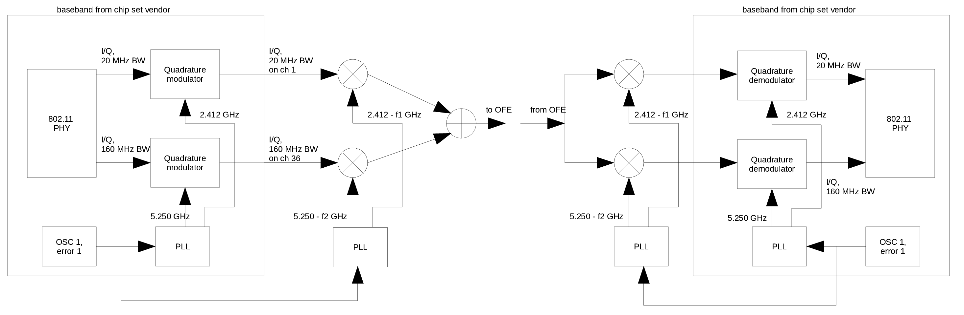
Possible concept for the LC HE PHY (2)

Slide 7
Dynamic channel switch
A channel switch is an attempt to move a BSS to a new operating channel.
AP may find it necessary or favorable to grow up/down to another channel in different situations.
Dynamic channel switch procedure:
  To select
    AP may make use of the information in Supported Channel elements and the results of measurements to assist the selection of the new channel.
  To inform
    Advertise the switch using Channel Switch Announcement elements in Beacon frames, Probe Response frames, and Channel Switch Announcement frames until the intended channel switch time.

