Slide 1
11be Spectral Mask
Date: 2020-08-01
Authors:
Name | Affiliations | Address | Phone | Email
Lin Yang | Qualcomm
Youhan Kim
Bin Tian
Notes:
September 2012

Slide 2
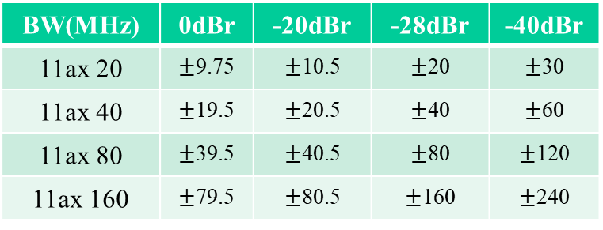
Overview of 11ax Spectral Mask
BW(MHz) | 0dBr | -20dBr | -28dBr | -40dBr
11ax 20 | $±$9.75 | $±$10.5 | $±$20 | $±$30
11ax 40 | $±$19.5 | $±$20.5 | $±$40 | $±$60
11ax 80 | $±$39.5 | $±$40.5 | $±$80 | $±$120
11ax 160 | $±$79.5 | $±$80.5 | $±$160 | $±$240
PSD
0
dBr
-
20
dBr
-
28
dBr
-
40
dBr
Freq
[
MHz
]
-
30
-
20
-
10.5
-
9.75
9.75
10.5
20
30
Transmit Spectral Mask for HE 20 MHz PPDU
PSD
0
PSD
PSD
0
dBr
dBr
0
dBr
-
20
dBr
-
-
20
dBr
-
20
dBr
28
-
dBr
28
dBr
-
28
dBr
-
40
dBr
-
dBr
Freq
[
MHz
]
40
Freq
MHz
-
40
dBr
[
]
Freq
[
MHz
]
-
60
-
40
-
20.5
-
19.5
19.5
20.5
40
60
-
120
-
80
-
40.5
-
39.5
39.5
40.5
80
120
-
240
-
160
-
80.5
-
79.5
79.5
80.5
160
240
Transmit Spectral Mask for HE 40 MHz PPDU
Transmit Spectral Mask for HE 80 MHz PPDU
Transmit Spectral Mask for HE 160 MHz PPDU
Propose to leverage over for 11be, except for puncture mask
  11ax puncturing mask with 20dBr down at the puncture edge is too loose

Slide 3
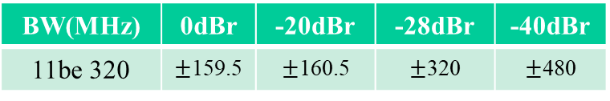
Spectral Mask for a EHT 320 MHz PPDU
Propose EHT 320MHz spectral mask has the skirt scaled to that of HE 160MHz and 1st rolloff identical to HE 40/80/160MHz
    320MHz tone plan has same number of guard tones ([12, 11]) as HE 40/80/160MHz
BW(MHz) | 0dBr | -20dBr | -28dBr | -40dBr
11be 320 | $±$159.5 | $±$160.5 | $±$320 | $±$480
PSD
0
dBr
-
20
dBr
-
28
dBr
-
40
dBr
Freq
[
MHz
]
-
480
-
320
-
160.5
-
159.5
159.5
160.5
320
480
Spectral Mask for a EHT 320 MHz PPDU

Slide 4
Spectral Mask for EHT 240 MHz Transmission
Passed SP : 240Mhz transmission is defined as 320MHz PPDU with 80Mhz punctured
  320MHz mask + tightened puncturing mask is good to go

Slide 5
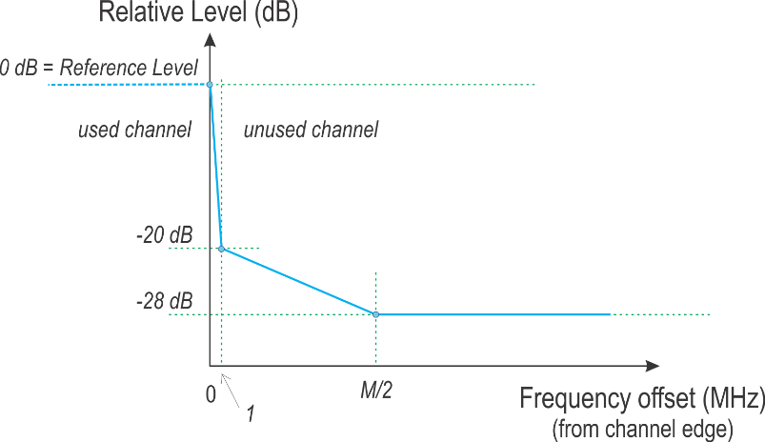
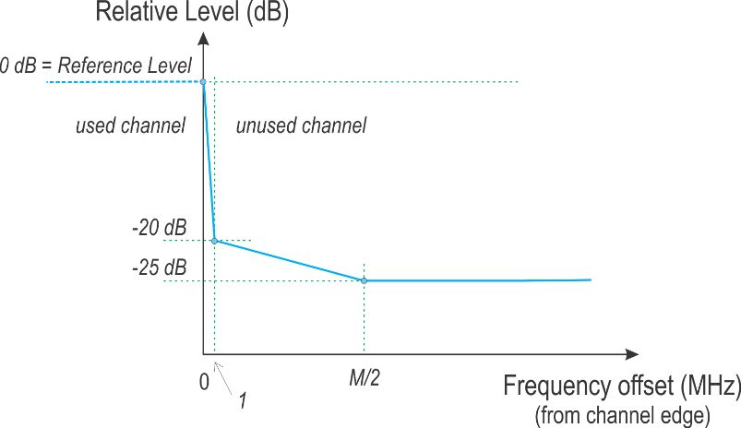
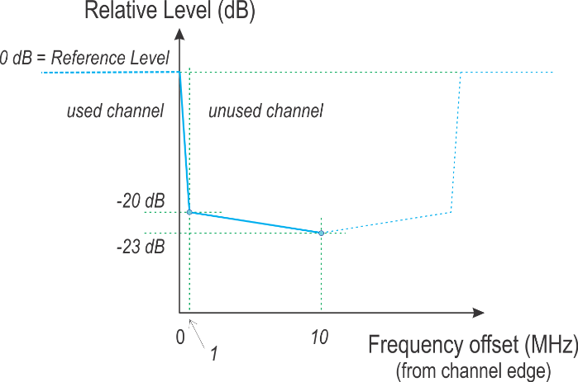
Discussion on Puncturing Mask
(ETSI (top) vs. 11ax (bottom) )
Edge puncture
Mid puncture>20MHz
Mid puncture=20MHz
Edge puncture
Mid puncture
 | 11ax | ETSI
RBW | 100KHz | 1MHz
1st slope transition | 0.5MHz | 1MHz
Mask floor | -20dBr | -28/-25/-23dBr

Slide 6
Proposal on 11be Puncturing Mask
 | 11ax | ETSI | 11be
RBW | 100KHz | 1MHz | 100KHz
1st slope transition | 0.5MHz | 1MHz | 0.5MHz
Mask floor | -20dBr | -28/-25/-23dBr | -28/-25/-23dBr
Take RBW=100KHz to avoid smearing in measurement
  Same as 11ax
0.5MHz transition band at 1st slope, starting at the punctured band edge
  Same as 11ax
  Depends on the adoption of RBW=100kHz
  Less interference to adjacent band, as the guard band of 11ax/11be is < 1 MHz
Mask floor: Same as ETSI for lower ACI

Slide 7
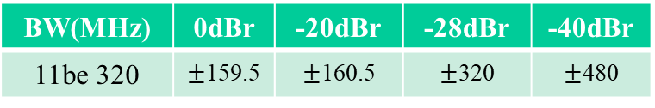
SP #1
Do you support the following mask for 320MHz transmission in EHT PPDU?
BW(MHz) | 0dBr | -20dBr | -28dBr | -40dBr
11be 320 | $±$159.5 | $±$160.5 | $±$320 | $±$480
PSD
0
dBr
-
20
dBr
-
28
dBr
-
40
dBr
Freq
[
MHz
]
-
480
-
320
-
160.5
-
159.5
159.5
160.5
320
480
Spectral Mask for an EHT 320 MHz PPDU

Slide 8
SP #2
Do you support using a 100 kHz resolution bandwidth for 11be spectrum measurement?
  Same as 11ax

Slide 9
SP #3
For 11be puncturing mask do you support using 0.5MHz transition band at the 1st slope from 0dBr to -20dBr, starting at the punctured band edge?
  [N*10, N*10+0.5] at the right edge of transmission band
  [N*10-0.5, N*10] at the left edge of transmision band
  Note: This is for EHT PPDU
  Note: Same as 11ax

