Slide 1
Follow-ups on Channel Measurement Procedure for WLAN Sensing
Date: 2020-06-13
Authors:
Name | Affiliation | Address | Phone | Email
Chenchen LIU | Huawei |  |  | liuchenchen1@huawei.com
Meihong Zhang
Rui Du
Yingxiang Sun

Slide 2
Abstract
In this contribution, we discuss the sensing measurement feedback procedure

Slide 3
Outline
Background of WLAN sensing
Feedback from the responders
No feedback
Threshold based NDP feedback
Comparation
References

Slide 4




Background of WLAN sensing
Basic principle
Signal reflected from the target carriers info of the target(e.g. velocity, location, etc.)
Advantages
  Ubiquitous
  Device-free
  Privacy
  High precision
  field of view
intruder detection
Fall detection
Gesture recognition
Gesture recognition

Slide 5
Background of WLAN sensing
Sensing based on channel sounding
  Explicit
  Implicit
Channel direction not crucial
  Typical use cases only track changes over time
Periodicity
  Some use cases like intruder detection might need a reliable periodicity of CSI feedback
  Most of the feedbacks over a period may be highly correlated

Slide 6
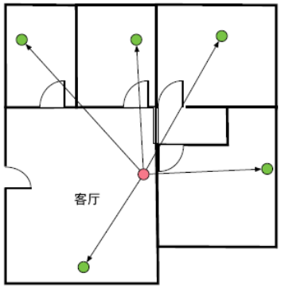
Feedback from the responders
TX STA and RX STA diversity is very important in sensing applications [2]
The ISTA broadcast the NDP to all the RSTAs
The RSTAs feedback the sensing measurement report to the ISTA
RSTA
RSTA
RSTA
RSTA
ISTA
RSTA

Slide 7
Feedback from the responders
An example of the sensing procedure with feedback from multiple RSTA
Problems:
  Large overhead
  Need special coordination
  Capability mismatch

Slide 8
No feedback
The ISTA trigger each RSTA to send the NDP to the ISTA
The ISTA receive the NDP from each RSTA and do the sensing measurement within itself
RSTA
RSTA
RSTA
RSTA
ISTA
RSTA

Slide 9
No feedback
Examples of the sensing procedure with no feedback from the ISTA
Problems:
  MU may cause interference, ISTA may need some processing time before processing the next NDP
  Non-MU cost more airtime
  Complexity at the ISTA

Slide 10
Threshold based NDP feedback
The ISTA set the threshold for Each RSTA, and periodically transmit the NDP to all RSTAs
The RSTA measure the CSI and compare it with previous measurement result
If the CSI difference exceeds the threshold, the RSTA sends a NDP to the ISTA(schedule may needed). Otherwise, the RSTA store measurement result and feedback nothing
The ISTA do the sensing measurement within itself based on the NDP feedback

Slide 11
Threshold based NDP feedback
An example of the sensing procedure with threshold based NDP feedback
Problems:
  May cause some delay for certain application

Slide 12
Comparation
Feedback procedure | Pros | Cons
from the responders | Simple measurement | Large overhead
No feedback | No feedback needed | Interference
Threshold based | Small overhead | Latency

Slide 13
Summary
In this contribution, three sensing and feedback procedures and their corresponding pros and cons are discussed.

Slide 14
References
[1] CSI-based Wi-Fi Sensing: Results and Standardization Challenges, doc.: IEEE 802.11-19/1769
[2] Wi-Fi Sensing: Cooperation and Standard Support, doc.: IEEE 802.11-19/1416r0
[3] Z. Wu, Y. Han, Y. Chen and K. J. R. Liu, "A Time-Reversal Paradigm for Indoor Positioning System," in IEEE Transactions on Vehicular Technology, vol. 64, no. 4, pp. 1331-1339, April 2015

Slide 15
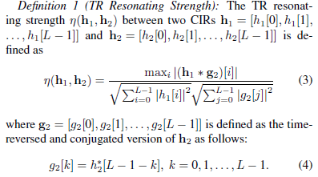
Backup
Threshold could be TRRS

