Slide 1
MLD AP Power-saving (PS) Considerations
Date: 2020-07-xx
Authors:

Slide 2
Background
In 802.11ax and the previous SPEC, a lot of PS at STA side had be defined, such as (D)TIM, WMM-PS, WNM-PS, TWT, intra-PPDU and so on.
Multi-Link feature becomes a hot candidate feature being discussed in TGbe group
References [1,2,3] have made a lot of contributions on Multi-Link PS operation.
To address the issue that the power consumption increase linearly with the number of links , References [2] and [3] introduce Anchor/Primary link mechanism.
In this presentation, we want to talk about different kinds of PS mode at the MLD AP side based on the concept of Anchor/Primary links, especially for mobile APs or repeaters powered by battery.

Slide 3
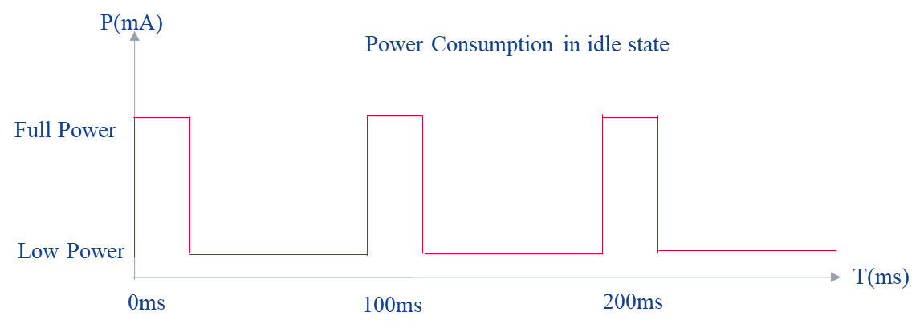
Probable design for mobile APs
Mobile APs wake up at TBTT(LP->FP) and then switch to sleep mode(FP->LP) after sending out Beacon frame in idle state.
A Mobile AP will stay at FP mode if any STA connects to it.

Slide 4
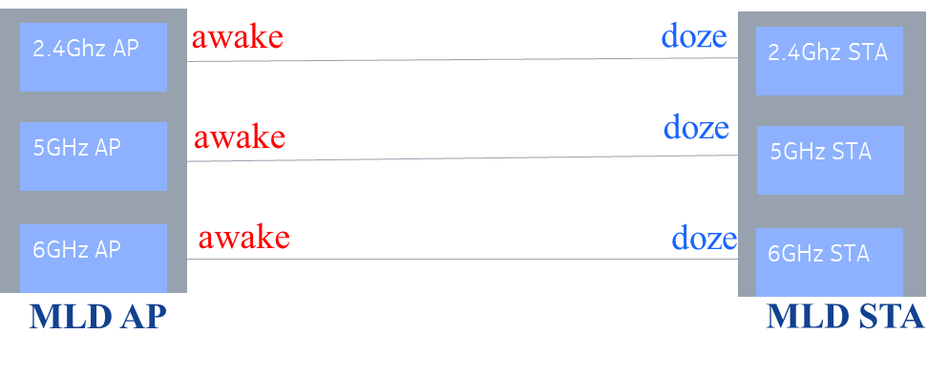
Proposed solution for the MLD AP in PS mode
A MLD device can set up more than one link according to 802.11be SFD. That’s to say, any AP affiliated to the same MLD AP will not be able to enter PS mode even if all associated STAs within the same MLD STA on the same channel are in PS mode. It will consume too much power at the MLD AP side.
We propose to define a mechanism that allow the AP within the MLD AP to enter PS mode if the following conditions are met
1) The AP work on the non-primary link
2) NO non-MLD devices connected to the AP
Since a non-MLD device only has one link associated with the MLD AP, so the AP needs to be kept in awake state to receive UL traffic in time.

Slide 5
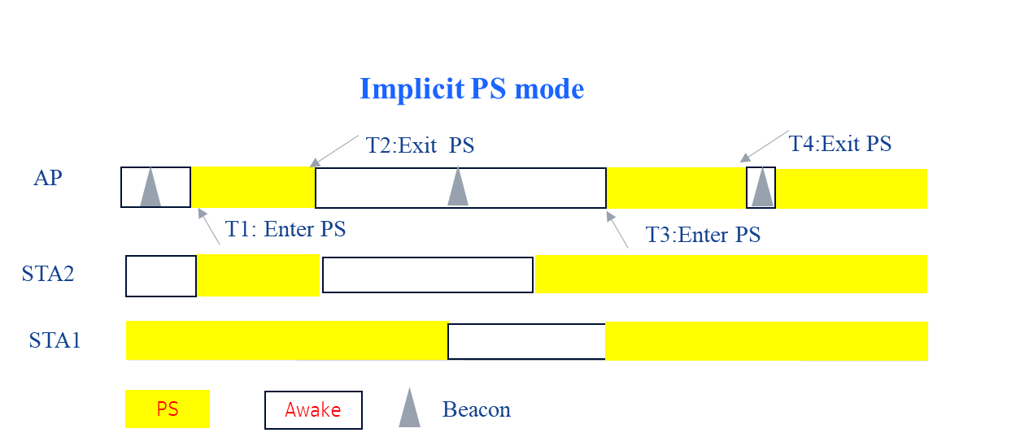
Proposed solution for MLD AP in PS mode (cont. )
Implicit mode:
The AP within the MLD AP cannot enter PS mode unless all STAs within the MLD STA on the link stay in PS mode, and need to wake up before any STA exit PS mode or TBTT time comes.

Slide 6
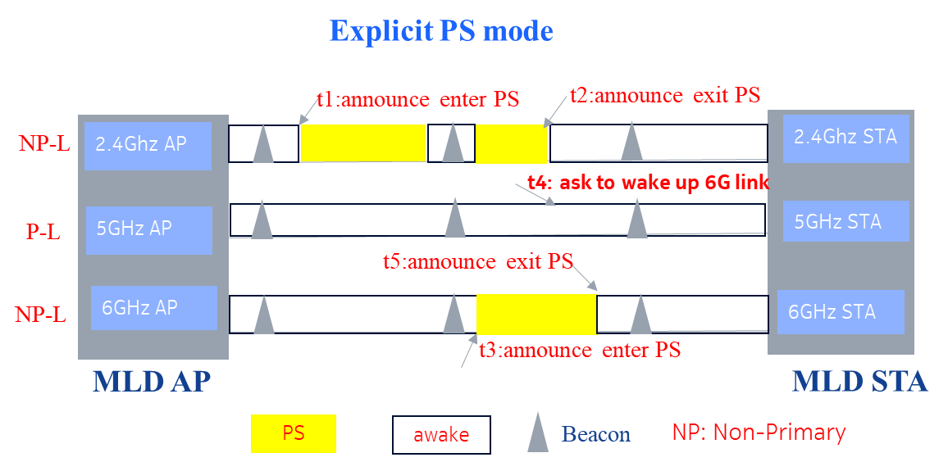
Proposed solution for MLD AP in PS mode (cont. )
Explicit mode:
Define a signal which can be sent or indicated by the AP on non-primary link and can be indicated by the AP within the same MLD AP on the primary link that indicates the AP on the non-primary link enters PS mode, and APs in this scenario can be woke up by any MLD STA on the primary link.
Op1: The AP on the non-primary link announce it will enter PS mode in the DTIM time(Beacon frame) so that all associated STAs can wake up and receive this signal.
Op2: The AP within the same MLD AP on the primary link can indicate the PS-mode AP’s status in the RNR or ML element.
Signal TBD(consider reuse TWT IE)

Slide 7
Summary
Proposal to define a PS mechanism at the MLD AP side
Introduction to two methods about MLD AP PS mode

Slide 8
References
[1] IEEE 802.11-19/1526r0 multi-link power save
[2] IEEE 802.11-19/1510r0 power saving considering multi-link
[3] IEEE 802.11-19/1988r3 Power Save for Multi-link
Jay Yang (Nokia)

Slide 9
SP 1
Do you agree to define a mechanism or signal to indicate that the MLD AP enters PS mode in R2?
Note:
Signaling TBD

Slide 10
SP 2
Do you agree to set certain conditions under which APs within the MLD AP can enter PS mode, and STAs within the MLD STA can wake up the PS-mode AP through the primary link (Implicit mode) in R2?
Conditions:
1) The AP works on the non-primary link
2) No non-MLD STAs connected to the AP
3) Sleep time should be within all STAs’ doze time

Slide 11
SP 3
Do you agree to set certain conditions under which APs affiliated to the MLD AP can announce to enter PS mode, and STAs within the MLD STA can wake up through the primary link? The announcement can be sent by the AP planning to enter PS mode in DTIM on the non-primary link and the PS status of the AP on non-primary link can be indicated by the AP within the same MLD AP on primary link (Explicit mode) in R2?
Conditions:
1) The AP works on the non-primary link
2) No non-MLD STAs connected to the AP affiliated to the MLD AP
Note:
Signaling TBD

