Slide 1
MLO Security Considerations
Date: 2020-07-18
Authors:

Slide 2
Background
With lots of security protocols been defined to supply a safer method to protect user info, there is still no solution to the de-auth attack issue even though IEEE has defined the 802.11w/PMF protocol. That’s because:
→1. The PMF protocol only works under the precondition that both STA and AP support it.
→2. Many STAs do not support 802.11W in default.
→3. Many legacy IOT devices will not send Associate Request frame if the AP set PMF capable flag in Beacon and Probe Response frame. Therefore, to be compatible with legacy IOT devices, the AP do not support the PMF protocol by default.
Reference[2] mentioned another attack type in which the MAC address was replaced with other values during the association process.
If three links (on 2.4GHz, 5Ghz and 6GHz) of MLD AP are configured in WPA2-PSK mode, the end user will not be able to input the password three times to set up three links on MLD STA.

Slide 3
Proposal
An open question: Is it necessary to repeat the Auth/Assoc and 4-way handshake procedure on each link of MLD devices?
It is known that EAPOL frame exchange in legacy data rate is not able to meet the low latency requirement of 802.11be in some scenarios.
In this presentation, we want to talk about a safer and faster key exchange method for each link (exclude the first link) once the first link has been set up. This method is compatible with legacy devices, and can fix the two attack types mentioned above.

Slide 4
Solution
We would like to define some new service primitives similar to TDLS primitives: MLME-LINK-SETKEY-REQUEST,MLME-LINK-SETKEY-RESPONSE, MLME-LINK-TEAR-DOWN.
→MLME-LINK-SETKEY-REQUEST: This primitive requests that an MLD AP send a set key request frame containing [Link ID, cypher type, TK, GTK…] to an MLD STA.
→MLME-LINK-SETKEY-RESPONSE: This primitive requests that an MLD STA use MLME-SETKEYS.primitive to install TK and GTK on the MAC of link-x and then sent a set key response frame containing [Link ID, key install status] to the MLD AP.
→MLME-LINK-TEAR-DOWN: This primitive requests that a link tear down frame containing [Link ID, tear down reason code] be sent to the MLD peer device.
These new service primitives are characterized by encapsulating set key frames and a tear down frame in Data frames, allowing them to be transmitted through the first link transparently.

Slide 5
MLD AP
MLD STA
Auth/Assoc Procedure
Link Set Up and Tear Down Sequence Chart
802.1X,WPS or other OOB authentication
Establishment
procedure of the first link
4-way handshake
obtain IP address:
DHCP or static
MLD Link Set Key
Request frame
Establishment
procedure of other links
MLD Link Set Key
Response frame
MLD Link
Tear down frame
Tear down
procedure of other links

Slide 6
SME
MLME
MLME
SME
The diagram on the right shows the link establishment procedure of the MLD device with MLME primitives.
Note: this is only an example of the basic procedure.
MLME-SETKEY
REQUEST.req
MLD Link Set Key
Request frame
MLME-SETKEY
REQUEST.ind
MLME-SETKEY
REQUEST.cfm
MLME-SETKEY
RESPONSE.ind
MLD Link Set Key
Response frame
MLME-SETKEY
RESPONSE.req
MLME-SETKEY
RESPONSE.cfm
MLD AP
MLD STA
MLD Link Establishment
Notes:
SME station management entity

Slide 7
In order to protect the link from de-auth attacks, we propose to use Link Tear Down primitive to replace conventional De-auth or Dis-assoc frame if any side decides to disconnect the link.
The diagram on the right shows the link tear down procedure of the MLD device with MLME primitives.
SME
MLME
MLME
SME
MLME-TEARDOWN.req
Link Tear down frame
MLME-TEARDOWN.ind
MLME-TEARDOWN.cfm
MLD AP/STA
MLD STA/AP
MLD Link Teardown

Slide 8
The format in data frame
802.11MAC header | Ethernet type: MLD | MLD LINK ID | Status | Primitive ID | KEY Info
802.11MAC header | Ethernet type: MLD | MLD LINK ID | Status | Primitive ID | KEY Info
AMPDU | AMPDU
AMPDU

Slide 9
Summary
Proposal to define a safer and faster key exchange method in 802.11be SPEC to tackle two attack types.
To define new primitives and describe the implementation method(s) to realize the above target.

Slide 10
References
[1] IEEE 802.11-19/1900r0 MLA MAC Addresses Considerations
[2] IEEE 802.11-20/0727R0 MLA: MAC Addresses Security
[3] IEEE 802.11z Extensions to Direct-Link SETKEY(DLS)
[4] IEEE 802.11i Medium Access Control(MAC) Security Enhancement
Jay Yang (Nokia)

Slide 11
SP 1
Do you agree to complete the key delivery (or exchange) on the first link of the two MLD devices rather than repeating the 4-way handshake procedure on each link?

Slide 12
SP 2
Do you agree to define a mechanism in 802.11be SPEC to address the two attack types mentioned in page2?

Slide 13
SP 3
Do you agree to define the following service primitives to achieve the safer and faster key exchange end?(the primitive language can be further talk)
→MLME-LINK-SETKEY-REQUEST,
→MLME-LINK-SETKEY-RESPONSE,
→MLME-LINK-TEAR-DOWN

Slide 14
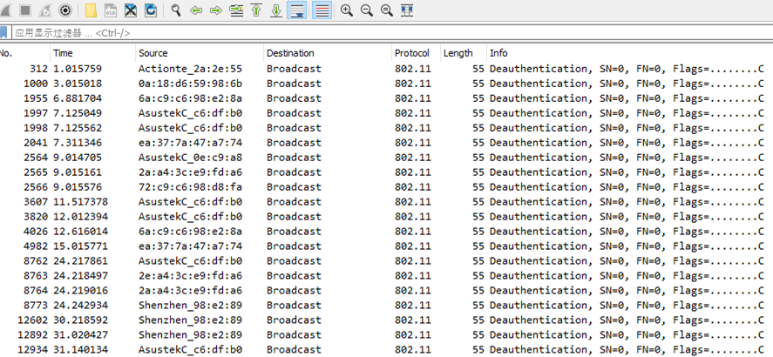
Backup-1:De-auth attacks were found in Nokia Seattle office

Slide 15
Backup-2: Time costs of different certification types
Security mode | Connection procedure | Time cost
Open | Authentication+Association | 5ms
WPA/WPA2+PSK | Authentication+Association +Four way handshake | 80ms
WPA/WPA2+802.1X | Authentication + Association +802.1x+ Four way handshake | 230ms
802.11R fast roaming | Authentication + Re-Association | 50ms

