Slide 1
Secure LTF using DFT Precoded OFDM
Date: 2020-07-15
Authors:

Slide 2
PHY Security
Attacker tries to modify the measured range
  Make STA appear closer to AP to fake proximity detection
  Spoof time-stamps t2 or t4 to achieve that
Focus on physical layer attack
  Assume that MAC level is authenticated/encrypted
  Includes time-stamps t1/t4 feedback to initiator

Slide 3
Integrity Attack Scenario
First line security
  Use secure LTF (sequence unknown to attacker)
  Replace Cyclic Prefix (CP) with zero-padded Guard Interval (to reduce structure)
Attack types
  Computational attack: attacker observes fraction of symbol and predicts the rest to attack the later part
  Replay attack: for both Cyclic Prefix or Guard Interval, attacker repeats first quarter portion of secure LTF with offset
  Brute-force attack: attacker tries to guess the secure LTF
  Noise only: performance in low SNR or attacker caused SINR

Slide 4
Attacker Type 1
Computational Attack
  Attacker will listen to first half portion of LTF
  Then try to estimate the full time-domain LTF waveform (typically by estimating frequency QAM symbols)
  Change measured t2 or t4 by transmitting the last (estimated) quarter of time-domain LTF waveform with timing advance
Waveform for channel measurement
First half
Timing advance
Waveform transmitted by attacker
Last quarter

Slide 5
Attacker Type 2
Guard Interval (GI) Replay Attack
  Attacker will listen to first quarter portion of LTF
  Then try to change measured t2 or t4 by re-transmitting the first quarter with timing advance at the end
  Will affect overlap-add based receiver
Waveform for channel measurement
First quarter
Timing advance
Waveform transmitted by attacker
Copy

Slide 6
Attacker Type 4
Brute Force Attack
  Attacker will try to change measured t2 or t4 by guessing the secure LTF and transmitting with timing advance
  Attack efficacy depends on likelihood of high cross-correlation between sequences A and B
Waveform for channel measurement
LTF Sequence A
Waveform transmitted by attacker
Timing advance
LTF Sequence B

Slide 7
Attacker Type 4
Performance in Noise
  Even without an attacker the likelihood of triggering a false proximity detection increases with decreasing SNR
  Attacker can send interference to artificially lower SNR
  Used as a baseline to compare effectiveness of attacks
Measures of PHY security
  If brute-force attack achieves no worse performance as noise-only
  If replay attack achieves no worse performance than brute-force

Slide 8
Example: Computational Attack
Setup
  40 MHz, overlap-add receiver
  LTF with random QPSK symbols
  Observation period 50%
Observations
  First half of time domain, contains information about all symbols
  Intercarrier-interference (ICI) between neighboring symbols

Slide 9
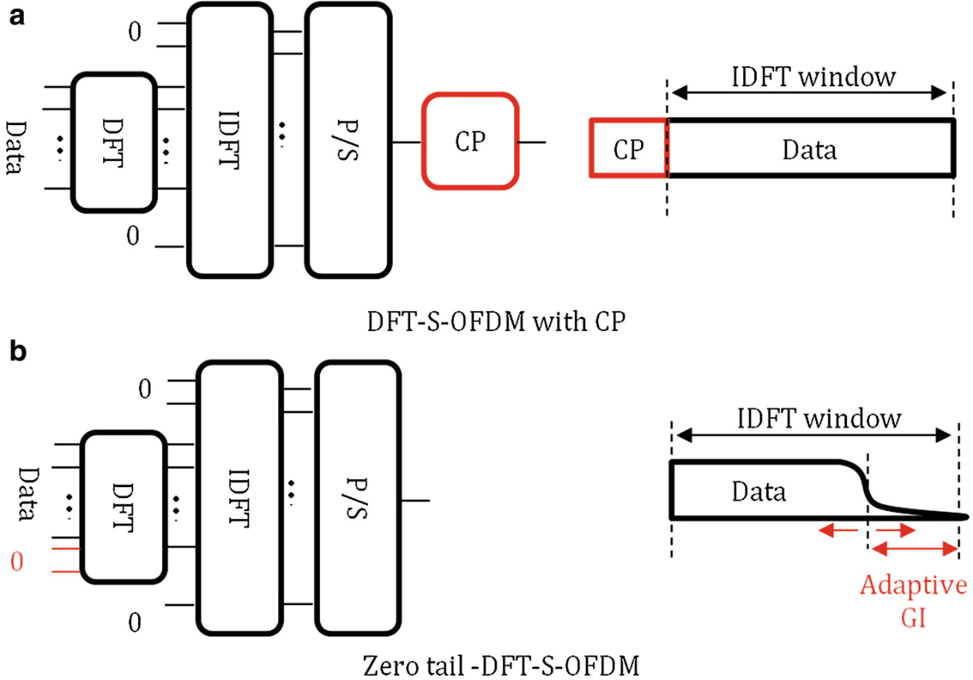
DFT Precoded OFDM
Overview
  Data symbols are precoded with a DFT matrix before IFFT processing
  Can be used with cyclic prefix or without
  Effectively Sinc interpolation of symbols instead of traditional pulse shaper
  Can also omit DC

Slide 10
Example of DFT Precoded LTF
Setup
  Use VHT40 as example
  128 QPSK symbols, DFT precoded
  Zero out 3 DC tones + guard bands
  Keep 114 non-zero subcarriers

Slide 11
Example of DFT Precoded LTF
Setup
  40 MHz, overlap-add receiver
  LTF with DFT precoded random QPSK
  Observation period 50%
Observations
  First half of time domain, contains little information about second half
  Only source is ICI between neighboring symbols (quickly decreasing)

Slide 12
PAPR Comparison
DFT Precoded OFDM
  Peaks up to 2x due to interpolation (same neighboring symbols)
  About 1 dB worse than Golay
  About 2-3 dB better than QPSK

Slide 13
Conclusion
Presented DFT Precoded OFDM for Secure LTF
  Requires extra FFT operation to populate subcarriers
  PAPR closer to frequency Golay sequences
Attacker resilience
  Can be used without CP to avoid replay attack
  Large signal space to avoid brute force attack
  Low cross-correlation in time-domain prevents computational attack

