Slide 1
Non-AP STA TXOP Frame Bursting Testing
Date: 2020-07-13
Authors:

Slide 2
Abstract
When the AP broadcasts the EDCA Parameter Set, associated non-AP STAs shall use these values, otherwise they shall use the default values. We measured the behavior of six different client devices when the AP broadcasts different TXOP limits in the EDCA Parameter Set for Best Effort and Video traffic access categories. Furthermore, with TXOP Limit = 0, the STAs shall only transmit a single PPDU in the TXOP. We also measured the behavior of client devices when the AP specifically broadcasted TXOP Limit = 0. All but one client device violated the TXOP Limit broadcasted by the AP.

Slide 3
Test Equipment and Configuration
Client devices
  Device A: silicon vendor 1, phone, 11ax, 2 antennas
  Device B: silicon vendor 1, phone, 11ax, 2 antennas
  Device C: silicon vendor 2, laptop, 11ax, 2 antennas
  Device D: silicon vendor 3, phone, 11ac, 2 antennas
  Device E: silicon vendor 4, laptop, 11ac, 2 antennas
  Device F: silicon vendor 5, USB adapter, 11ac, 2 antennas
Aruba 11ax AP: 80 MHz, SU UL PPDU
  EDCA Parameter Set broadcast in Beacon

Slide 4
Test Cases
Explore behavior the client devices when AP broadcasts different EDCA TXOP limits for Best Effort and Video access categories
Best effort
  0 (special value, and default value in 802.11-2012; 2.528 msec is default in 802.11-2016)
  1024 usec
  For some devices we also tested 512 usec
Video:
  3008 usec (default value in 802.11-2012; 4.096 msec is default in 802.11-2016)
  For some devices we also tested 1024 and 512 usec
Single client UL UDP over-the-air test, 1460 bytes packet, full buffer load (1 Gbps), 30 seconds IxChariot test
Typical MCS was 9 for 11ac devices, and 11 for 11ax devices
  However for device B, in order to avoid loss in the packet capture, the UL MCS was restricted to HE MCS 7

Slide 5
Analysis Method
Algorithms for plotting the UL stats
  Packet captures were taken and analyzed to generate histograms of TXOP duration, number of Block Acks in each TXOP, and PPDU duration
  For devices A, B and C, frame bursting starts with RTS/CTS, so we use RTS/CTS to identify the beginning of the TXOP
  For devices D, E and F, frame bursting does not start with RTS/CTS, therefore we use IFS between PPDUs to identify the beginning of the TXOP
    If IFS between a BA and next UL PPDU is equal to SIFS, we mark as a burst; if greater than SIFS, then separate TXOP
  PPDU duration, all client types: use the Length field in L-SIG to calculate the TXTIME of the PPDU

Slide 6
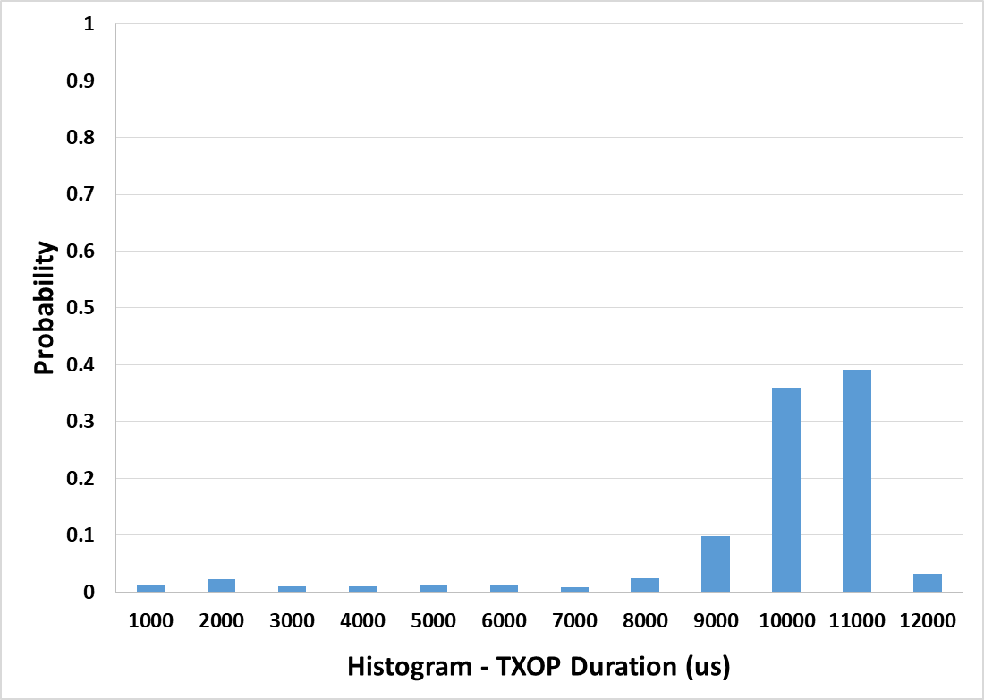
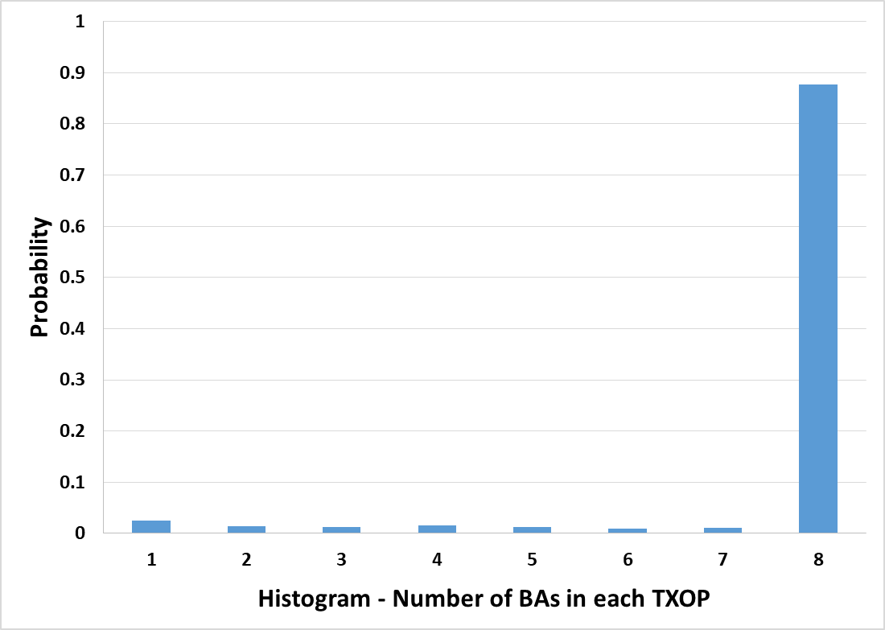
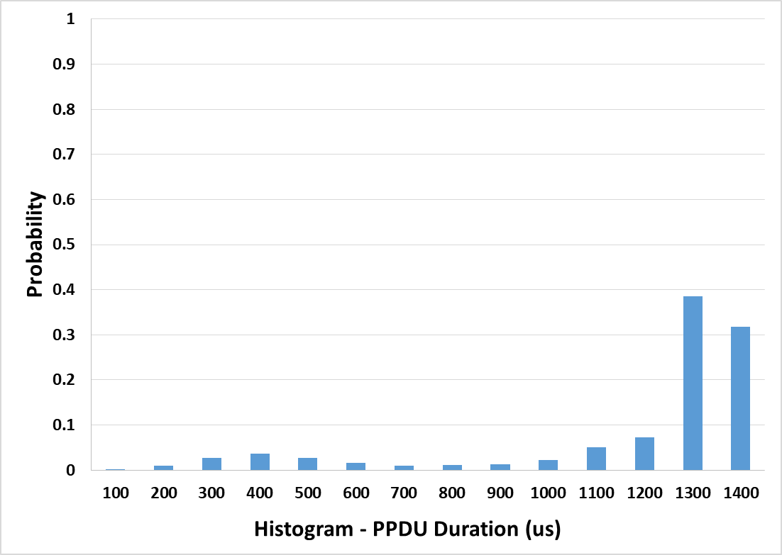
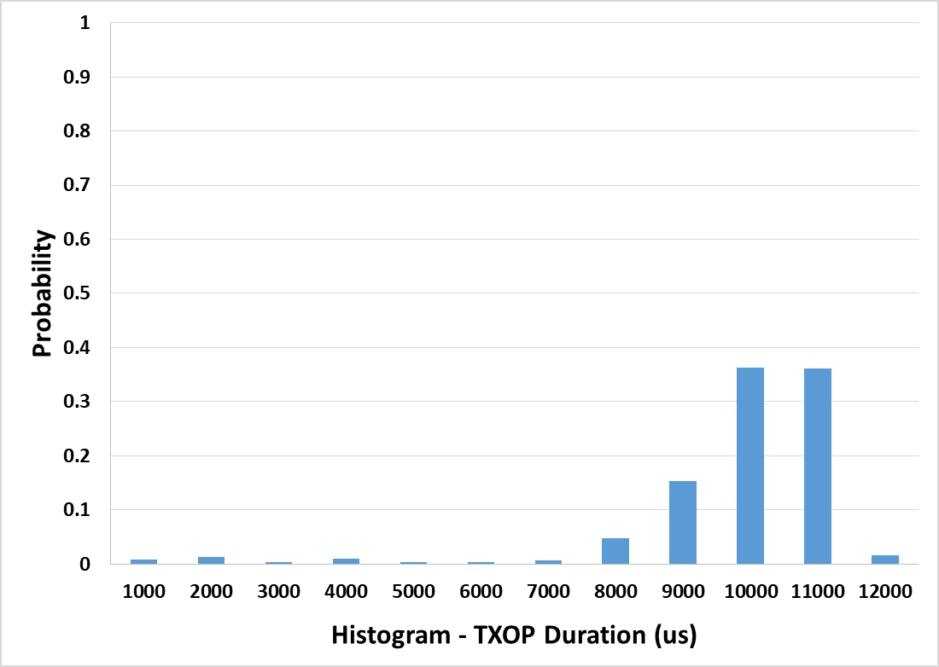
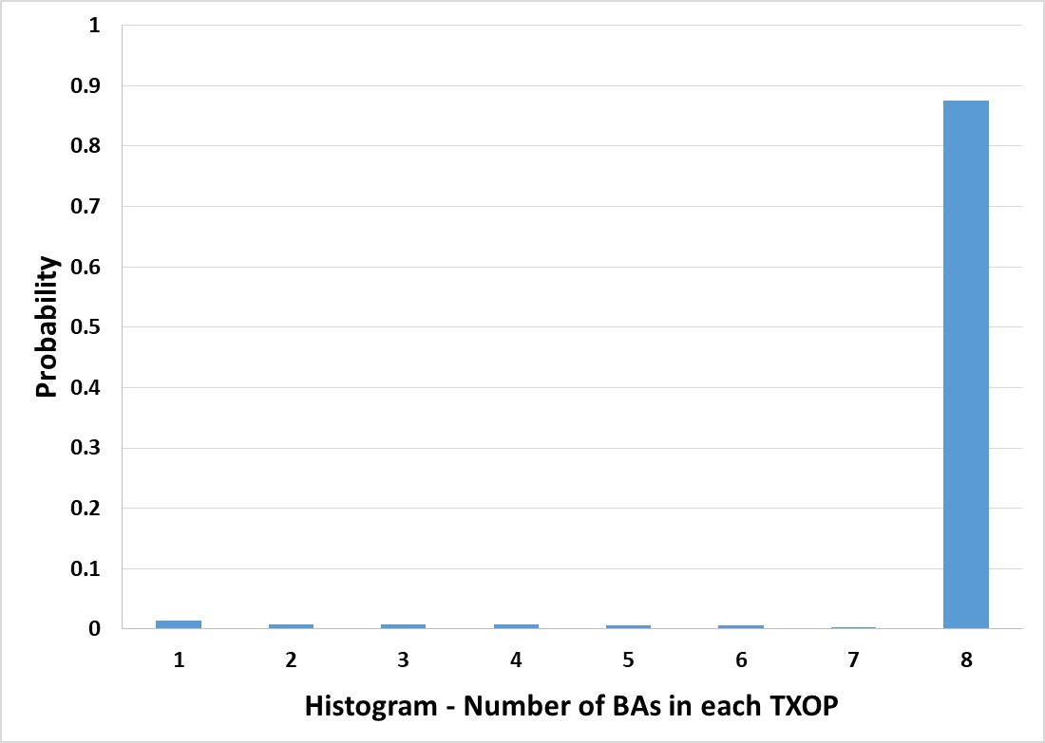
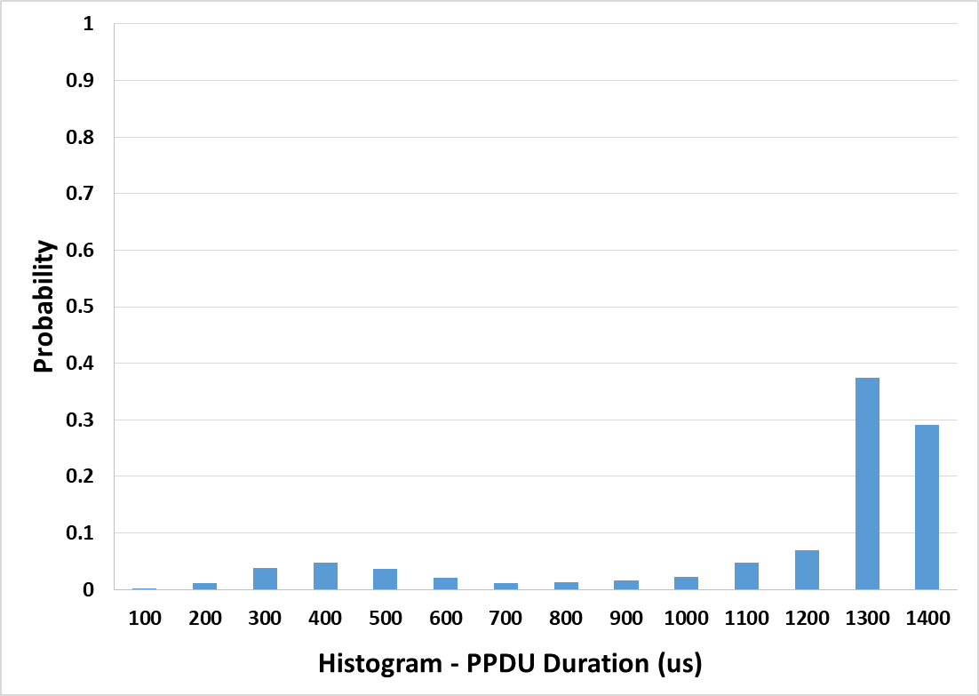
Device A – Best Effort
TXOP Limit = 0
0
0
TXOP Limit = 1024 us
1024 us
1024 us

Slide 7
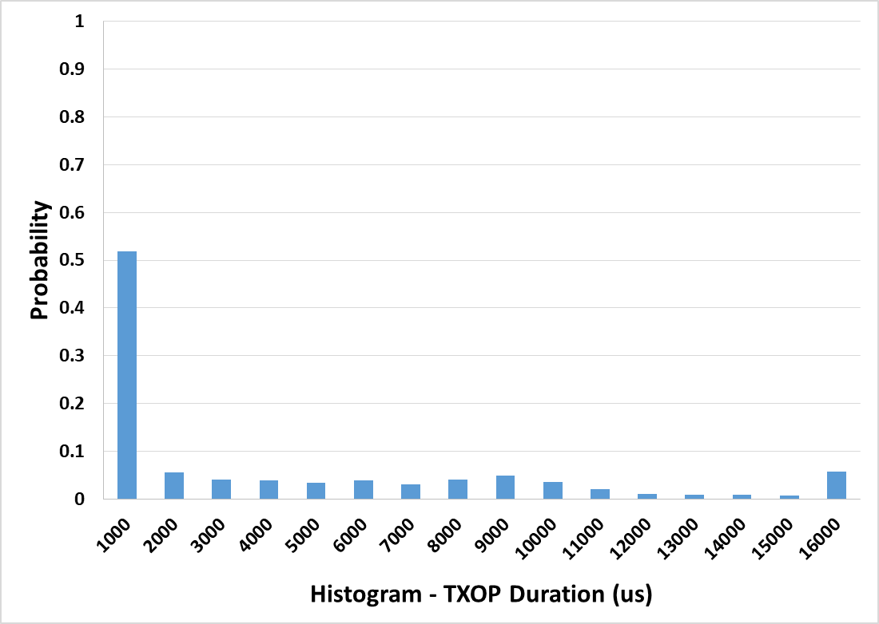
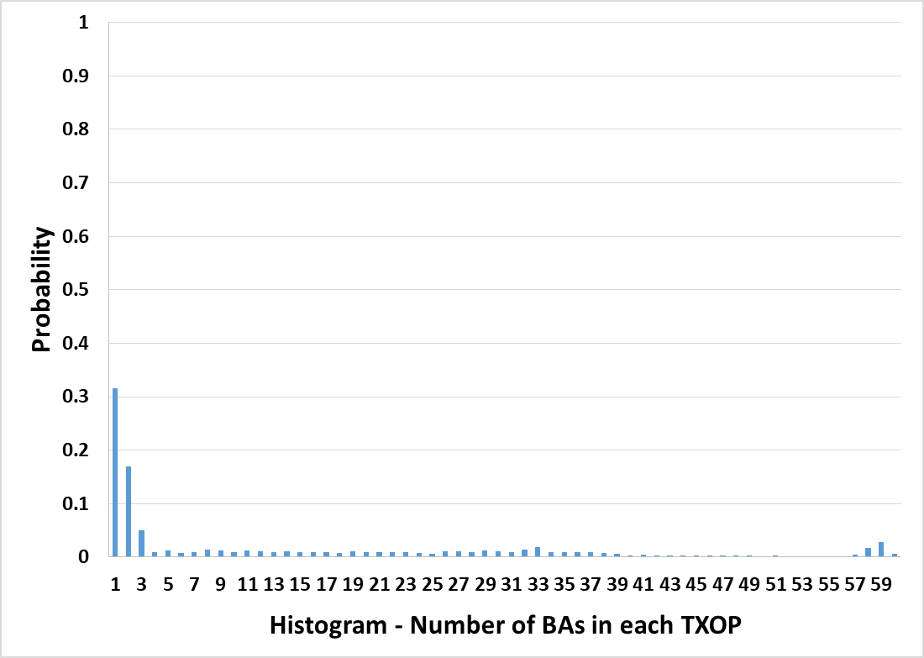
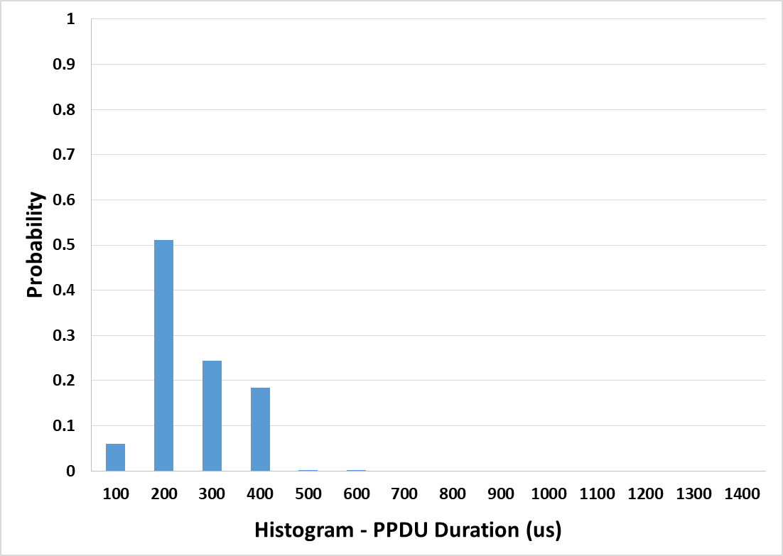
Device A – Video
TXOP Limit = 3008 us
3008 us
3008 us

Slide 8
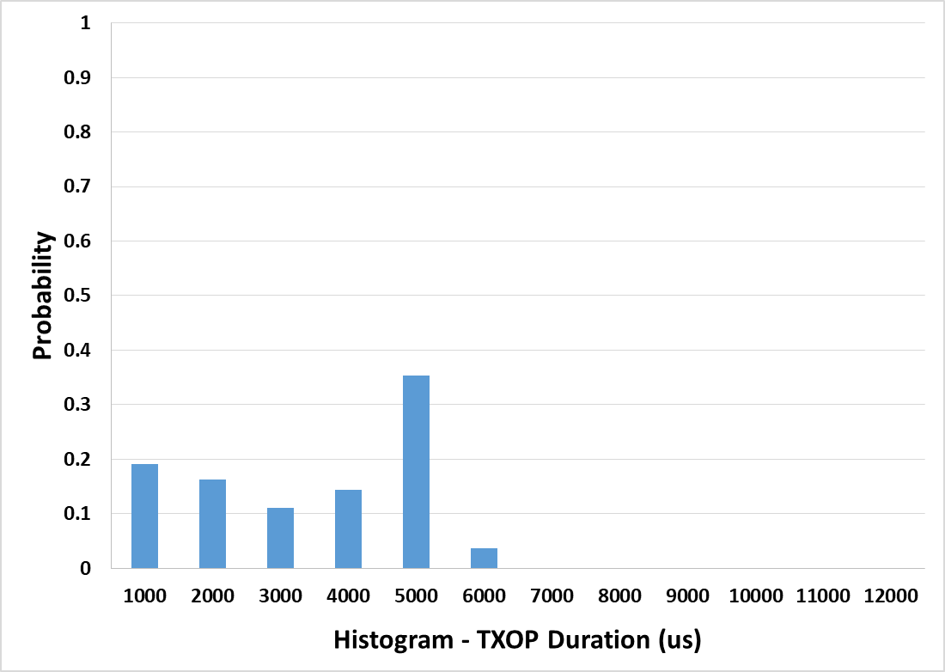
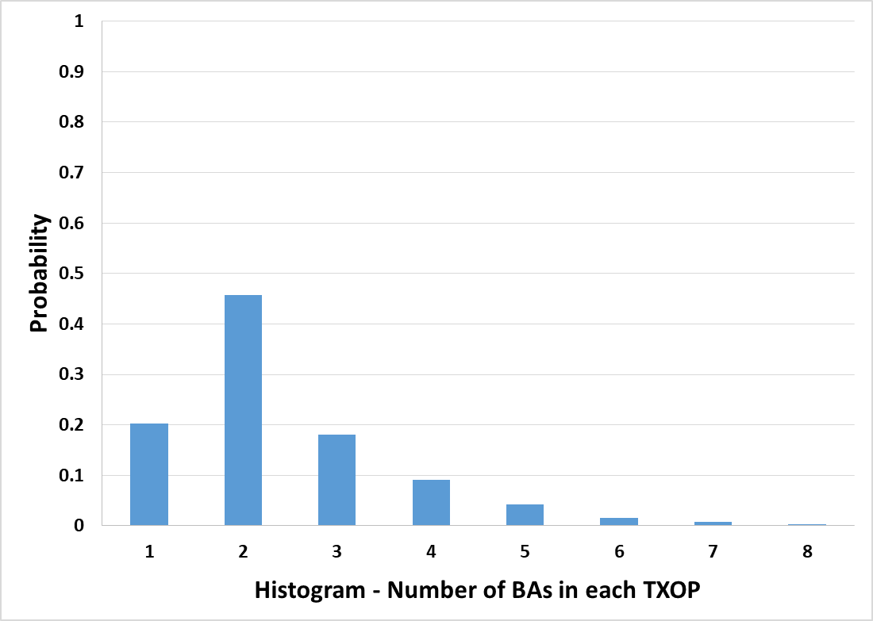
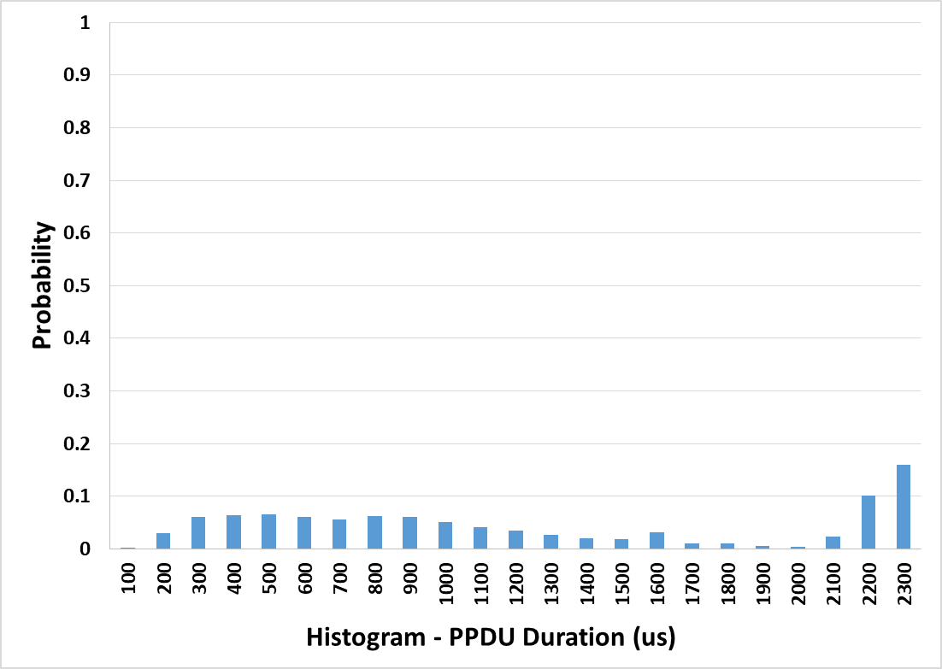
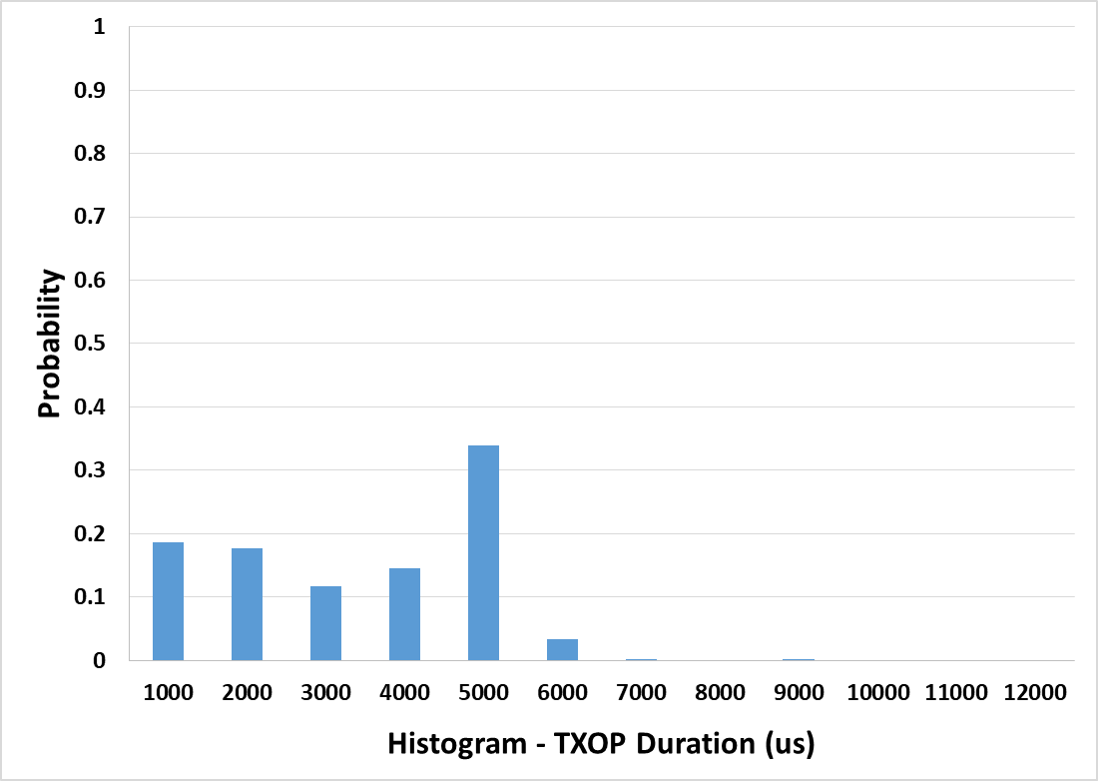
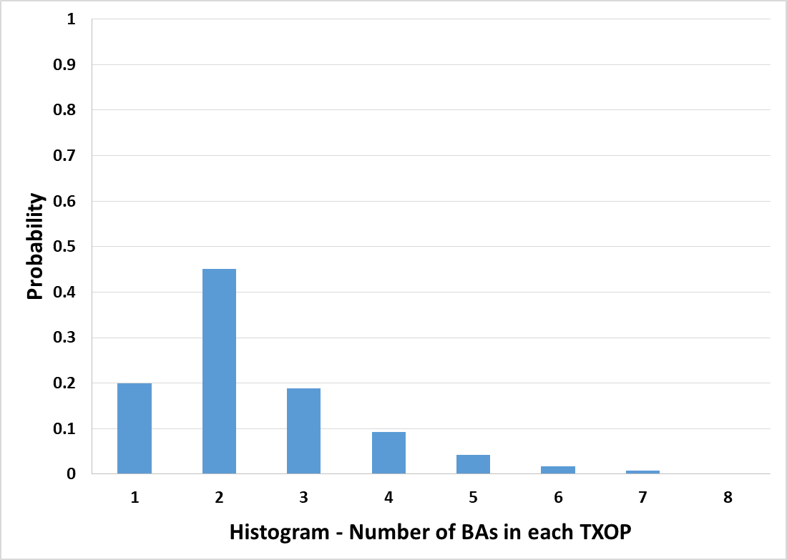

Device B – Best Effort
TXOP Limit = 0
0
0
TXOP Limit = 1024 us
1024 us
1024 us

Slide 9
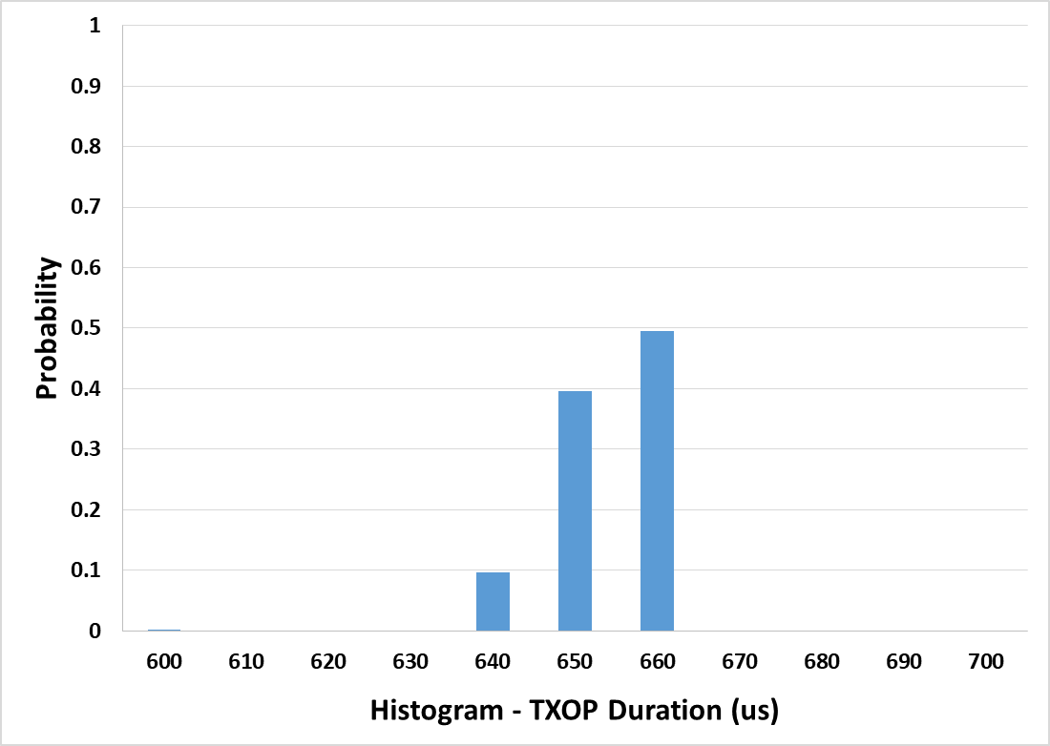
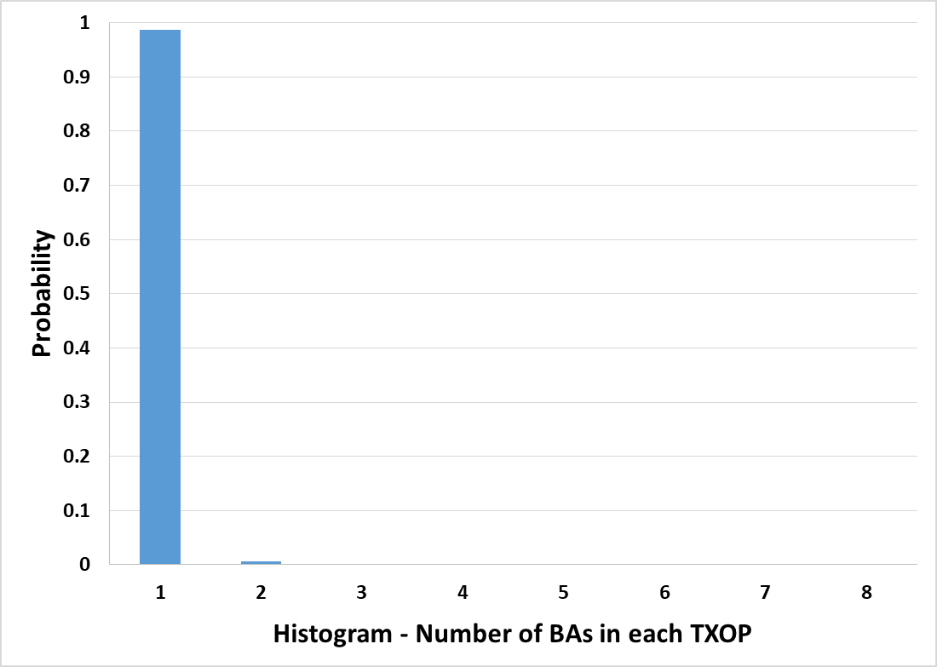
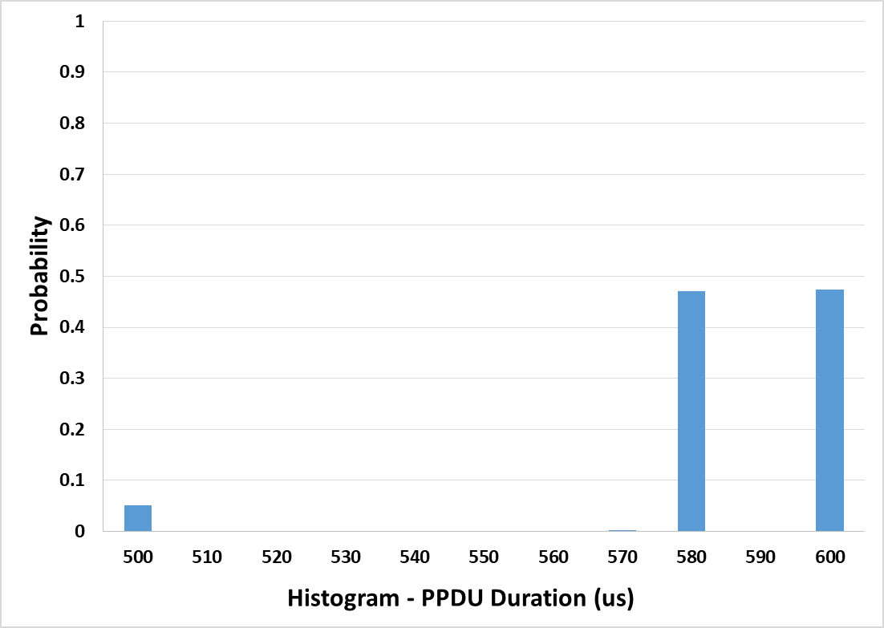
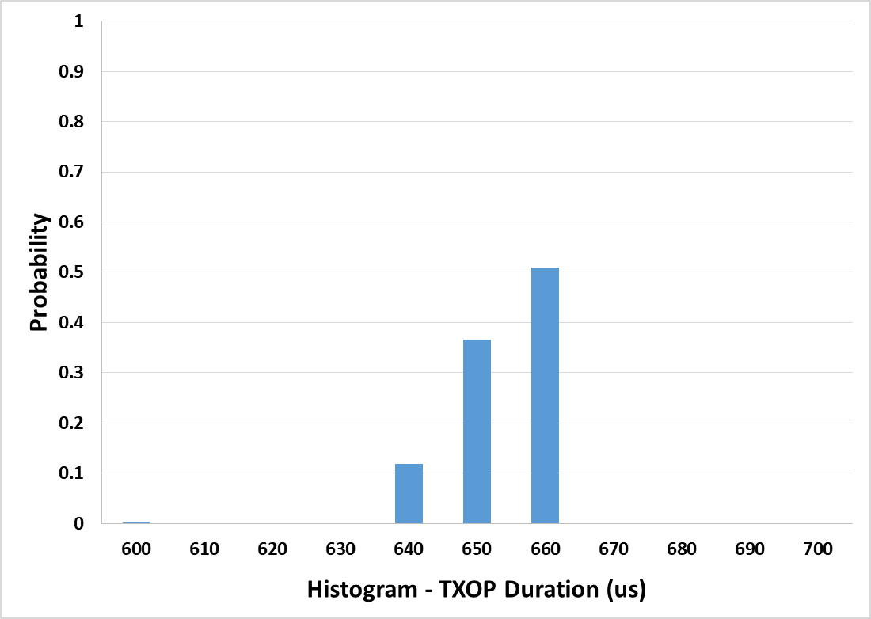

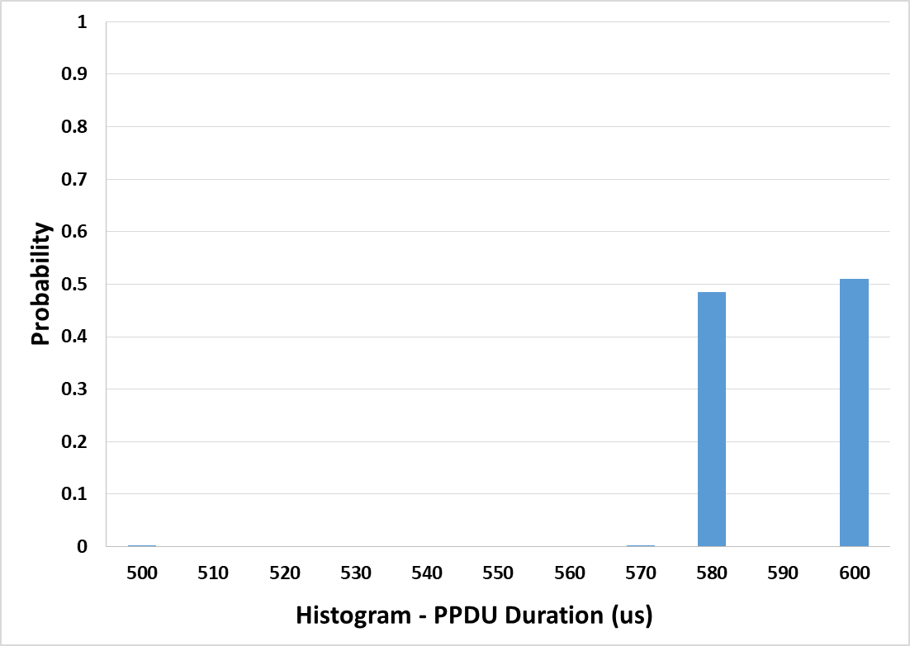
Device B – Video
TXOP Limit = 3008 us
3008 us
3008 us
TXOP Limit = 512 us
512 us
512 us

Slide 10
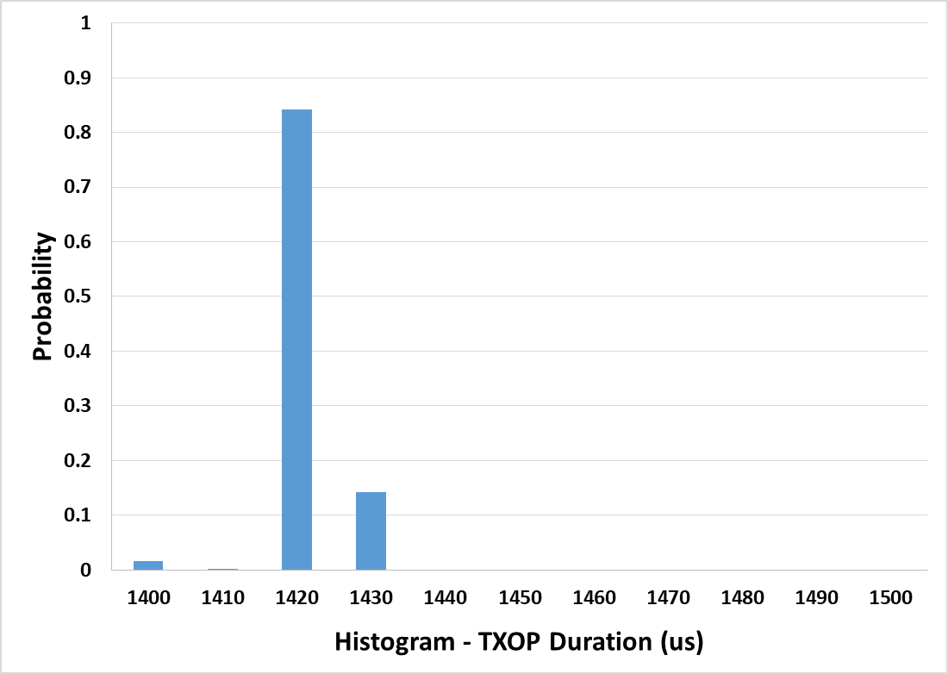
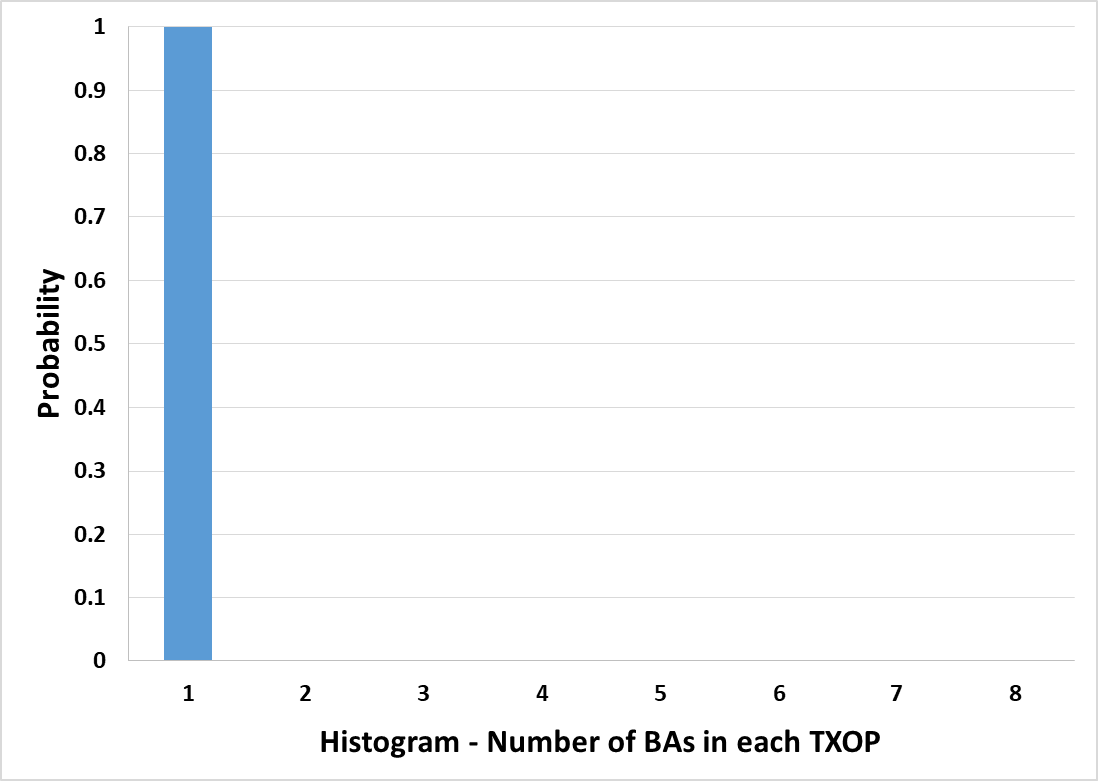
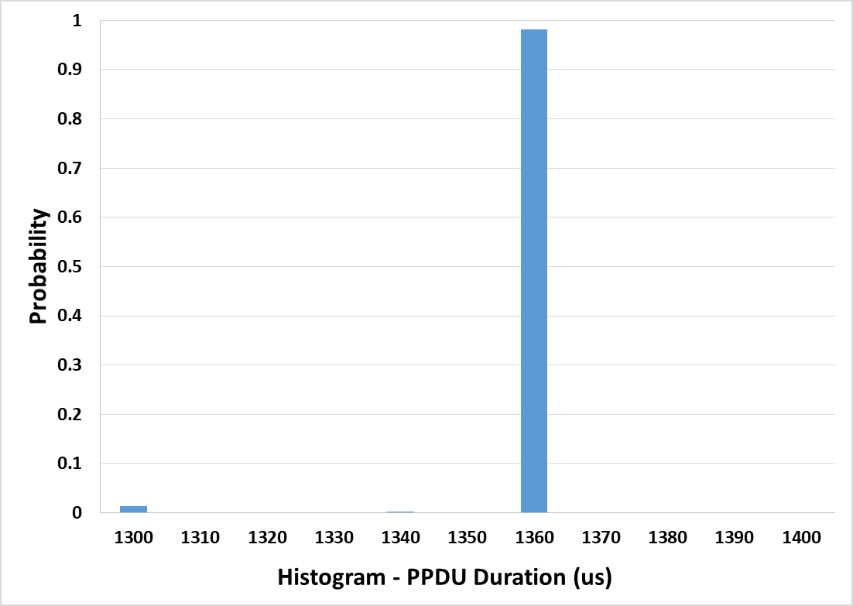
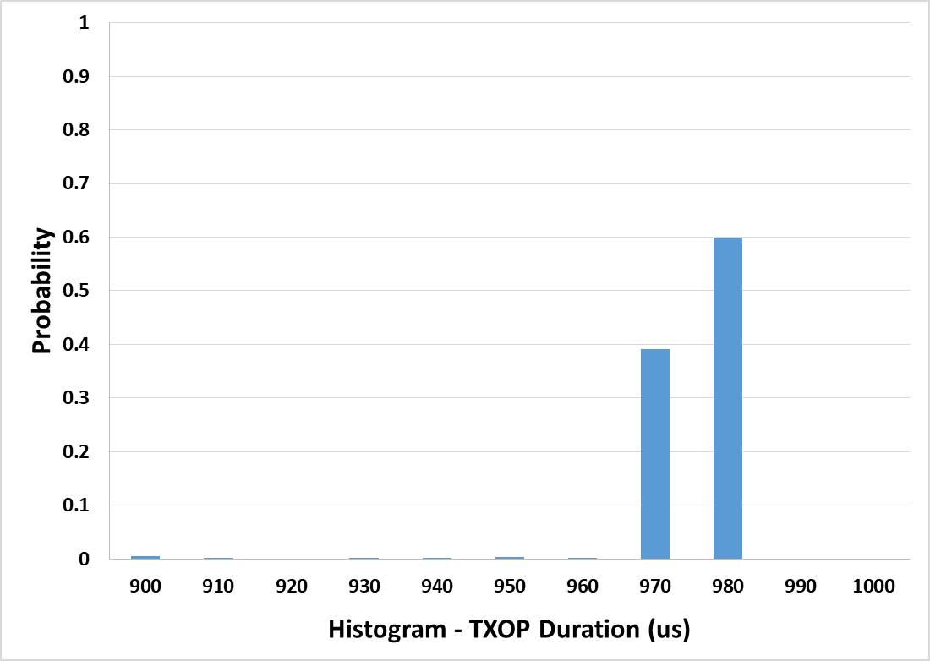
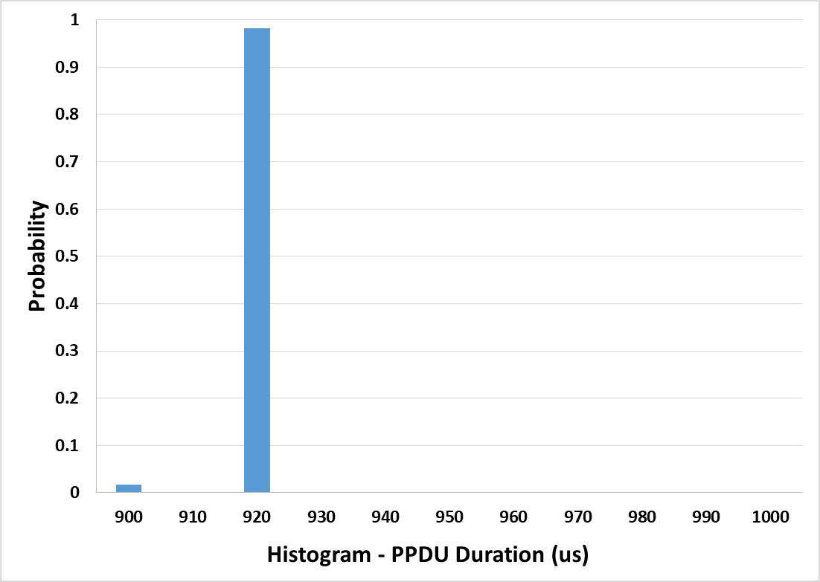
Device C – Best Effort
TXOP Limit = 0
0
0
TXOP Limit = 1024 us
1024 us
1024 us

Slide 11
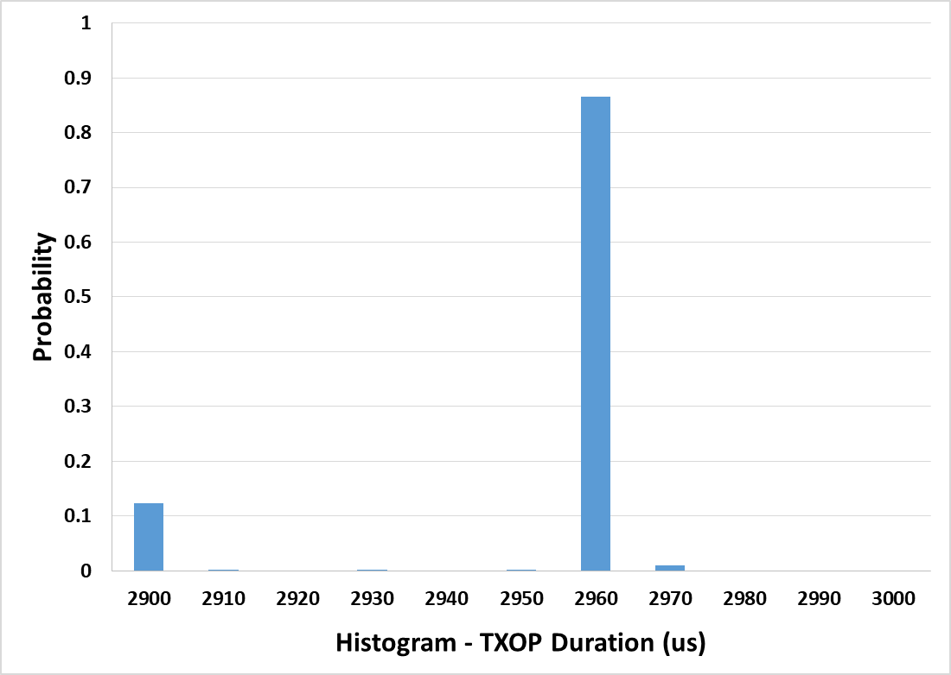
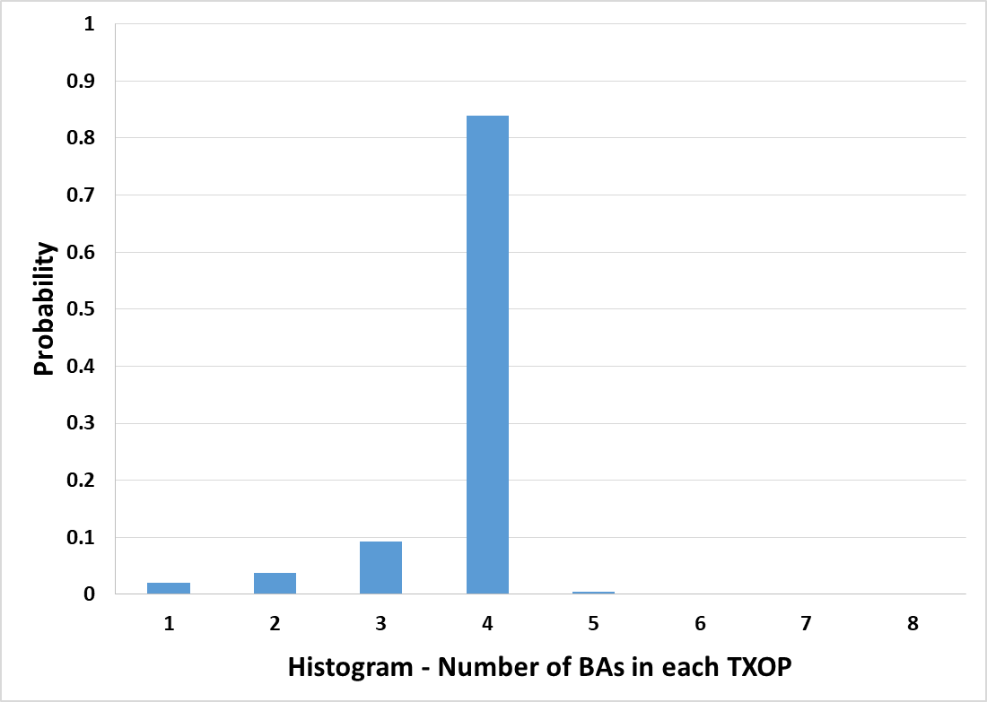
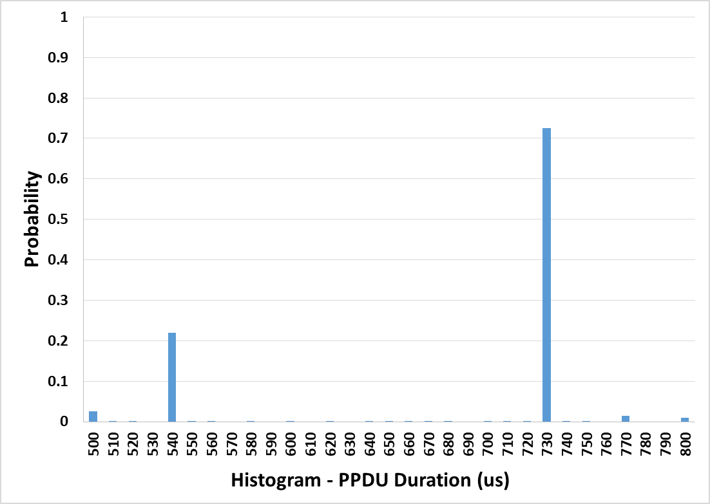
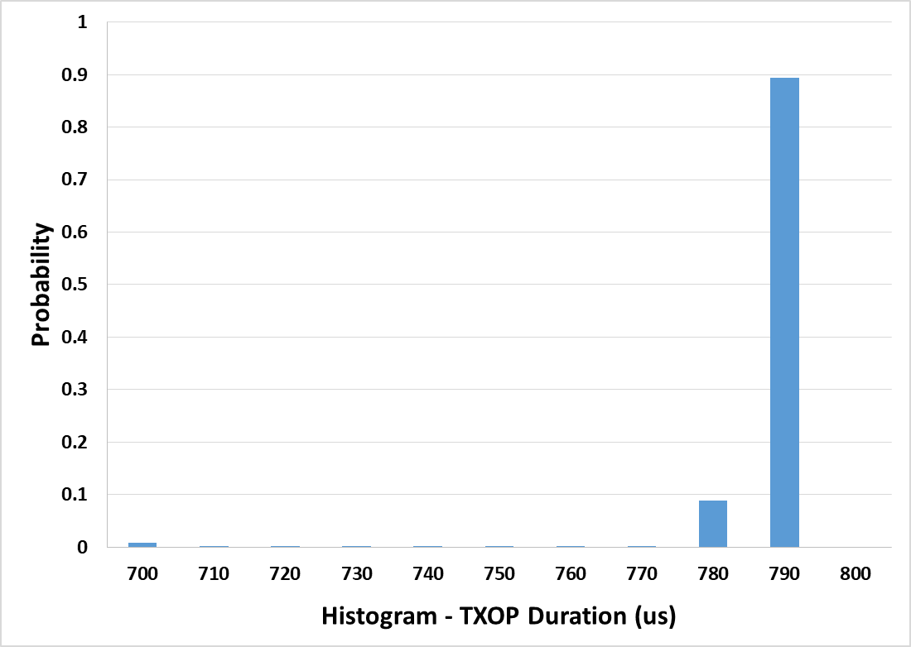
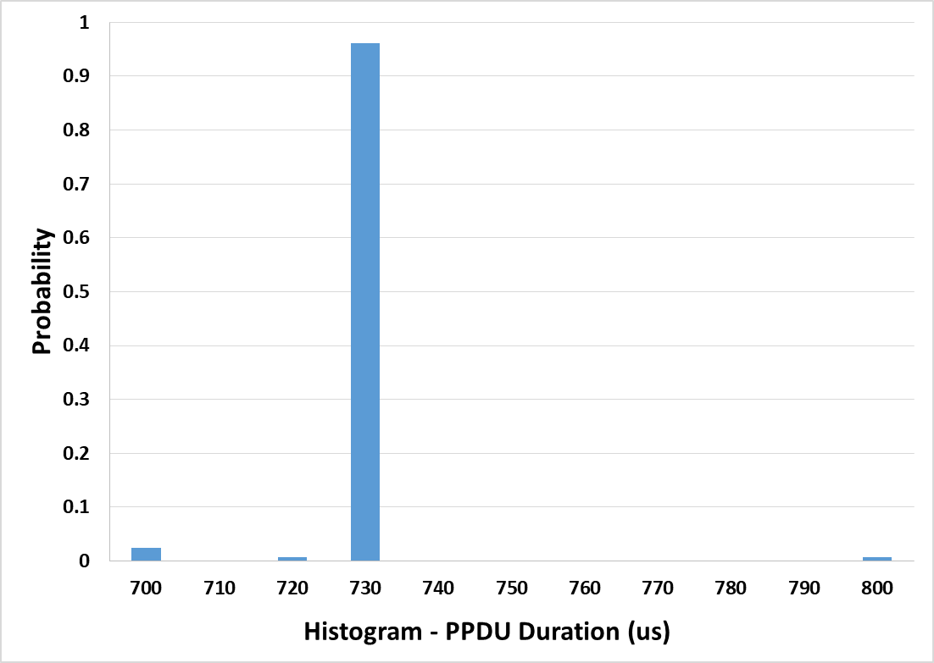
Device C – Video
TXOP Limit = 3008 us
3008 us
3008 us
TXOP Limit = 1024 us
1024 us
1024 us

Slide 12
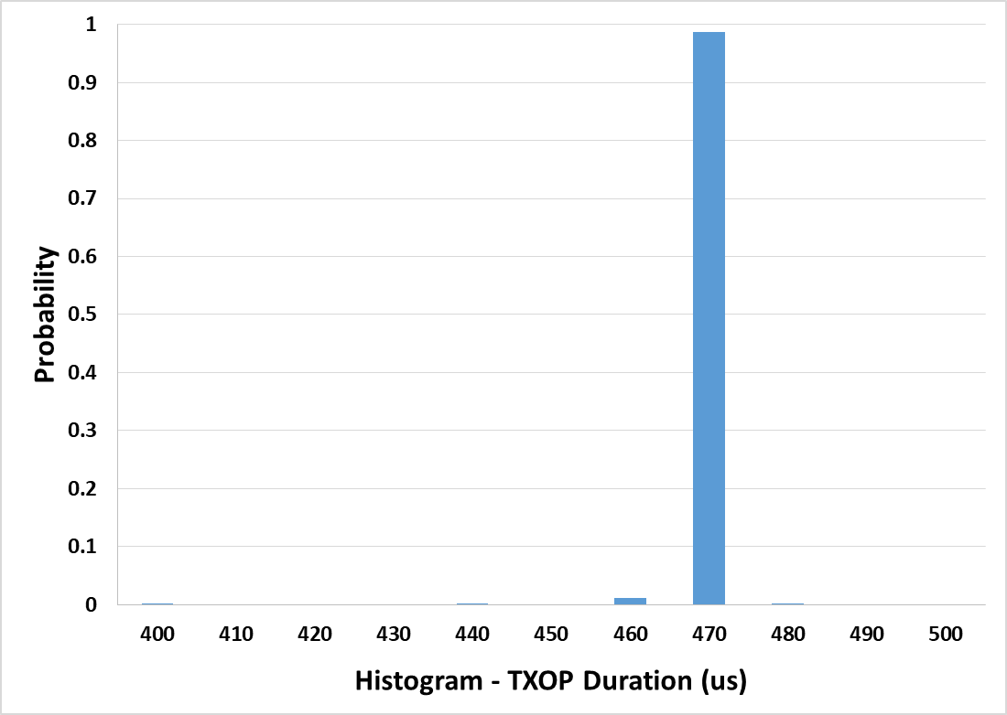
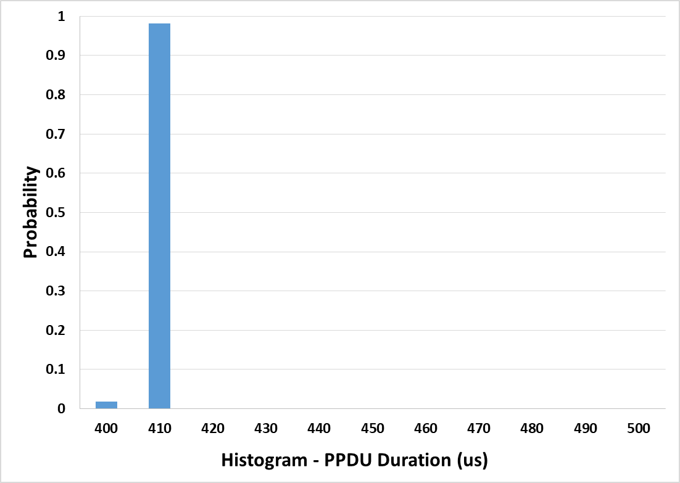
Device C – Video
TXOP Limit = 512 us
512 us
512 us

Slide 13
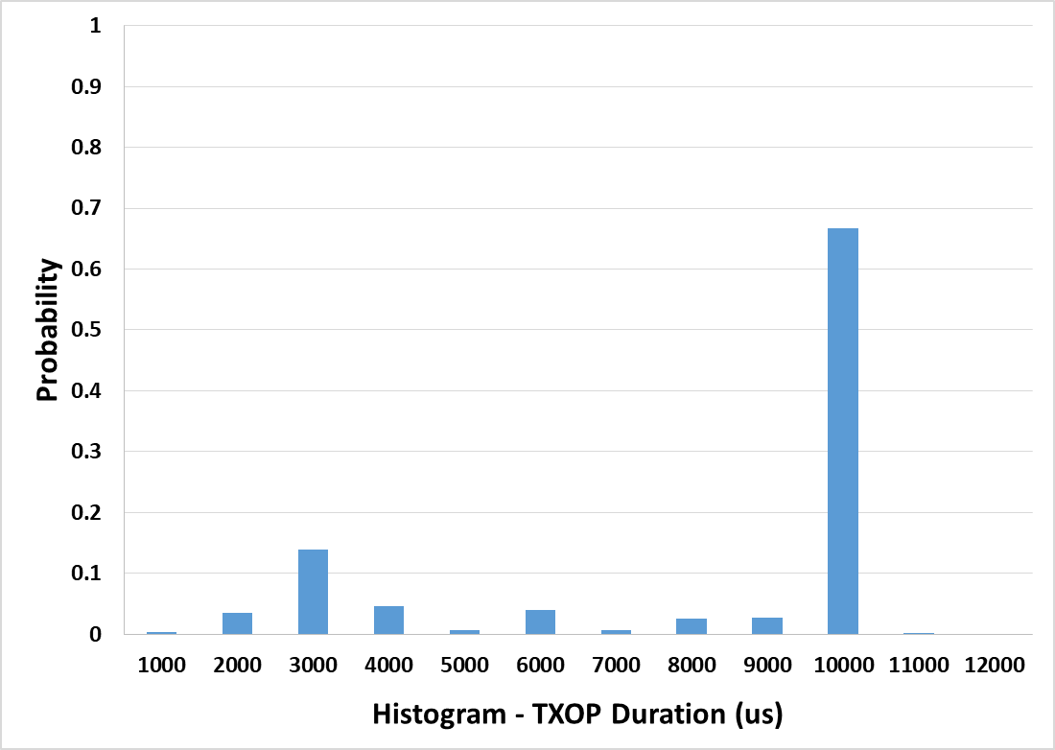
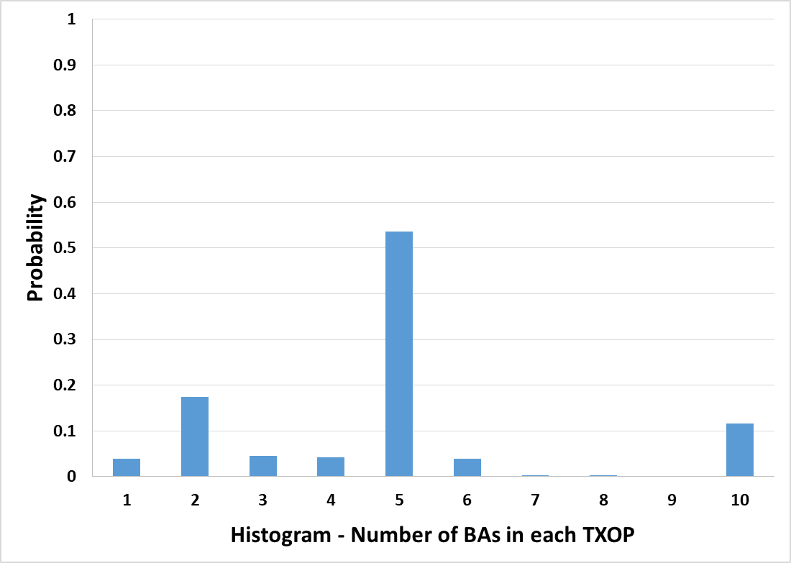
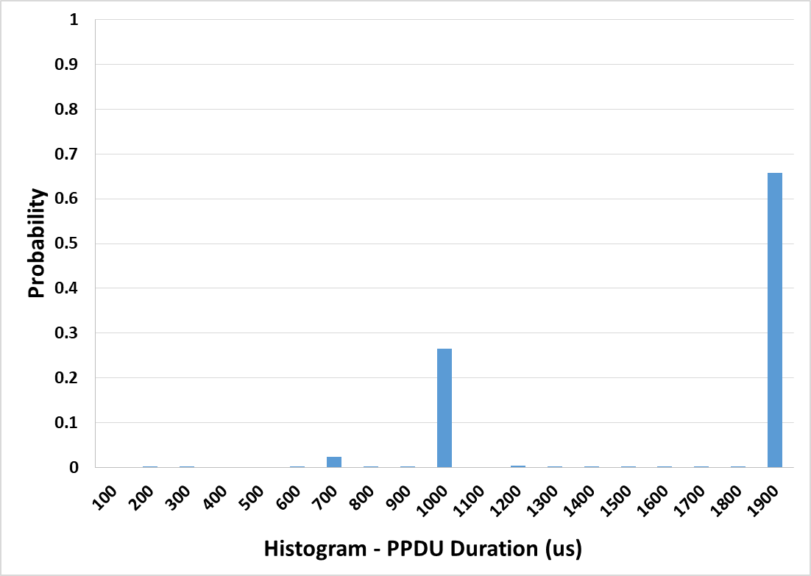
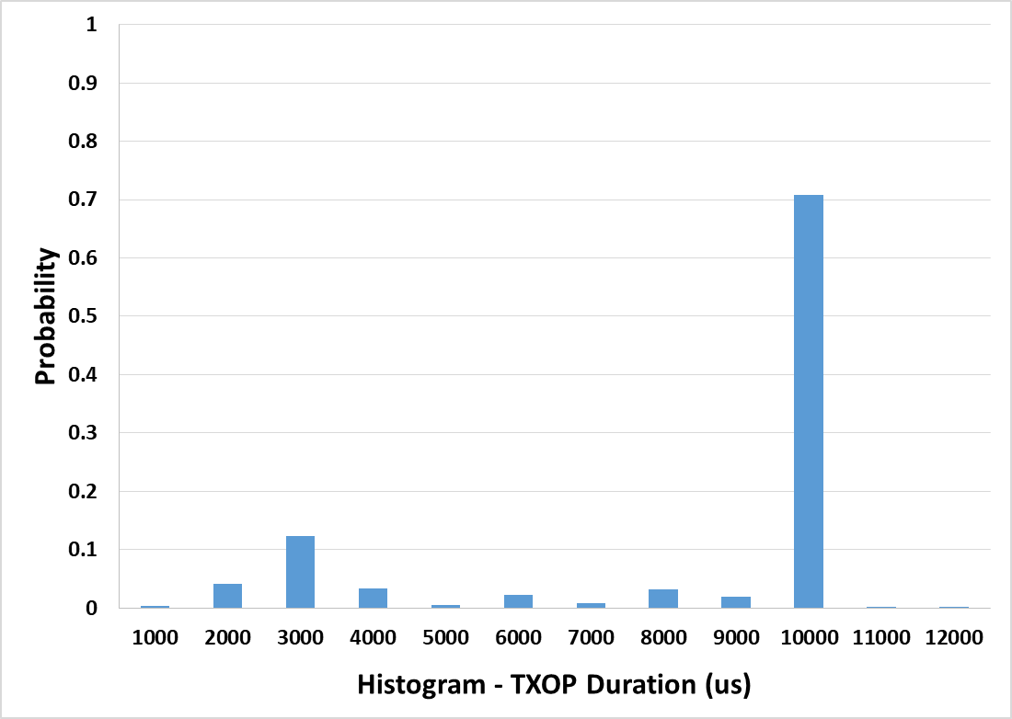
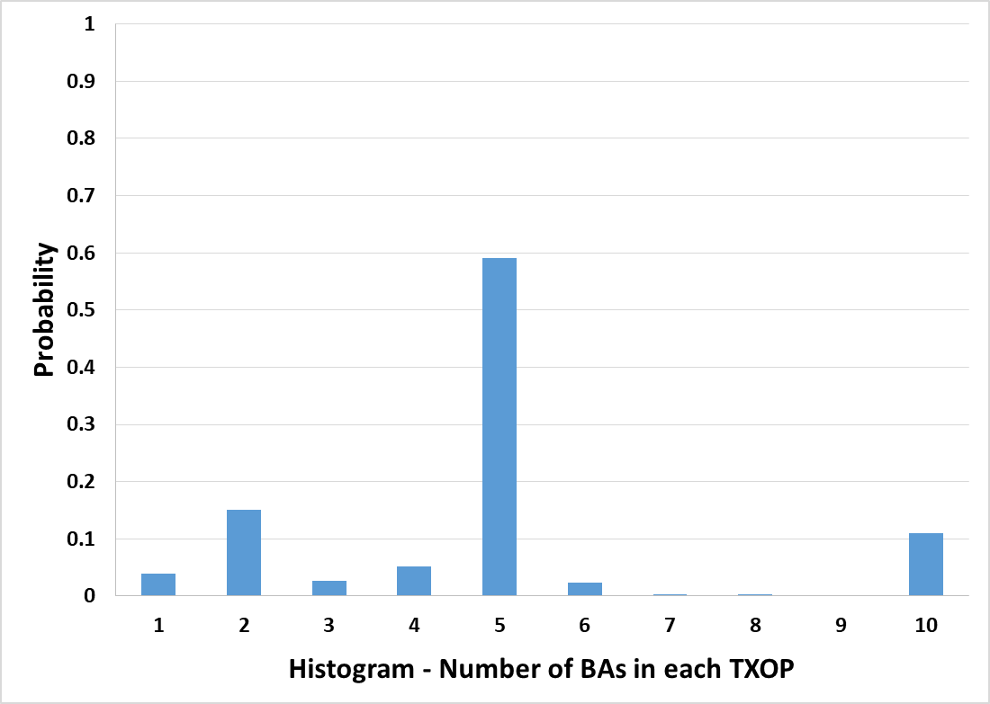
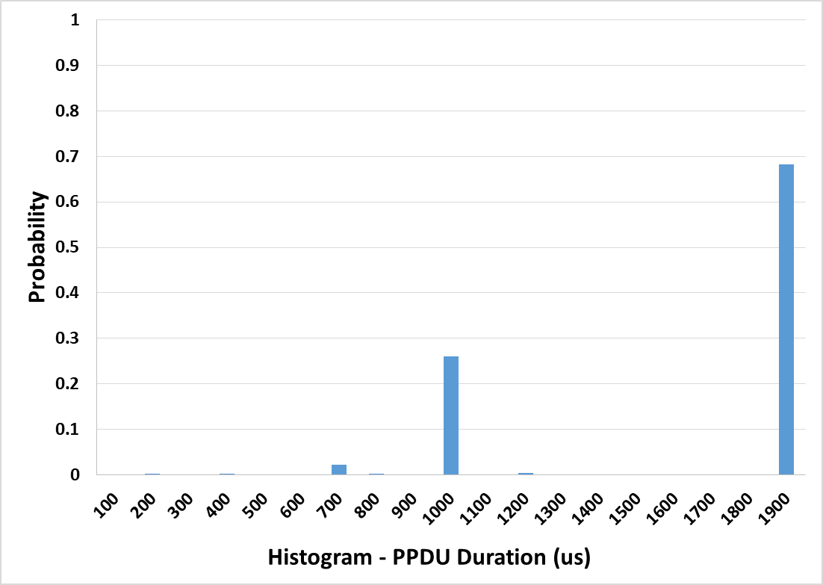
Device D – Best Effort
TXOP Limit = 0
0
0
TXOP Limit = 1024 us
1024 us
1024 us

Slide 14
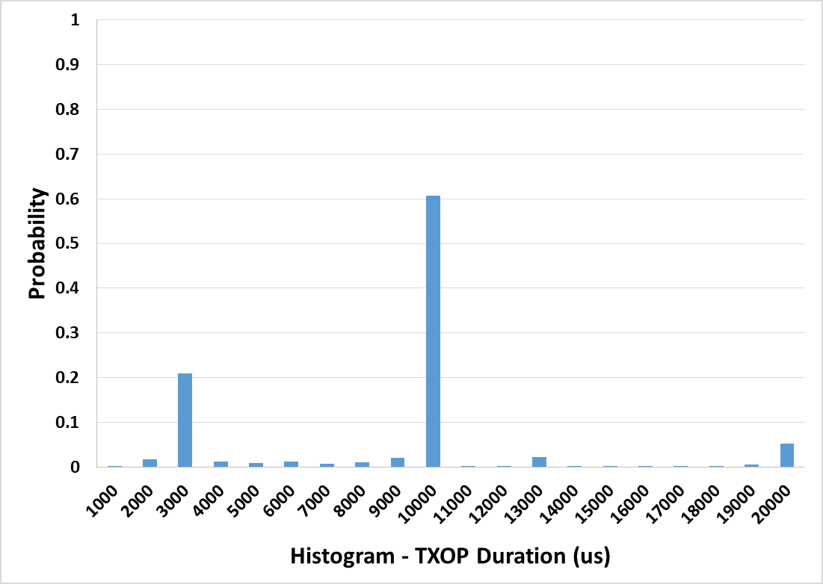
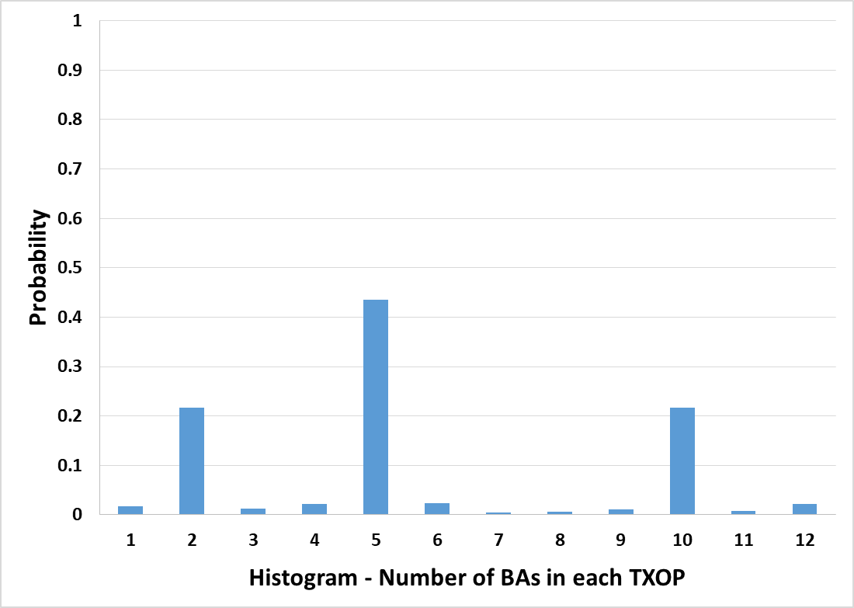
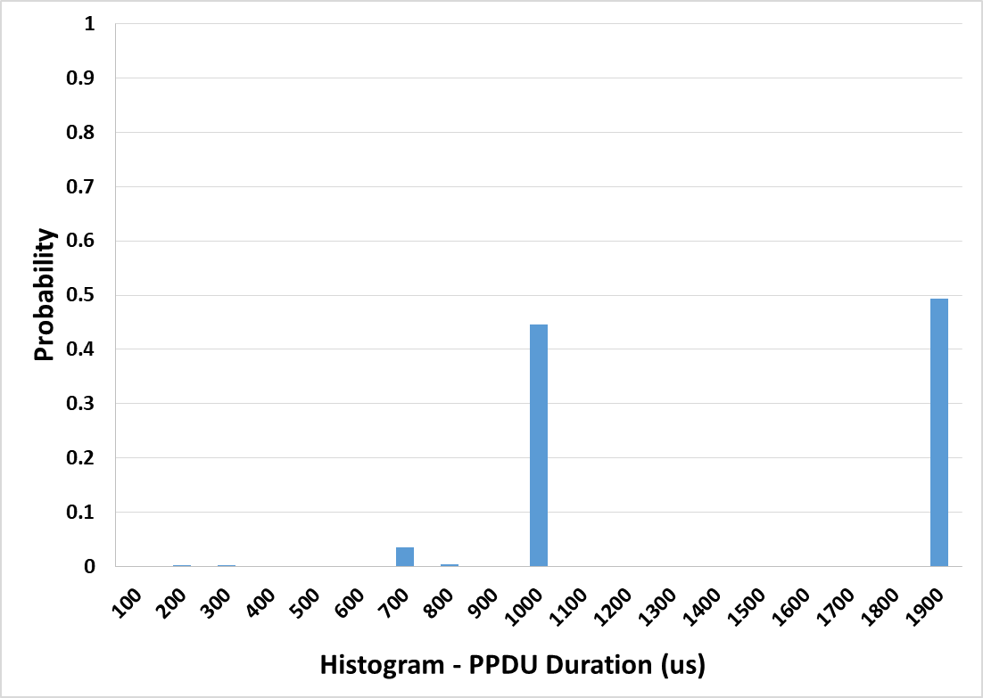
Device D – Video
TXOP Limit = 3008 us
3008 us
3008 us

Slide 15
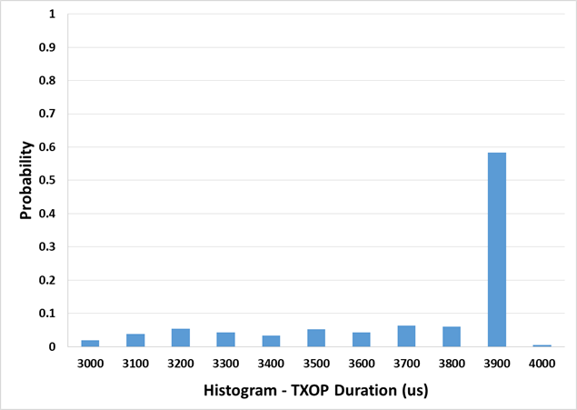
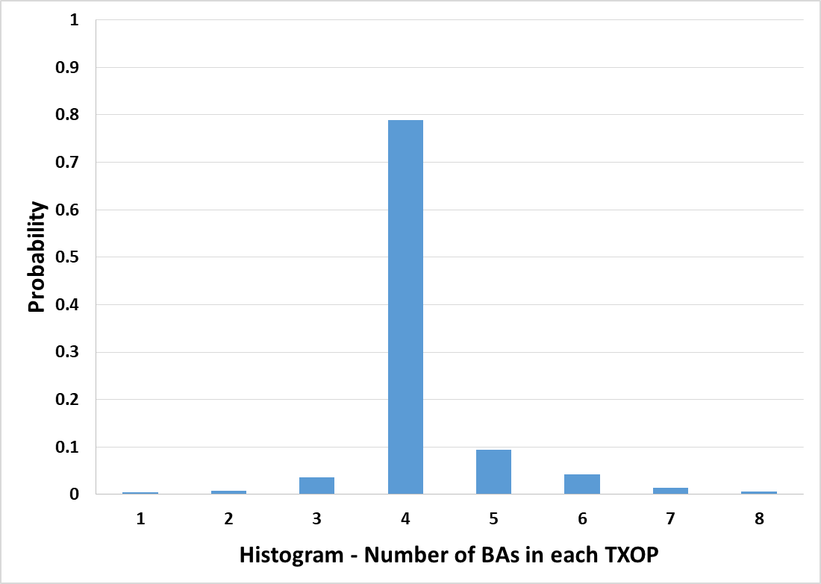
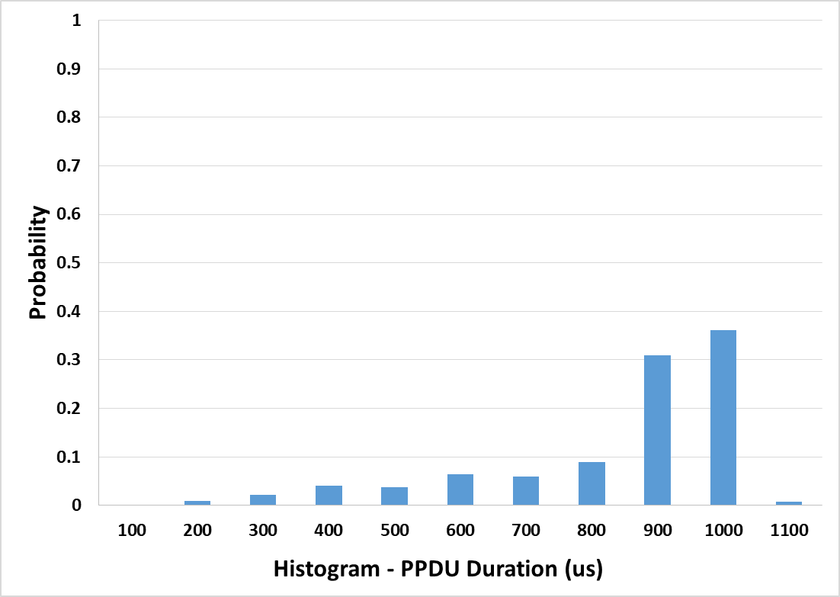
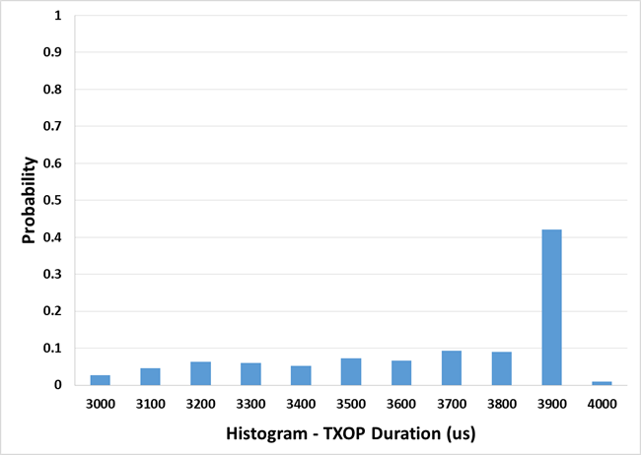
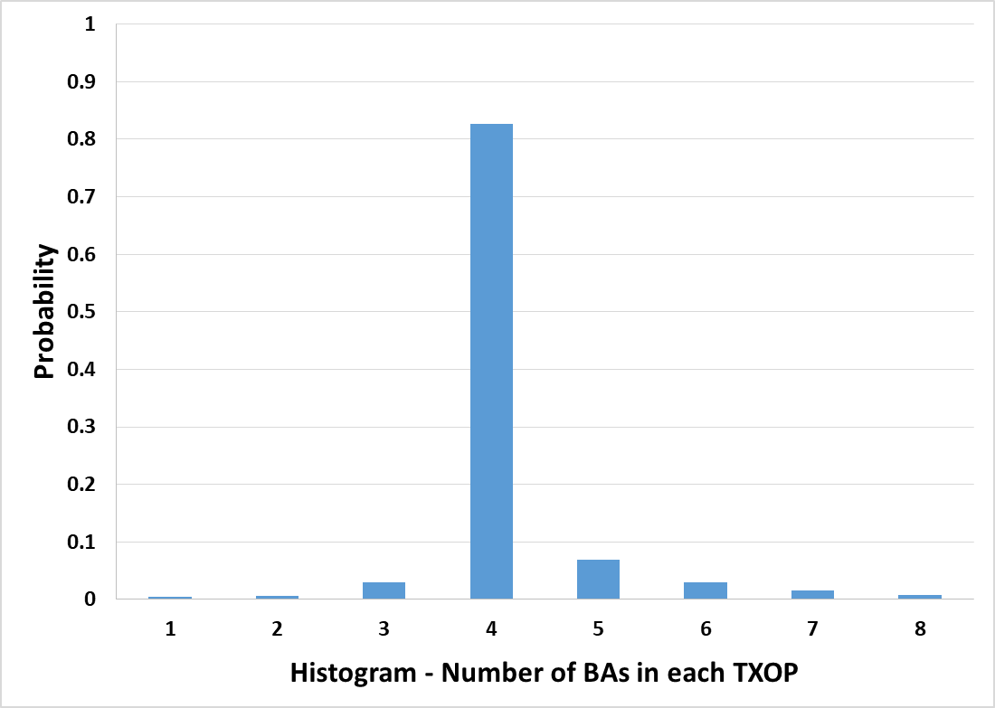
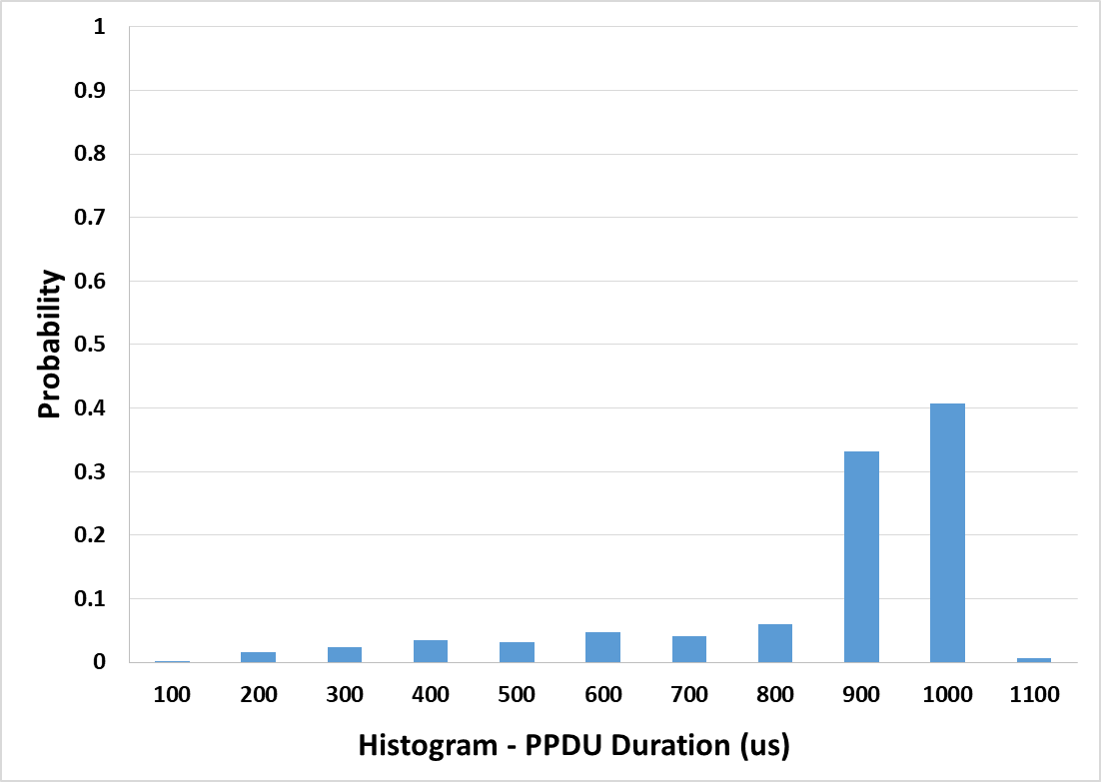
Device E – Best Effort
TXOP Limit = 0
0
0
TXOP Limit = 1024 us
1024 us
1024 us

Slide 16
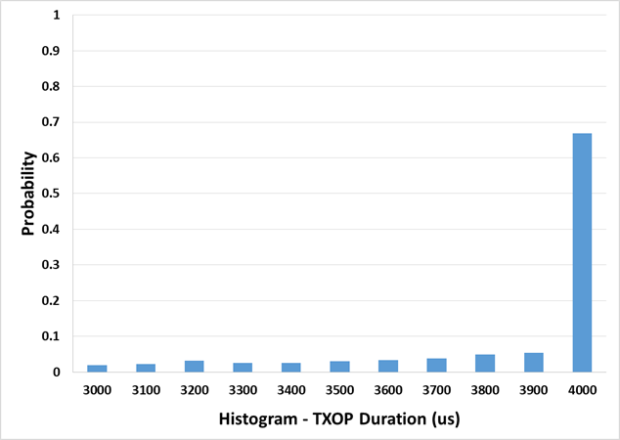
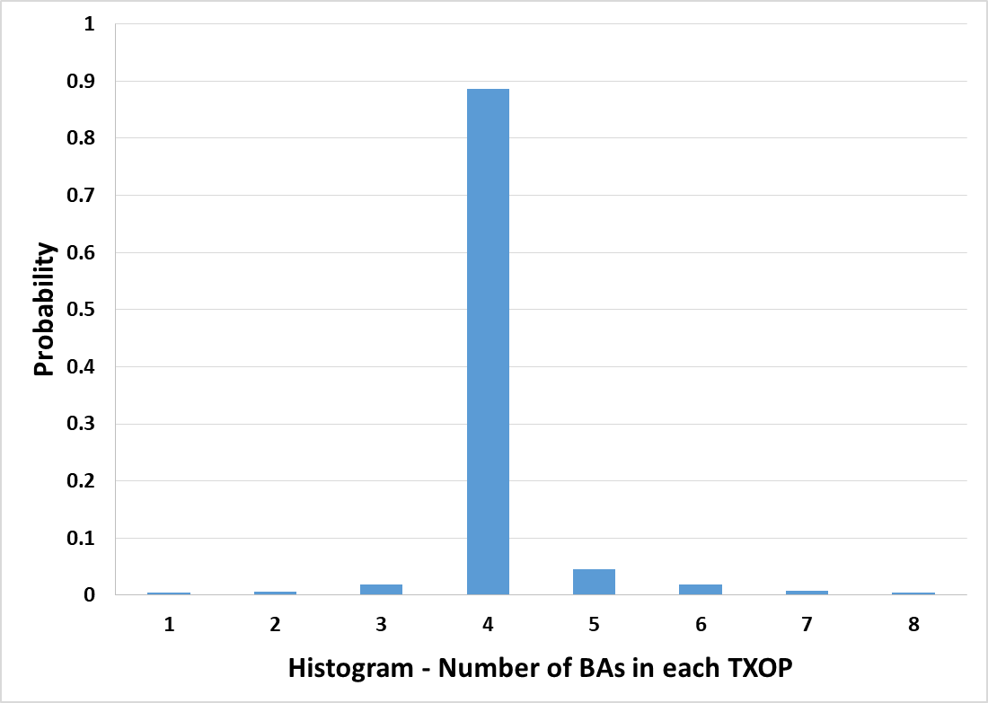
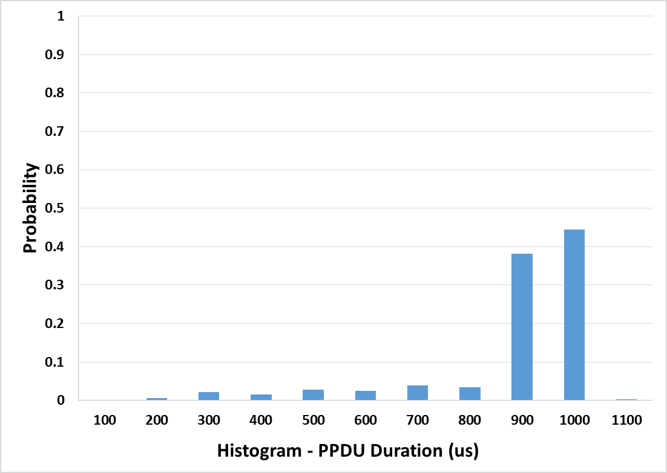
Device E – Best Effort
TXOP Limit = 512 us
512 us
512 us

Slide 17
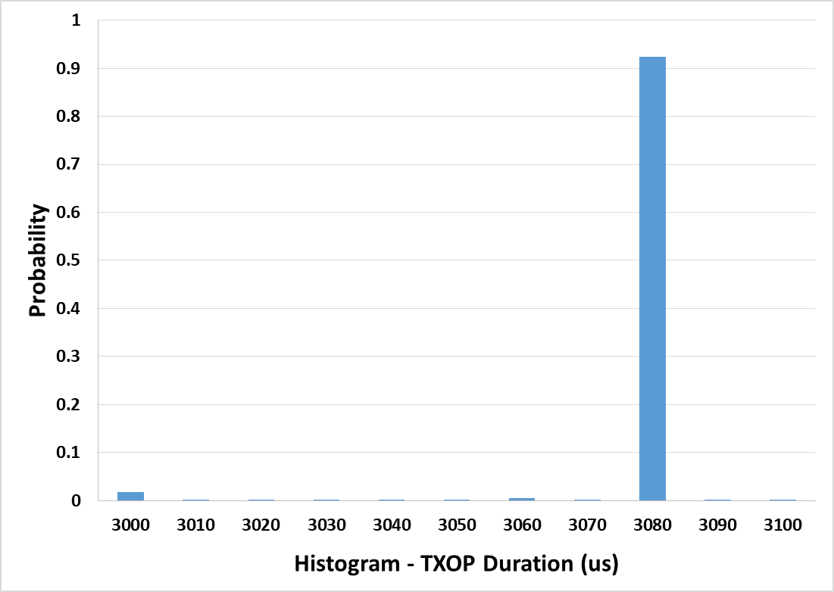





Device E – Video
TXOP Limit = 3008 us
3008 us
3008 us
TXOP Limit = 1024 us
1024 us
1024 us

Slide 18



Device E – Video
TXOP Limit = 512 us
512 us
512 us

Slide 19






Device F – Best Effort
TXOP Limit = 0
0
0
TXOP Limit = 1024 us
1024 us
1024 us

Slide 20






Device F – Video
TXOP Limit = 3008 us
3008 us
3008 us
TXOP Limit = 1024 us
1024 us
1024 us

Slide 21



Device F – Video
TXOP Limit = 512 us
512 us
512 us

Slide 22
Summary of Results
Client Device | Best Effort |  |  |  | Video
 | TXOP Limit = 0 |  | TXOP Limit = 1024 us |  | TXOP Limit = 3008 us |  | TXOP Limit = 1024 us |  | TXOP Limit = 512 us
 | TXOP Duration (95%) | PPDUs Per TXOP (95%) | TXOP Duration (95%) | PPDUs Per TXOP (95%) | TXOP Duration (95%) | PPDUs Per TXOP (95%) | TXOP Duration (95%) | PPDUs Per TXOP (95%) | TXOP Duration (95%) | PPDUs Per TXOP (95%)
Device A | 11042 us | 8 | 10959 us | 8 | 15475 us | 58 | N/A | N/A | N/A | N/A
Device B | 4911 us | 5 | 4895 us | 5 | 660 us | 1 | N/A | N/A | 660 us | 1
Device C | 1421 us | 1 | 972 us | 1 | 2959 us | 4 | 783 us | 1 | 469 us | 1
Device D | 9986 us | 10 | 9983 us | 10 | 19341 us | 10 | N/A | N/A | N/A | N/A
Device E | 3865 us | 6 | 3865 us | 6 | 3076 us | 3 | 1924 us | 2 | 1013 us | 1
Device F | 3150 us | 5 | 3142 us | 5 | 1914 us | 3 | 692 us | 1 | 692 us | 1

Slide 23
Conclusion
In order to make spec unambiguous with respect to TXOP limit and bursting, we propose to revise the following subclauses
  10.23.2.2 EDCA backoff procedure
  10.23.2.9 TXOP limits

