Slide 1
WLAN Localization and Sensing With Mid-Grained Channel Measurements
Date: 2020-07-14
Authors:
Name | Affiliation | Address | Phone | Email
Pu (Perry) Wang | Mitsubishi Electric Research Laboratories (MERL) | 201 Broadway, Cambridge, MA 02139, USA |  | pwang@merl.com
Toshiaki Koike-Akino |  |  |  | koike@merl.com
Philip V. Orlik |  |  |  | porlik@merl.com
Notes:
September 2012

Slide 2
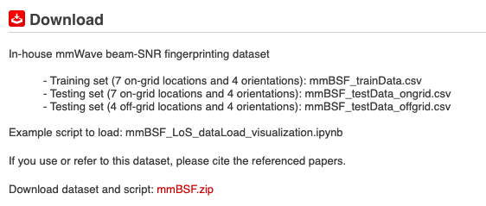
Abstract
This contribution proposes to leverage
  mid-grained channel measurement – beam attributes (e.g., beam SNRs)
for high-resolution, zero-overhead localization and sensing.
The measurement is complementary to two mainstream channel measurements
  coarse-grained received signal strength indicator (RSSI)
  fine-grained channel state information (CSI)
We release an open-access mmBSF dataset (60-GHz 802.11ad ) to promote the use of mid-grained channel measurement for WLAN sensing and localization.
https://www.merl.com/demos/mmBSF
mmBSF: millimeter-wave beam SNR fingerprinting

Slide 3
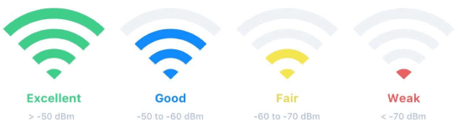
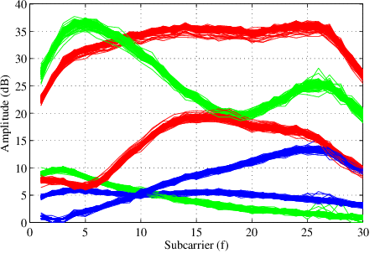
Background
WLAN sensing and , particularly, indoor localization mainly use two kinds of WiFi channel measurements
  Coarse-grained RSSI (received signal strength indicator)
    In the unit of dBm
    Easy to access
    Coarse information about spatial multipath geometry
  Fine-grained CSI (channel state information)
    Complex amplitudes at (32/64) OFDM subcarriers
    802.11n and 802.11ac
    WiFi CSI can be accessible from commercial routers in earlier 2010s
    The CSI-based fingerprinting outperforms the RSSI-based fingerprinting
    (DeepFi’16, PhaseFi’17, BiLoc’18, CSI-Net’19)
    CSI as Multipath Temporal (power delay profile) Features
      Related to channel impulse response (CIR): Multipath delay profile
CSI sequences for 2 Tx & 3 Rx
Picture sources: https://www.netspotapp.com/ and [7]

Slide 4
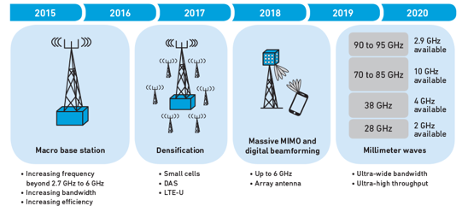
mmWave WiFi/Local 5G
    Ubiquitous existence: mmWave signals are increasingly available due to 5G and 802.11ad/ay WiFi.
    Higher spatial resolution: beamforming; beam training
    Ultrawide bandwidth: provided by available spectrum at mmWave band; resolve multipath
    Larger path loss: requires beamforming for compensation
    Smaller coverage: dense deployments (street-light pole, in-room units, repeaters)
    Stronger scattering effect: good for sensing applications
mmWave Beam Training for path loss compensation
Picture sources: https://www.google.com/imghp?hl=en/ and [16]

Slide 5
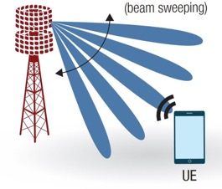
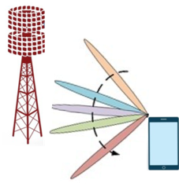
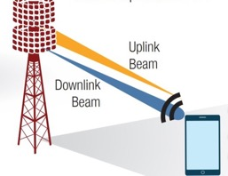
Beam Training
Step 1
Step 2
Step 3
Base Station (BS) or Access Point (AP) sweeps beams over angles
Then, User sweeps beams over angles
Identify the best beam pair for data transmission
Beam Attributes (SNRs) received at UE
Beam Attributes (SNRs, RSSI, throughput) received at AP
Best Beam Index Pair
Mid-Grained Channel Measurements – Beam Attributes
They are more informative and direct measurements in the spatial domain (the use of multiple directional beams) than the RSSI and CSI.
They (spatial-domain measurements at mmWave bands) are complementary to the fine-grained CSI (frequency-domain sub-carrier measurements at sub-6 GHz).
Data collection and exchange (between AP and User) are defined and already facilitated during mmWave beam training (therefore, minimal additional overhead).
Picture sources: https://www.linkedin.com/pulse/
5g-nr-beam-management-scheduling-everything-beams-ramalingam

Slide 6
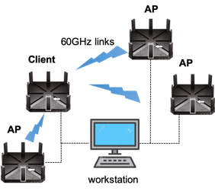
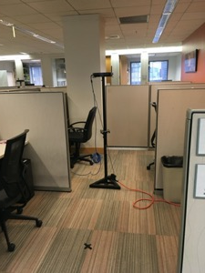
In-House Testbed
3 APs at fixed locations
User is at one of 7 locations
APs & Clients are commercial-off-the-shelf 802.11ad routers [10,11]
At each location, user can be at one of 4 possible orientations (0⁰, 90⁰, 180⁰, 270⁰)
At each of 28 location-orientation pairs, record training/test dataset (weeks apart) during regular business hours
Mid-grained measurements: beam SNRs (channel measurements during beam training)
measurement collection at APs
Client at one Loc
measurement exchange via ethernet cables

Slide 7
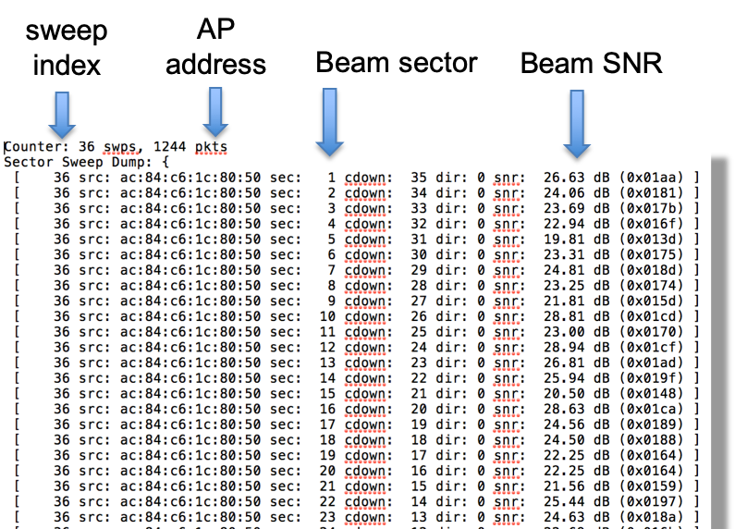
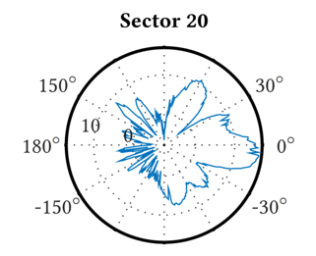
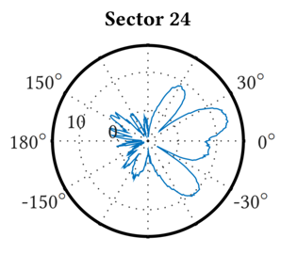
Beam SNRs
Base Station (BS) or Access Point (AP) sweeps beams over angles
Sweeping Beam Patterns
(Irregular beampatterns measured in a chamber – TU Darmstadt [9])
Picture source: https://www.linkedin.com/pulse/
5g-nr-beam-management-scheduling-everything-beams-ramalingam

Slide 8
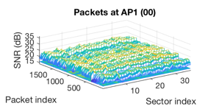
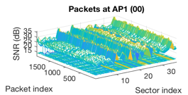
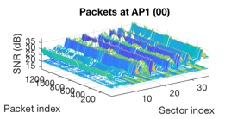
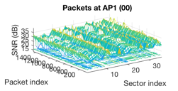
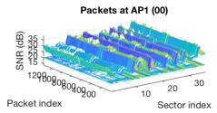
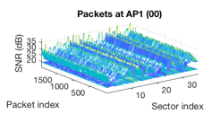
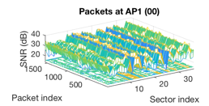
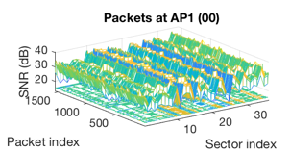
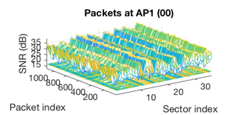
In-House Mid-Grained Measurements
Location 1 Orientation 90°
Location 2 Orientation 90°
Location 3 Orientation 90°
Location 3
Orientation 0°
Orientation 90°
Orientation 180°
Orientation 270°
Training Data
Test Data
Weeks Apart

Slide 9
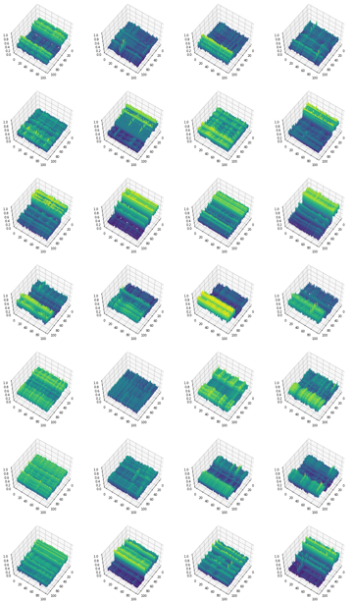
mmBSF Dataset: open access
1 training dataset over 7 locations with 4 orientations
  12007 samples
  For each entries, it has
    A location label (1 to 7)
    A global location-and-orientation label (1 to 28)
    An orientation degree (0∘,90∘,180∘,270∘)
    A two-dimensional coordinate
    108 beam SNR values (36 beam SNR values for one AP)
2 test datasets
  on-grid test dataset: the same 7 locations and 4 orientations (4 weeks after the training dataset)
    7361 samples
  off-grid test dataset: 4 different locations with 4 orientations (4 months after the training dataset)
    2044 samples
https://www.merl.com/demos/mmBSF
16

Slide 10
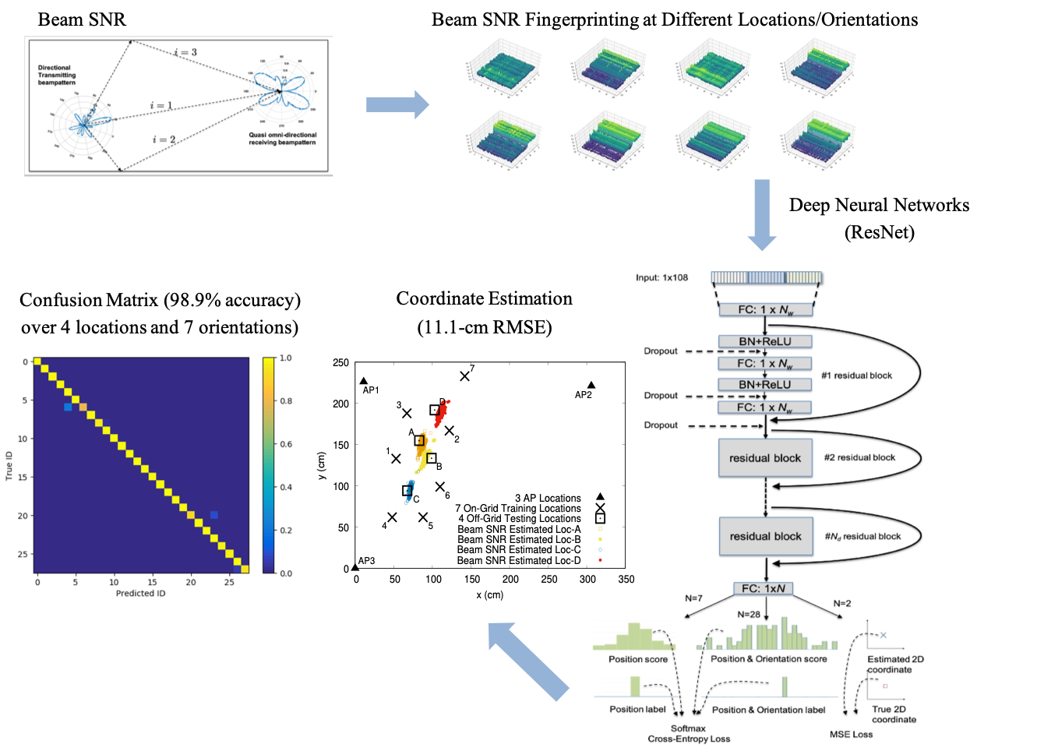
Fingerprinting-based Indoor Localization
Offline Fingerprinting
Online Localization

Slide 11
Evaluation Performance
(Confusion Matrix)
Traditional RSSI
Beam SNR (ResNet)
Position-only
Position-and-Orientation

Slide 12
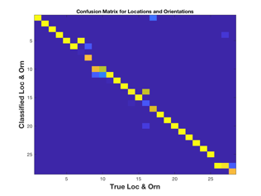
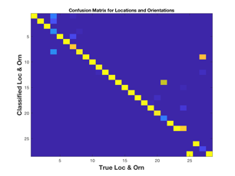
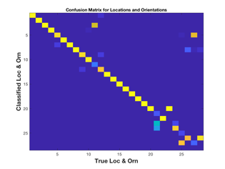
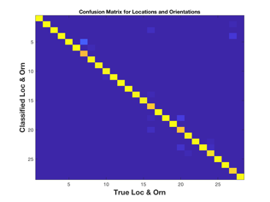
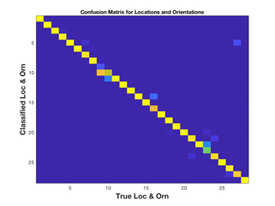
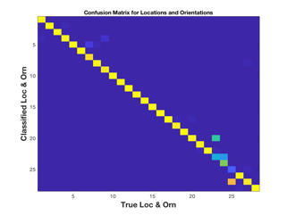
Impact of APs
AP 1
AP 2
AP 3
AP 1 + AP 2
AP 1 + AP 3
AP 2 + AP 3

Slide 13
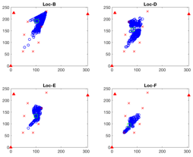
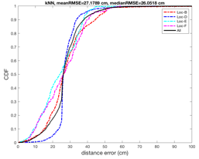
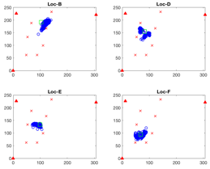
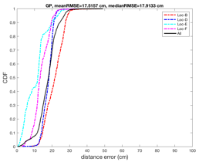

Coordinate Estimation
Deep Learning (ResNet)
weighted k-nearest-neighbor (kNN)
Gaussian Process (GP)
mmWave fingerprinting (3 APs, grid size:~35 cm)

Slide 14
Conclusions
This contribution demonstrated the potential of a mid-grained channel measurements (beam attributes (e.g., SNRs) during beam training) for fingerprinting-based indoor localization (position and orientation).
With our testbed, it can achieve the decimeter-level accuracy for coordinate estimation with the residual neural networks.
We release an open-access mmBSF dataset (60-GHz 11ad measurements) to promote the use of mid-grained channel measurement for WLAN sensing and localization.
https://www.merl.com/demos/mmBSF

Slide 15
References
[1] CSI-based Wi-Fi Sensing: Results and Standardization Challenges, IEEE 802.11-19/1769r1
[2] 802.11 sensing: Applications, feasibility, standardization, IEEE 802.11-19/1626r1
[3] Wi-Fi sensing in 60GHz band, IEEE 802.11-19/1551r1
[4] Wi-Fi sensing, IEEE 802.11-19/1164
[5] Wi-Fi sensing: cooperation and standard support, IEEE 802.11-19/1416
[6] “Spotfi: Decimeter Level Localization using WiFi”, Manikanta Kotaru, Kiran Joshi, Dinesh Bharadia, Sachin Katti
[7] X. Wang, L. Gao, S. Mao and S. Pandey, "DeepFi: Deep learning for indoor fingerprinting using channel state information," WCNC, New Orleans, LA, 2015, pp. 1666-1671
[8] "Towards Context-assisted Indoor Navigation", Ayyalasomayajula Roshan, Aditya Arun, Chenfeng Wu, Sanatan Sharma, Deepak Vasisht, Abhishek Sethi, Dinesh Bharadia
[9] D. Steinmetzer, D. Wegemer, M. Schulz, J. Widmer, and M. Hollick, ‘‘Compressive millimeter-wave sector selection in off-the-shelf IEEE 802.11ad devices,’’ in Proc. 13th Int. Conf. Emerg. Netw. EXperiments Technol., Nov. 2017
[10] D. Steinmetzer D. Wegemer and M. Hollick Talon Tools: The Framework for Practical IEEE 802.11ad Research 2018 [online] Available: https://seemoo.de/talon-tools/
[11] M. Schulz D. Wegemer and M. Hollick Nexmon: The C-Based Firmware Patching Framework 2017
[12] Z. Wang K. Jiang Y. Hou W. Dou C. Zhang Z. Huang et al. "A survey on human behavior recognition using channel state information" IEEE Access vol. 7 pp. 155986-156024 2019. 32.
[13] M. Pajovic P. Wang T. Koike-Akino H. Sun and P. V. Orlik "Fingerprinting-based indoor localization with commercial mmWave WiFi—Part I: RSS and beam indices" GLOBECOM 2019, pp. 1-6, Dec. 2019.
[14] P. Wang M. Pajovic T. Koike-Akino H. Sun and P. V. Orlik "Fingerprinting-based indoor localization with commercial mmWave WiFi—Part II: Spatial beam SNRs" GLOBECOM 2019, pp. 1-6 Dec. 2019.
[15] T. Koike-Akino, P. Wang M. Pajovic H. Sun and P. V. Orlik "Fingerprinting-based indoor localization with commercial mmWave WiFi: A Deep Learning Approach”, IEEE Access, Vol. 8, pp. 84879-84892, 2020.
[16] W. Wu N. Cheng N. Zhang P. Yang W. Zhuang and X. Shen "Fast mmWave beam alignment via correlated bandit learning" IEEE Trans. Wireless Commun. vol. 18 no. 12 pp. 5894-5908 Dec 2019.

Slide 16
  Performance Analysis
Classification Methods
Training Size

Slide 17
Orientation Mismatch

