Slide 1
2x EHT-LTFs Sequences Design
Date: 2020-07-16
Authors:
Name | Affiliations | Address | Phone | email
Chenchen Liu | Huawei Technologies Co., Ltd | Huawei Base, Bantian, Shenzhen |  | liuchenchen1@huawei.com
Dandan Liang
Bo Gong
Ming Gan
Yan Xin
Wei Lin

Slide 2
Introduction
In this contribution, the 320MHz/160+160MHz 2x EHT-LTF sequences are proposed for both with considering the punctured 240MHz/160MHz+80MHz transmission.

Slide 3
Introduction
 | 2x EHT-LTF Full bandwidth & PP & MRU Patterns
RU size | RU26 | RU52 | RU26+RU52 | RU106 | RU26+RU106 | RU242 | RU484 | RU242+RU484 | RU996 | RU484+RU996 | RU2*996 | RU484+RU2*996 | RU 3*996 | RU3*996+RU484 | RU 4*996
Number of type considered | 36*4 | 16*4 | 4*4 | 8*4 | 4*4 | 4*4 | 2*4 | 4*4 | 1*4 | 4*2 | 2 | 2*6 | 4 | 8 | 1

Slide 4
Design Methods[3-4]
Option 1: Based on partial of 80MHz EHT-LTF
For 2x, repeating 11ax 80MHz LTF sequences and apply the coefficient value on the first - fifth part of 80MHz LTF [1,4].
Option 2: New Sequences
Not using 11ax 80MHz 2x LTF sequences to construct the 320MHz/160+160MHz 2x LTF sequences.

Slide 5
Sequences Design Considerations
Optimized the PAPR of all RU or aggregated RU size: page 4.
Single stream pilot impact [5]:
  Pilot position: passed SPs [2]
  P matrices:

Slide 6
320MHz 2x EHT-LTF
Option 1:
320MHz 2x EHT-LTF_{-2036,2036} = [HE-LTF_{80MHz_part1_2x} HE-LTF_{80MHz_part2_2x} (-1)* HE-LTF_{80MHz_part3_2x} (-1)* HE-LTF_{80MHz_part4_2x} (-1)* HE-LTF_{80MHz_part5_2x} 0₂₃ (-1)* HE-LTF_{80MHz_part1_2x} (-1)* HE-LTF_{80MHz_part2_2x} (-1)*HE-LTF_{80MHz_part3_2x} (-1)* HE-LTF_{80MHz_part4_2x} (-1)* HE-LTF_{80MHz_part5_2x} 0₂₃ (-1)* HE-LTF_{80MHz_part1_2x} HE-LTF_{80MHz_part2_2x} HE-LTF_{80MHz_part3_2x} HE-LTF_{80MHz_part4_2x} HE-LTF_{80MHz_part5_2x} 0₂₃ HE-LTF_{80MHz_part1_2x} HE-LTF_{80MHz_part2_2x} HE-LTF_{80MHz_part3_2x} HE-LTF_{80MHz_part4_2x} HE-LTF_{80MHz_part5_2x}];
Coefficient values = [1 1 -1 -1 -1 -1 -1 -1 -1 -1 -1 1 1 1 1 1 1 1 1 1]
HE-LTF_{80MHz_part1_2x} =HE-LTF_{80M_2x} (-500:-259),
HE-LTF_{80MHz_part2_2x} =HE-LTF_{80M_2x} (-258:-17),
HE-LTF_{80MHz_part3_2x} =HE-LTF_{80M_2x} (-16:16),
HE-LTF_{80MHz_part4_2x} =HE-LTF_{80M_2x} (17:258),
HE-LTF_{80MHz_part5_2x} =HE-LTF_{80M_2x} (259:500)

Slide 7
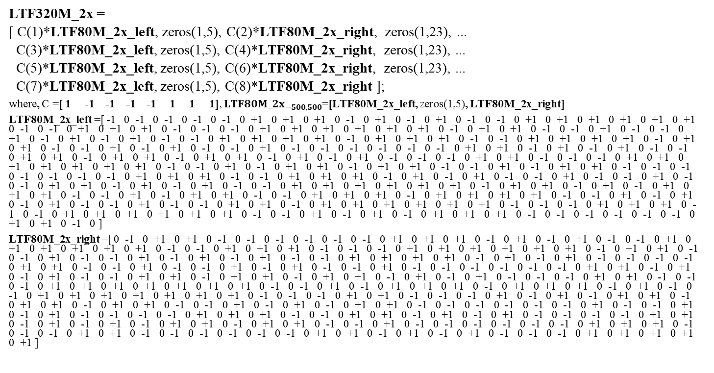
New Sequences-Option-2A:
LTF320M_2x =
[ C(1)*LTF80M_2x_left, zeros(1,5), C(2)*LTF80M_2x_right, zeros(1,23), ...
C(3)*LTF80M_2x_left, zeros(1,5), C(4)*LTF80M_2x_right, zeros(1,23), ...
C(5)*LTF80M_2x_left, zeros(1,5), C(6)*LTF80M_2x_right, zeros(1,23), ...
C(7)*LTF80M_2x_left, zeros(1,5), C(8)*LTF80M_2x_right ];
where, C =[ 1 -1 -1 -1 -1 1 1 1], ${LTF80M_2x}_{−500,500}$=[LTF80M_2x_left, zeros(1,5), LTF80M_2x_right]
LTF80M_2x_left =[ -1 0 -1 0 -1 0 -1 0 -1 0 +1 0 +1 0 +1 0 -1 0 +1 0 -1 0 +1 0 -1 0 -1 0 +1 0 +1 0 +1 0 +1 0 +1 0 +1 0 -1 0 -1 0 +1 0 +1 0 +1 0 -1 0 -1 0 -1 0 +1 0 +1 0 +1 0 +1 0 +1 0 +1 0 -1 0 +1 0 +1 0 -1 0 -1 0 +1 0 -1 0 -1 0 +1 0 -1 0 +1 0 -1 0 +1 0 -1 0 -1 0 +1 0 +1 0 +1 0 +1 0 -1 0 +1 0 +1 0 +1 0 -1 0 -1 0 +1 0 +1 0 +1 0 +1 0 -1 0 +1 0 +1 0 -1 0 -1 0 +1 0 -1 0 +1 0 -1 0 -1 0 +1 0 -1 0 -1 0 -1 0 -1 0 -1 0 -1 0 +1 0 +1 0 -1 0 +1 0 -1 0 +1 0 -1 0 -1 0 +1 0 +1 0 -1 0 +1 0 +1 0 -1 0 +1 0 +1 0 -1 0 +1 0 -1 0 +1 0 -1 0 -1 0 -1 0 +1 0 +1 0 -1 0 -1 0 -1 0 +1 0 +1 0 +1 0 +1 0 +1 0 +1 0 +1 0 -1 0 -1 0 +1 0 -1 0 +1 0 +1 0 -1 0 +1 0 +1 0 -1 0 -1 0 +1 0 -1 0 +1 0 +1 0 -1 0 -1 0 -1 0 -1 0 -1 0 -1 0 -1 0 +1 0 +1 0 +1 0 -1 0 -1 0 +1 0 +1 0 +1 0 -1 0 +1 0 -1 0 +1 0 -1 0 -1 0 +1 0 -1 0 -1 0 +1 0 -1 0 -1 0 +1 0 +1 0 -1 0 +1 0 -1 0 +1 0 -1 0 -1 0 +1 0 +1 0 +1 0 +1 0 +1 0 +1 0 -1 0 +1 0 +1 0 -1 0 +1 0 -1 0 +1 0 +1 0 +1 0 -1 0 -1 0 +1 0 -1 0 +1 0 +1 0 -1 0 -1 0 +1 0 +1 0 +1 0 -1 0 +1 0 +1 0 +1 0 +1 0 -1 0 -1 0 +1 0 -1 0 +1 0 -1 0 +1 0 -1 0 -1 0 +1 0 -1 0 -1 0 +1 0 +1 0 -1 0 +1 0 +1 0 +1 0 +1 0 +1 0 +1 0 -1 0 -1 0 -1 0 +1 0 +1 0 +1 0 -1 0 -1 0 +1 0 +1 0 +1 0 +1 0 +1 0 +1 0 -1 0 -1 0 +1 0 -1 0 +1 0 -1 0 +1 0 +1 0 +1 0 -1 0 -1 0 -1 0 -1 0 -1 0 -1 0 +1 0 +1 0 -1 0 ]
LTF80M_2x_right =[ 0 -1 0 +1 0 +1 0 -1 0 -1 0 -1 0 -1 0 -1 0 -1 0 +1 0 +1 0 +1 0 -1 0 +1 0 -1 0 +1 0 -1 0 -1 0 +1 0 +1 0 +1 0 +1 0 +1 0 +1 0 -1 0 -1 0 +1 0 +1 0 +1 0 -1 0 -1 0 -1 0 +1 0 +1 0 +1 0 +1 0 +1 0 +1 0 -1 0 +1 0 +1 0 -1 0 -1 0 +1 0 -1 0 -1 0 +1 0 -1 0 +1 0 -1 0 +1 0 -1 0 -1 0 +1 0 +1 0 +1 0 +1 0 -1 0 +1 0 -1 0 +1 0 -1 0 -1 0 -1 0 -1 0 +1 0 +1 0 -1 0 -1 0 +1 0 -1 0 -1 0 +1 0 -1 0 +1 0 -1 0 -1 0 +1 0 -1 0 -1 0 -1 0 -1 0 -1 0 -1 0 +1 0 +1 0 -1 0 +1 0 -1 0 +1 0 -1 0 -1 0 +1 0 +1 0 -1 0 +1 0 +1 0 -1 0 +1 0 +1 0 -1 0 +1 0 -1 0 +1 0 -1 0 -1 0 -1 0 +1 0 +1 0 -1 0 -1 0 -1 0 +1 0 +1 0 +1 0 +1 0 +1 0 +1 0 +1 0 -1 0 -1 0 +1 0 -1 0 +1 0 +1 0 +1 0 -1 0 +1 0 +1 0 +1 0 -1 0 +1 0 -1 0 -1 0 +1 0 +1 0 +1 0 +1 0 +1 0 +1 0 +1 0 -1 0 -1 0 -1 0 +1 0 +1 0 -1 0 -1 0 -1 0 +1 0 -1 0 +1 0 -1 0 +1 0 +1 0 -1 0 +1 0 +1 0 -1 0 +1 0 +1 0 -1 0 -1 0 +1 0 -1 0 +1 0 -1 0 +1 0 +1 0 -1 0 -1 0 -1 0 -1 0 -1 0 -1 0 +1 0 -1 0 -1 0 +1 0 -1 0 +1 0 -1 0 -1 0 -1 0 -1 0 +1 0 +1 0 +1 0 -1 0 -1 0 +1 0 +1 0 -1 0 +1 0 -1 0 +1 0 -1 0 -1 0 -1 0 -1 0 +1 0 +1 0 -1 0 +1 0 -1 0 +1 0 -1 0 +1 0 +1 0 -1 0 +1 0 +1 0 -1 0 -1 0 +1 0 -1 0 -1 0 -1 0 -1 0 -1 0 -1 0 +1 0 +1 0 +1 0 -1 0 -1 0 -1 0 +1 0 +1 0 -1 0 -1 0 -1 0 -1 0 -1 0 -1 0 +1 0 +1 0 -1 0 +1 0 -1 0 +1 0 -1 0 -1 0 -1 0 +1 0 +1 0 +1 0 +1 0 +1 ]

Slide 8
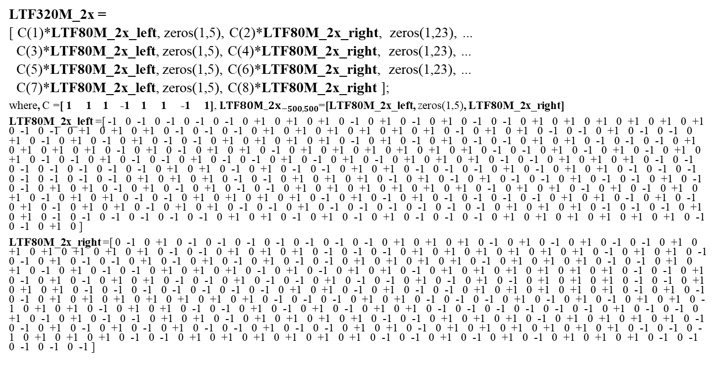
New Sequences-Option-2B:
LTF320M_2x =
[ C(1)*LTF80M_2x_left, zeros(1,5), C(2)*LTF80M_2x_right, zeros(1,23), ...
C(3)*LTF80M_2x_left, zeros(1,5), C(4)*LTF80M_2x_right, zeros(1,23), ...
C(5)*LTF80M_2x_left, zeros(1,5), C(6)*LTF80M_2x_right, zeros(1,23), ...
C(7)*LTF80M_2x_left, zeros(1,5), C(8)*LTF80M_2x_right ];
where, C =[ 1 1 1 -1 1 1 -1 1], ${LTF80M_2x}_{−500,500}$=[LTF80M_2x_left, zeros(1,5), LTF80M_2x_right]
LTF80M_2x_left =[ -1 0 -1 0 -1 0 -1 0 -1 0 +1 0 +1 0 +1 0 -1 0 +1 0 -1 0 +1 0 -1 0 -1 0 +1 0 +1 0 +1 0 +1 0 +1 0 +1 0 -1 0 -1 0 +1 0 +1 0 +1 0 -1 0 -1 0 -1 0 +1 0 +1 0 +1 0 +1 0 +1 0 +1 0 -1 0 +1 0 +1 0 -1 0 -1 0 +1 0 -1 0 -1 0 +1 0 -1 0 +1 0 -1 0 +1 0 -1 0 -1 0 +1 0 +1 0 +1 0 +1 0 -1 0 +1 0 -1 0 +1 0 -1 0 -1 0 +1 0 +1 0 -1 0 -1 0 -1 0 +1 0 +1 0 +1 0 +1 0 -1 0 +1 0 -1 0 +1 0 +1 0 -1 0 +1 0 +1 0 +1 0 +1 0 +1 0 +1 0 -1 0 -1 0 +1 0 -1 0 +1 0 -1 0 +1 0 +1 0 -1 0 -1 0 +1 0 -1 0 -1 0 +1 0 -1 0 -1 0 +1 0 -1 0 +1 0 -1 0 +1 0 +1 0 +1 0 -1 0 -1 0 +1 0 +1 0 +1 0 -1 0 -1 0 -1 0 -1 0 -1 0 -1 0 -1 0 +1 0 +1 0 -1 0 +1 0 -1 0 -1 0 +1 0 +1 0 -1 0 -1 0 -1 0 +1 0 -1 0 +1 0 +1 0 -1 0 -1 0 -1 0 -1 0 -1 0 -1 0 -1 0 +1 0 +1 0 +1 0 -1 0 -1 0 +1 0 +1 0 +1 0 -1 0 +1 0 -1 0 +1 0 -1 0 -1 0 +1 0 -1 0 -1 0 +1 0 -1 0 -1 0 +1 0 +1 0 -1 0 +1 0 -1 0 +1 0 -1 0 -1 0 +1 0 +1 0 +1 0 +1 0 +1 0 +1 0 -1 0 +1 0 +1 0 -1 0 +1 0 -1 0 +1 0 +1 0 -1 0 +1 0 +1 0 -1 0 -1 0 +1 0 +1 0 +1 0 +1 0 -1 0 +1 0 -1 0 +1 0 -1 0 -1 0 -1 0 -1 0 +1 0 +1 0 -1 0 +1 0 -1 0 +1 0 -1 0 +1 0 +1 0 -1 0 +1 0 +1 0 -1 0 -1 0 +1 0 -1 0 -1 0 -1 0 -1 0 -1 0 -1 0 +1 0 +1 0 +1 0 -1 0 -1 0 -1 0 +1 0 +1 0 -1 0 -1 0 -1 0 -1 0 -1 0 -1 0 +1 0 +1 0 -1 0 +1 0 -1 0 +1 0 -1 0 -1 0 -1 0 +1 0 +1 0 +1 0 +1 0 +1 0 +1 0 -1 0 -1 0 +1 0 ]
LTF80M_2x_right =[ 0 -1 0 +1 0 -1 0 -1 0 -1 0 -1 0 -1 0 -1 0 -1 0 +1 0 +1 0 +1 0 -1 0 +1 0 -1 0 +1 0 -1 0 -1 0 +1 0 +1 0 +1 0 +1 0 +1 0 +1 0 -1 0 -1 0 +1 0 +1 0 +1 0 -1 0 -1 0 -1 0 +1 0 +1 0 +1 0 +1 0 +1 0 +1 0 -1 0 +1 0 +1 0 -1 0 -1 0 +1 0 -1 0 -1 0 +1 0 -1 0 +1 0 -1 0 +1 0 -1 0 -1 0 +1 0 +1 0 +1 0 +1 0 -1 0 +1 0 +1 0 +1 0 -1 0 -1 0 +1 0 +1 0 -1 0 +1 0 -1 0 -1 0 +1 0 +1 0 +1 0 -1 0 +1 0 -1 0 +1 0 +1 0 -1 0 +1 0 +1 0 +1 0 +1 0 +1 0 +1 0 -1 0 -1 0 +1 0 -1 0 +1 0 -1 0 +1 0 +1 0 -1 0 -1 0 +1 0 -1 0 -1 0 +1 0 -1 0 -1 0 +1 0 -1 0 +1 0 -1 0 +1 0 +1 0 +1 0 -1 0 -1 0 +1 0 +1 0 +1 0 -1 0 -1 0 -1 0 -1 0 -1 0 -1 0 -1 0 +1 0 +1 0 -1 0 +1 0 -1 0 -1 0 +1 0 +1 0 +1 0 +1 0 +1 0 -1 0 +1 0 -1 0 -1 0 +1 0 +1 0 +1 0 +1 0 +1 0 +1 0 +1 0 -1 0 -1 0 -1 0 +1 0 +1 0 -1 0 -1 0 -1 0 +1 0 -1 0 +1 0 -1 0 +1 0 +1 0 -1 0 +1 0 +1 0 -1 0 +1 0 +1 0 -1 0 -1 0 +1 0 -1 0 +1 0 -1 0 +1 0 +1 0 -1 0 -1 0 -1 0 -1 0 -1 0 -1 0 +1 0 -1 0 -1 0 +1 0 -1 0 +1 0 -1 0 -1 0 +1 0 +1 0 -1 0 +1 0 +1 0 +1 0 +1 0 -1 0 -1 0 +1 0 +1 0 +1 0 -1 0 +1 0 +1 0 +1 0 +1 0 -1 0 -1 0 +1 0 -1 0 +1 0 -1 0 +1 0 -1 0 -1 0 +1 0 -1 0 -1 0 +1 0 +1 0 -1 0 +1 0 +1 0 +1 0 +1 0 +1 0 +1 0 -1 0 -1 0 -1 0 +1 0 +1 0 +1 0 -1 0 -1 0 +1 0 +1 0 +1 0 +1 0 +1 0 +1 0 -1 0 -1 0 +1 0 -1 0 +1 0 -1 0 +1 0 +1 0 +1 0 -1 0 -1 0 -1 0 -1 0 -1 ]

Slide 9
New Sequences Simulation Results:
Multi-RU PAPR for Nss = 1 to 8
RU size | Median of BPSK | LTF Opt1 | LTF Opt2A | LTF Opt2B
RU996 | 8.84 | 7.47 | 5.69 | 5.42
 |  | 6.52 | 5.37 | 5.63
 |  | 8.63 | 5.69 | 5.42
 |  | 6.52 | 5.37 | 5.63
RU996 + RU484 | 9.17 | 7.77 | 7.54 | 7.58
 |  | 9.06 | 7.13 | 7.44
 |  | 8.49 | 7.31 | 7.09
 |  | 9.98 | 7.17 | 7.10
 |  | 7.77 | 7.54 | 7.43
 |  | 8.04 | 7.13 | 7.74
 |  | 9.91 | 7.31 | 7.59
 |  | 7.91 | 7.17 | 7.63
RU2*996 | 9.27 | 10.05 | 6.01 | 5.58
 |  | 7.84 | 6.01 | 5.62
RU3*996 (puncture 80MHz) | 9.54 | 8.78 | 7.69 | 7.79
 |  | 9.22 | 7.45 | 7.93
 |  | 8.78 | 7.45 | 7.20
 |  | 8.90 | 7.45 | 7.83
RU3*996 + RU484 (puncture 40MHz) | 9.55 | 9.95 | 8.20 | 7.88
 |  | 9.50 | 8.28 | 7.32
 |  | 9.35 | 7.89 | 7.91
 |  | 9.08 | 7.85 | 7.64
 |  | 9.83 | 8.07 | 6.51
 |  | 8.77 | 7.84 | 6.71
 |  | 9.41 | 8.01 | 7.87
 |  | 9.52 | 8.10 | 7.83
RU4*996 | 9.60 | 9.59 | 8.33 | 5.75
RU size | Median of BPSK | LTF Opt1 | LTF Opt2A | LTF Opt2B
RU2*996 + RU484 | 9.50 | 9.06 | 7.13 | 7.67
 |  | 10.04 | 6.84 | 7.74
 |  | 8.77 | 8.31 | 8.94
 |  | 9.06 | 7.92 | 8.99
 |  | 8.98 | 7.13 | 7.67
 |  | 9.05 | 6.87 | 7.74
 |  | 8.59 | 6.78 | 6.88
 |  | 9.41 | 6.85 | 6.85
 |  | 9.04 | 8.04 | 8.44
 |  | 9.85 | 8.01 | 8.20
 |  | 8.63 | 6.73 | 7.15
 |  | 8.82 | 6.86 | 7.02
RU2*996 discrete | 9.28 | 10.05 | 8.58 | 8.16
 |  | 9.49 | 8.32 | 8.53
 |  | 8.97 | 8.58 | 8.16
 |  | 10.05 | 8.32 | 8.53

Slide 10
New Sequences Simulation Results:
Worst case PAPR for Nss = 1 to 8
Sequence | BPSK Median | LGE M-HE | BRCM | BRCM Appendix_Opt2 | Huawei Opt1 | Huawei Opt2A | Huawei Opt2B
RU26 | 5.89 | 4.46 | 5.30 | 4.79 | 7.95 | 5.76 | 5.76
RU52 | 6.71 | 4.69 | 4.31 | 4.31 | 7.43 | 4.98 | 4.98
RU52 + RU26 | 7.10 | 5.94 | 6.78 | 6.44 | 6.37 | 6.23 | 6.23
RU106 | 7.29 | 5.42 | 4.92 | 4.92 | 6.71 | 4.55 | 4.55
RU106 + RU26 | 7.44 | 6.62 | 6.61 | 6.93 | 6.64 | 5.45 | 5.45
RU242 | 7.94 | 5.58 | 5.14 | 5.14 | 8.24 | 5.09 | 5.09
RU484 | 8.44 | 6.58 | 6.34 | 5.57 | 7.45 | 5.53 | 5.53
RU484 + RU242 | 8.83 | 8.59 | 7.68 | 7.75 | 9.68 | 7.61 | 7.61
RU996 | 8.84 | 9.26 | 7.15 | 5.89 | 8.63 | 5.69 | 5.63
RU996 + RU484 | 9.17 | 9.12 | 7.81 | 8.25 | 9.98 | 7.54 | 7.74
RU2*996 | 9.27 | 8.99 | 7.45 | 6.39 | 10.05 | 6.01 | 5.62
RU2*996 + RU484 | 9.50 | 9.61 | 8.32 | 9.68 | 10.04 | 8.31 | 8.99
RU3*996 | 9.54 | 9.40 | 7.80 | 8.11 | 9.22 | 7.69 | 7.93
RU3*996 + RU484 | 9.55 | 9.49 | 8.49 | 8.23 | 9.95 | 8.28 | 7.91
RU4*996 | 9.60 | 7.79 | 7.04 | 5.89 | 9.59 | 8.33 | 5.75

Slide 11
Conclusion
In this contribution, 2x EHT-LTF sequences in
320MHz/160+160 transmission are proposed.

Slide 12
Reference
[1] Dandan Liang, et al, <EHT-LTFs Sequences Design>, IEEE 802.11-20/0926r0
[2] Edward Au, <IEEE P802.11 Wireless LANs>, IEEE 802.11-20/0566r29
[3] <802.11ax Draft>, D6.0.
[4] Jinyoung Chun, et al, <EHT-LTF sequences in new tone plan>, IEEE 802.11-20/825r1
[5] Le Liu, et al, <HE-LTF Sequence Design>, IEEE 802.11-15/1334

Slide 13
Straw Poll 1
Do you support to add to SFD：320MHz/160+160MHz 2x EHT-LTF sequences:
320MHz 2x EHT-LTF_{-2036,2036} = [HE-LTF_{80MHz_part1_2x} HE-LTF_{80MHz_part2_2x} (-1)* HE-LTF_{80MHz_part3_2x} (-1)* HE-LTF_{80MHz_part4_2x} (-1)* HE-LTF_{80MHz_part5_2x} 0₂₃ (-1)* HE-LTF_{80MHz_part1_2x} (-1)* HE-LTF_{80MHz_part2_2x} (-1)*HE-LTF_{80MHz_part3_2x} (-1)* HE-LTF_{80MHz_part4_2x} (-1)* HE-LTF_{80MHz_part5_2x} 0₂₃ (-1)* HE-LTF_{80MHz_part1_2x} HE-LTF_{80MHz_part2_2x} HE-LTF_{80MHz_part3_2x} HE-LTF_{80MHz_part4_2x} HE-LTF_{80MHz_part5_2x} 0₂₃ HE-LTF_{80MHz_part1_2x} HE-LTF_{80MHz_part2_2x} HE-LTF_{80MHz_part3_2x} HE-LTF_{80MHz_part4_2x} HE-LTF_{80MHz_part5_2x}];
Coefficient values = [1 1 -1 -1 -1 -1 -1 -1 -1 -1 -1 1 1 1 1 1 1 1 1 1]
HE-LTF_{80MHz_part1_2x} =HE-LTF_{80M_2x} (-500:-259),
HE-LTF_{80MHz_part2_2x} =HE-LTF_{80M_2x} (-258:-17),
HE-LTF_{80MHz_part3_2x} =HE-LTF_{80M_2x} (-16:16),
HE-LTF_{80MHz_part4_2x} =HE-LTF_{80M_2x} (17:258),
HE-LTF_{80MHz_part5_2x} =HE-LTF_{80M_2x} (259:500)

Slide 14
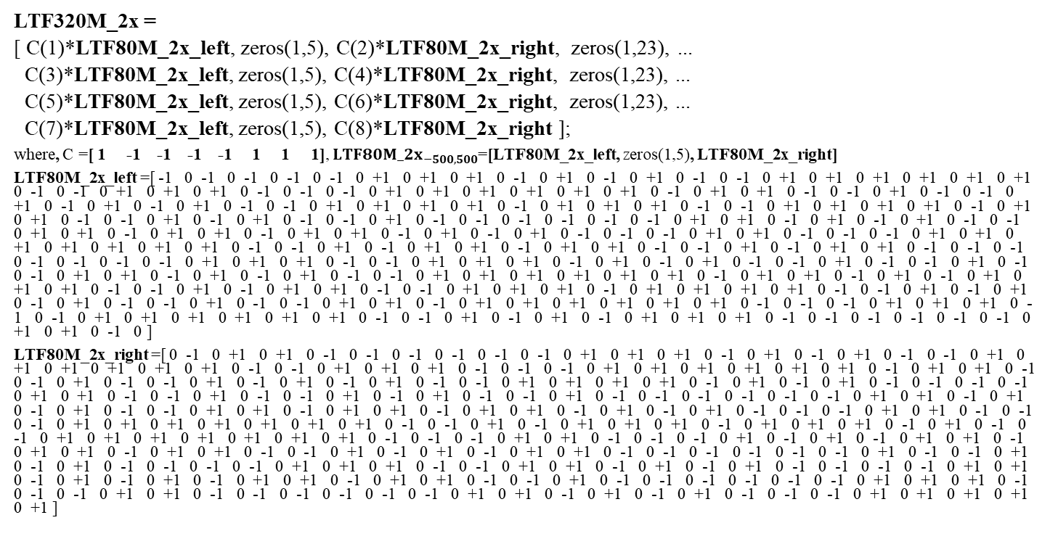
Straw Poll 2
Do you support to add to SFD：EHT-LTF Sequence Option 2A
LTF320M_2x =
[ C(1)*LTF80M_2x_left, zeros(1,5), C(2)*LTF80M_2x_right, zeros(1,23), ...
C(3)*LTF80M_2x_left, zeros(1,5), C(4)*LTF80M_2x_right, zeros(1,23), ...
C(5)*LTF80M_2x_left, zeros(1,5), C(6)*LTF80M_2x_right, zeros(1,23), ...
C(7)*LTF80M_2x_left, zeros(1,5), C(8)*LTF80M_2x_right ];
where, C =[ 1 -1 -1 -1 -1 1 1 1], ${LTF80M_2x}_{−500,500}$=[LTF80M_2x_left, zeros(1,5), LTF80M_2x_right]
LTF80M_2x_left =[ -1 0 -1 0 -1 0 -1 0 -1 0 +1 0 +1 0 +1 0 -1 0 +1 0 -1 0 +1 0 -1 0 -1 0 +1 0 +1 0 +1 0 +1 0 +1 0 +1 0 -1 0 -1 0 +1 0 +1 0 +1 0 -1 0 -1 0 -1 0 +1 0 +1 0 +1 0 +1 0 +1 0 +1 0 -1 0 +1 0 +1 0 -1 0 -1 0 +1 0 -1 0 -1 0 +1 0 -1 0 +1 0 -1 0 +1 0 -1 0 -1 0 +1 0 +1 0 +1 0 +1 0 -1 0 +1 0 +1 0 +1 0 -1 0 -1 0 +1 0 +1 0 +1 0 +1 0 -1 0 +1 0 +1 0 -1 0 -1 0 +1 0 -1 0 +1 0 -1 0 -1 0 +1 0 -1 0 -1 0 -1 0 -1 0 -1 0 -1 0 +1 0 +1 0 -1 0 +1 0 -1 0 +1 0 -1 0 -1 0 +1 0 +1 0 -1 0 +1 0 +1 0 -1 0 +1 0 +1 0 -1 0 +1 0 -1 0 +1 0 -1 0 -1 0 -1 0 +1 0 +1 0 -1 0 -1 0 -1 0 +1 0 +1 0 +1 0 +1 0 +1 0 +1 0 +1 0 -1 0 -1 0 +1 0 -1 0 +1 0 +1 0 -1 0 +1 0 +1 0 -1 0 -1 0 +1 0 -1 0 +1 0 +1 0 -1 0 -1 0 -1 0 -1 0 -1 0 -1 0 -1 0 +1 0 +1 0 +1 0 -1 0 -1 0 +1 0 +1 0 +1 0 -1 0 +1 0 -1 0 +1 0 -1 0 -1 0 +1 0 -1 0 -1 0 +1 0 -1 0 -1 0 +1 0 +1 0 -1 0 +1 0 -1 0 +1 0 -1 0 -1 0 +1 0 +1 0 +1 0 +1 0 +1 0 +1 0 -1 0 +1 0 +1 0 -1 0 +1 0 -1 0 +1 0 +1 0 +1 0 -1 0 -1 0 +1 0 -1 0 +1 0 +1 0 -1 0 -1 0 +1 0 +1 0 +1 0 -1 0 +1 0 +1 0 +1 0 +1 0 -1 0 -1 0 +1 0 -1 0 +1 0 -1 0 +1 0 -1 0 -1 0 +1 0 -1 0 -1 0 +1 0 +1 0 -1 0 +1 0 +1 0 +1 0 +1 0 +1 0 +1 0 -1 0 -1 0 -1 0 +1 0 +1 0 +1 0 -1 0 -1 0 +1 0 +1 0 +1 0 +1 0 +1 0 +1 0 -1 0 -1 0 +1 0 -1 0 +1 0 -1 0 +1 0 +1 0 +1 0 -1 0 -1 0 -1 0 -1 0 -1 0 -1 0 +1 0 +1 0 -1 0 ]
LTF80M_2x_right =[ 0 -1 0 +1 0 +1 0 -1 0 -1 0 -1 0 -1 0 -1 0 -1 0 +1 0 +1 0 +1 0 -1 0 +1 0 -1 0 +1 0 -1 0 -1 0 +1 0 +1 0 +1 0 +1 0 +1 0 +1 0 -1 0 -1 0 +1 0 +1 0 +1 0 -1 0 -1 0 -1 0 +1 0 +1 0 +1 0 +1 0 +1 0 +1 0 -1 0 +1 0 +1 0 -1 0 -1 0 +1 0 -1 0 -1 0 +1 0 -1 0 +1 0 -1 0 +1 0 -1 0 -1 0 +1 0 +1 0 +1 0 +1 0 -1 0 +1 0 -1 0 +1 0 -1 0 -1 0 -1 0 -1 0 +1 0 +1 0 -1 0 -1 0 +1 0 -1 0 -1 0 +1 0 -1 0 +1 0 -1 0 -1 0 +1 0 -1 0 -1 0 -1 0 -1 0 -1 0 -1 0 +1 0 +1 0 -1 0 +1 0 -1 0 +1 0 -1 0 -1 0 +1 0 +1 0 -1 0 +1 0 +1 0 -1 0 +1 0 +1 0 -1 0 +1 0 -1 0 +1 0 -1 0 -1 0 -1 0 +1 0 +1 0 -1 0 -1 0 -1 0 +1 0 +1 0 +1 0 +1 0 +1 0 +1 0 +1 0 -1 0 -1 0 +1 0 -1 0 +1 0 +1 0 +1 0 -1 0 +1 0 +1 0 +1 0 -1 0 +1 0 -1 0 -1 0 +1 0 +1 0 +1 0 +1 0 +1 0 +1 0 +1 0 -1 0 -1 0 -1 0 +1 0 +1 0 -1 0 -1 0 -1 0 +1 0 -1 0 +1 0 -1 0 +1 0 +1 0 -1 0 +1 0 +1 0 -1 0 +1 0 +1 0 -1 0 -1 0 +1 0 -1 0 +1 0 -1 0 +1 0 +1 0 -1 0 -1 0 -1 0 -1 0 -1 0 -1 0 +1 0 -1 0 -1 0 +1 0 -1 0 +1 0 -1 0 -1 0 -1 0 -1 0 +1 0 +1 0 +1 0 -1 0 -1 0 +1 0 +1 0 -1 0 +1 0 -1 0 +1 0 -1 0 -1 0 -1 0 -1 0 +1 0 +1 0 -1 0 +1 0 -1 0 +1 0 -1 0 +1 0 +1 0 -1 0 +1 0 +1 0 -1 0 -1 0 +1 0 -1 0 -1 0 -1 0 -1 0 -1 0 -1 0 +1 0 +1 0 +1 0 -1 0 -1 0 -1 0 +1 0 +1 0 -1 0 -1 0 -1 0 -1 0 -1 0 -1 0 +1 0 +1 0 -1 0 +1 0 -1 0 +1 0 -1 0 -1 0 -1 0 +1 0 +1 0 +1 0 +1 0 +1 ]

Slide 15
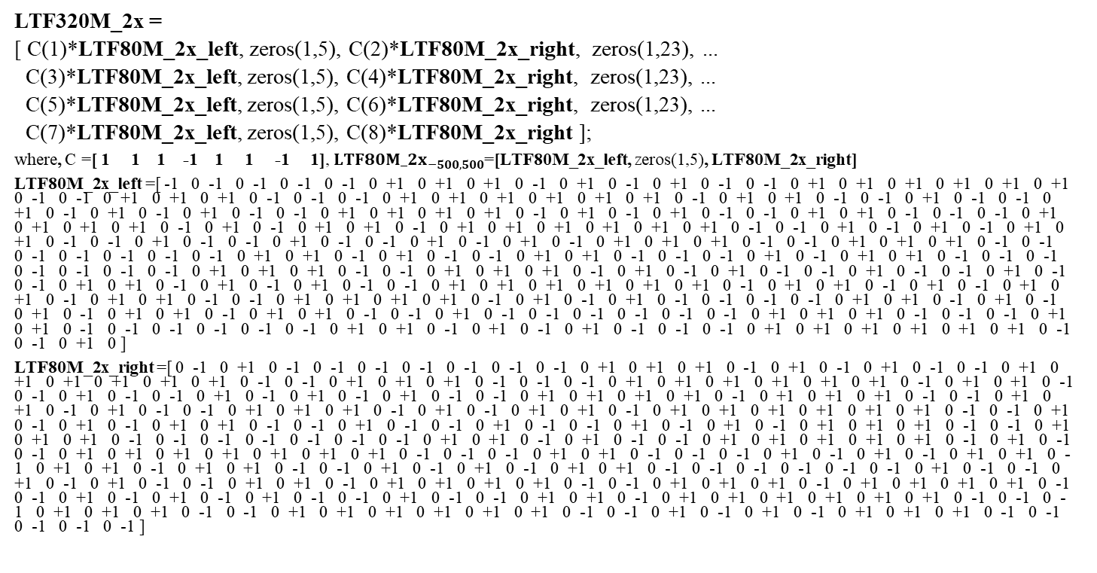
Straw Poll 3
Do you support to add to SFD：EHT-LTF Sequence Option 2B
LTF320M_2x =
[ C(1)*LTF80M_2x_left, zeros(1,5), C(2)*LTF80M_2x_right, zeros(1,23), ...
C(3)*LTF80M_2x_left, zeros(1,5), C(4)*LTF80M_2x_right, zeros(1,23), ...
C(5)*LTF80M_2x_left, zeros(1,5), C(6)*LTF80M_2x_right, zeros(1,23), ...
C(7)*LTF80M_2x_left, zeros(1,5), C(8)*LTF80M_2x_right ];
where, C =[ 1 1 1 -1 1 1 -1 1], ${LTF80M_2x}_{−500,500}$=[LTF80M_2x_left, zeros(1,5), LTF80M_2x_right]
LTF80M_2x_left =[ -1 0 -1 0 -1 0 -1 0 -1 0 +1 0 +1 0 +1 0 -1 0 +1 0 -1 0 +1 0 -1 0 -1 0 +1 0 +1 0 +1 0 +1 0 +1 0 +1 0 -1 0 -1 0 +1 0 +1 0 +1 0 -1 0 -1 0 -1 0 +1 0 +1 0 +1 0 +1 0 +1 0 +1 0 -1 0 +1 0 +1 0 -1 0 -1 0 +1 0 -1 0 -1 0 +1 0 -1 0 +1 0 -1 0 +1 0 -1 0 -1 0 +1 0 +1 0 +1 0 +1 0 -1 0 +1 0 -1 0 +1 0 -1 0 -1 0 +1 0 +1 0 -1 0 -1 0 -1 0 +1 0 +1 0 +1 0 +1 0 -1 0 +1 0 -1 0 +1 0 +1 0 -1 0 +1 0 +1 0 +1 0 +1 0 +1 0 +1 0 -1 0 -1 0 +1 0 -1 0 +1 0 -1 0 +1 0 +1 0 -1 0 -1 0 +1 0 -1 0 -1 0 +1 0 -1 0 -1 0 +1 0 -1 0 +1 0 -1 0 +1 0 +1 0 +1 0 -1 0 -1 0 +1 0 +1 0 +1 0 -1 0 -1 0 -1 0 -1 0 -1 0 -1 0 -1 0 +1 0 +1 0 -1 0 +1 0 -1 0 -1 0 +1 0 +1 0 -1 0 -1 0 -1 0 +1 0 -1 0 +1 0 +1 0 -1 0 -1 0 -1 0 -1 0 -1 0 -1 0 -1 0 +1 0 +1 0 +1 0 -1 0 -1 0 +1 0 +1 0 +1 0 -1 0 +1 0 -1 0 +1 0 -1 0 -1 0 +1 0 -1 0 -1 0 +1 0 -1 0 -1 0 +1 0 +1 0 -1 0 +1 0 -1 0 +1 0 -1 0 -1 0 +1 0 +1 0 +1 0 +1 0 +1 0 +1 0 -1 0 +1 0 +1 0 -1 0 +1 0 -1 0 +1 0 +1 0 -1 0 +1 0 +1 0 -1 0 -1 0 +1 0 +1 0 +1 0 +1 0 -1 0 +1 0 -1 0 +1 0 -1 0 -1 0 -1 0 -1 0 +1 0 +1 0 -1 0 +1 0 -1 0 +1 0 -1 0 +1 0 +1 0 -1 0 +1 0 +1 0 -1 0 -1 0 +1 0 -1 0 -1 0 -1 0 -1 0 -1 0 -1 0 +1 0 +1 0 +1 0 -1 0 -1 0 -1 0 +1 0 +1 0 -1 0 -1 0 -1 0 -1 0 -1 0 -1 0 +1 0 +1 0 -1 0 +1 0 -1 0 +1 0 -1 0 -1 0 -1 0 +1 0 +1 0 +1 0 +1 0 +1 0 +1 0 -1 0 -1 0 +1 0 ]
LTF80M_2x_right =[ 0 -1 0 +1 0 -1 0 -1 0 -1 0 -1 0 -1 0 -1 0 -1 0 +1 0 +1 0 +1 0 -1 0 +1 0 -1 0 +1 0 -1 0 -1 0 +1 0 +1 0 +1 0 +1 0 +1 0 +1 0 -1 0 -1 0 +1 0 +1 0 +1 0 -1 0 -1 0 -1 0 +1 0 +1 0 +1 0 +1 0 +1 0 +1 0 -1 0 +1 0 +1 0 -1 0 -1 0 +1 0 -1 0 -1 0 +1 0 -1 0 +1 0 -1 0 +1 0 -1 0 -1 0 +1 0 +1 0 +1 0 +1 0 -1 0 +1 0 +1 0 +1 0 -1 0 -1 0 +1 0 +1 0 -1 0 +1 0 -1 0 -1 0 +1 0 +1 0 +1 0 -1 0 +1 0 -1 0 +1 0 +1 0 -1 0 +1 0 +1 0 +1 0 +1 0 +1 0 +1 0 -1 0 -1 0 +1 0 -1 0 +1 0 -1 0 +1 0 +1 0 -1 0 -1 0 +1 0 -1 0 -1 0 +1 0 -1 0 -1 0 +1 0 -1 0 +1 0 -1 0 +1 0 +1 0 +1 0 -1 0 -1 0 +1 0 +1 0 +1 0 -1 0 -1 0 -1 0 -1 0 -1 0 -1 0 -1 0 +1 0 +1 0 -1 0 +1 0 -1 0 -1 0 +1 0 +1 0 +1 0 +1 0 +1 0 -1 0 +1 0 -1 0 -1 0 +1 0 +1 0 +1 0 +1 0 +1 0 +1 0 +1 0 -1 0 -1 0 -1 0 +1 0 +1 0 -1 0 -1 0 -1 0 +1 0 -1 0 +1 0 -1 0 +1 0 +1 0 -1 0 +1 0 +1 0 -1 0 +1 0 +1 0 -1 0 -1 0 +1 0 -1 0 +1 0 -1 0 +1 0 +1 0 -1 0 -1 0 -1 0 -1 0 -1 0 -1 0 +1 0 -1 0 -1 0 +1 0 -1 0 +1 0 -1 0 -1 0 +1 0 +1 0 -1 0 +1 0 +1 0 +1 0 +1 0 -1 0 -1 0 +1 0 +1 0 +1 0 -1 0 +1 0 +1 0 +1 0 +1 0 -1 0 -1 0 +1 0 -1 0 +1 0 -1 0 +1 0 -1 0 -1 0 +1 0 -1 0 -1 0 +1 0 +1 0 -1 0 +1 0 +1 0 +1 0 +1 0 +1 0 +1 0 -1 0 -1 0 -1 0 +1 0 +1 0 +1 0 -1 0 -1 0 +1 0 +1 0 +1 0 +1 0 +1 0 +1 0 -1 0 -1 0 +1 0 -1 0 +1 0 -1 0 +1 0 +1 0 +1 0 -1 0 -1 0 -1 0 -1 0 -1 ]

Slide 16
Appendix: QAM Data PAPR

