Slide 1
2x EHT-LTFs Sequences Design
Date: 2020-07-16
Authors:
Name | Affiliations | Address | Phone | email
Dandan Liang | Huawei Technologies Co., Ltd | Huawei Base, Bantian, Shenzhen |  | Dandan.liang@huawei.com
Chenchen Liu
Ming Gan
Yan Xin
Wei Lin

Slide 2
Introduction
In this contribution, the 320MHz/160+160MHz 2x EHT-LTF sequences are proposed for both with considering the punctured 240MHz/160MHz+80MHz transmission.

Slide 3
Introduction
 | 2x EHT-LTF Full bandwidth & PP & MRU Patterns
RU size | RU26 | RU52 | RU26+RU52 | RU106 | RU26+RU106 | RU242 | RU484 | RU242+RU484 | RU996 | RU484+RU996 | RU2*996 | RU484+RU2*996 | RU 3*996 | RU3*996+RU484 | RU 4*996
Number of type considered | 36*4 | 16*4 | 4*4 | 8*4 | 4*4 | 4*4 | 2*4 | 4*4 | 1*4 | 4*2 | 3*4 | 4*6 | 4 | 8 | 1

Slide 4
Design Methods[3-4]
Option 1: Based on partial of 80MHz EHT-LTF
For 2x, repeating 11ax 80MHz LTF sequences and apply the coefficient value on the first - fifth part of 80MHz LTF [1,4].
Option 2: New Sequences
Not using 11ax 80MHz 2x LTF sequences to construct the 320MHz/160+160MHz 2x LTF sequences.

Slide 5
Sequences Design Considerations
Optimized the PAPR of all RU or aggregated RU size: page 4.
Single stream pilot impact [5]:
  Pilot position: passed SPs [2]
  P matrices:

Slide 6
320MHz 2x EHT-LTF
Option 1:
320MHz 2x EHT-LTF_{-2036,2036} = [HE-LTF_{80MHz_part1_2x} HE-LTF_{80MHz_part2_2x} (-1)* HE-LTF_{80MHz_part3_2x} (-1)* HE-LTF_{80MHz_part4_2x} (-1)* HE-LTF_{80MHz_part5_2x} 0₂₃ (-1)* HE-LTF_{80MHz_part1_2x} (-1)* HE-LTF_{80MHz_part2_2x} (-1)*HE-LTF_{80MHz_part3_2x} (-1)* HE-LTF_{80MHz_part4_2x} (-1)* HE-LTF_{80MHz_part5_2x} 0₂₃ (-1)* HE-LTF_{80MHz_part1_2x} HE-LTF_{80MHz_part2_2x} HE-LTF_{80MHz_part3_2x} HE-LTF_{80MHz_part4_2x} HE-LTF_{80MHz_part5_2x} 0₂₃ HE-LTF_{80MHz_part1_2x} HE-LTF_{80MHz_part2_2x} HE-LTF_{80MHz_part3_2x} HE-LTF_{80MHz_part4_2x} HE-LTF_{80MHz_part5_2x}];
Coefficient values = [1 1 -1 -1 -1 -1 -1 -1 -1 -1 -1 1 1 1 1 1 1 1 1 1]

Slide 7
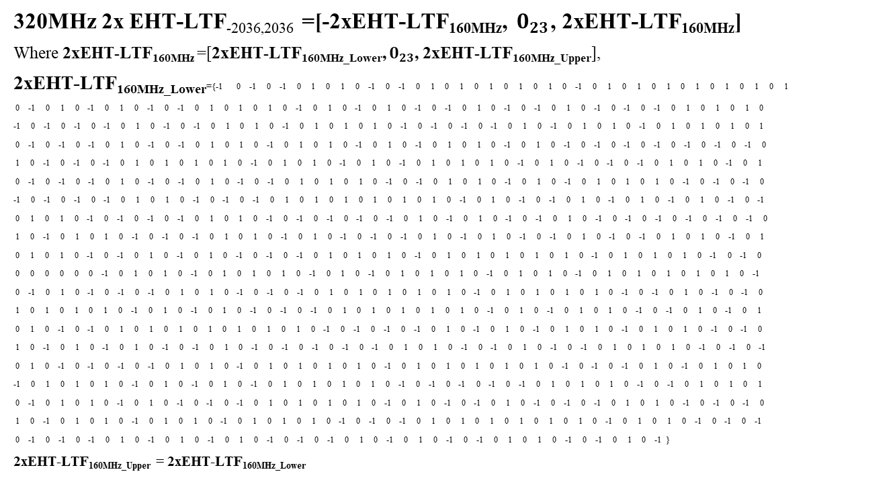
New Sequences
320MHz 2x EHT-LTF_{-2036,2036} =[-2xEHT-LTF_{160MHz}, $0_{23}$, 2xEHT-LTF_{160MHz}]
Where 2xEHT-LTF_{160MHz} =[2xEHT-LTF_{160MHz_Lower}, $0_{23}$, 2xEHT-LTF_{160MHz_Upper}],
2xEHT-LTF_{160MHz_Lower}={-1 0 -1 0 -1 0 1 0 1 0 -1 0 -1 0 1 0 1 0 1 0 1 0 1 0 -1 0 1 0 1 0 1 0 1 0 1 0 1 0 1
0 -1 0 1 0 -1 0 1 0 -1 0 -1 0 1 0 1 0 1 0 -1 0 1 0 -1 0 1 0 -1 0 -1 0 1 0 -1 0 -1 0 1 0 -1 0 -1 0 -1 0 1 0 1 0 1 0
-1 0 -1 0 -1 0 -1 0 1 0 -1 0 -1 0 1 0 1 0 -1 0 1 0 1 0 1 0 -1 0 -1 0 -1 0 -1 0 1 0 -1 0 1 0 1 0 -1 0 1 0 1 0 1 0 1
0 -1 0 -1 0 -1 0 1 0 -1 0 -1 0 1 0 1 0 -1 0 1 0 1 0 -1 0 1 0 -1 0 1 0 1 0 -1 0 1 0 -1 0 -1 0 -1 0 -1 0 -1 0 -1 0 -1 0
1 0 -1 0 -1 0 -1 0 1 0 1 0 1 0 1 0 -1 0 1 0 1 0 -1 0 1 0 -1 0 1 0 1 0 1 0 -1 0 1 0 -1 0 -1 0 -1 0 1 0 1 0 -1 0 1
0 -1 0 -1 0 -1 0 1 0 -1 0 -1 0 1 0 -1 0 -1 0 1 0 1 0 1 0 -1 0 -1 0 1 0 1 0 -1 0 1 0 -1 0 1 0 1 0 1 0 -1 0 -1 0 -1 0
-1 0 -1 0 -1 0 -1 0 1 0 1 0 -1 0 -1 0 -1 0 1 0 1 0 1 0 1 0 1 0 1 0 -1 0 1 0 -1 0 -1 0 1 0 -1 0 1 0 -1 0 1 0 -1 0 -1
0 1 0 1 0 -1 0 -1 0 -1 0 -1 0 1 0 1 0 -1 0 -1 0 -1 0 -1 0 -1 0 1 0 -1 0 1 0 -1 0 -1 0 1 0 -1 0 -1 0 -1 0 -1 0 -1 0 -1 0
1 0 -1 0 1 0 1 0 -1 0 -1 0 -1 0 1 0 1 0 -1 0 1 0 -1 0 -1 0 -1 0 1 0 -1 0 1 0 -1 0 -1 0 1 0 -1 0 -1 0 1 0 1 0 -1 0 1
0 1 0 1 0 -1 0 -1 0 1 0 -1 0 1 0 -1 0 -1 0 -1 0 1 0 1 0 1 0 -1 0 1 0 1 0 1 0 1 0 1 0 -1 0 1 0 1 0 1 0 -1 0 -1 0
0 0 0 0 0 0 -1 0 1 0 1 0 -1 0 1 0 1 0 1 0 -1 0 1 0 -1 0 1 0 1 0 1 0 -1 0 1 0 1 0 -1 0 1 0 1 0 1 0 1 0 1 0 -1
0 -1 0 1 0 -1 0 -1 0 -1 0 1 0 1 0 -1 0 -1 0 -1 0 1 0 1 0 1 0 1 0 1 0 -1 0 1 0 1 0 1 0 1 0 -1 0 -1 0 1 0 -1 0 -1 0
1 0 1 0 1 0 1 0 -1 0 1 0 -1 0 1 0 -1 0 -1 0 -1 0 1 0 1 0 1 0 1 0 1 0 -1 0 1 0 -1 0 1 0 1 0 -1 0 -1 0 1 0 -1 0 1
0 1 0 -1 0 -1 0 1 0 1 0 1 0 1 0 1 0 1 0 1 0 -1 0 -1 0 -1 0 -1 0 1 0 -1 0 1 0 -1 0 1 0 1 0 -1 0 1 0 1 0 -1 0 -1 0
1 0 -1 0 1 0 -1 0 1 0 -1 0 -1 0 1 0 -1 0 -1 0 -1 0 -1 0 -1 0 1 0 1 0 -1 0 -1 0 1 0 -1 0 -1 0 1 0 1 0 1 0 -1 0 -1 0 -1
0 1 0 -1 0 -1 0 -1 0 -1 0 1 0 1 0 -1 0 1 0 1 0 1 0 1 0 -1 0 1 0 1 0 1 0 1 0 1 0 -1 0 -1 0 -1 0 1 0 -1 0 1 0 1 0
-1 0 1 0 1 0 1 0 -1 0 1 0 -1 0 1 0 -1 0 1 0 1 0 1 0 1 0 -1 0 -1 0 -1 0 -1 0 -1 0 1 0 1 0 1 0 -1 0 -1 0 1 0 1 0 1
0 -1 0 1 0 1 0 -1 0 1 0 -1 0 -1 0 -1 0 1 0 1 0 1 0 1 0 -1 0 1 0 -1 0 -1 0 1 0 -1 0 -1 0 -1 0 1 0 1 0 -1 0 -1 0 -1 0
1 0 -1 0 1 0 1 0 -1 0 1 0 1 0 -1 0 1 0 1 0 1 0 -1 0 -1 0 -1 0 1 0 1 0 1 0 1 0 1 0 1 0 -1 0 1 0 1 0 -1 0 -1 0 -1
0 -1 0 -1 0 -1 0 1 0 -1 0 1 0 -1 0 1 0 -1 0 -1 0 -1 0 1 0 -1 0 1 0 -1 0 -1 0 1 0 1 0 -1 0 -1 0 1 0 -1 }
2xEHT-LTF_{160MHz_Upper} = 2xEHT-LTF_{160MHz_Lower}

Slide 8
320MHz 2x EHT-LTF
Option 1 simulation results:
1st80MHz
4.4605 | 4.4605 | 4.4605 | 4.4605 | 4.4605 | 4.4605 | 4.4605 | 4.4605 | 4.4605 | 5.8494 | 6.9809 | 5.8494 | 6.9809 | 5.6374 | 4.7677 | 7.9454 | 4.7677 | 5.8494 | 5.8494 | 4.7677 | 7.9454 | 4.7677 | 5.6374 | 6.9809 | 5.8494 | 6.9809 | 5.8494 | 4.4605 | 4.4605 | 4.4605 | 4.4605 | 4.4605 | 4.4605 | 4.4605 | 4.4605 | 4.4605
4.6942 |  | 4.6942 |  |  | 4.6942 |  | 4.6942 |  | 7.4339 |  | 7.4339 |  |  | 7.4339 |  | 5.8786 |  | 5.8786 |  | 7.4339 |  |  | 7.4339 |  | 7.4339 |  | 4.6942 |  | 4.6942 |  |  | 4.6942 |  | 4.6942
5.4199 |  |  |  |  | 5.4109 |  |  |  | 6.4299 |  |  |  |  | 6.4895 |  |  |  | 6.4895 |  |  |  |  | 6.4299 |  |  |  | 5.4109 |  |  |  |  | 5.4199
5.5768 |  |  |  |  |  |  |  |  | 7.3876 |  |  |  |  |  |  |  |  | 7.3114 |  |  |  |  |  |  |  |  | 5.5768
6.8645 |  |  |  |  |  |  |  |  |  |  |  |  |  |  |  |  |  | 6.5837
7.4709
5.9411 |  |  |  |  |  |  |  |  | 6.3682 |  |  |  |  |  |  |  |  | 6.3682 |  |  |  |  |  |  |  |  | 5.9411
6.2519 |  |  |  |  |  |  |  |  | 6.644 |  |  |  |  |  |  |  |  | 6.644 |  |  |  |  |  |  |  |  | 6.2519
7.9972 |  |  |  |  |  |  |  |  | 8.0269 |  |  |  |  |  |  |  |  | 9.0745 |  |  |  |  |  |  |  |  | 8.1309
RU26
RU52
RU106
RU242
RU484
RU996
RU52+26
RU106+26
RU484+242
2nd & 4th 80MHz
4.4605 | 4.4605 | 4.4605 | 4.4605 | 4.4605 | 4.4605 | 4.4605 | 4.4605 | 4.4605 | 5.8494 | 6.9809 | 5.8494 | 6.9809 | 5.6374 | 4.7677 | 7.9454 | 4.7677 | 5.7625 | 5.8494 | 4.7677 | 7.9454 | 4.7677 | 5.6374 | 6.9809 | 5.8494 | 6.9809 | 5.8494 | 4.4605 | 4.4605 | 4.4605 | 4.4605 | 4.4605 | 4.4605 | 4.4605 | 4.4605 | 4.4605
4.6942 |  | 4.6942 |  |  | 4.6942 |  | 4.6942 |  | 7.4339 |  | 7.4339 |  |  | 7.4339 |  | 5.9301 |  | 5.8786 |  | 7.4339 |  |  | 7.4339 |  | 7.4339 |  | 4.6942 |  | 4.6942 |  |  | 4.6942 |  | 4.6942
5.4199 |  |  |  |  | 5.4109 |  |  |  | 6.4299 |  |  |  |  | 6.7073 |  |  |  | 6.4895 |  |  |  |  | 6.4299 |  |  |  | 5.4109 |  |  |  |  | 5.4199
5.5768 |  |  |  |  |  |  |  |  | 8.2385 |  |  |  |  |  |  |  |  | 7.3114 |  |  |  |  |  |  |  |  | 5.5768
7.3472 |  |  |  |  |  |  |  |  |  |  |  |  |  |  |  |  |  | 6.5837
6.5164
5.9411 |  |  |  |  |  |  |  |  | 6.3682 |  |  |  |  |  |  |  |  | 6.3682 |  |  |  |  |  |  |  |  | 5.9411
6.2519 |  |  |  |  |  |  |  |  | 6.6065 |  |  |  |  |  |  |  |  | 6.644 |  |  |  |  |  |  |  |  | 6.2519
8.5628 |  |  |  |  |  |  |  |  | 8.6875 |  |  |  |  |  |  |  |  | 9.6763 |  |  |  |  |  |  |  |  | 8.1829
RU26
RU52
RU106
RU242
RU484
RU996
RU52+26
RU106+26
RU484+242

Slide 9
320MHz 2x EHT-LTF
Option 1 simulation results:
3rd 80MHz
4.4605 | 4.4605 | 4.4605 | 4.4605 | 4.4605 | 4.4605 | 4.4605 | 4.4605 | 4.4605 | 5.8494 | 6.9809 | 5.8494 | 6.9809 | 5.6374 | 4.7677 | 7.9454 | 4.7677 | 5.7625 | 5.8494 | 4.7677 | 7.9454 | 4.7677 | 5.6374 | 6.9809 | 5.8494 | 6.9809 | 5.8494 | 4.4605 | 4.4605 | 4.4605 | 4.4605 | 4.4605 | 4.4605 | 4.4605 | 4.4605 | 4.4605
4.6942 |  | 4.6942 |  |  | 4.6942 |  | 4.6942 |  | 7.4339 |  | 7.4339 |  |  | 7.4339 |  | 5.9301 |  | 5.8786 |  | 7.4339 |  |  | 7.4339 |  | 7.4339 |  | 4.6942 |  | 4.6942 |  |  | 4.6942 |  | 4.6942
5.4199 |  |  |  |  | 5.4109 |  |  |  | 6.4299 |  |  |  |  | 6.7073 |  |  |  | 6.4895 |  |  |  |  | 6.4299 |  |  |  | 5.4109 |  |  |  |  | 5.4199
5.5768 |  |  |  |  |  |  |  |  | 8.2385 |  |  |  |  |  |  |  |  | 7.3114 |  |  |  |  |  |  |  |  | 5.5768
7.4499 |  |  |  |  |  |  |  |  |  |  |  |  |  |  |  |  |  | 6.5837
8.6291
5.9411 |  |  |  |  |  |  |  |  | 6.3682 |  |  |  |  |  |  |  |  | 6.3682 |  |  |  |  |  |  |  |  | 5.9411
6.2519 |  |  |  |  |  |  |  |  | 6.6065 |  |  |  |  |  |  |  |  | 6.644 |  |  |  |  |  |  |  |  | 6.2519
7.9972 |  |  |  |  |  |  |  |  | 8.6875 |  |  |  |  |  |  |  |  | 8.6909 |  |  |  |  |  |  |  |  | 8.3240
RU26
RU52
RU106
RU242
RU484
RU996
RU52+26
RU106+26
RU484+242
9.9503 | 9.4954 | 9.3479 | 9.0787 | 9.834 | 8.7716 | 9.4144 | 9.5244
8.7827 | 9.2171 | 8.7827 | 8.8965
9.7038 | 9.3527 | 8.3182 | 8.8433 | 9.4922 | 9.3837
9.3124 | 9.8853 | 8.8523 | 8.8747 | 8.2622 | 9.6814
9.0595 | 10.043 | 8.7657 | 9.0575 | 8.9771 | 9.0549
8.5889 | 9.4114 | 9.0418 | 9.8471 | 8.6334 | 8.8241
10.047 | 7.9376 | 8.9745
9.4879 | 7.9376 | 7.8418
8.6498 | 8.9745 | 7.8418
10.047 | 9.4879 | 8.6498
7.7723 | 9.0647 | 8.4855 | 9.9838 | 7.7723 | 8.0424 | 9.9091 | 7.9129
9.589
RU484+3x996
RU3x996
RU2x996+484
RU2x996
RU484+996
RU4x996

Slide 10
New Sequences Simulation Results
4.6419 | 5.1960 | 5.0680 | 5.2566 | 5.1442 | 3.7540 | 4.9816 | 4.2895 | 4.6706 | 4.9486 | 4.8713 | 3.9825 | 4.2895 | 3.9825 | 4.4949 | 4.8274 | 5.2037 | 4.6280 | 4.6280 | 5.2037 | 4.8274 | 4.4949 | 3.9825 | 4.2895 | 3.9825 | 4.8713 | 4.9486 | 4.6706 | 4.2895 | 4.9816 | 3.7540 | 5.1442 | 5.2566 | 5.0680 | 5.1960 | 4.6419
4.4756 |  | 4.1344 |  |  | 4.4544 |  | 4.4096 |  | 4.3064 |  | 4.5803 |  |  | 4.3063 |  | 4.4896 |  | 4.4896 |  | 4.3063 |  |  | 4.5803 |  | 4.3064 |  | 4.4096 |  | 4.4544 |  |  | 4.1344 |  | 4.4756
4.7971 |  |  |  |  | 4.9860 |  |  |  | 5.1920 |  |  |  |  | 4.8907 |  |  |  | 4.8907 |  |  |  |  | 5.1920 |  |  |  | 4.8960 |  |  |  |  | 4.7971
5.3570 |  |  |  |  |  |  |  |  | 5.4249 |  |  |  |  |  |  |  |  | 5.4249 |  |  |  |  |  |  |  |  | 5.3570
5.5066 |  |  |  |  |  |  |  |  |  |  |  |  |  |  |  |  |  | 5.5066
5.7787
5.1865 |  |  |  |  |  |  |  |  | 5.1216 |  |  |  |  |  |  |  |  | 5.1216 |  |  |  |  |  |  |  |  | 5.1865
5.9815 |  |  |  |  |  |  |  |  | 5.8047 |  |  |  |  |  |  |  |  | 5.8047 |  |  |  |  |  |  |  |  | 5.9815
6.9761 |  |  |  |  |  |  |  |  | 6.7322 |  |  |  |  |  |  |  |  | 6.7322 |  |  |  |  |  |  |  |  | 6.9761
8.5730 | 8.6474 | 9.4816 | 9.4493 | 9.4493 | 9.4816 | 8.6474 | 8.5370 | RU484+3*RU996
9.0403 | 9.0403 | 7.7216 | 7.7216 |  |  |  |  | 3*RU996
8.4307 | 8.5269 | 9.1371 | 9.1493 | 8.9239 |  | 8.9006 |  | RU484+2*RU996
8.9006 | 8.9239 | 9.1493 | 9.1371 | 8.5269 |  | 8.4307
7.5159 | 7.6273 | 8.6393 | 8.3794 | 7.4898 |  | 7.5082
7.5082 | 7.4898 | 8.3794 | 8.6393 | 7.6273 |  | 7.5159
8.4047 |  | 8.5372 |  | 8.5134 |  |  |  | 2*RU996
8.5134 |  | 8.5372 |  | 8.4047
8.5628 |  | 8.5134 |  | 8.4047
8.4047 |  | 8.5134 |  | 8.5628
7.5193 | 7.5032 | 7.5032 | 7.5193 | 7.5193 | 7.5032 | 7.5032 | 7.5193 | RU484+RU996
9.0743 |  |  |  |  |  |  |  | 4*RU996

Slide 11
Conclusion
In this contribution, 2x EHT-LTF sequences in
320MHz/160+160 transmission are proposed.

Slide 12
Reference
[1] Dandan Liang, et al, <EHT-LTFs Sequences Design>, IEEE 802.11-20/0926r0
[2] Edward Au, <IEEE P802.11 Wireless LANs>, IEEE 802.11-20/0566r29
[3] <802.11ax Draft>, D6.0.
[4] Jinyoung Chun, et al, <EHT-LTF sequences in new tone plan>, IEEE 802.11-20/825r1
[5] Le Liu, et al, <HE-LTF Sequence Design>, IEEE 802.11-15/1334

Slide 13
Straw Poll 1
Do you support to add to SFD：320MHz/160+160MHz 2x EHT-LTF sequences:
320MHz 2x EHT-LTF_{-2036,2036} = [HE-LTF_{80MHz_part1_2x} HE-LTF_{80MHz_part2_2x} (-1)* HE-LTF_{80MHz_part3_2x} (-1)* HE-LTF_{80MHz_part4_2x} (-1)* HE-LTF_{80MHz_part5_2x} 0₂₃ (-1)* HE-LTF_{80MHz_part1_2x} (-1)* HE-LTF_{80MHz_part2_2x} (-1)*HE-LTF_{80MHz_part3_2x} (-1)* HE-LTF_{80MHz_part4_2x} (-1)* HE-LTF_{80MHz_part5_2x} 0₂₃ (-1)* HE-LTF_{80MHz_part1_2x} HE-LTF_{80MHz_part2_2x} HE-LTF_{80MHz_part3_2x} HE-LTF_{80MHz_part4_2x} HE-LTF_{80MHz_part5_2x} 0₂₃ HE-LTF_{80MHz_part1_2x} HE-LTF_{80MHz_part2_2x} HE-LTF_{80MHz_part3_2x} HE-LTF_{80MHz_part4_2x} HE-LTF_{80MHz_part5_2x}];
Coefficient values = [1 1 -1 -1 -1 -1 -1 -1 -1 -1 -1 1 1 1 1 1 1 1 1 1]

Slide 14
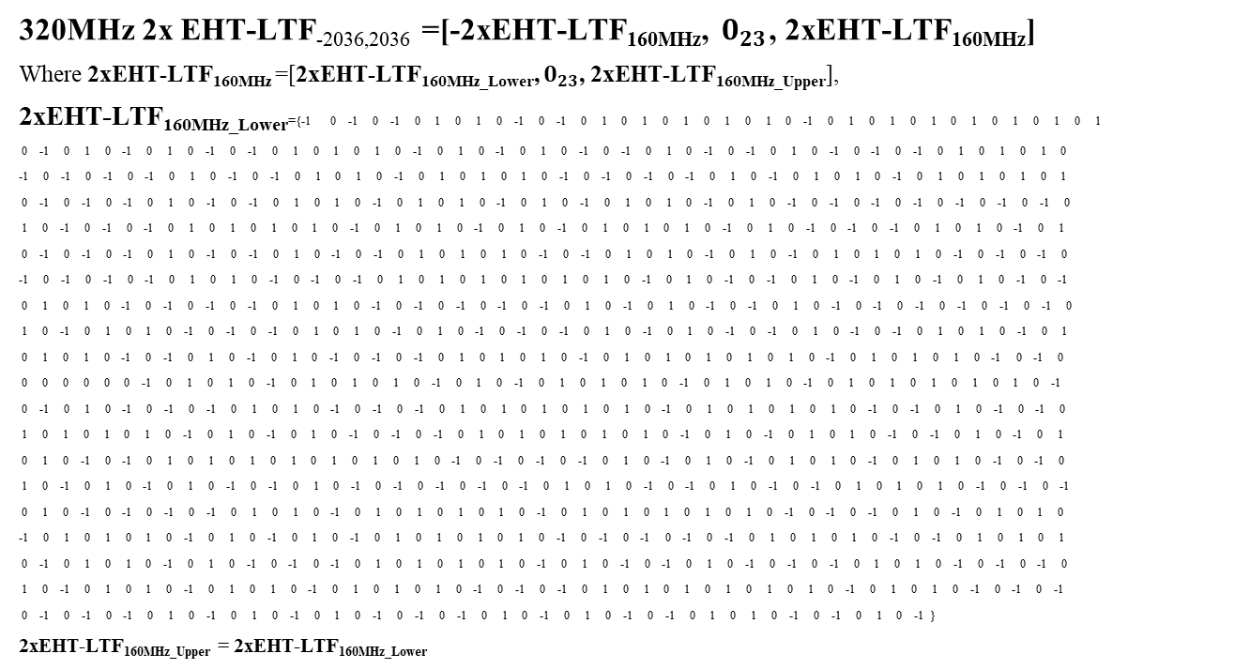
Straw Poll 2
Do you support to add to SFD：320MHz/160+160MHz 2x EHT-LTF sequences:
320MHz 2x EHT-LTF_{-2036,2036} =[-2xEHT-LTF_{160MHz}, $0_{23}$, 2xEHT-LTF_{160MHz}]
Where 2xEHT-LTF_{160MHz} =[2xEHT-LTF_{160MHz_Lower}, $0_{23}$, 2xEHT-LTF_{160MHz_Upper}],
2xEHT-LTF_{160MHz_Lower}={-1 0 -1 0 -1 0 1 0 1 0 -1 0 -1 0 1 0 1 0 1 0 1 0 1 0 -1 0 1 0 1 0 1 0 1 0 1 0 1 0 1
0 -1 0 1 0 -1 0 1 0 -1 0 -1 0 1 0 1 0 1 0 -1 0 1 0 -1 0 1 0 -1 0 -1 0 1 0 -1 0 -1 0 1 0 -1 0 -1 0 -1 0 1 0 1 0 1 0
-1 0 -1 0 -1 0 -1 0 1 0 -1 0 -1 0 1 0 1 0 -1 0 1 0 1 0 1 0 -1 0 -1 0 -1 0 -1 0 1 0 -1 0 1 0 1 0 -1 0 1 0 1 0 1 0 1
0 -1 0 -1 0 -1 0 1 0 -1 0 -1 0 1 0 1 0 -1 0 1 0 1 0 -1 0 1 0 -1 0 1 0 1 0 -1 0 1 0 -1 0 -1 0 -1 0 -1 0 -1 0 -1 0 -1 0
1 0 -1 0 -1 0 -1 0 1 0 1 0 1 0 1 0 -1 0 1 0 1 0 -1 0 1 0 -1 0 1 0 1 0 1 0 -1 0 1 0 -1 0 -1 0 -1 0 1 0 1 0 -1 0 1
0 -1 0 -1 0 -1 0 1 0 -1 0 -1 0 1 0 -1 0 -1 0 1 0 1 0 1 0 -1 0 -1 0 1 0 1 0 -1 0 1 0 -1 0 1 0 1 0 1 0 -1 0 -1 0 -1 0
-1 0 -1 0 -1 0 -1 0 1 0 1 0 -1 0 -1 0 -1 0 1 0 1 0 1 0 1 0 1 0 1 0 -1 0 1 0 -1 0 -1 0 1 0 -1 0 1 0 -1 0 1 0 -1 0 -1
0 1 0 1 0 -1 0 -1 0 -1 0 -1 0 1 0 1 0 -1 0 -1 0 -1 0 -1 0 -1 0 1 0 -1 0 1 0 -1 0 -1 0 1 0 -1 0 -1 0 -1 0 -1 0 -1 0 -1 0
1 0 -1 0 1 0 1 0 -1 0 -1 0 -1 0 1 0 1 0 -1 0 1 0 -1 0 -1 0 -1 0 1 0 -1 0 1 0 -1 0 -1 0 1 0 -1 0 -1 0 1 0 1 0 -1 0 1
0 1 0 1 0 -1 0 -1 0 1 0 -1 0 1 0 -1 0 -1 0 -1 0 1 0 1 0 1 0 -1 0 1 0 1 0 1 0 1 0 1 0 -1 0 1 0 1 0 1 0 -1 0 -1 0
0 0 0 0 0 0 -1 0 1 0 1 0 -1 0 1 0 1 0 1 0 -1 0 1 0 -1 0 1 0 1 0 1 0 -1 0 1 0 1 0 -1 0 1 0 1 0 1 0 1 0 1 0 -1
0 -1 0 1 0 -1 0 -1 0 -1 0 1 0 1 0 -1 0 -1 0 -1 0 1 0 1 0 1 0 1 0 1 0 -1 0 1 0 1 0 1 0 1 0 -1 0 -1 0 1 0 -1 0 -1 0
1 0 1 0 1 0 1 0 -1 0 1 0 -1 0 1 0 -1 0 -1 0 -1 0 1 0 1 0 1 0 1 0 1 0 -1 0 1 0 -1 0 1 0 1 0 -1 0 -1 0 1 0 -1 0 1
0 1 0 -1 0 -1 0 1 0 1 0 1 0 1 0 1 0 1 0 1 0 -1 0 -1 0 -1 0 -1 0 1 0 -1 0 1 0 -1 0 1 0 1 0 -1 0 1 0 1 0 -1 0 -1 0
1 0 -1 0 1 0 -1 0 1 0 -1 0 -1 0 1 0 -1 0 -1 0 -1 0 -1 0 -1 0 1 0 1 0 -1 0 -1 0 1 0 -1 0 -1 0 1 0 1 0 1 0 -1 0 -1 0 -1
0 1 0 -1 0 -1 0 -1 0 -1 0 1 0 1 0 -1 0 1 0 1 0 1 0 1 0 -1 0 1 0 1 0 1 0 1 0 1 0 -1 0 -1 0 -1 0 1 0 -1 0 1 0 1 0
-1 0 1 0 1 0 1 0 -1 0 1 0 -1 0 1 0 -1 0 1 0 1 0 1 0 1 0 -1 0 -1 0 -1 0 -1 0 -1 0 1 0 1 0 1 0 -1 0 -1 0 1 0 1 0 1
0 -1 0 1 0 1 0 -1 0 1 0 -1 0 -1 0 -1 0 1 0 1 0 1 0 1 0 -1 0 1 0 -1 0 -1 0 1 0 -1 0 -1 0 -1 0 1 0 1 0 -1 0 -1 0 -1 0
1 0 -1 0 1 0 1 0 -1 0 1 0 1 0 -1 0 1 0 1 0 1 0 -1 0 -1 0 -1 0 1 0 1 0 1 0 1 0 1 0 1 0 -1 0 1 0 1 0 -1 0 -1 0 -1
0 -1 0 -1 0 -1 0 1 0 -1 0 1 0 -1 0 1 0 -1 0 -1 0 -1 0 1 0 -1 0 1 0 -1 0 -1 0 1 0 1 0 -1 0 -1 0 1 0 -1 }
2xEHT-LTF_{160MHz_Upper} = 2xEHT-LTF_{160MHz_Lower}

Slide 15
Comparison
RU size | Median PAPR of BPSK Data | Max PAPR for Option 1(HE based) | Max PAPR for New sequence | Max PAPR for doc:1065r1
RU52+RU26 | 7.10 | 6.644 | 5.19
RU106+RU26 | 7.44 | 6.3682 | 5.98
RU242 | 7.94 | 8.2385 | 5.42 | 5.58
RU484 | 8.44 | 7.4499 | 5.51 | 6.59
RU484+RU242 | 8.83 | 9.6763 | 6.98 | 8.62
RU996 | 8.84 | 8.6291 | 5.78 | 9.26
RU996+ RU484 | 9.17 | 9.9838 | 7.52 | 9.12
RU2*996 | 9.27 or 9.28 | 10.047 | 8.54 or 8.56 | 8.99 or 9.03
RU2*996+ RU484 | 9.50 | 10.043 | 8.64 or 9.15 | 9.61
RU3*996 | 9.54 | 9.2171 | 9.04 | 9.4
RU3*996+ RU484 | 9.55 | 9.9503 | 9.48 | 9.49
RU4*996 | 9.60 | 9.589 | 9.07 | 7.79

Slide 16
Appendix: QAM Data PAPR

