Slide 1
4x EHT-LTF sequence

Slide 2
R1: Changes
We updated 4x EHT-LTF sequence with the updated MRU sets
  12 sets for 2*996+484 are removed and 2*996 shall not straddle in two 160MHz. [1]
  So the best coefficients, which consists of 20MHz units of 4x HE-LTF sequence, are changed as below. Then the worst PAPR is 9.09dB.
  Updated HE-based sequence
    EHTLTF_{-2036, 2036} = {LTF_{80MHz_1st_4x}, 23 zeros, LTF_{80MHz_2nd_4x}, 23 zeros, LTF_{80MHz_3rd_4x}, 23 zeros, LTF_{80MHz_4th_4x}}
    LTF_{80MHz_1st_4x} = {LTF_{80MHz_left_4x_1}, -LTF_{80MHz_left_4x_2}, 0, LTF_{80MHz_right_4x_1}, LTF_{80MHz_right_4x_2}}
    LTF_{80MHz_2nd_4x} = {LTF_{80MHz_left_4x_1}, LTF_{80MHz_left_4x_2}, 0, -LTF_{80MHz_right_4x_1}, LTF_{80MHz_right_4x_2}}
    LTF_{80MHz_3rd_4x} = {LTF_{80MHz_left_4x_1}, -LTF_{80MHz_left_4x_2}, 0, -LTF_{80MHz_right_4x_1}, -LTF_{80MHz_right_4x_2}}
    LTF_{80MHz_4th_4x} = {-LTF_{80MHz_left_4x_1}, -LTF_{80MHz_left_4x_2}, 0, -LTF_{80MHz_right_4x_1}, LTF_{80MHz_right_4x_2}}
    LTF_{80MHz_left_4x_1}= LTF_{80MHz_left_4x}(1:250), LTF_{80MHz_left_4x_2}= LTF_{80MHz_left_4x}(251:500),
    LTF_{80MHz_right_4x_1}= LTF_{80MHz_right_4x}(1:250), LTF_{80MHz_right_4x_2}= LTF_{80MHz_right_4x}(251:500)
    LTF_{80MHz_left_4x} and LTF_{80MHz_right_4x} are same as in 11ax.

Slide 3
Conclusion
We listed the worst PAPRs per (M)RU in multi-stream.
  All PAPRs are less than Data’s one
  and most are under 9dB.
  Only 2 MRUs has 9.09dB worst PAPR.
  The detail PAPRs are in Appendix.
There are some proposals with new sequence [2,3] with a little lower worst PAPR. But we prefer to reuse HE-LTF sequence since 4x LTF is the longest sequence that has a good performance, and 11be reuses HE-LTF sequences for 80/160MHz PPDU and even 1x LTF for 320MHz PPDU.
RU size | QPSK’s median | 4x LTF
242 | 8.37 | 7.83
484 | 8.84 | 7.46
242+484 | 8.83 | 8.97
996 | 9.23 | 8.47
996+484 | 9.54 | 8.78
2*996 | 9.58 | 8.52
3*996 | 9.86 | 8.48
3*996+484 | 9.89 | 9.09
4*996 | 9.93 | 8.79
2*996+484 | 9.82 | 9.09

Slide 4
Reference
[1] IEEE802.11-20/0566r63, “Compendium of straw polls and
potential changes to the Specification Framework Document”
[2] IEEE802.11-20-1073r3, “4x EHT-LTFs Sequences Design”
[3] IEEE802.11-20-1216r5, “4x 320MHz EHT-LTF-Design”

Slide 5
Straw poll 1
Do you agree to add the below text in SFD?
  In 320MHz transmission, 4x EHT-LTF sequence is given as below.
  EHTLTF_{-2036, 2036} = {LTF_{80MHz_1st_4x}, 23 zeros, LTF_{80MHz_2nd_4x}, 23 zeros, LTF_{80MHz_3rd_4x}, 23 zeros, LTF_{80MHz_4th_4x}}
    LTF_{80MHz_1st_4x} = {LTF_{80MHz_left_4x_1}, -LTF_{80MHz_left_4x_2}, 0, LTF_{80MHz_right_4x_1}, LTF_{80MHz_right_4x_2}}
    LTF_{80MHz_2nd_4x} = {LTF_{80MHz_left_4x_1}, LTF_{80MHz_left_4x_2}, 0, -LTF_{80MHz_right_4x_1}, LTF_{80MHz_right_4x_2}}
    LTF_{80MHz_3rd_4x} = {LTF_{80MHz_left_4x_1}, -LTF_{80MHz_left_4x_2}, 0, -LTF_{80MHz_right_4x_1}, -LTF_{80MHz_right_4x_2}}
    LTF_{80MHz_4th_4x} = {-LTF_{80MHz_left_4x_1}, -LTF_{80MHz_left_4x_2}, 0, -LTF_{80MHz_right_4x_1}, LTF_{80MHz_right_4x_2}}
    LTF_{80MHz_left_4x_1}= LTF_{80MHz_left_4x}(1:250),
    LTF_{80MHz_left_4x_2}= LTF_{80MHz_left_4x}(251:500),
    LTF_{80MHz_right_4x_1}= LTF_{80MHz_right_4x}(1:250),
    LTF_{80MHz_right_4x_2}= LTF_{80MHz_right_4x}(251:500)
    LTF_{80MHz_left_4x} and LTF_{80MHz_right_4x} are same as in 11ax.
  Y/N/Abs

Slide 6
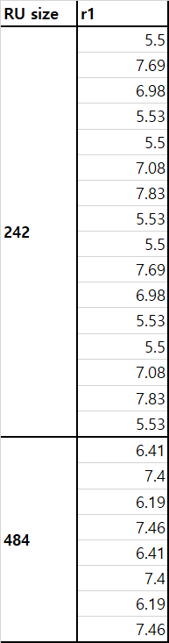
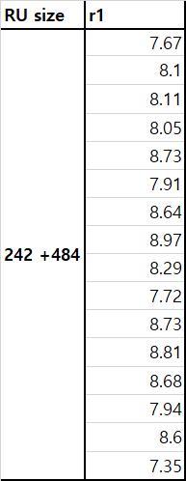
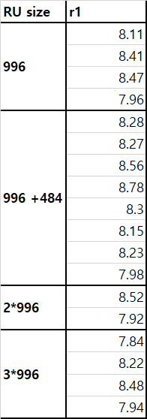
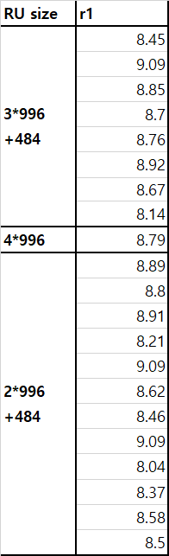
Appendix
PAPR results in RUs with multi-stream

