Slide 1
4x EHT-LTF sequence

Slide 2
Introduction
I suggested EHT-LTF sequences for 320MHz [1].
I generated 1/2/4x EHT-LTF sequences based on HE-LTF sequence, but 2/4x LTF has somewhat high PAPRs in some RUs.
So here I considered the further optimization of 4x EHT-LTF sequence.

Slide 3
4x EHT-LTF sequence according to transmission mode
There are two options
  Option1: 320MHz 4x EHT-LTF sequences are used for 320MHz OFDMA/non-OFDMA transmission and 240MHz OFDMA/non-OFDMA transmission together. The below RU sizes are considered.
    26, 52, 52+26, 106, 106+26, 242, 484, 242+484 in 80MHz segment, 996, 484+996 in continuous 160MHz, 2*996 in continuous 160MHz, 3*996, 3*996+484, 4*996 as well as 2*996, 2*996+484
  Option2: 320MHz 4x EHT-LTF sequences are used for 320MHz OFDMA/non-OFDMA transmission only. The below RU sizes are considered.
    26, 52, 52+26, 106, 106+26, 242, 484, 242+484 in 80MHz segment, 996, 484+996 in continuous 160MHz, 2*996, 3*996, 3*996+484, 4*996
    If we choose option2, we need to define 240MHz 4x EHT-LTF sequence, too. Then the below RU sizes are considered.
      26, 52, 52+26, 106, 106+26, 242, 484, 242+484 in 80MHz segment, 996, 484+996 in continuous 160MHz, 2*996, 3*996, 2*996+484
In this slide, EHT-LTF sequences for both options are suggested.

Slide 4
4x EHT-LTF sequence generation(1/2)
Case 1: 4x EHT-LTF sequence based on HE-LTF sequences of 40MHz subchannel
  I suggested 4x EHT-LTF sequences in [1]. But I found the sequences with 1 stream. Here I re-select the sequence with multi-stream as below.
  But as I said, any combinations based on LTF_{80MHz_left/right_4x} can’t put all PAPRs under data’s median in 4x LTF.
  EHTLTF_{320MHz_4x} = {LTF_{80MHz_lower1_4x}, 23 zeros, LTF_{80MHz_upper1_4x}, 23 zeros, LTF_{80MHz_lower2_4x}, 23 zeros, LTF_{80MHz_upper2_4x}}
    LTF_{80MHz_lower1_4x} = {n(1)*LTF_{80MHz_left_4x}, 0, n(2)*LTF_{80MHz_right_4x}}
    LTF_{80MHz_upper1_4x} = {n(3)*LTF_{80MHz_left_4x}, 0, n(4)*LTF_{80MHz_right_4x}}
    LTF_{80MHz_lower2_4x} = {n(5)*LTF_{80MHz_left_4x} 0, n(6)*LTF_{80MHz_right_4x}}
    LTF_{80MHz_upper2_4x} = {n(7)*LTF_{80MHz_left_4x}, 0, n(8)*LTF_{80MHz_right_4x}}
    LTF_{80MHz_left_4x}, LF_{80MHz_left_4x} are in 11ax
    n(1)~n(8) = [1 -1 -1 -1 -1 1 1 1] for option1, [1 1 1 1 1 -1 -1 1] for option2

Slide 5
4x EHT-LTF sequence generation(2/2)
Case 2: 4x EHT-LTF sequence based on HE-LTF sequences of 20MHz subchannel
  Divide LTF_{80MHz_left/right_4x} {1:500} in units of 20MHz subchannel and apply different coefficients in each subchannel as below.
    It's also aligned with the RU unit of new 80MHz segment in 11be.
  EHTLTF_{320MHz_4x} = {LTF_{80MHz_lower1_4x}, 23 zeros, LTF_{80MHz_upper1_4x}, 23 zeros, LTF_{80MHz_lower2_4x}, 23 zeros, LTF_{80MHz_upper2_4x}}
    LTF_{80MHz_lower1_4x} = {n(1)*LTF_{80MHz_left_4x_1}, n(2)*LTF_{80MHz_left_4x_2}, 0, n(3)*LTF_{80MHz_right_4x_1}, n(4)*LTF_{80MHz_right_4x_2}}
    LTF_{80MHz_upper1_4x} = {n(5)*LTF_{80MHz_left_4x_1}, n(6)*LTF_{80MHz_left_4x_2}, 0, n(7)*LTF_{80MHz_right_4x_1}, n(8)*LTF_{80MHz_right_4x_2}}
    LTF_{80MHz_lower2_4x} = {n(9)*LTF_{80MHz_left_4x_1}, n(10)*LTF_{80MHz_left_4x_2}, 0, n(11)*LTF_{80MHz_right_4x_1}, n(12)*LTF_{80MHz_right_4x_2}}
    LTF_{80MHz_upper2_4x} = {n(13)*LTF_{80MHz_left_4x_1}, n(14)*LTF_{80MHz_left_4x_2}, 0, n(15)*LTF_{80MHz_right_4x_1}, n(16)*LTF_{80MHz_right_4x_2}}
    LTF_{80MHz_left_4x_1} = LTF_{80MHz_left_4x}{1:250}
    LTF_{80MHz_left_4x_2} = LTF_{80MHz_left_4x}{251:500}
    LTF_{80MHz_right_4x_1} = LTF_{80MHz_right_4x}{1:250}
    LTF_{80MHz_right_4x_2} = LTF_{80MHz_right_4x}{251:500}
    n(1)~n(16)= [1 -1 1 -1 1 -1 -1 1 1 1 -1 -1 1 1 1 1] for option 1 and [1 1 -1 1 -1 1 1 1 1 1 1 -1 -1 1 -1 -1] for option 2

Slide 6
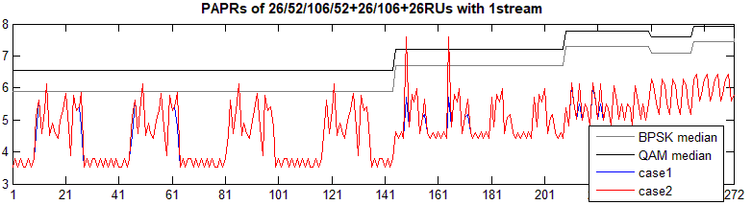
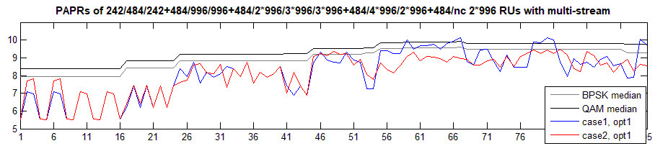
PAPR performance (1/3)
PAPRs of Small (M)RUs
  It shows some fluctuation because HE-LTF sequence is not optimized with RU units of 11be 80MHz tone plan, but mostly are lower than Data median.
PAPRs of Large (M)RUs
  In option1, the worst PAPRs of Case1 and Case2 are 10.12dB and 9.5dB, respectively. The second value is below Data’s median.

Slide 7
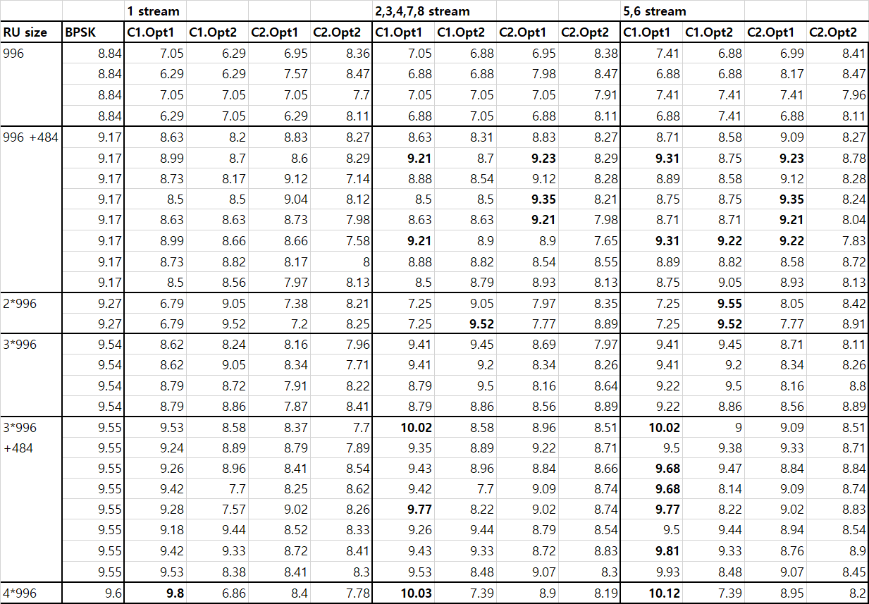
PAPR performance (2/3)

Slide 8
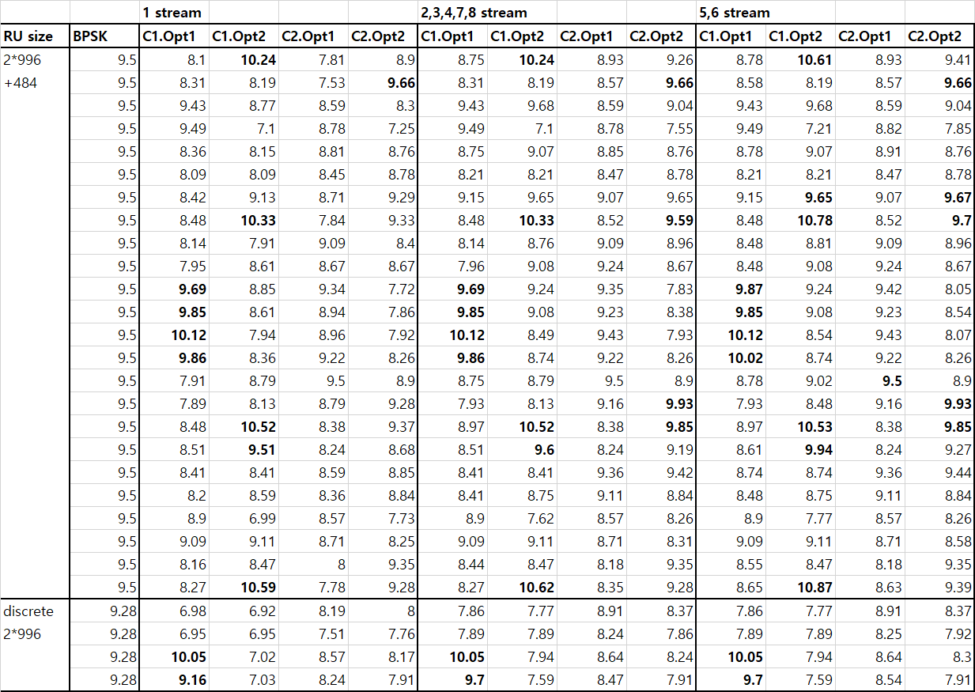
PAPR performance (3/3)

Slide 9
Analysis of PAPR results
Case 1 and Case 2
  Many PAPRs of case1 are higher than Data’s median. But most PAPRs of case2 sequence are under Data’s PAPR.
  The worst PAPRs of Case1 are 10.12dB in Option1 and 9.55dB in Option2, and in Case2, 9.5dB in Option1 and 8.91dB in Option2.
  So I prefer Case2.
Option1 and option2 in Case2
  The worst PAPRs of option1 are 9.5dB in 320MHz and 240MHz transmission. And the worst PAPRs of option2 are 8.91dB in 320MHz transmission and 9.35dB in 240MHz transmission (See Appendix).
  We slightly prefer option1 because PAPRs of option1 is lower than data’s median and there is no big gain with two separated sequences.

Slide 10
Conclusion
I showed the cases to make 4x EHT-LTF sequence for 320MHz as well as 240MHz
  Case1 is to use HE-LTF as it is and Case 2 is to use HE-LTF with more coefficients.
  We can’t catch Data’s PAPRs with Case 1, and so I prefer Case2.
And there are two options in each case
  Option1 is the best sequence for 240MHz and 320MHz transmission. It means, RU combination of 2*996+484RU is also considered with other RU sizes for 320MHz transmission, and the option2 is the best sequence for only 320MHz transmission.
  We can choose a option if 240MHz channelization or transmission is defined. But we can consider option1 regardless the decision because the performance of option 1 in case 2 is not bad in all RU sizes.

Slide 11
Reference
[1] IEEE802.11-20/0825r1, “EHT-LTF sequences considering new tone plan”

Slide 12
Straw poll 1
Do you agree to add the below text in SFD?
  In 320MHz transmission, 4x EHT-LTF sequence is given as below.
  EHTLTF_{-2036,2036}=
  {LTF_{80MHz_lower1_4x}, 0, 0, 0, 0, 0, 0, 0, 0, 0, 0, 0, 0, 0, 0, 0, 0, 0, 0, 0, 0, 0, 0, 0, LTF_{80MHz_upper1_4x}, 0, 0, 0, 0, 0, 0, 0, 0, 0, 0, 0, 0, 0, 0, 0, 0, 0, 0, 0, 0, 0, 0, 0, LTF_{80MHz_lower2_4x}, 0, 0, 0, 0, 0, 0, 0, 0, 0, 0, 0, 0, 0, 0, 0, 0, 0, 0, 0, 0, 0, 0, 0, LTF_{80MHz_upper2_4x}}
  Where
    LTF_{80MHz_lower1_4x} = {LTF_{80MHz_left_4x_1}, -LTF_{80MHz_left_4x_2}, 0, LTF_{80MHz_right_4x_1}, -LTF_{80MHz_right_4x_2}}
    LTF_{80MHz_upper1_4x} = {LTF_{80MHz_left_4x_1}, -LTF_{80MHz_left_4x_2}, 0, -LTF_{80MHz_right_4x_1}, LTF_{80MHz_right_4x_2}}
    LTF_{80MHz_lower2_4x} = {LTF_{80MHz_left_4x_1}, LTF_{80MHz_left_4x_2}, 0, -LTF_{80MHz_right_4x_1}, -LTF_{80MHz_right_4x_2}}
    LTF_{80MHz_upper2_4x} = {LTF_{80MHz_left_4x_1}, LTF_{80MHz_left_4x_2}, 0, LTF_{80MHz_right_4x_1}, LTF_{80MHz_right_4x_2}}
    LTF_{80MHz_left_4x_1} = LTF_{80MHz_left_4x}{1:250}
    LTF_{80MHz_left_4x_2} = LTF_{80MHz_left_4x}{251:500}
    LTF_{80MHz_right_4x_1} = LTF_{80MHz_right_4x}{1:250}
    LTF_{80MHz_right_4x_2} = LTF_{80MHz_right_4x}{251:500}
  Y/N/Abs

Slide 13
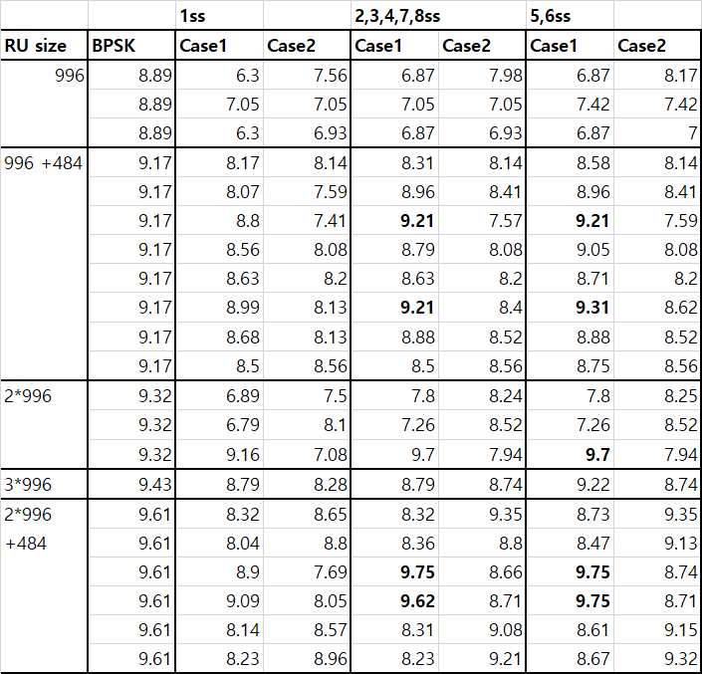
Appendix. 240MHz 4x EHT-LTF
4x EHT-LTF sequence for 240MHz transmission
  Case1
  EHTLTF_{320MHz_4x} = {LTF_{80MHz_lower1_4x}, 23 zeros,
  LTF_{80MHz_middle_4x}, 23 zeros, LTF_{80MHz_upper_4x}}
    LTF_{80MHz_lower_4x} = {n(1)*LTF_{80MHz_left_4x}, 0, n(2)*LTF_{80MHz_right_4x}}
    LTF_{80MHz_middle_4x} = {n(3)*LTF_{80MHz_left_4x}, 0, n(4)*LTF_{80MHz_right_4x}}
    LTF_{80MHz_upper_4x} = {n(5)*LTF_{80MHz_left_4x}, 0, n(6)*LTF_{80MHz_right_4x}}
    n(1)~n(6)= [1 1 1 -1 -1 -1]
  Case2
  EHTLTF_{320MHz_4x} = {LTF_{80MHz_lower_4x}, 23 zeros, LTF_{80MHz_middle_4x},
  23 zeros, LTF_{80MHz_upper_4x}}
    LTF_{80MHz_lower_4x} = {n(1)*LTF_{80MHz_left_4x_1}, n(2)*LTF_{80MHz_left_4x_2}, 0, n(3)*LTF_{80MHz_right_4x_1}, n(4)*LTF_{80MHz_right_4x_2}}
    LTF_{80MHz_middle_4x} = {n(5)*LTF_{80MHz_left_4x_1}, n(6)*LTF_{80MHz_left_4x_2}, 0, n(7)*LTF_{80MHz_right_4x_1}, n(8)*LTF_{80MHz_right_4x_2}}
    LTF_{80MHz_upper_4x} = {n(9)*LTF_{80MHz_left_4x_1}, n(10)*LTF_{80MHz_left_4x_2}, 0, n(11)*LTF_{80MHz_right_4x_1}, n(12)*LTF_{80MHz_right_4x_2}}
    n(1)~n(12)= [1 -1 -1 1 1 1 -1 -1 1 -1 1 -1]

Slide 14
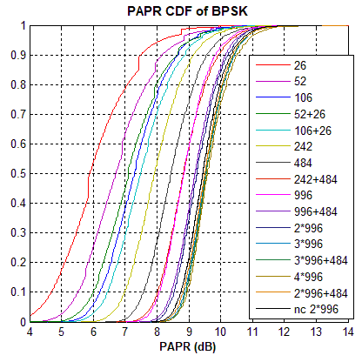
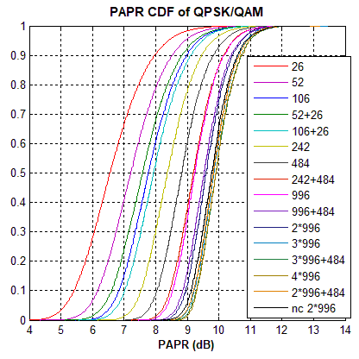
Appendix. PAPR CDF of Data parts

