Slide 1
2x EHT-LTF sequence

Slide 2
Introduction
I suggested EHT-LTF sequences for 320MHz in [1].
I generated 1/2/4x EHT-LTF sequences based on HE-LTF sequence, but 2/4x LTF has somewhat high PAPRs in some RUs.
So here I considered the further optimization of 2x EHT-LTF sequence.

Slide 3
2x EHT-LTF sequence based on HE-LTF
I suggested 2x EHT-LTF sequences based on HE-LTF as it is in [1]. But as I said, any combinations can’t put PAPRs under Data’s median in 2x LTF.
  At that time, I found the sequences with 1 stream. Here I re-select the sequence as below with multi-stream and the results are similar.
  EHTLTF_{320MHz_2x} = {LTF_{80MHz_1st_2x}, 23 zeros, LTF_{80MHz_2nd_2x}, 23 zeros, LTF_{80MHz_3rd_2x}, 23 zeros, LTF_{80MHz_4th_2x}}
    LTF_{80MHz_1st_2x} = {s(1)*LTF_{80MHz_part1_2x}, s(2)*LTF_{80MHz_part2_2x}, s(3)*LTF_{80MHz_part3_2x}, s(4)*LTF_{80MHz_part4_2x}, s(5)*LTF_{80MHz_part5_2x}}
    LTF_{80MHz_2nd_2x} = {s(6)*LTF_{80MHz_part1_2x}, s(7)*LTF_{80MHz_part2_2x}, s(8)*LTF_{80MHz_part3_2x}, s(9)*LTF_{80MHz_part4_2x}, s(10)*LTF_{80MHz_part5_2x}}
    LTF_{80MHz_3rd_2x} = {s(11)*LTF_{80MHz_part1_2x}, s(12)*LTF_{80MHz_part2_2x}, s(13)*LTF_{80MHz_part3_2x}, s(14)*LTF_{80MHz_part4_2x}, s(15)*LTF_{80MHz_part5_2x}}
    LTF_{80MHz_4th_2x} = {s(16)*LTF_{80MHz_part1_2x}, s(17)*LTF_{80MHz_part2_2x}, s(18)*LTF_{80MHz_part3_2x}, s(19)*LTF_{80MHz_part4_2x}, s(20)*LTF_{80MHz_part5_2x}}
    s(1)~s(20) = [+1, -1, -1, -1, +1, -1, +1, +1, +1, -1, -1, +1, +1, +1, -1, -1, +1, -1, -1, +1]
    The worst PAPR is 10.06dB in multi-stream and 9.97dB even in 1 stream, and many PAPRs are over BPSK median. (See the results in slide 7~11)

Slide 4
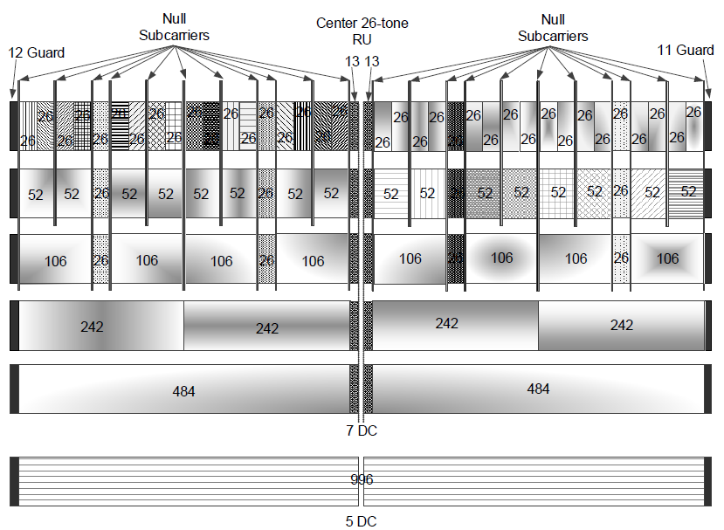
Proposed 2x EHT-LTF sequence (1/3)
Consideration on 2x HE-LTF sequence of 80/160MHz in 11ax
  HE-LTF sequence is optimized based on 26-tone RU including the location of pilots in 11ax.
  So the basis sequences (LTF_{80MHz_part1~5}) are matched with legacy 80MHz segment (-500: 500) as below. [2]
LTF_{80MHz_part1_2x} (-500~-259)
LTF_{80MHz_part2_2x} (-258~-17)
LTF_{80MHz_part3_2x} (-16~ +16)
LTF_{80MHz_part4_2x}(+17~+258)
LTF_{80MHz_part5_2x} (+259~+500)
< 80MHz tone plan in 11ax >

Slide 5
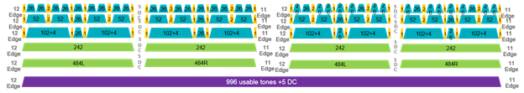
Proposed 2x EHT-LTF sequence (2/3)
But in 11be, 2x EHT-LTF sequence has to be considered in new 80MHz OFDMA tone plan
  11be 80MHz segments are changed as below. The center 26-tone RU are deleted and the location in 2nd and 3rd 242-tone RUs are also changed including pilots.[3]
  Therefore I suggested the basis sequences as below.
    LTF_{80MHz_part4_2x} and LTF_{80MHz_part2_2x} are changed each other due to the location of pilot and even tone sequence for 2x.
    Some parts of LTF_{80MHz_part3_2x} are moved to the shifted 5-tones.
LTF_{80MHz_part3_2x}
LTF_{80MHz_part1_2x}
LTF_{80MHz_part4_2x}
LTF_{80MHz_part2_2x}
LTF_{80MHz_part5_2x}
< 80MHz tone plan in 11be >

Slide 6
Proposed 2x EHT-LTF sequence (3/3)
Then, the proposed 2x EHT-LTF sequence is as below.
    EHTLTF_{-2036, 2036} = {LTF_{80MHz_1st_2x}, 23 zeros, LTF_{80MHz_2nd_2x}, 23 zeros, LTF_{80MHz_3rd_2x}, 23 zeros, LTF_{80MHz_4th_2x}}
    LTF_{80MHz_1st_2x} = {T(1)*LTF_{80MHz_part1_2x}, M₁, T(2)*LTF_{80MHz_part4_2x}, M₂, -M₃, T(3)*LTF_{80MHz_part2_2x}, -M₄, T(4)*LTF_{80MHz_part5_2x}}
    LTF_{80MHz_2nd_2x} = {T(5)*LTF_{80MHz_part1_2x}, -M₁, T(6)*LTF_{80MHz_part4_2x}, -M₂, M₃, T(7)*LTF_{80MHz_part2_2x}, M₄, T(8)*LTF_{80MHz_part5_2x}}
    LTF_{80MHz_3rd_2x} = {T(9)*LTF_{80MHz_part1_2x}, M₁, T(10)*LTF_{80MHz_part4_2x}, M₂, -M₃, T(11)*LTF_{80MHz_part2_2x}, -M₄, T(12)*LTF_{80MHz_part5_2x}}
    LTF_{80MHz_4th_2x} = {T(13)*LTF_{80MHz_part1_2x}, -M₁, T(14)*LTF_{80MHz_part4_2x}, -M₂, M₃, T(15)*LTF_{80MHz_part2_2x}, M₄, T(16)*LTF_{80MHz_part5_2x}}
    M₁= LTF_{80MHz_part3_2x}(1:5), M₂= LTF_{80MHz_part3_2x}(6:16), M₃= LTF_{80MHz_part3_2x}(17:28), M₄= LTF_{80MHz_part3_2x}(29:33) (the coefficients of Ms are selected by simulation.)
    T(1)~T(16) = [1 1 -1 -1 -1 -1 -1 -1 -1 -1 1 1 1 1 1 1]
The worst PAPR with multi-streams is 9.63dB. It shows better performance in comparison with the sequences to use 11ax as it is. The detail PAPRs are in the next slides.

Slide 7
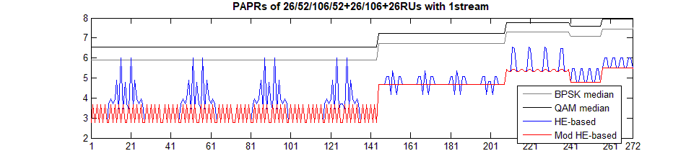
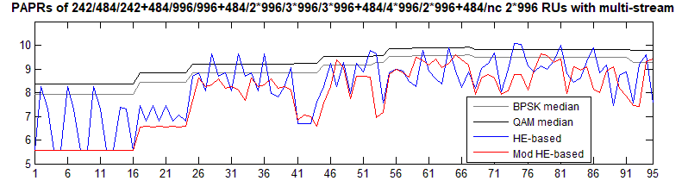
PAPR performance (1/5)
PAPRs of Small (M)RUs in 1 stream
  The modified HE-based sequence shows the stable PAPRs.
PAPRs of Large (M)RUs in multi-stream
  The modified HE-based sequence have lower PAPRs than HE-based sequence.

Slide 8
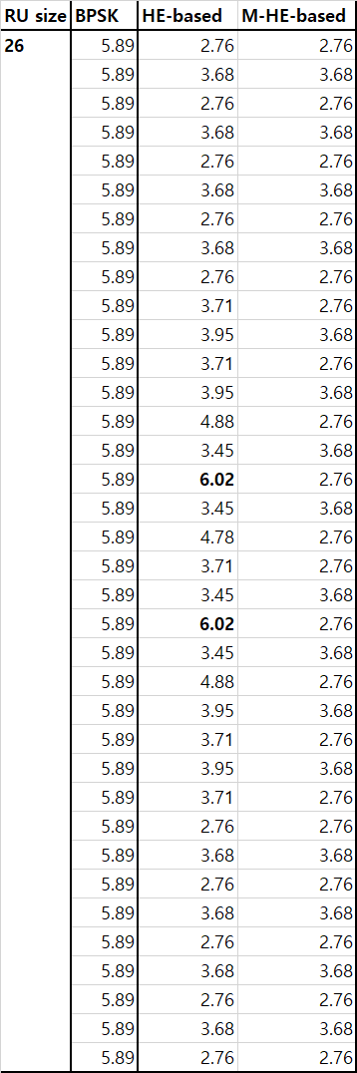
PAPR performance (2/5)
In Small RUs with 1stream

Slide 9
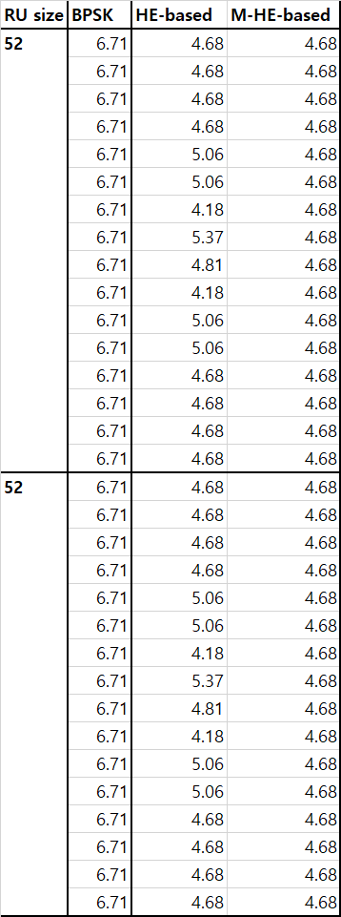
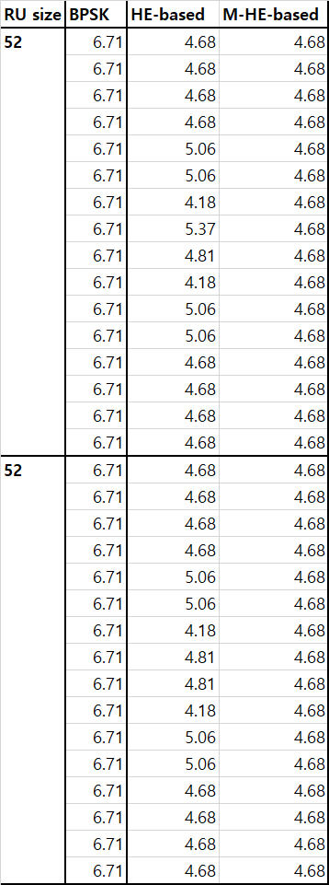
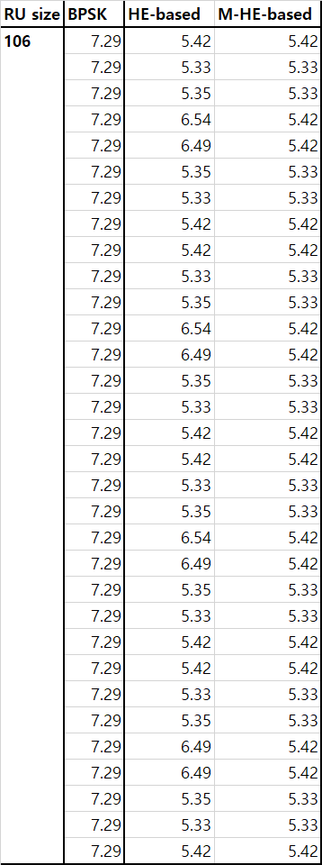
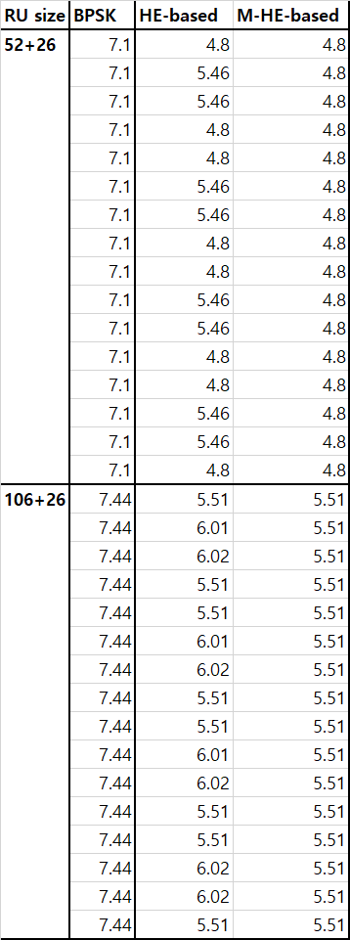
PAPR performance (3/5)
In Small RUs with 1stream (Cont’d)

Slide 10
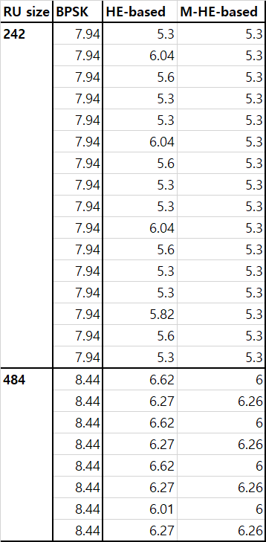
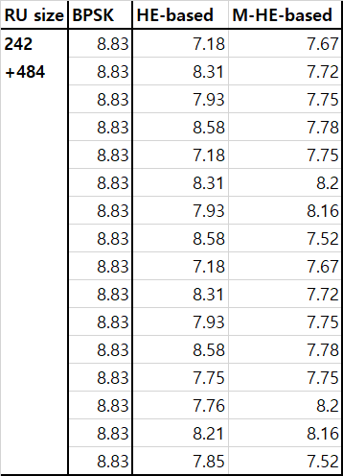
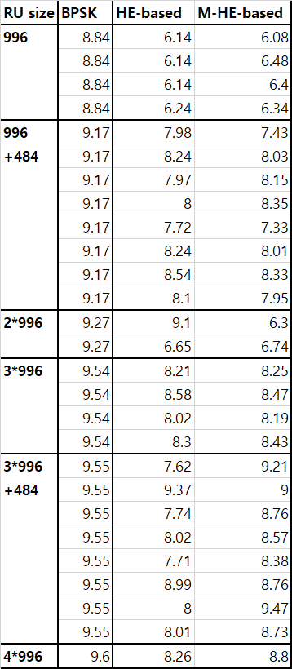
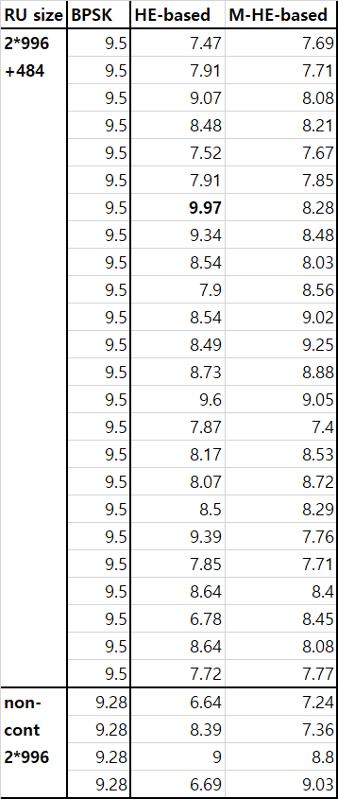
PAPR performance (4/5)
In Large RUs with 1stream

Slide 11
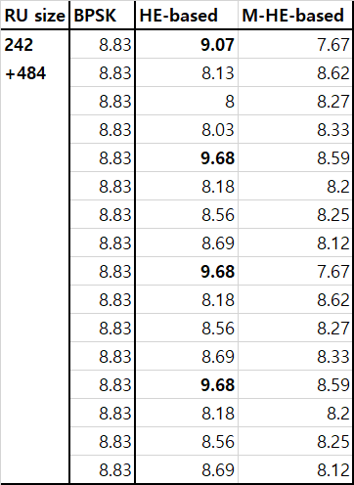
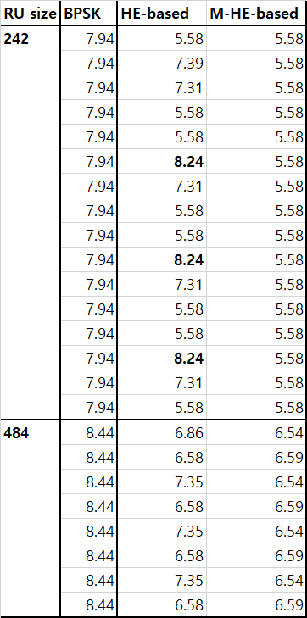
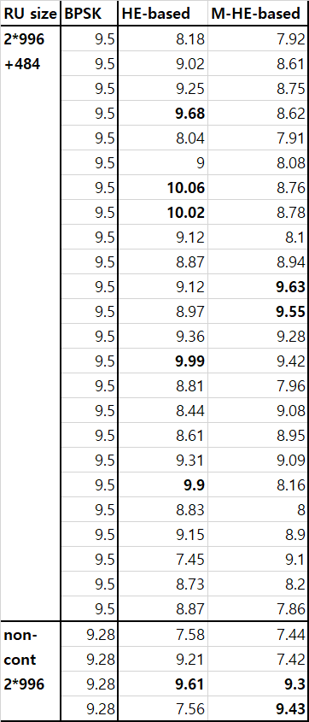
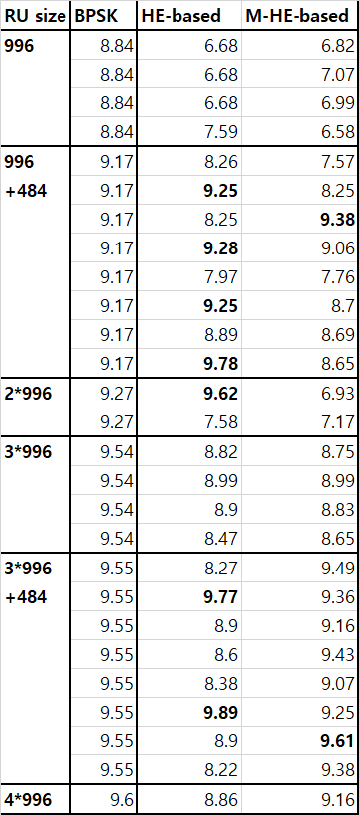
PAPR performance (5/5)
In Large RUs with multi-stream

Slide 12
Conclusion
I raised the issue to apply 2x HE-LTF to 2x EHT-LTF as it is.
  That’s because the 80MHz OFDMA tone-plan is changed and the PAPR of RUs in new tone plan of 11be are not optimized anymore.
  But we’d like to reuse HE-LTF sequences as possible.
Therefore I suggested defining 2x EHT-LTF sequence based on the modified 2x HE-LTF.
  Legacy 2x HE-LTF sequence consists of 5 parts, which are fit to 242RU, 242RU, center 26RU, 242RU, and 242RU in 11ax.
  So we can easily make 2x EHT-LTF sequence by shifting some of the center parts and changing 2nd and 4th parts each other.

Slide 13
Reference
[1] IEEE802.11-20/0825r1, “EHT-LTF sequences considering new tone plan”
[2] IEEE P802.11ax/D5.0
[3] IEEE802.11-19/1262r11, “Specification Framework for TGbe”

Slide 14
SP 1
Do you agree to add the below text in 11be SFD?
  In a 320MHz transmission using a 2x EHT-LTF, the 2x EHT-LTF sequence is given as below.
    EHTLTF_{-2036, 2036} = {LTF_{80MHz_1st_2x}, 0, 0, 0, 0, 0, 0, 0, 0, 0, 0, 0, 0, 0, 0, 0, 0, 0, 0, 0, 0, 0, 0, 0, LTF_{80MHz_2nd_2x}, 0, 0, 0, 0, 0, 0, 0, 0, 0, 0, 0, 0, 0, 0, 0, 0, 0, 0, 0, 0, 0, 0, 0, LTF_{80MHz_3rd_2x}, 0, 0, 0, 0, 0, 0, 0, 0, 0, 0, 0, 0, 0, 0, 0, 0, 0, 0, 0, 0, 0, 0, 0, LTF_{80MHz_4th_2x}}
    LTF_{80MHz_1st_2x} = {LTF_{80MHz_part1_2x}, +1, 0, -1, 0, -1, LTF_{80MHz_part4_2x}, 0, -1, 0, +1, 0, +1, 0, +1, 0, 0, 0, 0,
    0, 0, 0, -1, 0, +1, 0, +1, 0, -1, 0, -LTF_{80MHz_part2_2x}, -1, 0, +1, 0, -1, -LTF_{80MHz_part5_2x}}
    LTF_{80MHz_2nd_2x} = {-LTF_{80MHz_part1_2x}, -1, 0, +1, 0, +1, -LTF_{80MHz_part4_2x}, 0, +1, 0, -1, 0, -1, 0, -1, 0, 0, 0, 0,
    0, 0, 0, +1, 0, -1, 0, -1, 0, +1, 0, -LTF_{80MHz_part2_2x}, +1, 0, -1, 0, +1, -LTF_{80MHz_part5_2x}}
    LTF_{80MHz_3rd_2x} = {-LTF_{80MHz_part1_2x}, +1, 0, -1, 0, -1, -LTF_{80MHz_part4_2x}, 0, -1, 0, +1, 0, +1, 0, +1, 0, 0, 0, 0,
    0, 0, 0, -1, 0, +1, 0, +1, 0, -1, 0, LTF_{80MHz_part2_2x}, -1, 0, +1, 0, -1, LTF_{80MHz_part5_2x}}
    LTF_{80MHz_4th_2x} = {LTF_{80MHz_part1_2x}, -1, 0, +1, 0, +1, LTF_{80MHz_part4_2x}, 0, +1, 0, -1, 0, -1, 0, -1, 0, 0, 0, 0,
    0, 0, 0, +1, 0, -1, 0, -1, 0, +1, 0, LTF_{80MHz_part2_2x}, +1, 0, -1, 0, +1, LTF_{80MHz_part5_2x}}
  LTF_{80MHz_part1_2x}, LTF_{80MHz_part2_2x}, LTF_{80MHz_part4_2x} and LTF_{80MHz_part5_2x} are used as it is in 11ax.
  Y/N/Abs

Slide 15
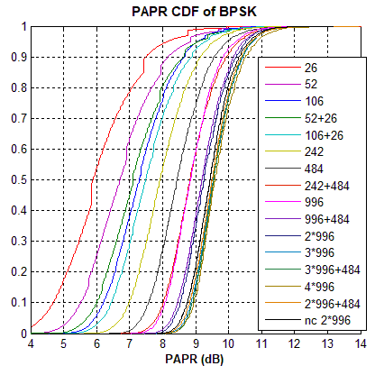
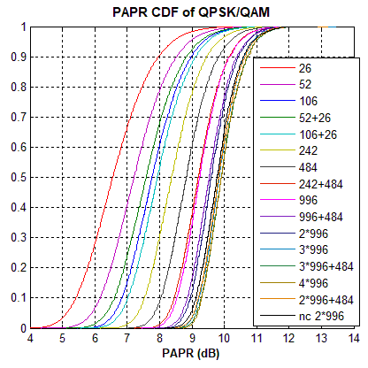
Appendix. PAPR CDF of Data parts

