Slide 1
Prioritized EDCA Access Slot Management
Date: 2020-07-29
Name | Affiliations | Address | Phone | email
Chunyu Hu | Facebook Inc. | 1 Hacker way Menlo Park, CA |  | chunyuhu@fb.com
Payam Torab |  |  |  | torab@ieee.org

Slide 2
Abstract
Background: new medium access method to provide more predictable, and prioritized channel access (11-20/408r3)
First part discusses traffic classification/signaling option to support it
Second part discuss the slot management handshake

Slide 3
Various Client Device (non-AP STA) Scenarios
Typically all traffic are destinated to AP STA
Note: TDLS / peer-to-peer links create multi-RA case, see NEXT slide / AP.
Wearable devices: a device is designed to carry latency sensitive traffic
➔ all traffic originated from/to this STA are desired to be prioritized
(there can be some small portion of application mgmt/control traffic)
A general computing device is running two types of traffic that falls into two categories: e.g. use BE/BK for regular traffic, and VI/VO for latency sensitive traffic; and they do not overlap
➔ traffic originated from and/or to this STA, affiliated with specific TID(s), can be prioritized; and rest remain as regular traffic
A general computing device is running multiple applications. Two of them are using the same VI, but one is latency sensitive (real-time interactive traffic, e.g. AR/VR), and one is regular (video subscription, e.g. Netflix)
➔ (RA, TID1/AC) and (RA, TID2/AC) differentiate the access service provided to each of these flows, provided they map to different access priority

Slide 4
AP STA Case
Traffic destinated to multiple clients (or the same client) with different DSCPs values co-exists
STA scenarios are special cases of AP
Note: DSCP has 6 bits, ranging in 0-63. Different DSCP values might map to a single TID and/or single AC
AP has the following info available:
Packets from IP layer carries {RA, DSCP}
DSCP maps to TSID / UP
Ether frame carries 802.1Q tag:
802.1Q tag → UP 0-7 / TID
Additional info from STA:
Attribute that can be attached to STA: operating mode
Can differentiate among STAs in internal queue management
Attribute that can be attached to the STA for a specific TID (for upstream)
Downstream traffic might indicate low QoS priority which can be remapped to a higher priority based on a mirroring of similar traffic travelling in the upstream direction (MSCS)

Slide 5
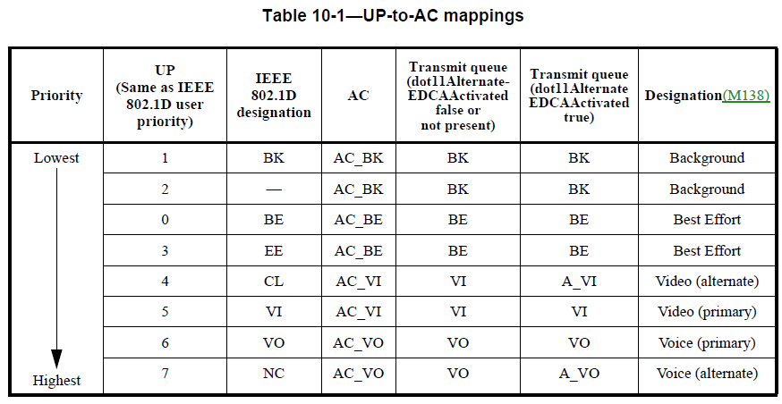
Consideration in (New) TID/TSID/AC
Classification steps:
Input: {RA, DSCP, 802.1Q UP}
➔ {RA, TSID, UP} internal (logic) queues
Tools: QoS mapping, TCLAS
➔ {RA, TID/UP} internal queues
Each (RA, TID) is associated with a BA agreement, and share a common sequence number space
Multiple TSIDs can be mapped into one TID, but doing so causes HOF blocking issue
Question: at any given time period, for all applications running on a non-AP STA, as a source or sink node, do we need more than 8 or even 6 different quality of service streams over one link?
Does the link even capable of providing that many differentiated channel access?
(Answer: no, we don’t really need to, and should avoid so if feasible/practical.)

Slide 6
Proposal
Classify traffic to (RA, TID -- L-marker)
L-marker = 1: latency sensitive traffic, associated with whatever mechanism AP/network enables to differentiate from regular traffic
L-marker = 0: regular traffic
Constraint: for the same (RA, TID) pair, there is only one L-marker value for the corresponding traffic stream at any given time
*: if TID range to be used in 11be is extended beyond 7, then extend range as well.
Options for signaling:
When establishing BA session, indicate if the associated TID (0-7) is desired to be served as latency sensitive traffic
Cons: may still want to transfer without a BA session. If don’t mind this limitation, could be a good option
Use a new IE following the Intra-Access Priority field that signals for alternateEDCA
User priority bitmap (16 bits) : each bit, if set, indicates being mapped/requested to use prioritized service over regular traffic
Use signaling as part of slot request/response handshake frames
Similar to ADDTS e.g.
TBD

Slide 7
Preferred Option
Options for signaling:
Create a slot assignment request/response frame exchange sequence
Create a field that has 16bits: bit x = 1, means TID x carries latency sensitive traffic
Any TID can be latency sensitive traffic, and follows corresponding medium access rule per P-EDCA
DSCP → UP mapping can use any of existing mechanisms, namely:
QoS map
TCLAS (used in conjunct with ADDBA e.g., but not limited to)
Note: TCLAS can be used in ADDBA
Expected operation flow:
Association, authentication
ADDBA (with TCLAS)
SLOT-ADD-REQ/RESP with per UP L-marker bitmap
Notes:
Q: if using TCLAS with ADDBA, does it redefine TID->UP definition and the TID in BA params == UP?
Q: consider if to introduce in MAC SAP a new primitive to indicate L-marker for a specific TID

Slide 8
Examples
Example 1: A STA marks any of 8 UPs/TIDs as latency sensitive, requesting corresponding service provided over the link
Example 2: A STA marks a subset of UPs/TID 0-7 as latency sensitive
Example 3: If traffic destinated to the same STA has both latency sensitive and regular traffic for the same AC, there are still at least 4 TID values for default/regular {BE,BK,VI,VO} traffic, the others (one or more) can be used for latency sensitive traffic.
QoS Mapping allows AP maps DSCP to UP with great flexibility
STA can also use TCLAS element in conjunction with ADDBA request to classify MSDU to desired TID/UP

Slide 9
Work Together with Prioritized EDCA Channel Access per 11-20/408
Traffic classified with {L-marker = 1} are transmitted over slot registered for prioritized access as described in 11-20/408 (next contribution is WIP)
Traffic with {L-marker=0} follows regular EDCA access
MAC switches transmit AC queues to serve queues of {L-marker=0} and {L-marker=1} multiplexed over time
Notes:
Add a parameter

