Slide 1
Prioritized EDCA Channel Access
Date: 2020-07-29
Name | Affiliations | Address | Phone | email
Chunyu Hu | Facebook Inc. | 1 Hacker way Menlo Park, CA |  | chunyuhu@fb.com
Payam Torab |  |  |  | torab@ieee.org
Muhammad Kumail Haider |  |  |  | haiderkumail@fb.com

Slide 2
Abstract
Background: new medium access method to provide more predictable, and prioritized channel access (11-20/408r6)
This contribution provides more details on channel access design, and associated signaling.

Slide 3
Time Slot Structure
The time is divided into slots of fixed, and configurable duration Ts
  The duration Ts is intended to be at txop level of granularity, long enough to hold one or more data frame exchange: rts/cts/a-mpdu/ba.
  Slot boundary is at time Ts, 2*Ts, …., (time satisfying (TSF % Ts) == 0)
  This provides a scalable way to represent medium/schedule status and can be conveniently described using a bitmap format
    E.g. a service period (SP) can be represented by a consecutive number of slots
    AP can share medium status or schedule info in slot bitmap format
      Good for both intra-BSS and inter-BSS coordination

Slide 4
Periodicity
The link may be able to share a common, periodic interval T, composed of fixed, and configurable number of slots. Interval boundary is at (TSF % T == 0).
  Example: two periodic streams with respective intervals: 16 TUs and 14 TUs ➔ AP can use an interval of 112 TUs
  Pros:
    Help non-AP STA to predict slot occupancy without receiving the beacon before contending for the medium
    Simplify the checking overlap / over-subscribing the utilization of a slot
    Beneficial for applications of similar characteristics
  Con: not realistic/practical all the time – it may require a very long bitmap. E.g. T1 = 200 TUs, T2 = 300 TUs and Ts = 1TUs.
    Usually it’s difficult to do so if one stream has small interval and the other has large interval – high/low bandwidth traffic
Propose: define maximum slot bitmap size, e.g. 256 bits. If possible to derive a common period T = N * Ts with N limited to maximum size, then AP can indicate if the schedule/slot bitmap info is repetitive/persistent

Slide 5
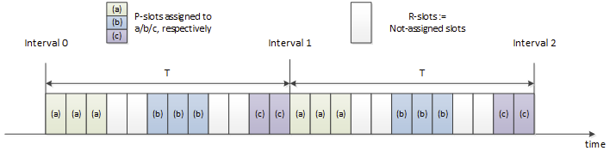
Definitions
Example where a period T is assumed: three non-AP STAs and one AP.
Terms:
  P-slot: a slot is called P-slot if the AP has assigned that slot to any STA(s) for prioritized access.
  R-slot: A slot is called R-slot if none of STA has requested this slot.
  MP-slot: from a STA’s perspective, if the slot has been assigned to this STA (there can be multiple STAs assigned to the same slot however.)
  OP-slot: from a STA’s perspective, it is not registered for this P-slot’s membership.

Slide 6
EDCA Parameters and Terms
Default EDCA parameters: used by regular traffic for channel access.
A second set of EDCA parameters: used by P-traffic to access P-slots. Called P-EDCA params.
Regular traffic (R-traffic) uses a backoff timer, timer-1, to access the channel.
Prioritized traffic (P-traffic) uses a second backoff timer, timer-2, to access the channel during P-slots.
Alternative AIFS (A-AIFS): AIFS value used by timer-1 during P-slots to determine if channel has become idle to resume counting down.

Slide 7
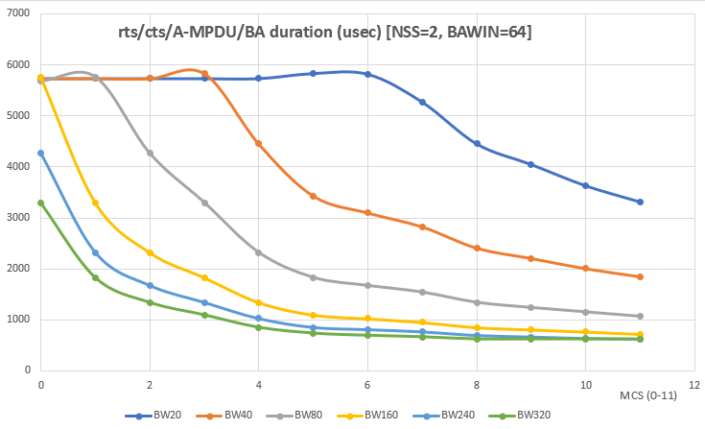
General Descriptions
AP advertises the following parameters:
  Slot duration: S TUs. E.g. ½, 1, 2, 4 TUs
  Interval T: T = N slots
  P-EDCA params
  A-AIFS
  Any additional TBD parameters as needed.
AP advertises the above info in Beacons, Probe responses and applicable management/action frames.
Each STA can request assignment of slots for DL/UL/p2p traffic. The STA can request multiple contiguous number of slots. A slot can be assigned to multiple STAs to conduct MU operation.
  A group of contiguous slots forms a service period (SP).
  Details of slot management are discussed in later slides.
Notes:
Comment: concern on beacon bloating.

Slide 8
Channel Access: General Principal
Assumed P-traffic pattern:
  Periodic
  Bursty: have packets ready at beginning of their MP-slots
  Traffic amount may vary due to fluctuation in application as channel/rate dynamics
Provide P-traffic prioritized access during P-slots
Handle certain range of traffic amount variants of P-traffic in each interval
  Protect beginning of a SP: tolerate small variants of time packets being ready
  Protect SP period when bursty P-traffic is undergoing: A-AIFS for R-traffic and default EDCA parameters
  Release SP period automatically when bursty P-traffic completes without requiring explicit signaling
Notes:
1) From a P-STA perspective

Slide 9
Backoff Behavior for R-Traffic
When there is no P-slots:
  When no STAs register any slot at AP, that is, there is no R-slots, then regular traffic access the channel following default EDCA access using default EDCA parameters. The channel access is not different from existing EDCA behavior.
When there are some P-slots:
  Regular traffic is not allowed to start transmission during a time window X usec before entering the P-slot boundary, and Y usec after the boundary. X, Y TBD, advertised by AP.
  If timer-1 is running, then suspend timer-1 X usec before the illustrated slot boundary, and can resume Y usec after the slot boundary. If medium is busy not due to its own transmission, then the slot is deemed as occupied (assumingly by its registered member), and the STA shall give priority to it – to that end, until the STA successfully win the medium, it uses a newly defined A-AIFS to decide if medium has become idle and resume timer-1 counting down.
  If timer-1 counts to 0 but didn’t have sufficient time for its transmission due to R->P slot boundary, re-generate backoff from CW.

Slide 10
Backoff Behavior for Prioritized Traffic
Medium access to MP-slots
  In general, timer-2 is not run and is suspended out of MP-slots. When MP slots start, timer-2 resumes (or reset CW to CWmin, and generate a new backoff value from current CW. TBD).
  Packets from P-traffic are transmitted using timer-2 during MP slots. If the STA doesn’t have any packets from P-traffic any more, it can use timer-1 to contend medium access for its regular traffic as described in previous sections.
  If the P-traffic for the current interval didn’t complete when MP-slots end, the STA may still transmit them, but follows the medium access rule for regular traffic.
Medium contention among STAs sharing the same SP / MP-slots
  The slot(s) can be assigned to
    a non-AP STA for its DL and/or UL traffic,
    multiple non-AP STAs for their DL and/or UL traffic, or
    peer-to-peer transmissions.
  STAs that have registered the slots’ membership contend medium access among themselves. To further mitigate the contention and reduce collision, the STAs can use any applicable mechanisms. For example, AP can use trigger frames to manage both DL and UL transmissions if the non-AP STA supports it. For another example, AP can use triggered P2P transmission procedure [11-20/813r6] to coordinate the peer-to-peer communication.

Slide 11
Slot Boundary (1)
For regular traffic:
  Regular traffic shall stop at a slot boundary when a slot transits from R-slot to P-slot.
  If the regular traffic wins the medium access during P-slots, its txop shall stop at the slot boundary, unless it knows the next slot belongs to the same STA(s) as the current P-slot. AP provides additional slot bitmap info for this purpose.

Slide 12
Slot Boundary (2)
For P-traffic:
  When transmitted during the MP-slots, the current txop shall end at the boundary of MP → OP slot.
  When transmitted during the MP-slots, the current txop should end at the boundary of MP → R slot, but is allowed to extend to next slot (but not beyond.)
  When transmitted during R-slots, follow the regular traffic rule.

Slide 13
Support of Peer-to-Peer Communication
The Peer-to-Peer communication can be prioritized as well
Some examples of peer-to-peer links:
  TDLS: either non-AP STA can request slot membership for their P-traffic, and follow corresponding channel access rules
  Tethered link using P2P (GO/GC): GO as non-AP STA associated with the AP, and request slot membership for the P-traffic carried over the p2p link
  Tethered link using SoftAP: similar to above
Additional tools that can be used to mitigate contention and improve efficiency:
  Trigger based access if SoftAP/GO supports it
  Triggered P2P communication [11-20/813r6]
Note: the slot assigned to the peer-to-peer communication, depending on supported frame sequence, may have to be limited to be exclusive to the peer-to-peer communication (not shared with other peer-to-peer links)

Slide 14
A Special, Simplified Configuration
If all prioritized traffic falls into the following cases, then we can disable EDCA for regular traffic during P-slots completely and uses A-AIFS sensing to resume regular traffic after prioritized traffic completes. This simplifies design but sacrifices flexibility.
  DL: AP transmits to associated non-AP STA
  UL: AP uses trigger frame to poll UL packets
  Peer-to-peer:
    “DL”: softAP/GO → its associated STA(s)
    “UL”: SoftAP/GO uses trigger based for its UL traffic
    Use the newly defined trigger based P2P frame sequence
Configuration:
  Don’t need a second set of EDCA parameters since all transmissions are initiated only by one designated STA.
  A-AIFS: STAs with regular traffic use A-AIFS to determine if the prioritized access has completed early.
  Only need existing backoff timer
Notes:
Special configuration keys:
Disable EDCA
Boundary handling
One timer with A-AIFS change during P-slots
(trigger-only?)
Time slot structure
Protected / boundary
If it’s triggered only is secdonary

Slide 15
Simulation
BSS and traffic configuration:
  1AP and a number non-AP STAs
  4 non-AP STAs with P-traffic: period 16 TUs, DL 80Mbps, UL 20Mbps UL
  Varying number of non-AP STAs with DL full buffer regular traffic: from 0 to 8
MAC/PHY Parameters
  BW 80MHz, P-traffic nss2 mcs9, regular traffic nss2 mcs1
  Use rts/cts, BA win 64, amsdu: 2 msdus per A-MSDU
P-EDCA Parameters
  Slot duration S = 1 TU, X=50 usec, Y= 100 usec, A-AIFSN=9
  Schedule:

Slide 16
Compare Three Schemes
Methodology: Compare throughput/delay of three schemes:
  Default (AC-BE): default EDCA with all traffic using AC-BE
  Default (AC-VO): default EDCA with P-traffic using AC-VO (with txop=0) and R-traffic using AC-BE
  P-EDCA: P-traffic uses AC-VO in assigned slots, R-traffic uses AC-BE
Increase number of non-AP STAs with full buffer traffic
Metrics: P-traffic delay, throughput

Slide 17
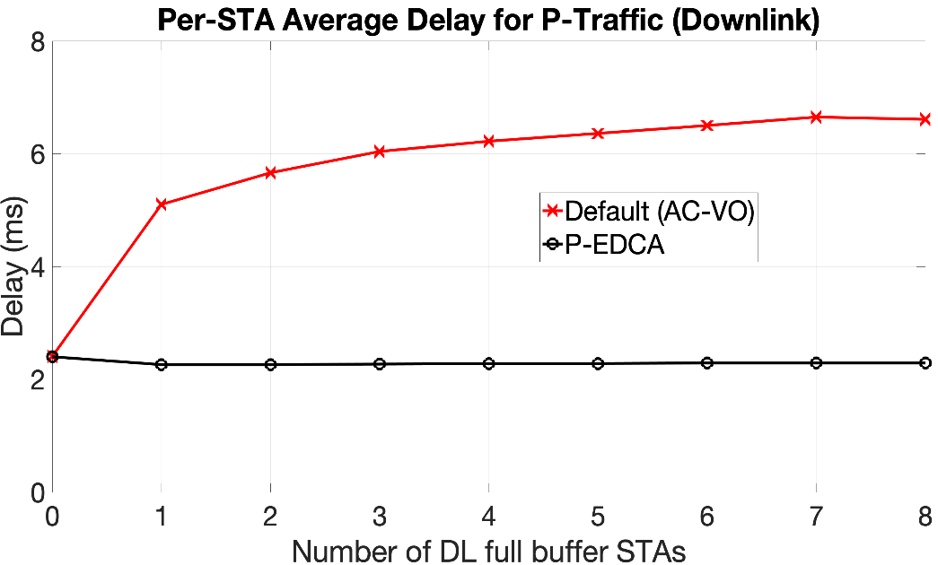
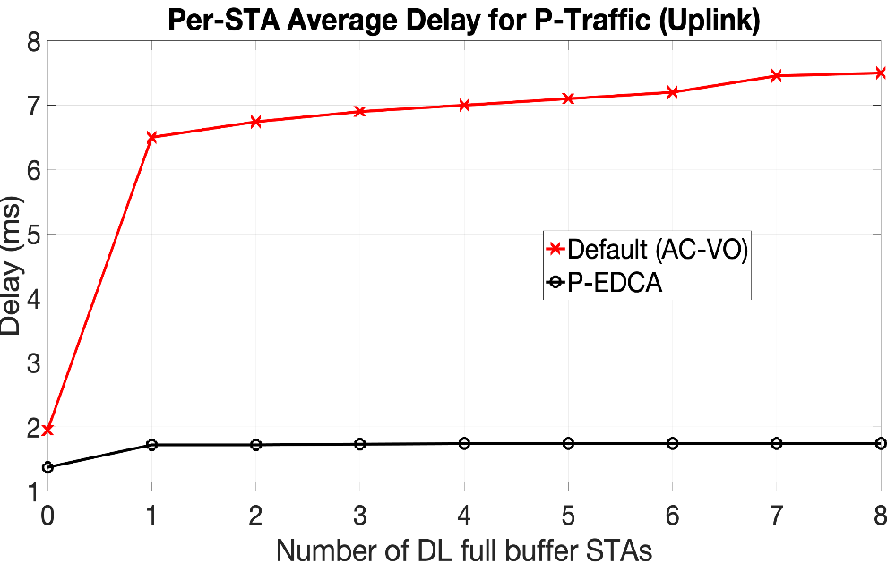
Simulation Results
Delay (queueing + medium access) comparison for DL/UL P-traffic
Observations:
  P-EDCA reduces mean latency in DL by ~4ms and UL by ~5ms
  Latency for default EDCA using VO increases as full buffer traffic stream increases, while for P-EDCA delay remains nearly unaffected
  Full buffer traffic slightly increases UL latency as P-traffic uplink stream may collide with DL full buffer traffic.

Slide 18
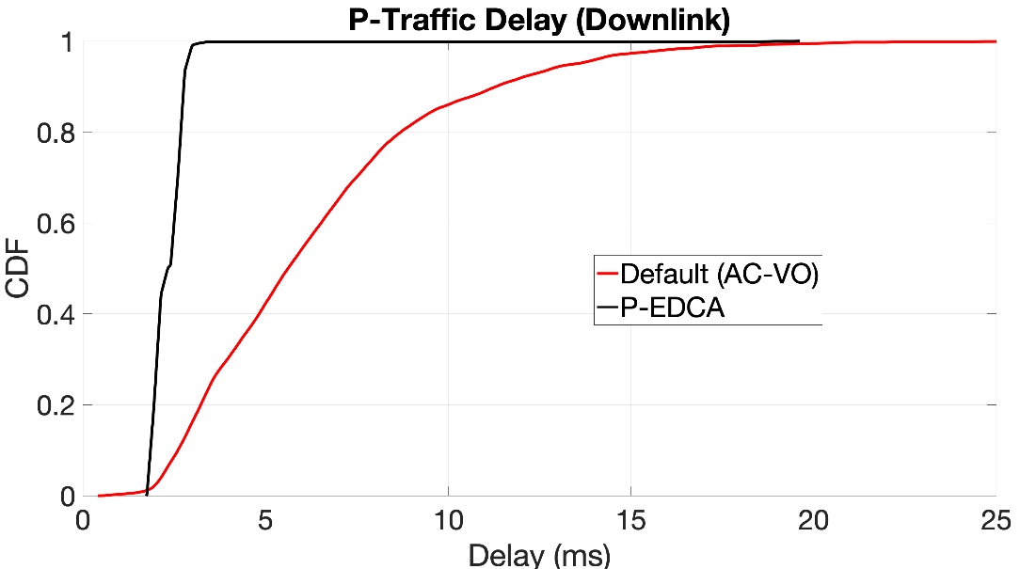
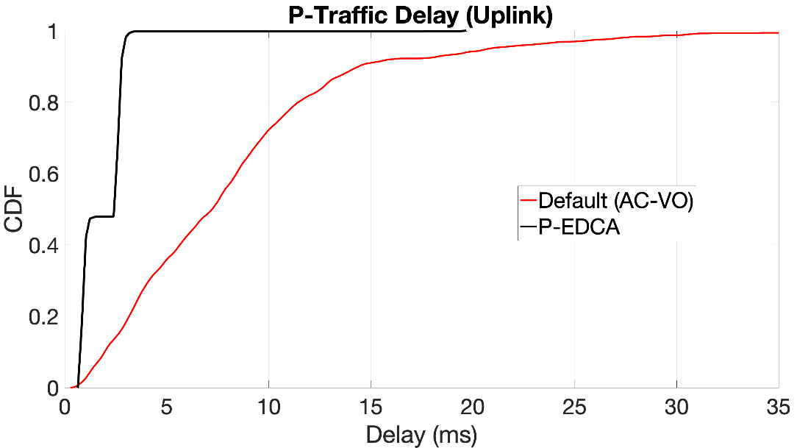
Results
Delay CDFs for P-traffic (6 full buffer non-APSTAs case)
Main observation:
  P-EDCA improves worst case of UL/DL delay compares to default EDCA AC-VO very effectively, showing the criticalness of distributing and protected prioritized access
Notes:
(some notes are in backup slide)

Slide 19
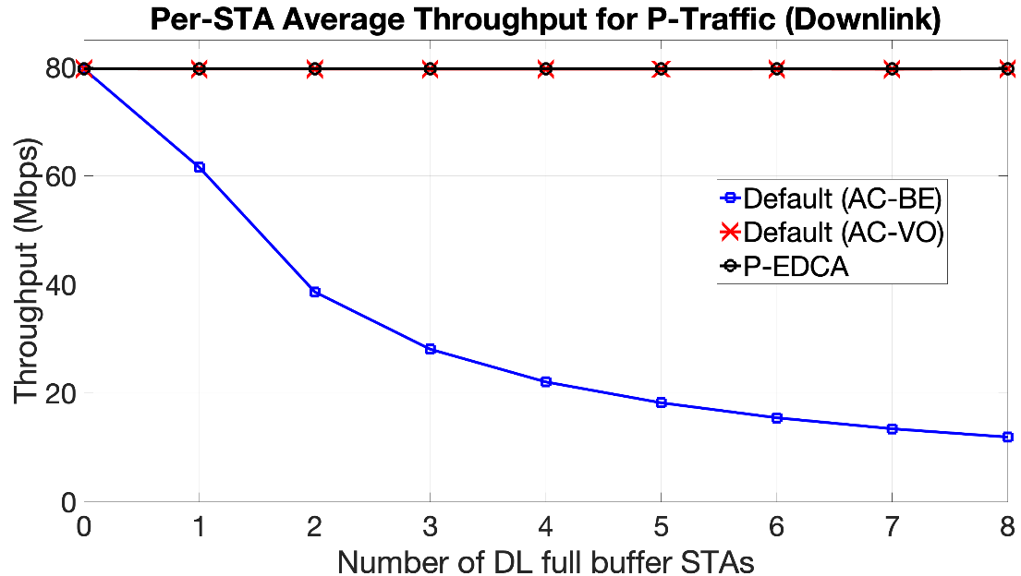
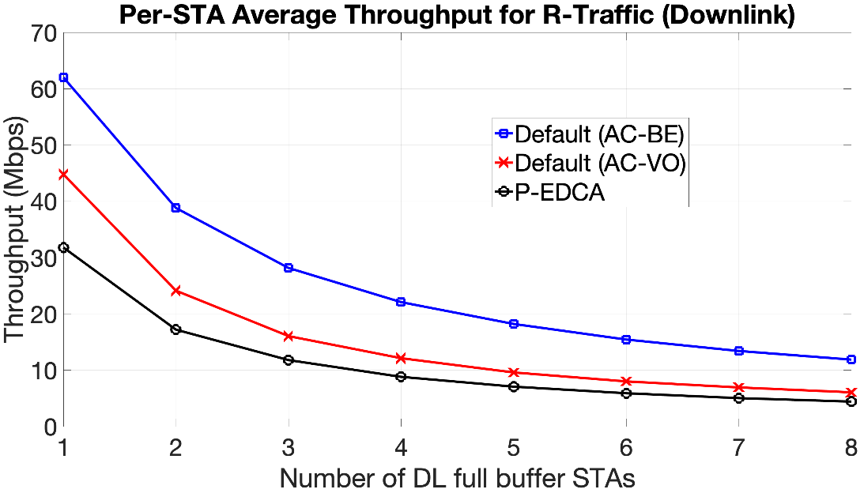
Results
Average DL throughput:
Observations:
  For P-traffic (left), both Default (AC-VO) and P-EDCA get 80Mbps. Default (AC-BE) cannot meet the throughput requirement as downlink access is shared equally between R and P traffic
  For R-traffic, P-EDCA gets some penalty due to slot boundaries and A-AIFS. However, the gap between Default (AC-VO) and P-EDCA closes as the full buffer traffic increases

Slide 20
Slot Assignment To Traffic Stream

Slide 21
Various Scenarios at STAs
At top level a traffic stream is classified per (RA, TA/DST)
  ➔ slots can be assigned to a STA’s DL/UL/P2P traffic
  A STA may have mixed regular and latency sensitive traffic to/from it. See below.
Wearable devices: a device is designed to run latency sensitive applications
  ➔ all traffic originated from/to this STA are desired to be prioritized
    (there can be some small portion of application mgmt/control traffic)
A general computing device is running two types of traffic that falls into two categories: e.g. use BE/BK for regular traffic, and VI/VO for latency sensitive traffic; and they do not overlap
  ➔ In this case, traffic can be differentiated based on AC
A general computing device is running multiple applications. Two of them are using the same VI, but one is latency sensitive (real-time interactive traffic, e.g. AR/VR), and one is regular (video subscription, e.g. Netflix)
  ➔ (RA, TID1/AC) and (RA, TID2/AC) differentiate the access service provided to each of these flows, provided they map to different access priority

Slide 22
Proposal
Associate each traffic stream classified per (source/destination, TID) with an attribute: L-marker
  L-marker = 1: latency sensitive traffic, associated with whatever mechanism AP/network enables to differentiate from regular traffic
  L-marker = 0: regular traffic
Options for signaling:
  When establishing BA session, indicate if the associated TID is desired to be served as latency sensitive traffic
    Cons: may still want to transfer without a BA session. If don’t mind this limitation, could be a good option
  Use a new IE containing a bitmap:
    Each bit, if set, indicates being mapped/requested to use prioritized service over regular traffic
  Use a field as part of slot request/response handshake frames

Slide 23
Example:
Queues @ AP

Slide 24
Slot Information Description

Slide 25
Slot Information
A slot bitmap in slot request/grant/reporting frames
  Share schedule info
  Let non-AP STA know the available slots to sign up
  Share with OBSS STAs
Slot duration: can be ½, 1, 2, 3, 4, 5, 6 …, TUs. Can use coded/calculated value (TBD).
Period: indicate period in number of slots. = 0: non-periodic.
Persistency:
Two types of bitmaps:
  Status bitmap: indicate occupancy, request or assignment: 1 bit per slot.
  Information bitmap: 4 bits per slot – [ p2p | OBSS | trigger-only | Full ]
    Full: the slot doesn’t accept any new member.
    Trigger-only: this slot uses trigger-only frame sequence
    OBSS: this slot is occupied by OBSS traffic
    P2p: this slot is assigned to p2p traffic

Slide 26
An Example Format Design
Slot Dur (value a): Duration is calculated as (value + 1) * ½ TUs. Another option: 2 ^ (a-1) TUs.
Bitmap Len (value c): # of slots included in the bitmap. The status bitmap has ceil(c/8) octets.
Information Bitmap Present: indicates if <Information Bitmap> is present.
Period (value b): = 0 : non-periodic; > 0 : periodic with b slots as period
Persistence: indicate number of TBTTs during which the indicated info is valid
Status Bitmap: has ceil (c / 8) octets. The padding bits are set to 0. Each bit indicates the status of the slot: occupied or requested or assigned.
Information Bitmap: has ceil (c / 2) octets. Every four bits for a slot:
  Bits 3-0 : p2p | OBSS | triggered-only | full

Slide 27
Carrying Frames
Reporting frames:
  Beacon, probe response or any applicable reporting frame(s): AP advertise slot configuration (dur, period), status and information bitmaps.
  Create slot info IE
Slot request/response frames:
  Create new action frames for handshake
  Can be carried in TWT frames to request TWT schedule and slot access
  In addition to slot information, has additional request/assignment info
Slot termination frame or field
Any applicable / TBD frames to conduct inter-BSS access coordination

Slide 28
Slot Requesting Frames
<Slot Information> field setting:
  Slot duration: shall set to same as AP’s
  Period: indicate period. = 0: once.
  Status bitmap: indicates requested slots
  Information bitmap: set <p2p> bit to 1 if requesting for tethered link
<Slot Control> field:
  Request type:
    New or change: replace existing schedule associated with this STA
    Add: additional slot request (existing ones remain)
  Flexible slot offset indicator:
  Exclusive indicator: indicate if okay to share slots with other STA(s)
  <minSlots, minRU, minNSS>:
    minSlots: minimum number of slots requested assuming <minRU> and <minNSS>
    MinRU: minimum RU needed, in case OFDMA is in use
    MinNSS: minimum NSS needed, in case MU-MIMO is in use

Slide 29
Slot Utilization Monitoring
AP monitors the utilization of slots, and may force release or change assignments

Slide 30
Summary
Proposed a general channel access method and associated signaling to provide a more predictable latency / throughput performance
  Operate on a time slot structure and support periodic traffic
  Scalable approach for both intra-BSS and inter-BSS schedule coordination
Can be used in combination with other power saving mechanisms such as TWT and U-APSD for example.
Existing:
Proposing:
+
U-APSD e.g.
BCAST/Individual TWT
pEDCA
+
TWT
Time
Time Slot structure

Slide 31
SP #1
Do you support that the TGbe SFD shall include (in R1):
  An optional mechanism of dividing medium time into slots of duration TBD during which prioritized EDCA access operates for specifically allowed STAs

Slide 32
SP #2
Do you support that the TGbe SFD shall include (in R2):
  An optional mechanism of dividing medium time into slots of duration TBD during which prioritized EDCA access operates for specifically allowed STAs

Slide 33
SP #3
Do you support the TGbe SFD shall include (in R1) a channel access enhancement that provides a more predictable latency performance:
  A protected service period (P-SP) where AP assigns to STAs (members) based a TBD handshake negotiation.
  For the members, there can be various cases where medium access is either EDCA and/or trigger based. AP and non-AP STAs should use available mechanism to mitigate and minimize contention.
  For the non-members,
    They shall end txop before start of P-SP
    They cannot transmit during a small TBD window at start of P-SP.
    They can start competing the medium subject to any existing NAV/CCA protection rule

Slide 34
SP #4
Do you support that the TGbe SFD shall support (in R1):
  A TBD signaling procedure that indicates a traffic stream classified per (source, destination, TID) carries latency sensitive traffic

Slide 35
SP #5
Do you support that the TGbe SFD shall support (in R1):
  AP advertises prioritized channel time periods in TBD format that provides the utilization status as well as more detailed information.
  A signaling procedure for AP to assign certain time period to requesting STA(s)
  The time period is described using a TBD time slot bitmap format assuming the medium time is divided in TBD slot duration.

Slide 36
Backup Slides

Slide 37
Results
Delay CDFs for P-traffic (6 full buffer non-APSTAs case)
Explanation of some seemingly ‘odds’:
  P-EDCA UL has lower medium access delay due to lower aggregation, resulting in lower mean latency.
  In some cases, delay for Default (AC-VO) can be lower than P-EDCA due to smaller AMPDU length.
This difference is due to larger agg size in DL vs UL
Notes:
viso software

Slide 38
Additional Simulation Results
BSS and traffic configuration:
  1AP and a number non-AP STAs
  4 non-AP STAs with P-traffic: period 16 TUs, DL 80Mbps, UL 20Mbps UL
  Varying number of non-AP STAs with full buffer regular traffic, half UL and half DL: Total full buffer STAs varies from 0 to 8 in steps of 2. E.g., for 4 full buffer STAs, 2 have UL and 2 have DL full buffer traffic.
MAC/PHY Parameters
  BW 80MHz, P-traffic nss2 mcs9, regular traffic nss2 mcs1
  Use rts/cts, BA win 64, amsdu: 2 msdus per A-MSDU
P-EDCA Parameters
  Slot duration S = 1 TU, X=50 usec, Y= 100 usec, A-AIFSN=16
  Schedule:

Slide 39
Compare Three Schemes
Methodology: Compare throughput/delay of three schemes:
  Default (AC-BE): default EDCA with all traffic using AC-BE
  Default (AC-VO): default EDCA with P-traffic using AC-VO (Txop limit=0) and R-traffic using AC-BE
  P-EDCA: P-traffic uses AC-VO (Txop limit=0) in assigned slots, R-traffic uses AC-BE
Increase number of non-AP STAs with full buffer traffic
Metrics: P-traffic delay, throughput

Slide 40
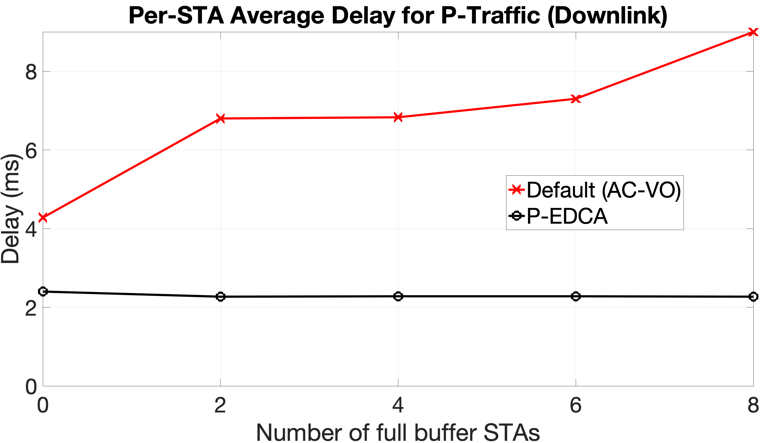
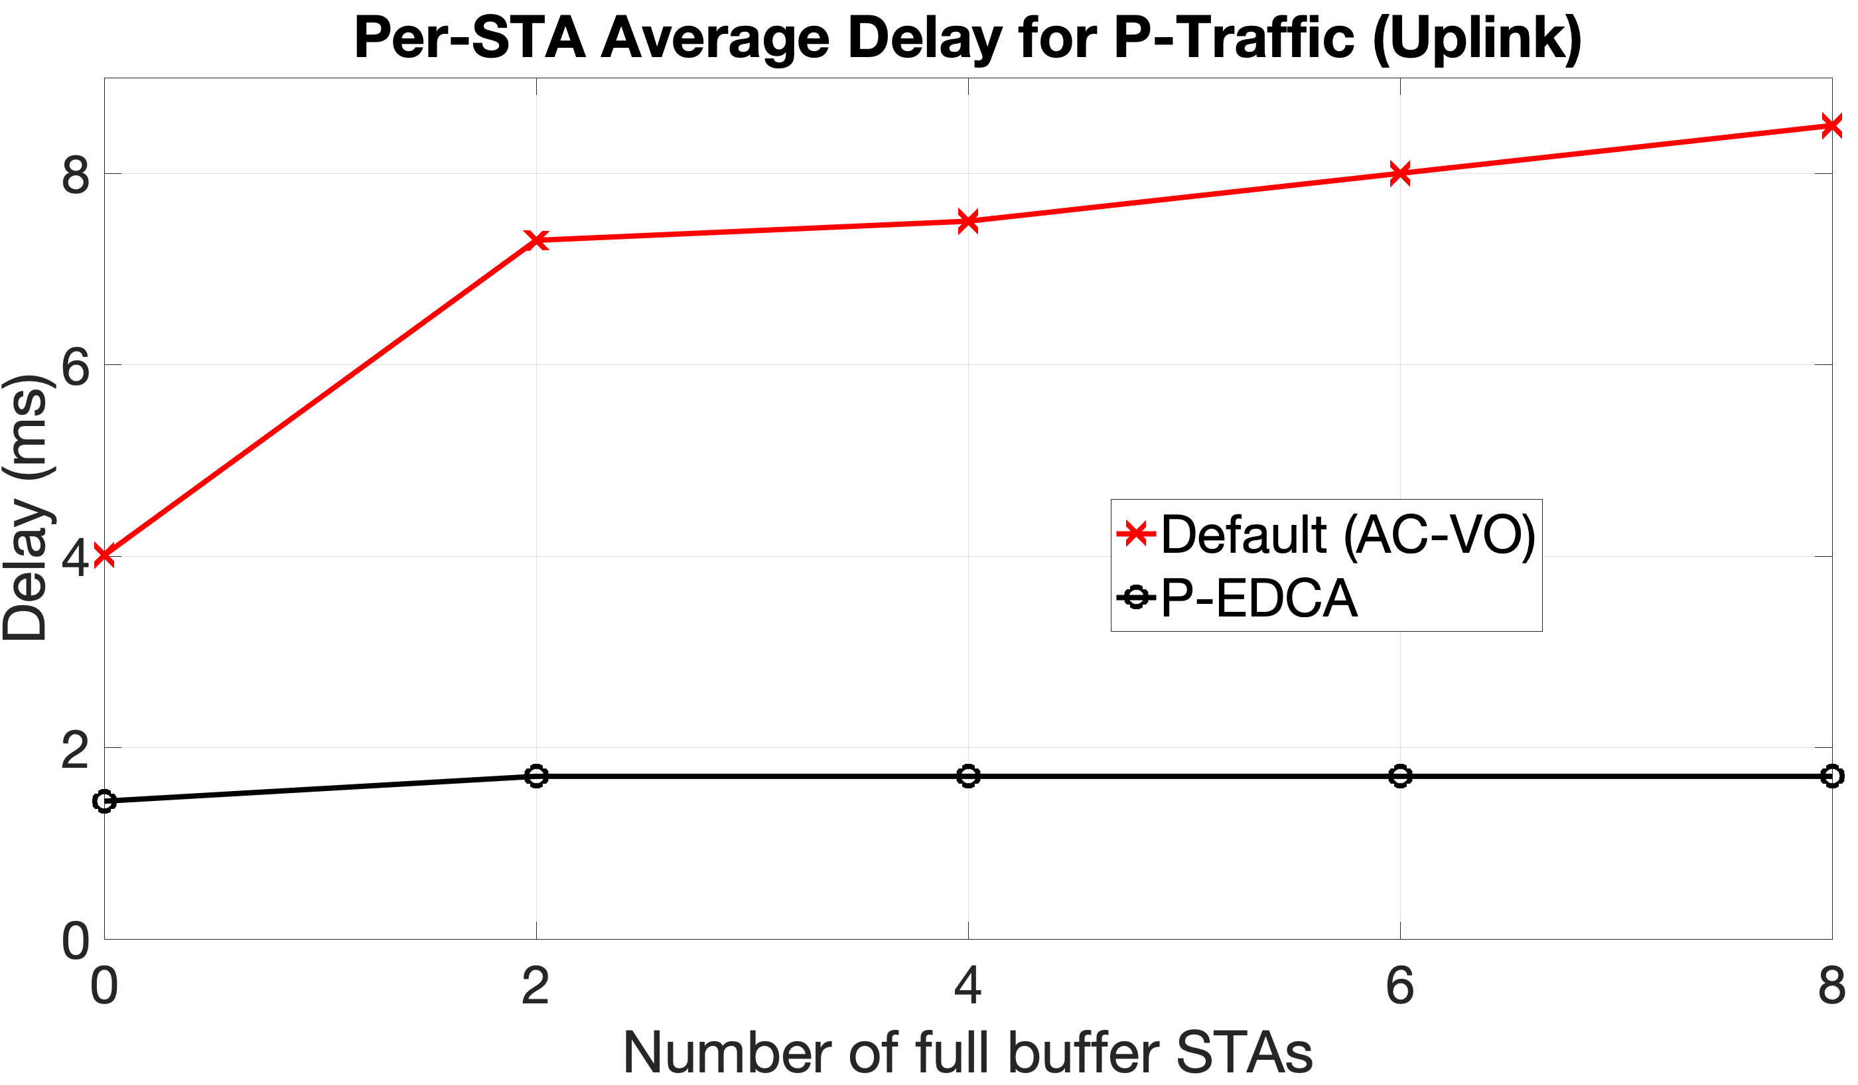
Simulation Results
Delay (queueing + medium access) comparison for DL/UL P-traffic
Observations:
  P-EDCA reduces mean latency in DL by ~3ms and UL by ~4ms
  Latency for default EDCA using VO increases as full buffer traffic streams increase, while for P-EDCA delay remains nearly unaffected
  Latency for P-EDCA DL is slightly higher due to larger AMPDU size (higher offered load for DL)

Slide 41
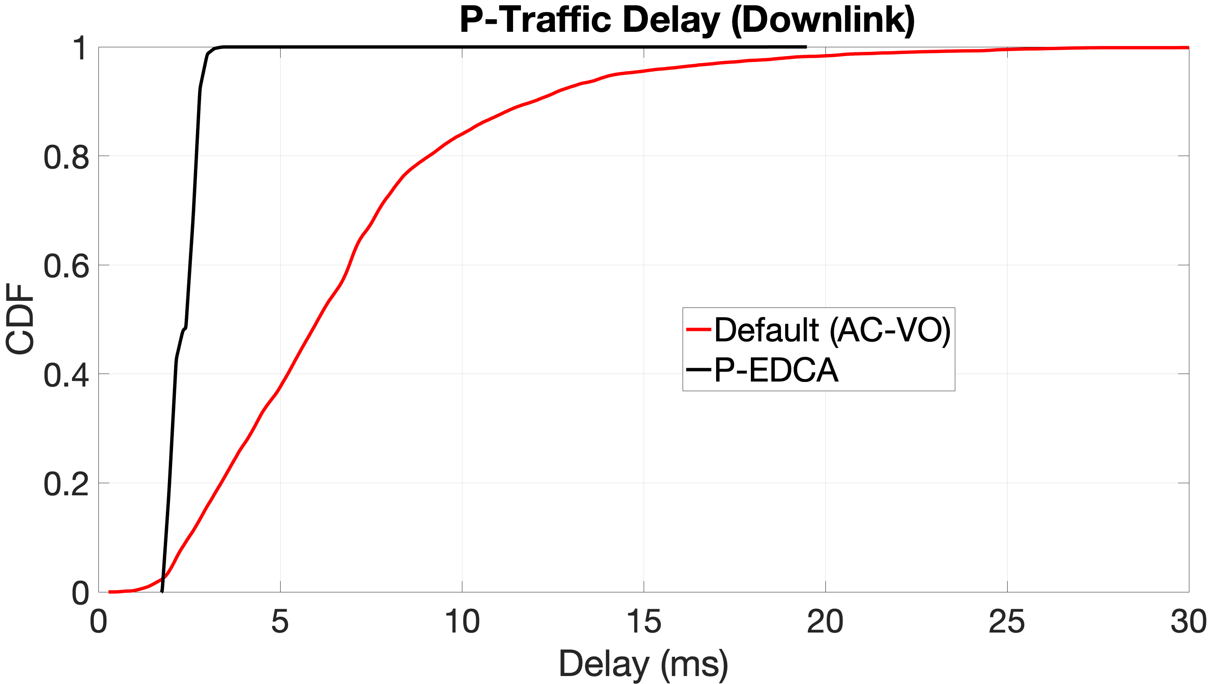
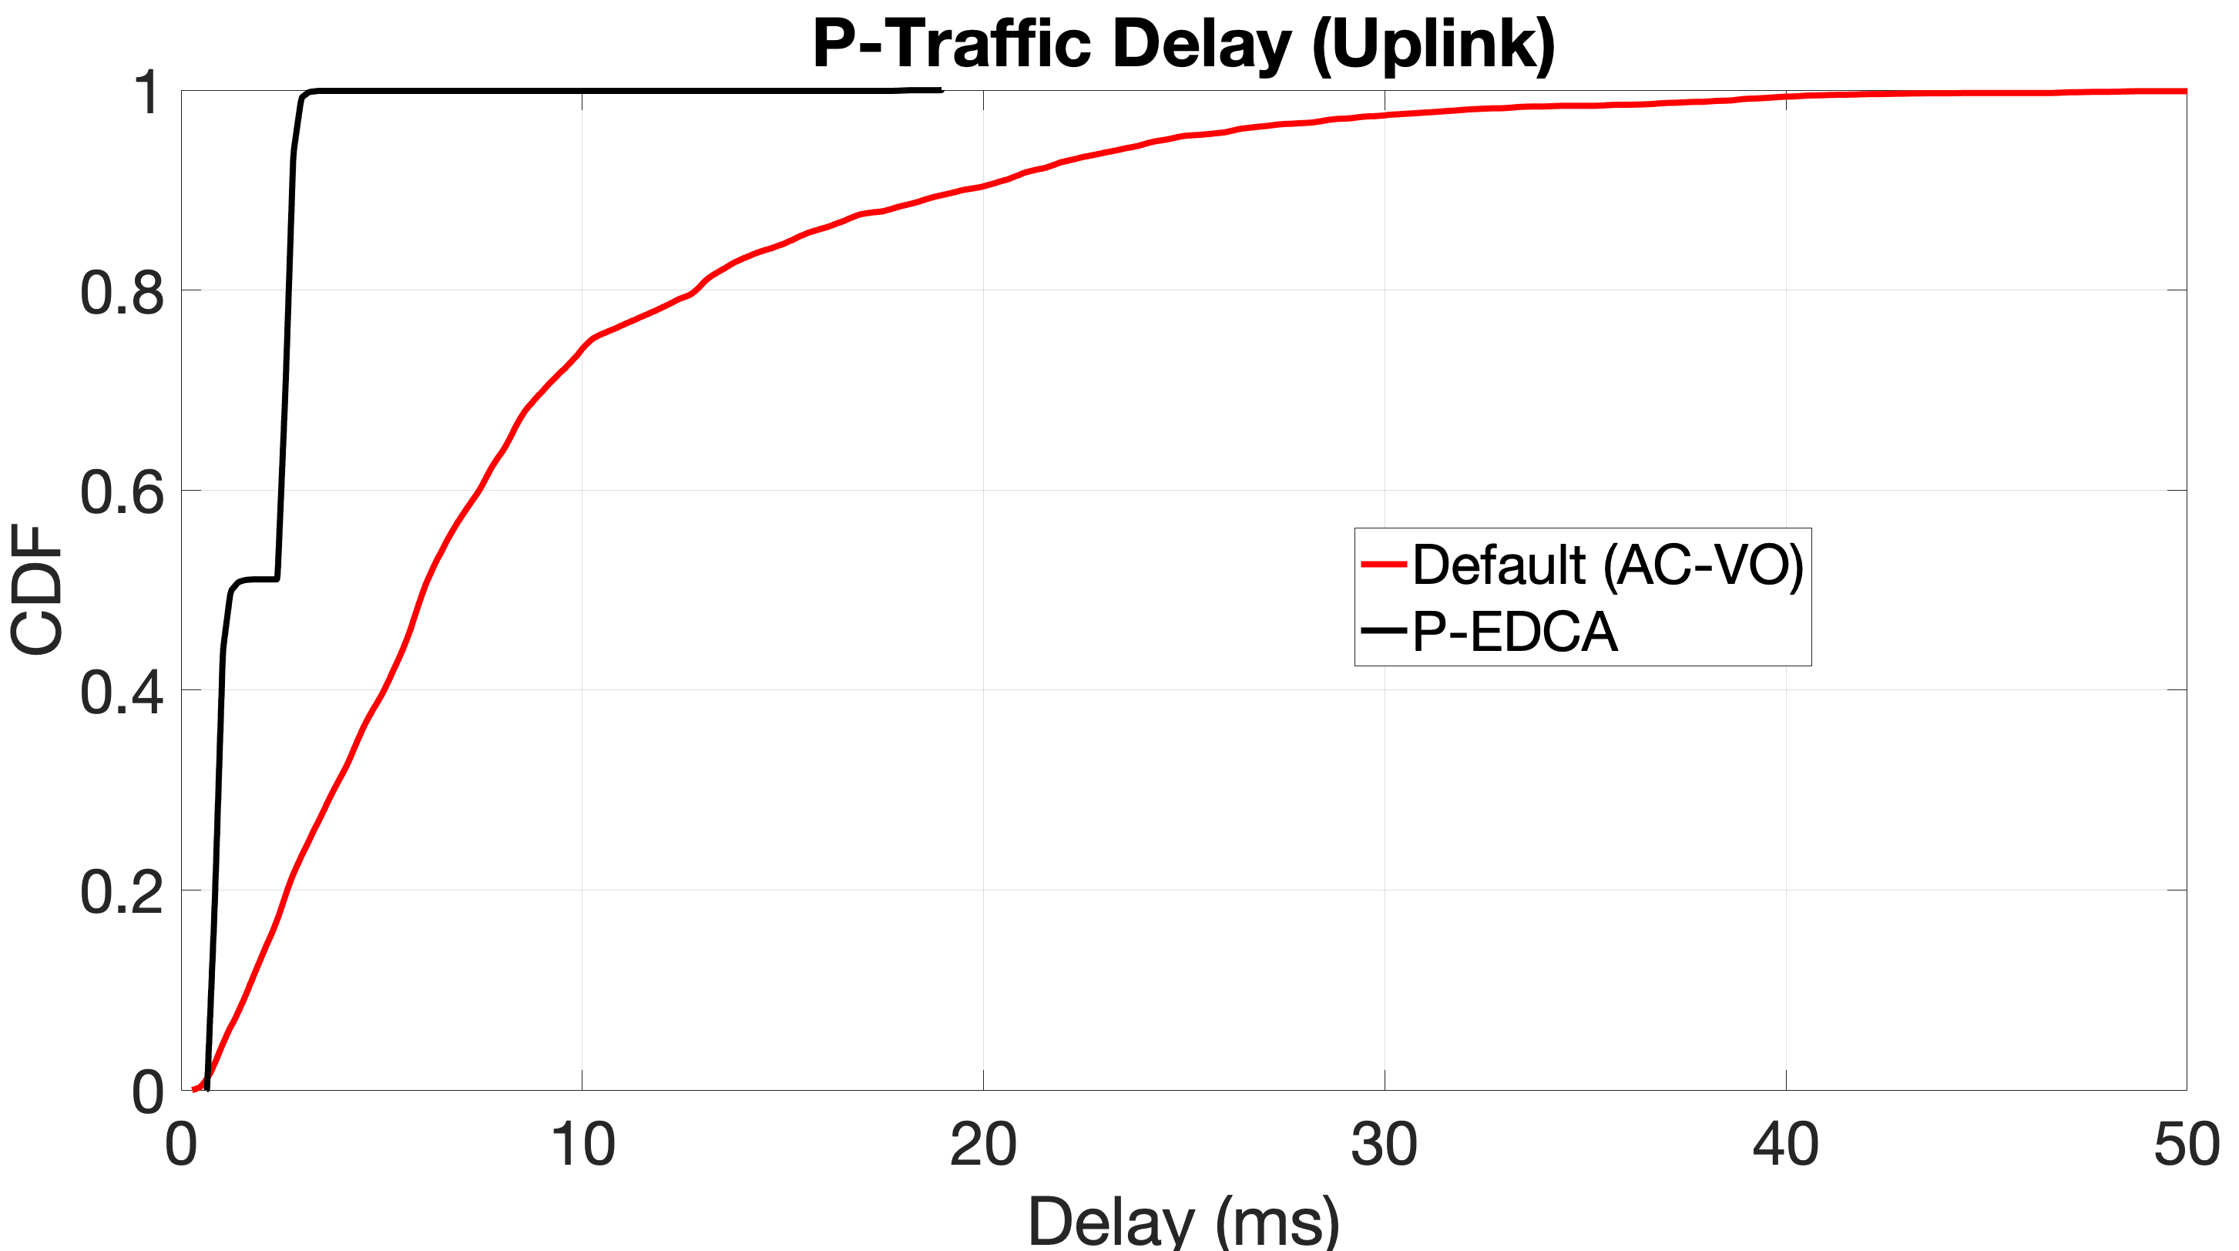
Results
Delay CDFs for P-traffic (6 full buffer non-APSTAs case)
Main observation:
  P-EDCA improves worst case of UL/DL delay compares to default EDCA AC-VO very effectively, showing the criticalness of distributing and protected prioritized access
Notes:
(some notes are in backup slide)

Slide 42
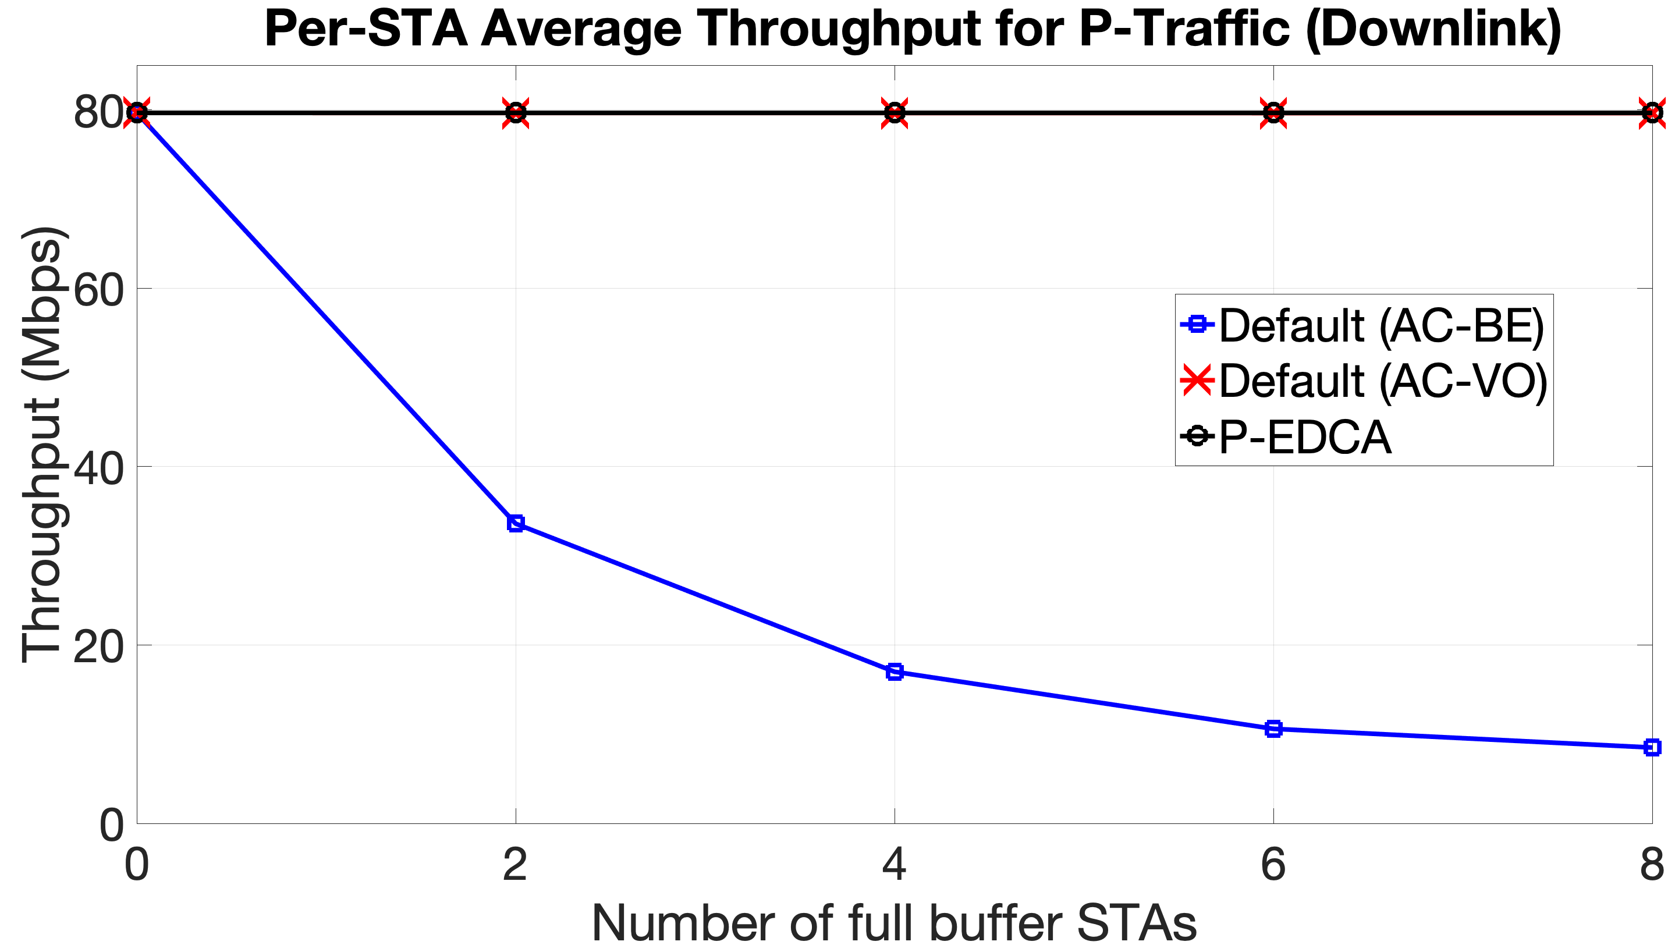
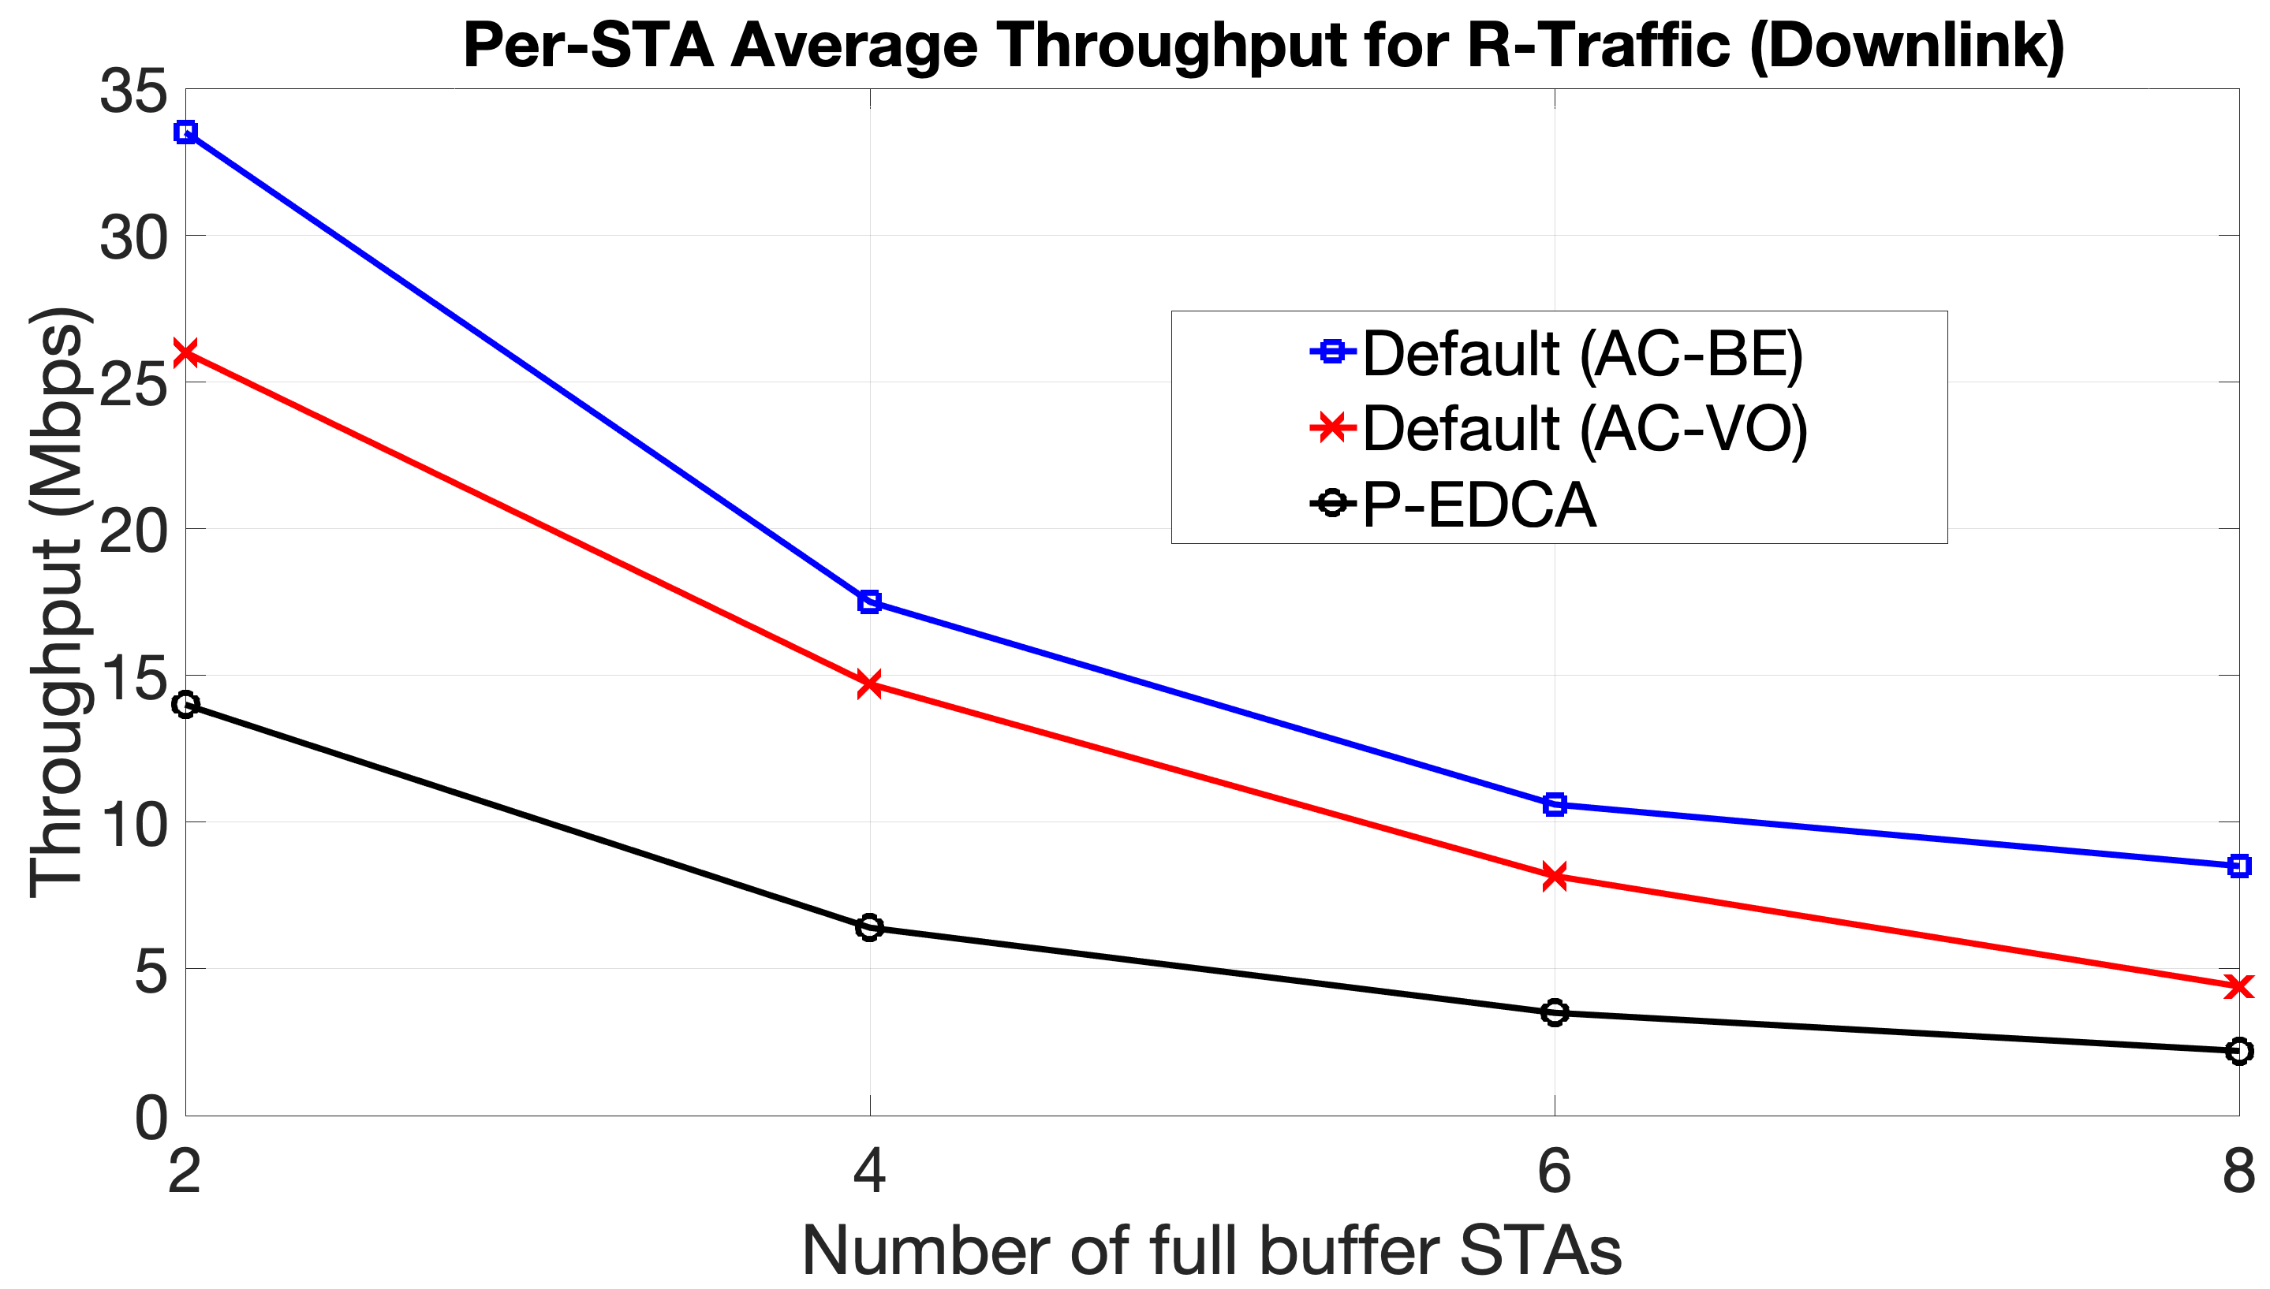
Results
Average DL throughput:
Observations:
  For P-traffic (left), both Default (AC-VO) and P-EDCA get 80Mbps. Default (AC-BE) cannot meet the throughput requirement as downlink access is shared equally between R and P traffic
  For R-traffic, P-EDCA gets some penalty due to slot boundaries and A-AIFS. However, the gap between Default (AC-VO) and P-EDCA closes as the full buffer traffic increases

Slide 43
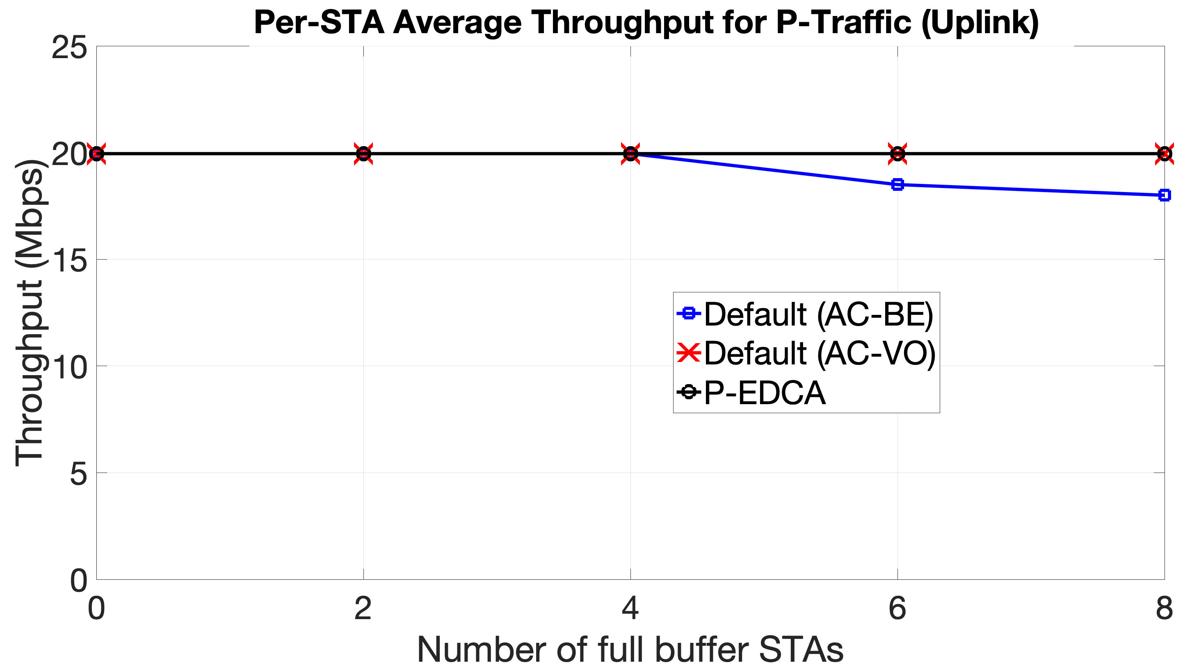
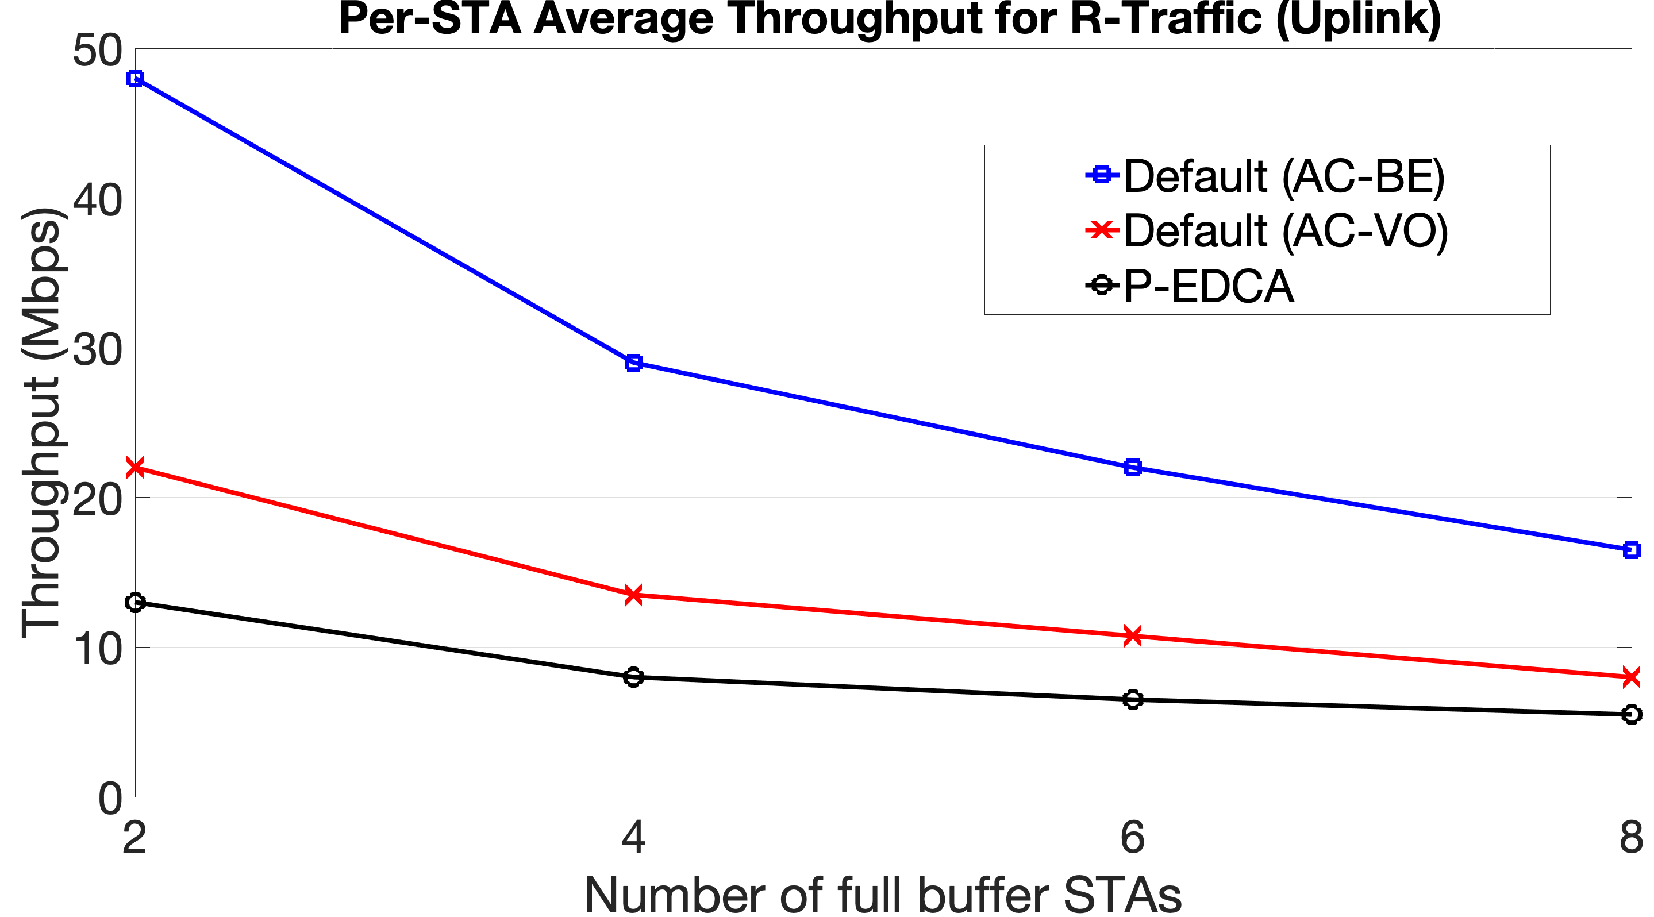
Results
Average UL throughput:
Observations:
  For P-traffic (left), both Default (AC-VO) and P-EDCA get 20Mbps. Default (AC-BE) cannot meet the throughput requirement beyond 4 full buffer STAs as UL streams share the available capacity
  For R-traffic, similar to DL throughput, P-EDCA gets some penalty due to slot boundaries and A-AIFS. However, the gap between Default (AC-VO) and P-EDCA closes as the full buffer traffic increases

