Slide 1
Prioritized EDCA Channel Access
Date: 2020-07-29
Name | Affiliations | Address | Phone | email
Chunyu Hu | Facebook Inc. | 1 Hacker way Menlo Park, CA |  | chunyuhu@fb.com
Payam Torab |  |  |  | torab@ieee.org

Slide 2
Abstract
Background: new medium access method to provide more predictable, and prioritized channel access (11-20/408r6)
This contribution provides more details on channel access design
A follow-up contribution will focus on signaling part of the protocol.

Slide 3
Time Slot Structure
The time is divided into slots of fixed, and configurable duration Ts
  The duration Ts is intended to be at txop level of granularity, long enough to hold one or more data frame exchange: rts/cts/a-mpdu/ba.
  Slot boundary is at time Ts, 2*Ts, …., (time satisfying (TSF % Ts) == 0)
  This provides a scalable way to represent medium/schedule status and can be conveniently described using a bitmap format
    E.g. a service period (SP) can be represented by a consecutive number of slots
    AP can share medium status or schedule info in slot bitmap format
      Good for both intra-BSS and inter-BSS coordination

Slide 4
Periodicity
The link may be able to share a common, periodic interval T, composed of fixed, and configurable number of slots. Interval boundary is at (TSF % T == 0).
  Example: two periodic streams with respective intervals: 16 TUs and 14 TUs ➔ AP can use an interval of 112 TUs
  Pros:
    Help non-AP STA to predict slot occupancy without receiving the beacon before contending for the medium
    Simplify the checking overlap / over-subscribing the utilization of a slot
    Beneficial for applications of similar characteristics
  Con: not realistic/practical all the time – it may require a very long bitmap. E.g. T1 = 200 TUs, T2 = 300 TUs and Ts = 1TUs.
    Usually it’s difficult to do so if one stream has small interval and the other has large interval – high/low bandwidth traffic
Propose: define maximum slot bitmap size, e.g. 256 bits. If possible to derive a common period T = N * Ts with N limited to maximum size, then AP can indicate if the schedule/slot bitmap info is repetitive/persistent

Slide 5
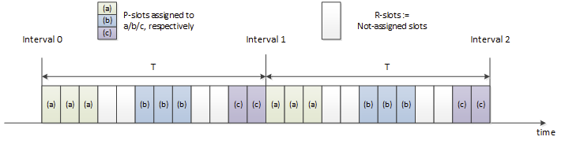
Definitions
Example where a period T is assumed: three non-AP STAs and one AP.
Terms:
  P-slot: a slot is called P-slot if any STA has requested AP to assign the slot for prioritized access.
  R-slot: A slot is called R-slot if none of STA has requested this slot.
  MP-slot: from a STA’s perspective, if the slot has been assigned to this STA (there can be multiple STAs assigned to the same slot however.)
  OP-slot: from a STA’s perspective, it is not registered for this P-slot’s membership.

Slide 6
EDCA Parameters and Terms
Default EDCA parameters: used by regular traffic for channel access.
A second set of EDCA parameters: used by P-traffic to access P-slots. Called P-EDCA params.
Regular traffic (R-traffic) uses a backoff timer, timer-1, to access the channel.
Prioritized traffic (P-traffic) uses a second backoff timer, timer-2, to access the channel during P-slots.
Alternative AIFS (A-AIFS): AIFS value used by timer-1 during P-slots.

Slide 7
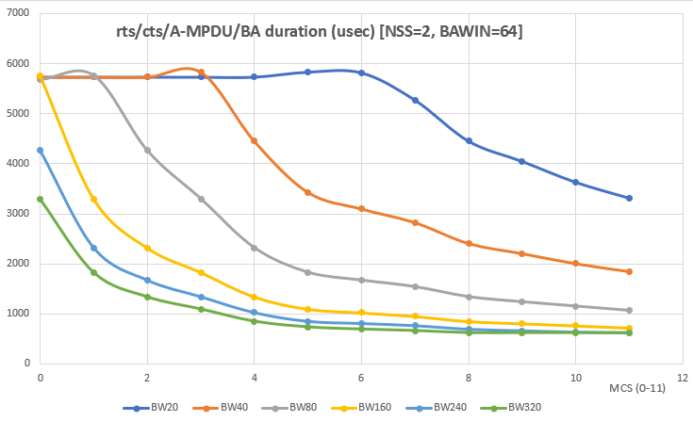
General Descriptions
AP advertises the following parameters:
  Slot duration: S TUs. E.g. ½, 1, 2, 4 TUs
  Interval T: T = N slots
  P-EDCA params
  A-AIFS
  Any additional TBD parameters as needed.
AP advertises the above info in Beacons, Probe responses and applicable management/action frames.
Each STA can request assignment of slots for DL/UL/p2p traffic. The STA can request multiple contiguous number of slots. A slot can be assigned to multiple STAs to conduct MU operation.
  A group of contiguous slots forms a service period (SP).
  Details of slot management are in a separate contribution.
Notes:
Comment: concern on beacon bloating.

Slide 8
Channel Access: General Principal
Assumed P-traffic pattern:
  Periodicity
  Bursty: have packets ready at beginning of their MP-slots
  Traffic may complete before end of current SP / a group of contiguous MP-slots and in that time period. The remaining time should allow R-traffic to access
Provide P-traffic prioritized access during P-slots
Handle certain range of traffic amount variants of P-traffic in each interval
  Protect beginning of a SP: tolerate small variants of time packets being ready
  Protect SP period when bursty P-traffic is undergoing: A-AIFS for R-traffic and default EDCA parameters
  Release SP period automatically when bursty P-traffic completes
Notes:
1) From a P-STA perspective

Slide 9
Backoff Behavior for R-Traffic
When there is no P-slots:
  When no STAs register any slot at AP, that is, there is no R-slots, then regular traffic access the channel following default EDCA access using default EDCA parameters. The channel access is not different from existing EDCA behavior.
When there are some P-slots:
  Regular traffic is not allowed to start transmission during a time window X usec before entering the P-slot boundary, and Y usec after the boundary.
  If timer-1 is running, then suspend timer-1 X usec before the illustrated slot boundary, and can resume Y usec after the slot boundary. If medium is busy not due to its own transmission, then the slot is deemed as occupied (assumingly by its registered member), and the STA shall give priority to it -- to that end, until the STA successfully win the medium, it uses a newly defined A-AIFS to decide if medium has become idle and resume timer-1 counting down.

Slide 10
Backoff Behavior for Prioritized Traffic
Medium access to MP-slots
  In general, timer-2 is not run and is suspended out of MP-slots. When MP slots start, timer-2 resumes (or reset CW to CWmin, and generate a new backoff value from current CW. TBD).
  Packets from P-traffic are transmitted using timer-2 during MP slots. If the STA doesn’t have any packets from P-traffic any more, it can use timer-1 to contend medium access for its regular traffic as described in previous sections.
  If the P-traffic for the current interval didn’t complete when MP-slots end, the STA may still transmit them, but follows the medium access rule for regular traffic.
Medium contention among STAs sharing the same SP / MP-slots
  The same slot can be assigned to a) a non-AP STA for its DL and/or UL traffic, b) multiple non-AP STAs for their DL and/or UL traffic, or c) peer-to-peer transmissions.
  STAs that have registered the slots’ membership contend medium access among themselves. To further mitigate the contention and reduce collision, the STAs can use any applicable mechanisms. For example, AP can use trigger frames to manage both DL and UL transmissions if the non-AP STA supports it. For another example, AP can use triggered P2P transmission procedure [11-20/813r6] to coordinate the peer-to-peer communication.

Slide 11
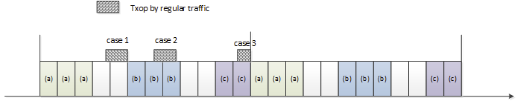
Slot Boundary (1)
For regular traffic:
  Regular traffic shall stop at a slot boundary when a slot transits from R-slot to P-slot.
  If the regular traffic wins the medium access during P-slots, its txop shall stop at the slot boundary, unless it knows the next slot belongs to the same STA(s) as the current P-slot. AP provides additional slot bitmap info for this purpose.

Slide 12
Slot Boundary (2)
For P-traffic:
  When transmitted during the MP-slots, the current txop shall end at the boundary of MP → OP slot.
  When transmitted during the MP-slots, the current txop should end at the boundary of MP → R slot, but is allowed to extend to next slot (but not beyond.)
  When transmitted during R-slots, follow the regular traffic rule.

Slide 13
Support of Peer-to-Peer Communication
The Peer-to-Peer communication can be prioritized as well
Some examples of peer-to-peer links:
  TDLS: either non-AP STA can request slot membership for their P-traffic, and follow corresponding channel access rules
  Tethered link using P2P (GO/GC): GO as non-AP STA associated with the AP, and request slot membership for the P-traffic carried over the p2p link
  Tethered link using SoftAP: similar to above
Additional tools that can be used to mitigate contention and improve efficiency:
  Trigger based access if SoftAP/GO supports it
  Triggered P2P communication [11-20/813r6]
Note: the slot assigned to the peer-to-peer communication, depending on supported frame sequence, may have to be limited to be exclusive to the peer-to-peer communication (not shared with other peer-to-peer links)

Slide 14
A Special / Simplified Configuration
If all prioritized traffic falls into the following cases, then we can disable EDCA for regular traffic during P-slots completely and uses A-AIFS sensing to resume regular traffic after prioritized traffic completes. This simplifies design but sacrifices flexibility.
  DL: AP transmits to associated non-AP STA
  UL: AP uses trigger frame to poll UL packets
  Peer-to-peer:
    “DL”: softAP/GO → its associated STA(s)
    “UL”: SoftAP/GO uses trigger based for its UL traffic
    Use the newly defined trigger based P2P frame sequence
Configuration:
  Don’t need a second set of EDCA parameters since all transmissions are initiated only by one designated STA.
  A-AIFS: STAs with regular traffic use A-AIFS to determine if the prioritized access has completed early.
  Only need existing backoff timer
Notes:
Special configuration keys:
Disable EDCA
Boundary handling
One timer with A-AIFS change during P-slots
(trigger-only?)
Time slot structure
Protected / boundary
If it’s triggered only is secdonary

Slide 15
SP #1
Do you support that the TGbe SFD shall include (in R1):
  An optional mechanism of dividing medium time into slots of duration TBD during which prioritized EDCA access operates for specifically allowed STAs

Slide 16
SP #2
Do you support that the TGbe SFD shall include (in R2):
  An optional mechanism of dividing medium time into slots of duration TBD during which prioritized EDCA access operates for specifically allowed STAs

Slide 17
SP #3
Do you support that the TGbe SFD shall include (in R1) a simple channel access enhancement that provides a more predictable latency performance in R1:
  Define prioritized access time period assigned for specifically allowed STA(s)
  AP advertises and share all such prioritized access time period in a TBD resolution
  TXOP shall end before start of any prioritized access time period

