Slide 1
Prioritized EDCA Channel Access
Date: 2020-07-29
Name | Affiliations | Address | Phone | email
Chunyu Hu | Facebook Inc. | 1 Hacker way Menlo Park, CA |  | chunyuhu@fb.com
Payam Torab |  |  |  | torab@ieee.org

Slide 2
Abstract
Background: new medium access method to provide more predictable, and prioritized channel access (11-20/408r6)
This contribution provides more details on channel access design
A follow-up contribution will focus on signaling part of the protocol.

Slide 3
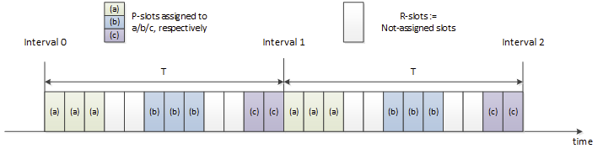
Slot Structure and Definitions
The time is divided into periodic intervals with duration T TUs. The interval is divided into slots.
Slot duration is intended to be at txop level of granularity, long enough to hold one or more data frame exchange: rts/cts/a-mpdu/ba.
  Slot boundary is at time satisfying (TSF % T) == 0.
Terms:
  P-slot: a slot is called P-slot if any STA has requested AP to assign the slot for prioritized access.
  R-slot: A slot is called R-slot if none of STA has requested this slot.
  MP-slot: from a STA’s perspective, if the slot has been assigned to this STA (there can be multiple STAs assigned to the same slot however.)
  OP-slot: from a STA’s perspective, it is not registered for this P-slot’s membership.

Slide 4
EDCA Parameters and Terms
Default EDCA parameters: used by regular traffic for channel access.
A second set of EDCA parameters: used by P-traffic to access P-slots. Called P-EDCA params.
Regular traffic (R-traffic) uses a backoff timer, timer-1, to access the channel.
Prioritized traffic (P-traffic) uses a second backoff timer, timer-2, to access the channel during P-slots.
Alternative AIFS (A-AIFS): AIFS value used by timer-1 during P-slots.

Slide 5
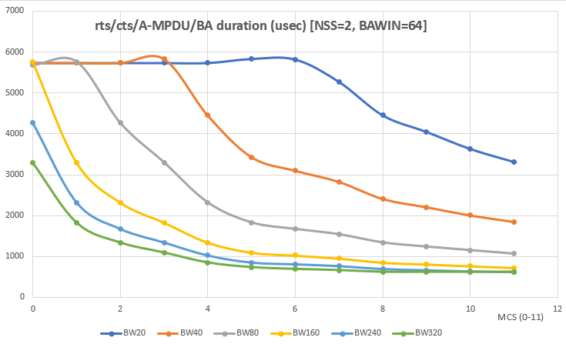
General Descriptions
AP advertises the following parameters:
  Interval T: T = 2^a TUs
  Slot duration: S TUs. E.g. ½, 1, 2, 4 TUs
  P-EDCA params
  A-AIFS
  Any additional TBD parameters as needed.
AP advertises the above info in Beacons, Probe responses and applicable action frames.
Each STA can request assignment of slots for DL and/or UL traffic. The STA can request multiple contiguous number of slots. A slot can be assigned to multiple STAs to conduct MU operation to be more efficient.
  A group of contiguous slots forms a service period (SP).
  Details of slot management are in a separate contribution.

Slide 6
Channel Access: General Principal
Assumed P-traffic pattern:
  Periodicity
  Bursty: have packets ready at beginning of their MP-slots
  Traffic may complete before end of current SP / a group of contiguous MP-slots and in that time period, allow R-traffic to access
Give P-traffic prioritized access during P-slots
Handle certain range of traffic amount variants of P-traffic in each interval
  Protect beginning of a SP: tolerate small variants of time packets being ready
  Protect SP period when bursty P-traffic is undergoing: A-AIFS for R-traffic and default EDCA parameters
  Release SP period automatically when burst P-traffic completes

Slide 7
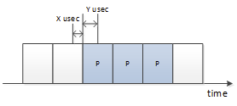
Backoff Behavior for R-Traffic
When there is no P-slots:
  When no STAs register any slot at AP, that is, there is no R-slots, then regular traffic access the channel following default EDCA access using default EDCA parameters. The channel access is no different from existing EDCA behavior.
When there are some P-slots:
  Regular traffic is not allowed to start transmission during a time window X usec before entering the P-slot boundary, and Y usec after the boundary.
  If timer-1 is running, then suspend timer-1 X usec before the illustrated slot boundary, and can resume Y usec after the slot boundary. If medium is busy not due to its own transmission, then the slot is deemed as occupied (assumingly by its registered member), and the STA shall give priority to it -- to that end, until the STA successfully win the medium, it uses a newly defined A-AIFS to decide if medium has become idle and resume timer-1 counting down.

Slide 8
Backoff Behavior for Prioritized Traffic
Medium access to MP-slots
  In general, timer-2 is not run and is suspended out of MP-slots. When MP slots start, timer-2 resumes (or reset CW to CWmin, and generate a new backoff value from current CW. TBD).
  Packets from P-traffic are transmitted using timer-2 during MP slots. If the STA doesn’t have any packets from P-traffic any more, it can use timer-1 to contend medium access for its regular traffic as described in previous sections.
  If the P-traffic for the current interval didn’t complete when MP-slots end, the STA may still transmit them, but follows the medium access rule for regular traffic.
Medium contention among STAs sharing the same SP / MP-slots
  The same slot can be assigned to a) a non-AP STA for its DL and/or UL traffic, b) multiple non-AP STAs for their DL and/or UL traffic, or c) peer-to-peer transmissions.
  STAs that have registered the slots’ membership contend medium access among themselves. To further mitigate the contention and reduce collision, the STAs can use any applicable mechanisms. For example, AP can use trigger frames to manage both DL and UL transmissions if the non-AP STA supports it. For another example, AP can use triggered P2P transmission procedure [11-20/813r6] to coordinate the peer-to-peer communication.

Slide 9
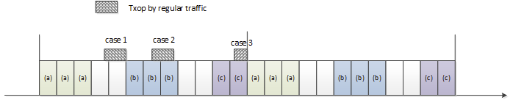
Slot Boundary (1)
For regular traffic:
  The regular traffic shall stop at a slot boundary when a slot transits from R-slot to P-slot.
  If the regular traffic wins the medium access during P-slots, its txop shall stop at the slot boundary, unless it knows the next slot belongs to the same STA(s) as the current P-slot. AP provides additional slot bitmap info for this purpose.

Slide 10
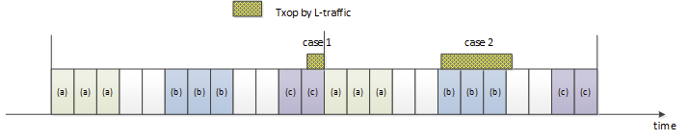
Slot Boundary (2)
For P-traffic:
  When transmitted during the MP-slots, the current transmission/txop shall end at the boundary of MP->OP slot.
  When transmitted during the MP-slots, the current transmission/txop should end at the boundary of MP->R slot, but is allowed to extend to next slot (but not beyond.)
  When transmitted during the R-slots, follow the regular traffic rule.

