Slide 1
EHT NDPA Frame Design Discussion
Date: 2020-07-07
Authors:
Name | Affiliation | Address | Phone | Email
Chenchen Liu | Huawei Technologies Co., Ltd Huawei Technologies Co., Ltd | Huawei Base, Bantian, Shenzhen |  | liuchenchen1@huawei.com
Ross Jian Yu |  |  |  | ross.Yujian@huawei.com
Dandan Liang
Ming Gan
Genadiy Tsodik
Shimi Shilo
Oded Redlich

Slide 2
Abstract
In this contribution, we will discuss the possible NDPA frame designs with respect to the EHT new features

Slide 3
Outline
Recap of NDPA frame
Motivations
EHT NDPA indication method
Summary
References
New in r4: partial bandwidth indication

Slide 4
Partial Bandwidth Indication
Several methods regarding partial bandwidth indication have been proposed in [6]-[9].
  Opt1: Bitmap method 1 ([8,6], Rui, Eunsung)
  Opt2: Bitmap method 2 ([6], Eunsung)
  Opt3: RU allocation table ([7,6]+this doc, Sameer, Chenchen, Eunsung)
  Opt4: RU start + RU end ([9] Cheng)
The first three can better support discontiguous MRU, and are analyzed in [6].
 | Option 1 Bitmap | Option 2 New Bitmap | Option 3 Table
Pros | Simple and intuitive | Possible for all RUs/MRUs in R1 Possible for 242 RU based feedback | No restriction in R2 Fewer bits
Cons | Impossible for some of the MRUs in R1 Some restrictions in R2 | A bit complex due to a coupled property Some restrictions in R2 | Need memory Complicated decoding
  It may be impossible to request for feedback on the channels corresponding to 242 RU or (484+242) MRU in 320MHz (Use case: 242 RU for 20MHz operating STA, (484+242) MRU for 80MHz operating STA and 3x996 RU for 320MHz operating STA in 320MHz DL OFDMA)

Slide 5
Partial Bandwidth Indication
It is mentioned the drawback of Opt3 (table based method) is:
  Need memory
  Complicated decoding
It is not always true for Opt 3 if we have the following restriction:
  Reuse exactly the same table as the RU allocation table in the trigger frame, with small RU/MRU entries reserved.
  For R2, if any new MRU pattern is introduced in the RU allocation table of the trigger frame, we can also introduce them in the RU allocation table of the NDPA frame. Still copy and paste.
Then the draw back turns into the advantage:
  No need of additional memory of bitmap
  Same decoding as the trigger frame, no additional decoding procedure
The advantages also include:
  All RU/MRU supported in R1
  Enable any possible extension in R2

Slide 6
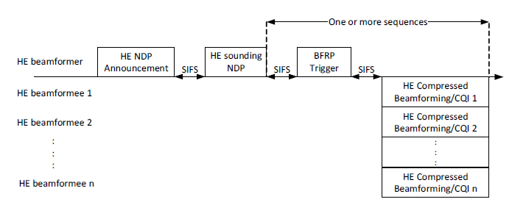
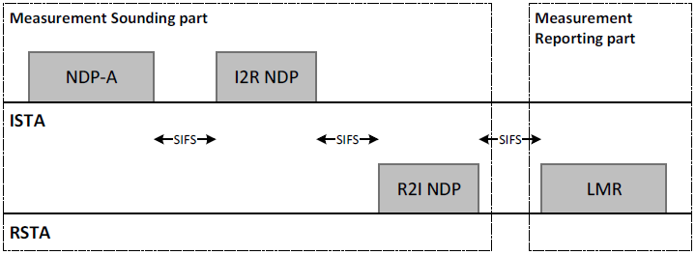
Recap of NDPA frame
In 802.11, three NDPA frame variants have been defined:
  VHT NDPA frame
  HE NDPA frame
  Ranging NDPA frame
In this contribution, we try to define a new variant for EHT NDPA frame.

Slide 7
Recap of NDPA frame
The Sounding Dialog Token field indicates the token number and NDPA type
Each NDPA contains one or multiple STA info fields, each with 4 bytes for HE and Ranging, 2 bytes for VHT

Slide 8
Sounding Dialog Token field
Ranging | HE | Description
0 | 0 | VHT NDPA
0 | 1 | HE NDPA
1 | 0 | Ranging NDPA
1 | 1 | Reserved
For the VHT, the first two bits in the Sounding Dialog Token field are reserved[1]
For the HE, the first bit is reserved and the second bit is used to distinguish the HE or VHT NDPA frame[2]
In 11az, the Ranging subfield and HE subfield are set to 1 and 0 respectively to identify the frame as Ranging NDPA frame [3]
The legacy VHT STA will regard all the NDPA as VHT NDPA, the legacy HE STA may regard it as HE NDPA as long as the HE subfield is set to 1
The remaining 6 bits are used to record the dialog token number

Slide 9
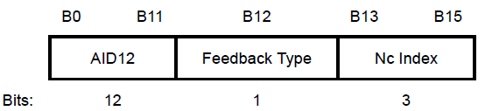
STA info field
HE NDPA
VHT NDPA
Ranging NDPA
For HE NDPA, AID11 subfield indicate the AID of STA if between 1 and 2007; indicates the Disallowed Subchannel Bitmap if equals 2047；other values are reserved
Partial BW Info subfield indicates the start and end index of the 26-tone RU for which the feedback is requested.
Nc subfield indicates the number of columns (corresponding to Nss of BFee)
Feedback Type And Ng subfield and Codebook Size subfield indicate the Ng, quantization resolution and feedback type.
Disambiguation subfield is set to 1 to prevent a non-HE VHT STA from wrongly determining its AID

Slide 10
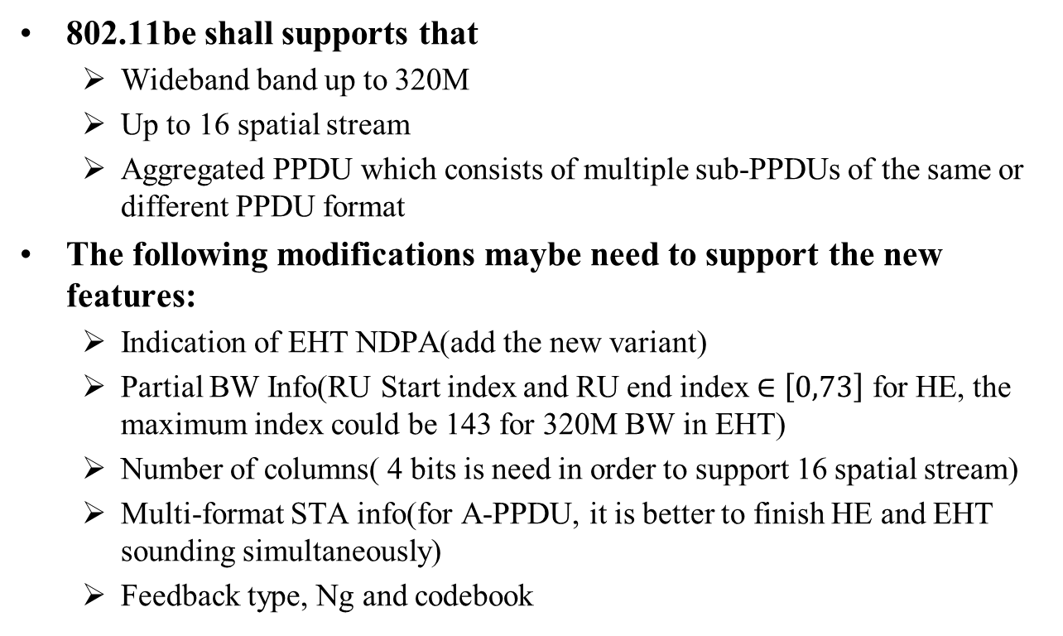
Motivations
802.11be shall supports that
  Wideband band up to 320M
  Up to 16 spatial stream
  Aggregated PPDU which consists of multiple sub-PPDUs of the same or different PPDU format
The following modifications maybe need to support the new features:
  Indication of EHT NDPA(add the new variant)
  Partial BW Info(RU Start index and RU end index $∈\left[0,73\right]$ for HE, the maximum index could be 143 for 320M BW in EHT)
  Number of columns( 4 bits is need in order to support 16 spatial stream)
  Multi-format STA info(for A-PPDU, it is better to finish HE and EHT sounding simultaneously)
  Feedback type, Ng and codebook

Slide 11
EHT NDPA Indication
Two options are proposed for EHT NDPA Indication:
  Option 1: Extend the length of STA Info subfield
  Option 2: Compress the Partial BW Info subfield

Slide 12
EHT NDPA Indication
Option 1: Extend the length of STA Info field
  Sounding Dialog Token field is set as follows
  STA Info field:
    Length of EHT STA Info can be extended to 2*n byte(e.g. n=3)
    HE STA will regards the EHT NDP as VHT NDP
    Thus only disambiguation subfield positioned at B(16*k+11)(B(i) start with i=0) for k=1, 2, …, n-1 shall be set to 1, so as to prevent a VHT STA from wrongly identifying its AID in the EHT NDPA
Ranging | HE/VHT | Description
0 | 0 | VHT or EHT NDPA
0 | 1 | HE NDPA
1 | 0 | Ranging NDPA
1 | 1 | Reserved

Slide 13
EHT NDPA Indication
There are many reserved state for the Partial BW Info subfield(for HE STA Info field, the RU Start index and the RU End index each occupies 7 bits, but their valid value rang is 0~73, since the maximum bandwidth is 160M)
Thus, instead of extending the length of STA Info field, the Partial BW Info subfield can be compressed for EHT
Therefore, the option 2 is proposed

Slide 14
EHT NDPA Indication
Option 2: Compress the Partial BW Info subfield
  Sounding Dialog Token field – Opt A:
  STA Info field:
    Opt2a: the 9-bit RU Allocation subfield[4] is used to replace the Partial BW Info subfield (6/7 bits with 242-tone RU granularity)
    Opt2b: compress the RU start and RU end index with larger granularity,
    Opt2c: RU size subfield and RU Position Index subfield with compressed bitwidth.
    The saved bits can be used for Nc and other subfields
Ranging | HE | Description
0 | 0 | VHT NDPA
0 | 1 | HE NDPA
1 | 0 | Ranging NDPA
1 | 1 | EHT NDPA

Slide 15
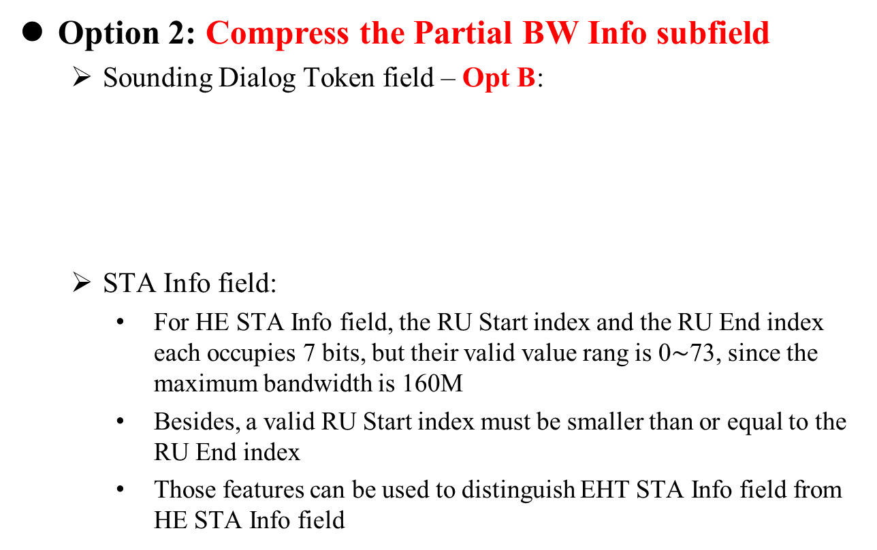
EHT NDPA Indication
Option 2: Compress the Partial BW Info subfield
  Sounding Dialog Token field – Opt B:
  STA Info field:
    For HE STA Info field, the RU Start index and the RU End index each occupies 7 bits, but their valid value rang is 0$\sim$73, since the maximum bandwidth is 160M
    Besides, a valid RU Start index must be smaller than or equal to the RU End index
    Those features can be used to distinguish EHT STA Info field from HE STA Info field
Ranging | HE/VHT | Description
0 | 0 | VHT NDPA
0 | 1 | HE or EHT NDPA
1 | 0 | Ranging NDPA
1 | 1 | Reserved

Slide 16
EHT NDPA Indication
Option 2: Compress the Partial BW Info subfield
  STA Info field:
    E.g., the two MSB corresponding to the RU End index of HE STA Info field are set to 1 to indicate this STA Info field is EHT STA Info field, Otherwise, it is a HE STA Info field
    The same compression method for Partial BW indication can be used as option2a/2b/2c.
    The save bits can be used for Nc subfield and Codebook Size subfield
    Unified HE/EHT NDPA frame may also support A-PPDU NDP.

Slide 17
Summary
In this contribution, two EHT NDPA frame design methods are proposed, their comparisons are summarized as following:
 | Pros. | Cons.
Option 1 | Sufficient bits for EHT new features; Similar structure with HE | Large overhead due to extended length; Not supporting aggregated sounding of EHT and HE
Option 2 | The same length of STA Info subfield as HE | Need to compress the partial BW Info subfield

Slide 18
References
[1] IEEE P802.11-REVmd™/D3.0
[2] IEEE P802.11ax™/D6.0
[3] IEEE P802.11az™/D2.1
[4] Specification Framework for TGbe , doc.: IEEE 802.11-20/0566r23
[5] RU Allocation Subfield Design for EHT Trigger Frame, doc.: IEEE 802.11-20/0828r0
[6] https://mentor.ieee.org/802.11/dcn/20/11-20-1814-01-00be-partial-bw-info-field-design-in-ndpa.pptx, Eunsung Park, LGE
[7] https://mentor.ieee.org/802.11/dcn/20/11-20-1436-06-00be-ndpa-and-mimo-control-field-design-for-eht.pptx, Sameer Vermani, Qualcomm
[8] https://mentor.ieee.org/802.11/dcn/20/11-20-1747-00-00be-eht-ndpa-partial-bw-info-design.pptx, Rui Cao, NXP
[9] https://mentor.ieee.org/802.11/dcn/20/11-20-1435-02-00be-eht-ndpa-frame-design.pptx, Cheng Chen, Intel

Slide 19
SP1
Do you support to reuse the VHT/HE NDPA frame for EHT NDPA frame
  Y/N/Abs

Slide 20
SP2
Do you support to keep the length of EHT STA Info field in the NDPA frame as 4 bytes
  Yes/No/Abstain

Slide 21
SP3
Do you support to set the Ranging subfield and HE subfield of Sounding Dialog Token subfield to 1 and 1 respectively to identify the frame as EHT NDPA frame
  Y/N/Abs
Ranging | HE | Description
0 | 0 | VHT NDPA
0 | 1 | HE NDPA
1 | 0 | HE Ranging NDPA
1 | 1 | EHT NDPA

Slide 22
SP4
Do you support to set the Ranging subfield and HE subfield of Sounding Dialog Token subfield to 0 and 1 respectively for the NDPA frame carriers EHT STA info field
  the variant of EHT/HE(or future generation) can be identified from the indication in the STA Info field
    Y/N/Abs
Ranging | HE/VHT | Description
0 | 0 | VHT NDPA
0 | 1 | HE or EHT NDPA
1 | 0 | HE Ranging NDPA
1 | 1 | Reserved

Slide 23
SP5
Do you agree to include the following into 11be SFD:
  The partial bandwidth indication in the NDPA frame reuses the same RU allocation table as the one defined in the trigger frame.
    This is for R1
    Note: RU allocation table will be defined later
    Y/N/Abs

