Slide 1
EHT NDPA Frame Design Discussion
Date: 2020-07-07
Authors:
Name | Affiliation | Address | Phone | Email
Chenchen Liu | Huawei Technologies Co., Ltd | Huawei Base, Bantian, Shenzhen |  | liuchenchen1@huawei.com
Ross Jian Yu
Dandan Liang
Ming Gan

Slide 2
Abstract
In this contribution, we will discuss the possible NDPA frame designs with respect to the EHT new features

Slide 3
Outline
Recap of NDPA frame
Motivations
EHT NDPA indication method
Summary
References

Slide 4
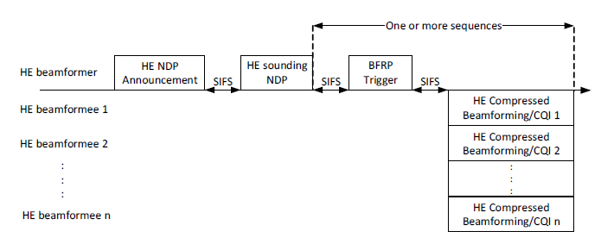
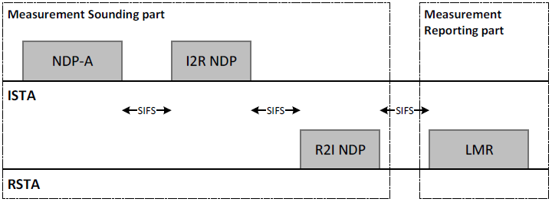
Recap of NDPA frame
In 802.11, three NDPA frame variants have been defined:
  VHT NDPA frame
  HE NDPA frame
  Ranging NDPA frame
In this contribution, we try to define a new variant for EHT NDPA frame.

Slide 5
Recap of NDPA frame
The Sounding Dialog Token field indicates the token number and NDPA type
Each NDPA contains one or multiple STA info fields, each with 4 bytes for HE and Ranging, 2 bytes for VHT

Slide 6
Sounding Dialog Token field
Ranging | HE | Description
0 | 0 | VHT NDPA
0 | 1 | HE NDPA
1 | 0 | HE Ranging NDPA
1 | 1 | Reserved
For the VHT, the first two bits in the Sounding Dialog Token field are reserved[1]
For the HE, the first bit is reserved and the second bit is used to distinguish the HE or VHT NDPA frame[2]
In 11az, the Ranging subfield and HE subfield are set to 1 and 0 respectively to identify the frame as Ranging NDPA frame [3]
The legacy VHT STA will regard all the NDPA as VHT NDPA, the legacy HE STA may regard it as HE NDPA as long as the HE subfield is set to 1
The remaining 6 bits are used to record the dialog token number

Slide 7
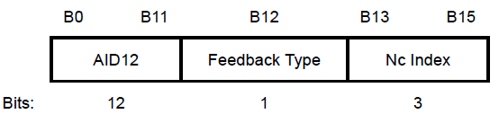
STA info field
HE NDPA
VHT NDPA
Ranging NDPA
For HE NDPA, AID11 subfield indicate the AID of STA if between 1 and 2007; indicates the Disallowed Subchannel Bitmap if equals 2047；other values are reserved
Partial BW Info subfield indicates the start and end index of the 26-tone RU for which the feedback is requested.
Nc subfield indicates the number of columns (corresponding to Nss of BFee)
Feedback Type And Ng subfield and Codebook Size subfield indicate the Ng, quantization resolution and feedback type.
Disambiguation subfield is set to 1 to prevent a non-HE VHT STA from wrongly determining its AID

Slide 8
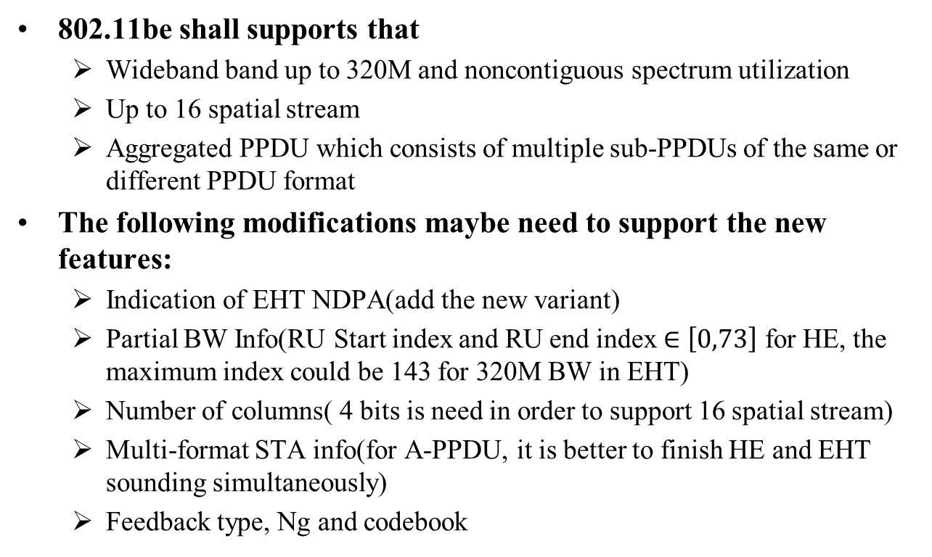
Motivations
802.11be shall supports that
  Wideband band up to 320M and noncontiguous spectrum utilization
  Up to 16 spatial stream
  Aggregated PPDU which consists of multiple sub-PPDUs of the same or different PPDU format
The following modifications maybe need to support the new features:
  Indication of EHT NDPA(add the new variant)
  Partial BW Info(RU Start index and RU end index $∈\left[0,73\right]$ for HE, the maximum index could be 143 for 320M BW in EHT)
  Number of columns( 4 bits is need in order to support 16 spatial stream)
  Multi-format STA info(for A-PPDU, it is better to finish HE and EHT sounding simultaneously)
  Feedback type, Ng and codebook

Slide 9
EHT NDPA Indication
One straightforward solution would be that using the reserved state in the Dialog Token field to indicate the EHT NDPA frame and extending the length of the STA Info field
For example, let the ETH STA Info field contains three part each with 2 bytes. Then in order to prevent a HE STA from wrongly determining its AID, the EHT STA Info field must have AID subfield in every two byte. The additional overhead is larger than the extended length, so it does not work.
Ranging | HE/VHT | Description
0 | 0 | VHT NDPA
0 | 1 | HE NDPA
1 | 0 | HE Ranging NDPA
1 | 1 | EHT NDPA

Slide 10
EHT NDPA Indication
Three options are proposed for EHT NDPA Indication:
  Option 1: Extend the length of STA Info subfield
  Option 2: Compress the Partial BW Info subfield
  Option 3: Aggregated NDPA (NDPA considering Aggregated-PPDU)

Slide 11
EHT NDPA Indication
Option 1: Extend the length of STA Info field
  Sounding Dialog Token field is set as follows
  STA Info field:
    Length of EHT STA Info can be extended to 2*n byte(e.g. n=3)
    HE STA will regards the EHT NDP as VHT NDP
    Thus only disambiguation subfield positioned at B(16*k+11)(B(i) start with i=0) for k=1, 2, …, n-1 shall be set to 1, so as to prevent a VHT STA from wrongly identifying its AID in the EHT NDPA
Ranging | HE/VHT | Description
0 | 0 | VHT or EHT NDPA
0 | 1 | HE NDPA
1 | 0 | HE Ranging NDPA
1 | 1 | Reserved

Slide 12
EHT NDPA Indication
There are many reserved state for the Partial BW Info subfield(for HE STA Info field, the RU Start index and the RU End index each occupies 7 bits, but their valid value rang is 0~73, since the maximum bandwidth is 160M)
Thus, instead of extending the length of STA Info field, the Partial BW Info subfield can be compressed for EHT
Therefore, the option 2 is proposed

Slide 13
EHT NDPA Indication
Option 2: Compress the Partial BW Info subfield
  Sounding Dialog Token field:
  STA Info field:
    The 9-bit RU Allocation subfield[4] is used to replace the Partial BW Info subfield
    The save bits can be used for Nc and other subfields
Ranging | HE | Description
0 | 0 | VHT NDPA
0 | 1 | HE NDPA
1 | 0 | HE Ranging NDPA
1 | 1 | EHT NDPA

Slide 14
EHT NDPA Indication
Option 2: Compress the Partial BW Info subfield
  STA Info field:
    Use 3 bits RU size subfield and 7 bits RU Position Index subfield to replace the Partial BW Info subfield
    The save bits can be used for Nc subfield and other subfields
RU size | Meaning | No. of RU | RU Position Index subfield
0 | 26RU | 144 | 7bits to indicated the position of 26RU in the rang of 0-127
1 | 26RU | 144 | 7bits to indicated the position of 26RU in the rang of 128-144
2 | 52RU | 64 | 6bits to indicated the position of 52RU and 1 for MRU indication
3 | 106RU | 32 | 5bits to indicated the position of 106RU and 2 for MRU indication
4 | 242RU | 16 | 4bits to indicated the position of 242RU and 3 for MRU indication
5 | 484RU | 8 | 3bits to indicated the position of 484RU and 4 for MRU indication
6 | 996RU or larger | 4 | 4bitmap to indicated the position of 996RU and 3 for MRU indication
7 | Reserved

Slide 15
EHT NDPA Indication
The EHT group has decided to support the aggregated PPDU feature(a.k.a. frequency domain aggregation of aggregated PPDUs)
To transmit EHT-HE aggregated PPDU with beamforming, both the channel sounding results of EHT SAT and HE STA are required
It is better and more efficient to finish EHT and HE sounding simultaneously
Therefore, option 3 is proposed herein

Slide 16
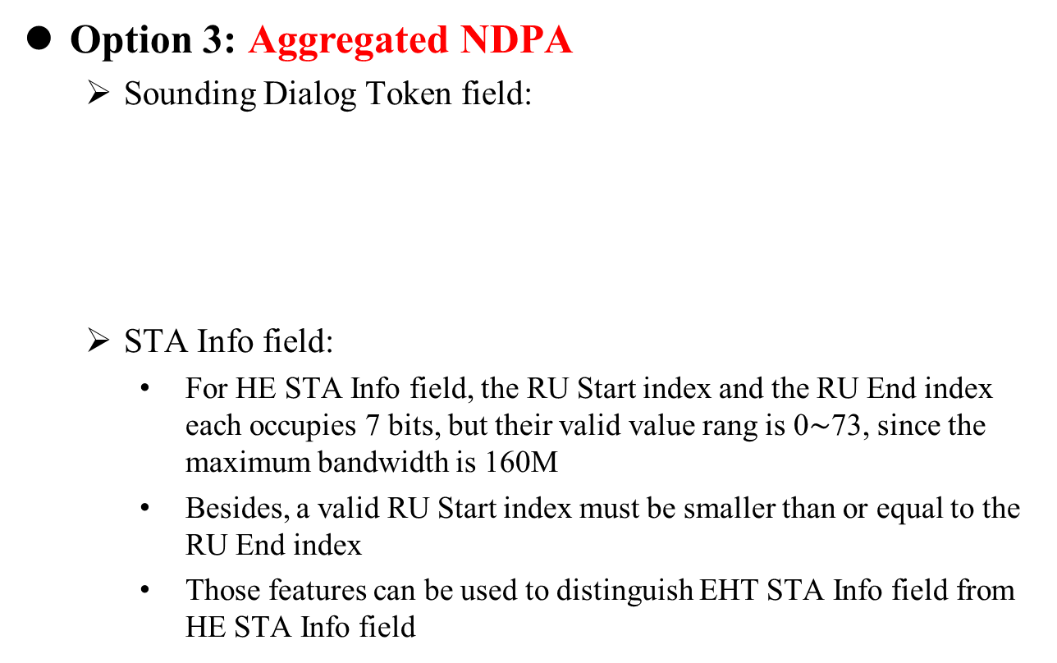
EHT NDPA Indication
Option 3: Aggregated NDPA
  Sounding Dialog Token field:
  STA Info field:
    For HE STA Info field, the RU Start index and the RU End index each occupies 7 bits, but their valid value rang is 0$\sim$73, since the maximum bandwidth is 160M
    Besides, a valid RU Start index must be smaller than or equal to the RU End index
    Those features can be used to distinguish EHT STA Info field from HE STA Info field
Ranging | HE/VHT | Description
0 | 0 | VHT NDPA
0 | 1 | HE or EHT NDPA
1 | 0 | HE Ranging NDPA
1 | 1 | Reserved

Slide 17
EHT NDPA Indication
Option 3: Aggregated NDPA
  STA Info field:
    E.g., the two MSB corresponding to the RU End index of HE STA Info field are set to 1 to indicate this STA Info field is EHT STA Info field, Otherwise, it is a HE STA Info field
    In this way, both EHT STA Info field and HE STA Info field can be in one NDPA frame, the channel for HE and EHT can be sounded simultaneously for A-PPDU transmission
    The same compression method for Partial BW indication can be used as option2
    The save bits can be used for Nc subfield and Codebook Size subfield

Slide 18
Summary
In this contribution, three EHT NDPA frame design methods are proposed, their comparisons are summarized as following:
 | Pros. | Cons.
Option 1 | Sufficient bits for EHT new features; Similar structure with HE | Large overhead due to extended length; Not supporting aggregated sounding of EHT and HE
Option 2 | The same length of STA Info subfield as HE | Not supporting aggregated sounding of EHT and HE
Option 3 | Can do the EHT and HE sounding within one NDPA; The same length of STA Info subfield as HE | Two bits EHT/HE indication in the STA Info subfield

Slide 19
References
[1] IEEE P802.11-REVmd™/D3.0
[2] IEEE P802.11ax™/D6.0
[3] IEEE P802.11az™/D2.1
[4] Specification Framework for TGbe , doc.: IEEE 802.11-20/0566r23
[5] RU Allocation Subfield Design for EHT Trigger Frame, doc.: IEEE 802.11-20/0828r0

Slide 20
SP1
Do you support to reuse the NDPA frame for EHT standard
  Y/N/Abs

Slide 21
SP2
Which NDPA frame design proposed in the contribution do you prefer
  Option 1: Extend the length of STA Info field(>4 bytes)
  Option 2: Compress the Partial BW Info subfield(4 bytes STA Info field)
  Option 3: Aggregated NDPA(4 bytes STA Info field)
  Abstain

Slide 22
SP3
Do you support to extend the length of the STA Info field in the NDPA frame for EHT, and set the Ranging subfield and HE subfield of Sounding Dialog Token subfield to 0 and 0 respectively for EHT NDPA frame
  Y/N/Abs
Ranging | HE/VHT | Description
0 | 0 | VHT or EHT NDPA
0 | 1 | HE NDPA
1 | 0 | HE Ranging NDPA
1 | 1 | Reserved

Slide 23
SP4
Do you support to set the Ranging subfield and HE subfield of Sounding Dialog Token subfield to 1 and 1 respectively to identify the frame as EHT NDPA frame, and keep the length of STA Info field for EHT to be 4 bytes
  Y/N/Abs
Ranging | HE | Description
0 | 0 | VHT NDPA
0 | 1 | HE NDPA
1 | 0 | HE Ranging NDPA
1 | 1 | EHT NDPA

Slide 24
SP5
Do you support to set the Ranging subfield and HE subfield of Sounding Dialog Token subfield to 0 and 1 respectively, and keep the length of STA Info field for EHT to be 4 bytes
  the variant of EHT or HE can be identified from the indication in the STA Info field
    Y/N/Abs
Ranging | HE/VHT | Description
0 | 0 | VHT NDPA
0 | 1 | HE or EHT NDPA
1 | 0 | HE Ranging NDPA
1 | 1 | Reserved

