Slide 1
Overlaps between IEEE 802.11ba Draft 6.0 and
ISO/IEC JTC 1/SC 6 N 17200 and ISO/IEC JTC 1/SC 6 N 17201
Date: 2020-7-6
Authors:

Slide 2
Abstract
This document compares IEEE 802.11ba Draft 6.0 and IEEE 802.11-16/605r3 against ISO/IEC JTC 1/SC 6 N 17200 and ISO/IEC JTC 1/SC 6 N 17201 project titled “Telecommunications and information exchange between systems – narrow band variable low power wake up radio signal protocols” and highlights overlaps between the two
References
  IEEE 802.11ba Draft 6.0: http://www.ieee802.org/11/private/Draft_Standards/11ba/index.html
  IEEE 802.11-16/605r3: https://mentor.ieee.org/802.11/dcn/16/11-16-0605-03-0wng-proposal-for-lp-wur-study-group.pptx
  ISO/IEC JTC 1/SC 6 N 17200 and ISO/IEC JTC 1/SC 6 N 17201: slides 115-117 in the JTC1 SC agenda: https://mentor.ieee.org/802.11/dcn/20/11-20-0812-03-0jtc-agenda-for-july-2020-virtually.pptx

Slide 3
There are considerable overlaps in the scope of project
IEEE 802.11ba PAR:
“5.2.b. Scope of the project: This amendment defines a physical (PHY) layer specification and defines modifications to the medium access control (MAC) layer specification that enables operation of a wake-up radio (WUR). The wake-up frames carry only control information. The reception of the wake-up frame by the WUR can trigger a transition of the primary connectivity radio out of sleep. The WUR is a companion radio to the primary connectivity radio and meets the same range requirement as the primary connectivity radio. The WUR devices coexist with legacy IEEE 802.11 devices in the same band. The WUR has an expected active receiver power consumption of less than one milliwatt.”
ISO/IEC JTC 1/SC 6 N 17200 :
“Scope of the proposed deliverable.
This standard proposed a method of transmitting an OOK modulated RF wake up radio signal using ISM legacy communication with adjusted payload length wake up packet in narrow band for waking up radio module of sensor devices. This standard defines an on-off keying (OOK) modulated RF wake-up technology in ISM band, for waking up IoT devices that are in sleep mode when they are not working, to reduce power consumption. It defines a method for sending the OOK modulated RF wake-up signal to a low-power, wake-up radio (LP-WUR) module through multiple packets or a single payload packet for which length has been adjusted for waking up a microprocessor control unit (MCU) of a device in sleep mode. The conditions required for implementing this technology and information on OOK modulated RF wake-up packet transfer procedure, LP-WUR module structure, PHY (modem), and MAC (Media Access Control protocol and data format) are included.
This standard describes two features as followings.
A. Adjustable Length and Number of OOK Wake up Signal Packet
-> When there are a large number of receiving IoT devices, the amount of power and distance required for the WUR module to wake up the MCU varies from IoT device to device.
B. Interoperability among ISM legacy communication
-> Using legacy communication (Wi-Fi, Bluetooth, Zigbee, etc.) in ISM band
-> This can be applied to all legacy communications by modulating the payload portion of the communication packet into an OOK wakeup signal formed by using OFDM / BPSK demodulation and etc.

Slide 4
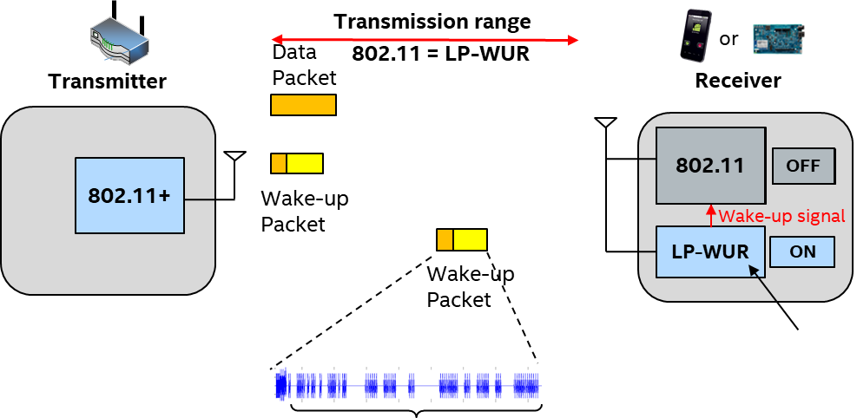
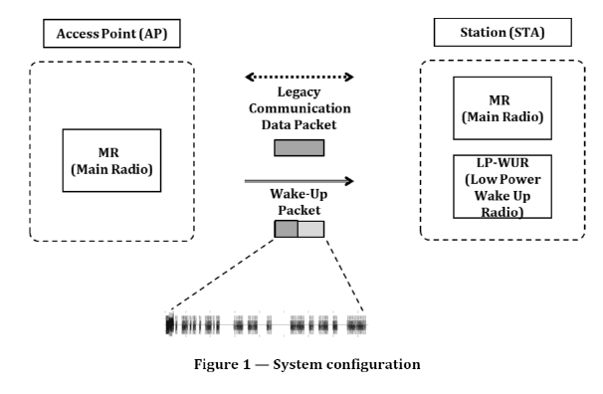
Operation scenario - System overview comparison
802.11ba [11-16/605r3, slide11]
ISO/IEC JTC 1/SC 6 N 17201 [page 3, figure 1]
=
Operation scenario and system overview overlaps between 802.11ba and ISO/IEC NP 5095
Some drawings are identical

Slide 5
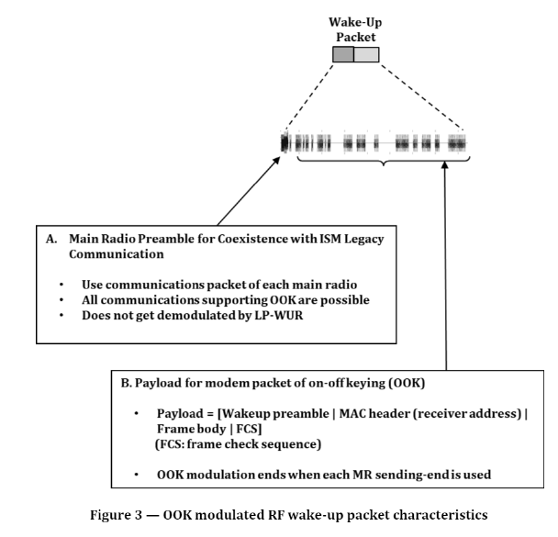
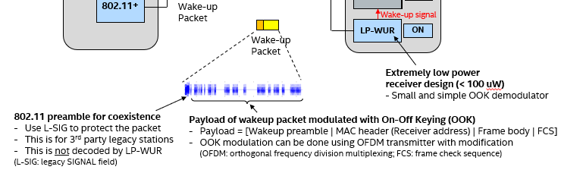
Wake-up packet design comparison
ISO/IEC JTC 1/SC 6 N 17201
[page 3, figure 3]
802.11ba [11-16/605r3, slide11]
=
Wake-up packet design overlaps between 802.11ba and ISO/IEC NP 5095
Some drawings are identical

Slide 6

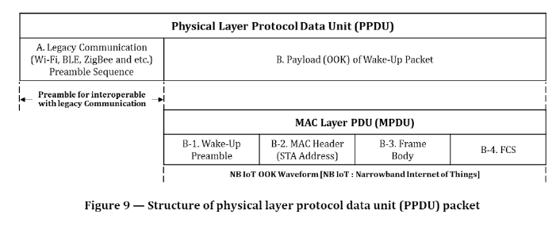
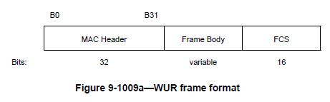
Wake-up packet PPDU structure comparison
802.11ba [Draft 6.0, page 137 and 75]
ISO/IEC JTC 1/SC 6 N 17201[page 9, figure 9]
802.11 legacy preamble
Wake-up preamble
=
Wake-up packet PPDU structure overlaps between 802.11ba and ISO/IEC WD 5095
Some drawings are identical

Slide 7
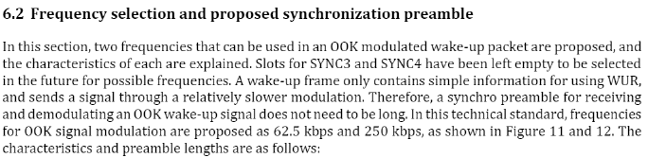
Data rate comparison
802.11ba [Draft 6.0, page 133]
“The WUR PHY provides support for data rates of 62.5 kb/s and 250 kb/s. WUR low data rate (LDR) indicates 62.5 kb/s, and WUR high data rate (HDR) indicates 250 kb/s.”
ISO/IEC JTC 1/SC 6 N 17201[page 10]
=
Supported data rates overlap between 802.11ba and ISO/IEC WD 5095

Slide 8
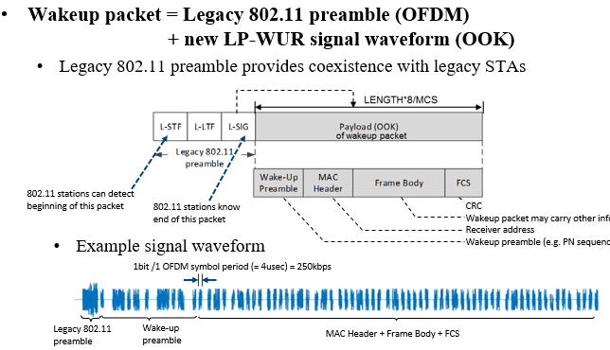
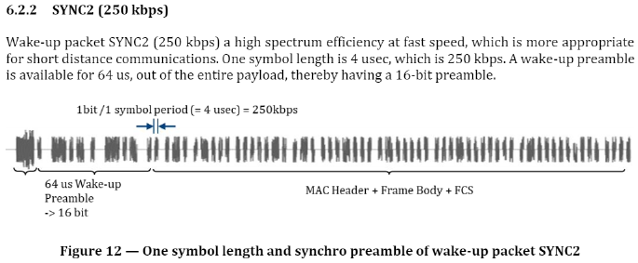
Wake-up preamble (WUR Sync) and data rate comparison
802.11ba [11-16/605r3, slide12][Draft 6.0, page 133]
ISO/IEC JTC 1/SC 6 N 17201 [page 11, figure 12]
=
Supported preamble/data rate overlap between 802.11ba and ISO/IEC WD 5095
Example waveform is identical

Slide 9
Conclusion
There are significant overlaps between IEEE 802.11ba and the ISO/IEC project proposed in ISO/IEC JTC 1/SC 6 N 17200 and ISO/IEC JTC 1/SC 6 N 17201
  Scope of the project
  Operation scenario and system overview
  Wake-up packet design and PPDU structure
  Supported data rates and wake-up preamble
  Many figures

