Slide 1
Optimized content transfer in mesh network
Date: 2020-07-13
Authors:

Slide 2
Abstract
This presentation addresses a technique for optimized content transfer in mesh network. It suggests a way to split the content to be transferred into file chunks considering the bandwidth of the channel.
The bandwidth (link quality) of destination nodes is calculated first and then content is split into chunks so that lower bandwidth channels can be utilized efficiently. In a unit time, a larger size chunk will propagate on high bandwidth, a smaller chunk will propagate on lower bandwidth channel.

Slide 3
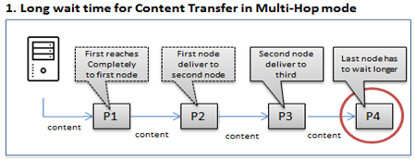
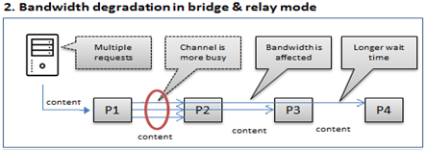
Problem Statement
In a mesh network, downloading data quickly to all nodes is time consuming.
Simultaneous download cause congestion and decrease network throughput resulting in unacceptable packet delays.
Duplicate packets transfer in mesh network throughput degrade.

Slide 4
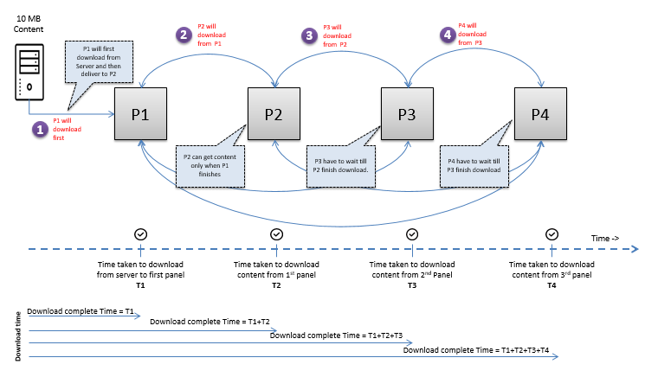
Currently two ways of downloading, (a) Download and Forward Mode
Problem1: The longer the device network, more time it takes to reach to last node.

Slide 5
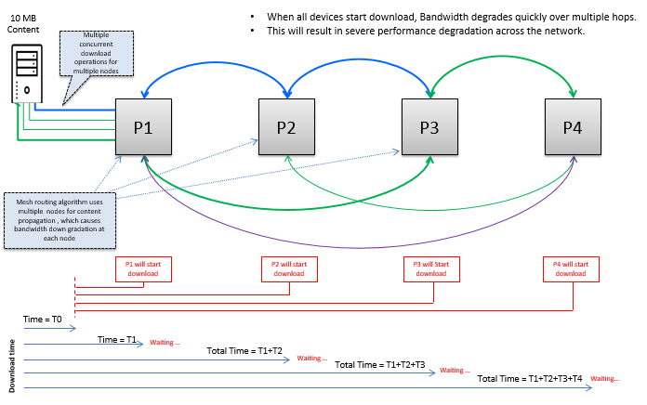
Currently two ways of downloading, (b) Simultaneous download from server
Problem2: All the devices downloading from server in mesh, results in bandwidth degradation.

Slide 6
Proposed Solution
Divide the file into chunks on the basis of node link quality & transfer on appropriate path. In a unit time, a larger chunk will reach to a good bandwidth node, in same time, a smaller chunk will reach to a lower bandwidth node.
Algorithm will assign appropriate file chunk to suitable bandwidth connection
10 MB Content
2
5MB Chunk
40Mb/s
40Mb/s
40Mb/s
P1
(5MB, 3MB, 2MB)
P2
P3
P4
10 MB file is split to bandwidth (5MB, 3MB, 2MB)
considering bandwidth
1
3MB Chunk
24Mb/s
24Mb/s
2MB Chunk
16Mb/s
Note: What is being shown above is not multicast but TCP/IP transfer.

Slide 7
Bandwidth strength table (for the nodes on selected path)
Proposed method suggests an optimization on Link State Routing by utilizing the channels of less Link quality which exists among the selected nodes for best path. The smaller data chunks will propagate on less efficient paths. The file chunk will be created that are best suitable for low bandwidth. NBS table contains information about bandwidth of nodes.
Best Path is detected using Link Quality assessment
Out of shortlisted nodes, detect the path of lower Link quality as well.
Create Bandwidth Strength table using Link Quality.
(NBS Table)
1
2
3
16Mb/s
24Mb/s
24Mb/s
No of connections
3
Connection Graphs
P1 | P2 | 40Mb/s
P1 | P3 | 24Mb/s
P1 | P4 | 16Mb/s
P2 | P1 | 40Mb/s
P2 | P3 | 40Mb/s
P2 | P4 | 24Mb/s
P3 | P1 | 24Mb/s
P3 | P2 | 40Mb/s
P3 | P4 | 40Mb/s
P4 | P1 | 16Mb/s
P4 | P2 | 24Mb/s
P4 | P3 | 40Mb/s
P1
40Mb/s
P2
P3
P4
40Mb/s
40Mb/s
P5
P6
P7

Slide 8
How it works (1) - Create NBS Table
16Mb/s
1
24Mb/s
24Mb/s
Create NBS table
40Mb/s
40Mb/s
40Mb/s
P1
P2
P3
P4
No of connections
3
Connection Graphs
P1 | P2 | 40Mb/s
P1 | P3 | 24Mb/s
P1 | P4 | 16Mb/s
P2 | P1 | 40Mb/s
P2 | P3 | 40Mb/s
P2 | P4 | 24Mb/s
P3 | P1 | 24Mb/s
P3 | P2 | 40Mb/s
P3 | P4 | 40Mb/s
P4 | P1 | 16Mb/s
P4 | P2 | 24Mb/s
P4 | P3 | 40Mb/s
No of connections
3
Connection Graphs
P2 | P1 | 40Mb/s
P2 | P3 | 40Mb/s
P2 | P4 | 24Mb/s
P1 | P2 | 40Mb/s
P1 | P3 | 24Mb/s
P1 | P4 | 16Mb/s
P3 | P1 | 24Mb/s
P3 | P2 | 40Mb/s
P3 | P4 | 40Mb/s
P4 | P1 | 16Mb/s
P4 | P2 | 24Mb/s
P4 | P3 | 40Mb/s
No of connections
3
Connection Graphs
P3 | P1 | 24Mb/s
P3 | P2 | 40Mb/s
P3 | P4 | 40Mb/s
P2 | P1 | 40Mb/s
P2 | P3 | 40Mb/s
P2 | P4 | 24Mb/s
P1 | P2 | 40Mb/s
P1 | P3 | 24Mb/s
P1 | P4 | 16Mb/s
P4 | P1 | 16Mb/s
P4 | P2 | 24Mb/s
P4 | P3 | 40Mb/s
No of connections
3
Connection Graphs
P4 | P1 | 16Mb/s
P4 | P2 | 24Mb/s
P4 | P3 | 40Mb/s
P2 | P1 | 40Mb/s
P2 | P3 | 40Mb/s
P2 | P4 | 24Mb/s
P3 | P1 | 24Mb/s
P3 | P2 | 40Mb/s
P3 | P4 | 40Mb/s
P1 | P2 | 40Mb/s
P1 | P3 | 24Mb/s
P1 | P4 | 16Mb/s
NBS table
NBS table
NBS table
NBS table

Slide 9
How it works (2) - Download the content on First Node
10 MB Content
24Mb/s
24Mb/s
40Mb/s
40Mb/s
40Mb/s
P1
(10 MB)
P2
P3
P4
2
Download content file
No of connections
3
Connection Graphs
P1 | P2 | 40Mb/s
P1 | P3 | 24Mb/s
P1 | P4 | 16Mb/s
P2 | P1 | 40Mb/s
P2 | P3 | 40Mb/s
P2 | P4 | 24Mb/s
P3 | P1 | 24Mb/s
P3 | P2 | 40Mb/s
P3 | P4 | 40Mb/s
P4 | P1 | 16Mb/s
P4 | P2 | 24Mb/s
P4 | P3 | 40Mb/s
No of connections
3
Connection Graphs
P1 | P2 | 40Mb/s
P1 | P3 | 24Mb/s
P1 | P4 | 16Mb/s
P2 | P1 | 40Mb/s
P2 | P3 | 40Mb/s
P2 | P4 | 24Mb/s
P3 | P1 | 24Mb/s
P3 | P2 | 40Mb/s
P3 | P4 | 40Mb/s
P4 | P1 | 16Mb/s
P4 | P2 | 24Mb/s
P4 | P3 | 40Mb/s
No of connections
3
Connection Graphs
P1 | P2 | 40Mb/s
P1 | P3 | 24Mb/s
P1 | P4 | 16Mb/s
P2 | P1 | 40Mb/s
P2 | P3 | 40Mb/s
P2 | P4 | 24Mb/s
P3 | P1 | 24Mb/s
P3 | P2 | 40Mb/s
P3 | P4 | 40Mb/s
P4 | P1 | 16Mb/s
P4 | P2 | 24Mb/s
P4 | P3 | 40Mb/s
No of connections
3
Connection Graphs
P1 | P2 | 40Mb/s
P1 | P3 | 24Mb/s
P1 | P4 | 16Mb/s
P2 | P1 | 40Mb/s
P2 | P3 | 40Mb/s
P2 | P4 | 24Mb/s
P3 | P1 | 24Mb/s
P3 | P2 | 40Mb/s
P3 | P4 | 40Mb/s
P4 | P1 | 16Mb/s
P4 | P2 | 24Mb/s
P4 | P3 | 40Mb/s
NBS table
NBS table
NBS table
NBS table

Slide 10
How it works (3) - Split the content
10 MB Content
16Mb/s
24Mb/s
24Mb/s
40Mb/s
40Mb/s
40Mb/s
P1
(5,3,2)
P2
P3
P4
Split the file on the basis of bandwidth
3
No of connections
3
Connection Graphs
P1 | P2 | 40Mb/s
P1 | P3 | 24Mb/s
P1 | P4 | 16Mb/s
P2 | P1 | 40Mb/s
P2 | P3 | 40Mb/s
P2 | P4 | 24Mb/s
P3 | P1 | 24Mb/s
P3 | P2 | 40Mb/s
P3 | P4 | 40Mb/s
P4 | P1 | 16Mb/s
P4 | P2 | 24Mb/s
P4 | P3 | 40Mb/s
No of connections
3
Connection Graphs
P1 | P2 | 40Mb/s
P1 | P3 | 24Mb/s
P1 | P4 | 16Mb/s
P2 | P1 | 40Mb/s
P2 | P3 | 40Mb/s
P2 | P4 | 24Mb/s
P3 | P1 | 24Mb/s
P3 | P2 | 40Mb/s
P3 | P4 | 40Mb/s
P4 | P1 | 16Mb/s
P4 | P2 | 24Mb/s
P4 | P3 | 40Mb/s
No of connections
3
Connection Graphs
P1 | P2 | 40Mb/s
P1 | P3 | 24Mb/s
P1 | P4 | 16Mb/s
P2 | P1 | 40Mb/s
P2 | P3 | 40Mb/s
P2 | P4 | 24Mb/s
P3 | P1 | 24Mb/s
P3 | P2 | 40Mb/s
P3 | P4 | 40Mb/s
P4 | P1 | 16Mb/s
P4 | P2 | 24Mb/s
P4 | P3 | 40Mb/s
No of connections
3
Connection Graphs
P1 | P2 | 40Mb/s
P1 | P3 | 24Mb/s
P1 | P4 | 16Mb/s
P2 | P1 | 40Mb/s
P2 | P3 | 40Mb/s
P2 | P4 | 24Mb/s
P3 | P1 | 24Mb/s
P3 | P2 | 40Mb/s
P3 | P4 | 40Mb/s
P4 | P1 | 16Mb/s
P4 | P2 | 24Mb/s
P4 | P3 | 40Mb/s
NBS table
NBS table
NBS table
NBS table

Slide 11
How it works (4) – Find suitable chunk, Initiate Transfer
2MB Chunk
16Mb/s
4
3MB Chunk
Initiate transfer
24Mb/s
24Mb/s
5MB Chunk
40Mb/s
40Mb/s
40Mb/s
P1
(5,3,2)
P2
P3
P4
10 MB Content
Legends
Time interval (in Sec) | P1 | P2 | P3 | P4
1 | Downloading
2 | 5,3,2
3 |  | 5 | 3 | 2
4 |  | 5,3 | 3,5 | 2,3
5 |  | 5,3,2 | 3,5,2 | 2,3,5
Node
Mission: make 10 MB content available to all 4 nodes
Download completed in 5 sec
NBS Table
NCA
Table

Slide 12
Structure of NBS & NCA Table
Node Bandwidth Strength (NBS) table
Node Content Availability (NCA) table
No of connections
3
Connection Graphs
P1 | P2 | 40Mb/s
P1 | P3 | 24Mb/s
P1 | P4 | 16Mb/s
P2 | P1 | 40Mb/s
P2 | P3 | 40Mb/s
P2 | P4 | 24Mb/s
P3 | P1 | 24Mb/s
P3 | P2 | 40Mb/s
P3 | P4 | 40Mb/s
P4 | P1 | 16Mb/s
P4 | P2 | 24Mb/s
P4 | P3 | 40Mb/s
No of Nodes
4
Nodes | File Part and Availability
P1 | FP1 (5MB) | FP2(3MB) | FP3(2MB)
 | Y | Y | Y
P2 | FP1 (5MB) | FP2(3MB) | FP3(2MB)
 | Y | N | N
P3 | FP1 (5MB) | FP2(3MB) | FP3(2MB)
 | N | Y | N
P4 | FP1 (5MB) | FP2(3MB) | FP3(2MB)
 | N | N | Y
NBS table will be created from Link Metric for best path nodes.
NBS will contain the alternative path as well along with best path but only for the nodes of best path.
This table entries will be used to split the content (file) to subparts (chunks)
NCA table at ‘T3’ i.e. third cycle of chunk transfer
NCA table will contain the information about which file part (chunk) is available on which node.
This table information will be broadcasted to whenever a node completes the chunk downloading.

Slide 13
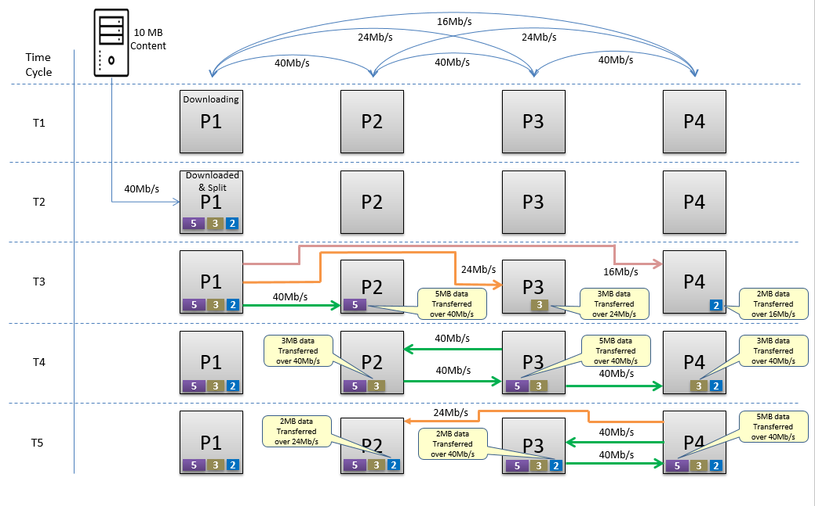
Visualization – Chunk downloading
.

Slide 14
Improvements
File splitting approach (proposed)
Legacy approach (Download and forward)
Time interval (in Sec) | P1 | P2 | P3 | P4
1 | Downloading
2 | 5,3,2
3 |  | 5 | 3 | 2
4 |  | 5,3 | 3,5 | 2,3
5 |  | 5,3,2 | 3,5,2 | 2,3,5
Time interval (in Sec) | P1 | P2 | P3 | P4
1 | Downloading
2 | 10MB
3 |  | Downloading
4 |  | 10MB
5 |  |  | Downloading
6 |  |  | 10 MB
7 |  |  |  | Downloading
8 |  |  |  | 10 MB
1
Mission: make 10 MB content available to all 4 nodes
~ 40% improvements
Time interval (in Sec) | P1 | P2 | P3 | P4 | P5
1 | Downloading
2 | Downloading
3 | 5,3,2,1 | 5 | 3 | 2 | 1
4 |  | 5 | 3 | 2 | 1
5 |  | 5,3 | 3,5 | 2,3 | 1,2
6 |  | 5,3,2 | 3,5,2 | 2,3,5 | 1,2,3
7 |  | 5,3,2,1 | 3,5,2,1 | 2,3,5,1 | 1,2,3,5
Time interval (in Sec) | P1 | P2 | P3 | P4 | P5
1 | Downloading
2 | Downloading
3 | 11MB
4 |  | Downloading
5 |  | Downloading
6 |  | 11MB
7 |  |  | Downloading
8 |  |  | Downloading
9 |  |  | 11 MB
10 |  |  |  | Downloading
11 |  |  |  | Downloading
12 |  |  |  | 11 MB
13 |  |  |  |  | Downloading
14 |  |  |  |  | Downloading
15 |  |  |  |  | 11 MB
2
Mission: make 11 MB content available to all 5 nodes
50% improvements

Slide 15
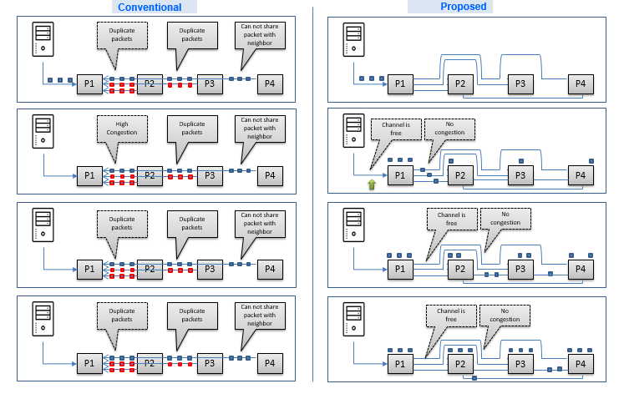
Advantages – Reduced congestion and duplicate packets

Slide 16
Implementation details
1
File distribution request initiated
2
Identify Link Quality
Bandwidth of one nodes to other node on Mesh network
3
Make Best Path
Select a best path by assessing link quality. List nodes of best path.
4
Make Alternate Path
Use selected nodes, create path which are having lesser Link Quality. Create Link Metric (NBS)
5
Split file to chunks
Read NBS table and split the file to chunks on the basis of bandwidth at one node.
6
Start chunk transfer
Assign appropriate chunk suitable for bandwidth
7
Update the location of Chunk
Chunk download successful > update NCA table
8
Broadcast NCA table
Make file Chunk location information available to all.
9
Find next chunk
Find Chunk location from NCA table & transfer chunk
10
Consume File
Merge all chunks and make original file.

Slide 17
Flow chart
Start
Check the node with best bandwidth with content server, term this as Gateway node
Content Transfer initiated
Download content to Gateway node
Link State Routing initiated for path
Link quality assessment
No
Content download finished on gateway node ?
Create best path for content transfer
Link Metric created
Yes
Get Bandwidth strength from NBS table & Split content file into chunks
Check alternative paths within best path node
Create Path List with lesser bandwidth
Add headers to file parts (Sequence No, Hash Key)
C1
Marked Link Metric NBS Table

Slide 18
Flow chart
C1
Adjust Routing with Capping as per bandwidth from NBS
Does all file parts download complete ?
Yes
Scan suitable bandwidth channel
for file part transfer
No
Check missing part on node, Scan NCA Table to find the availability of missing file-part on a nearby node
No
Is file-part suitable for channel bandwidth
Yes
Is Required file-part location found ?
Initiate file part transfer, file part received on node.
Yes
No
Update file part availability on NCA Table
Node Content availability NCA Table
Check file-part header and assemble content file.
Broadcast Content Table NCA
Stop

Slide 19
References
1. Multi-Hop Dilemma
https://www.semanticscholar.org/paper/Solving-the-Wireless-Mesh-Multi-Hop-Dilemma/122652dc85cc0bcfeba921de61f99045317b29fe
2. Mesh networking challenges in downloading
https://ieeexplore.ieee.org/stamp/stamp.jsp?arnumber=6761320
3. Latency in information delivery
https://www.researchgate.net/publication/314719782_80211s_QoS_Routing_for_Telemedicine_Service
4. Delay in synchronization
http://www.strixsystems.com/products/datasheets/strixwhitepaper_multihop.pdf
5. A New Link Scheduling Algorithm for Concurrent Tx/Rx Wireless Mesh Networks
https://ieeexplore.ieee.org/document/4533610

Slide 20
Thanks

