Slide 1
New Methods To Meet Low Latency Requirement
Date: 2020-06-03
Authors:

Slide 2
Abstract
In this submission, we discuss several new traffic engineering methods to meet low latency requirement.

Slide 3
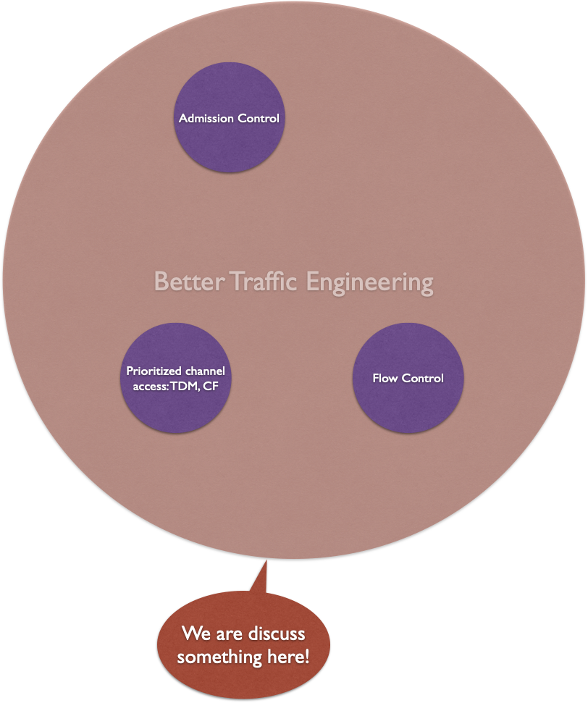
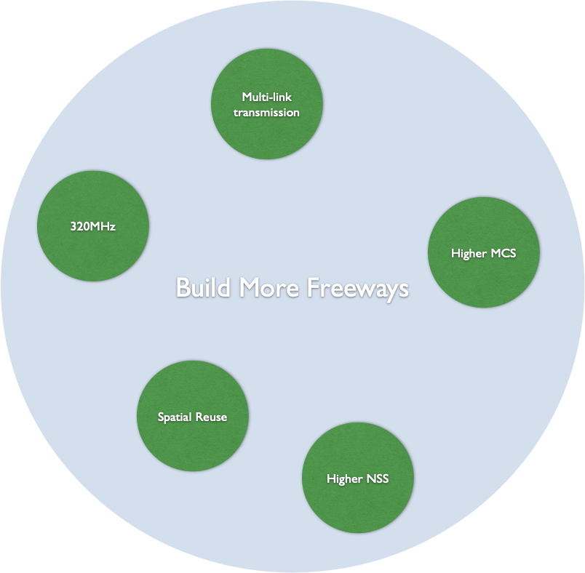
Build More Freeways vs. Better Traffic Engineering

Slide 4
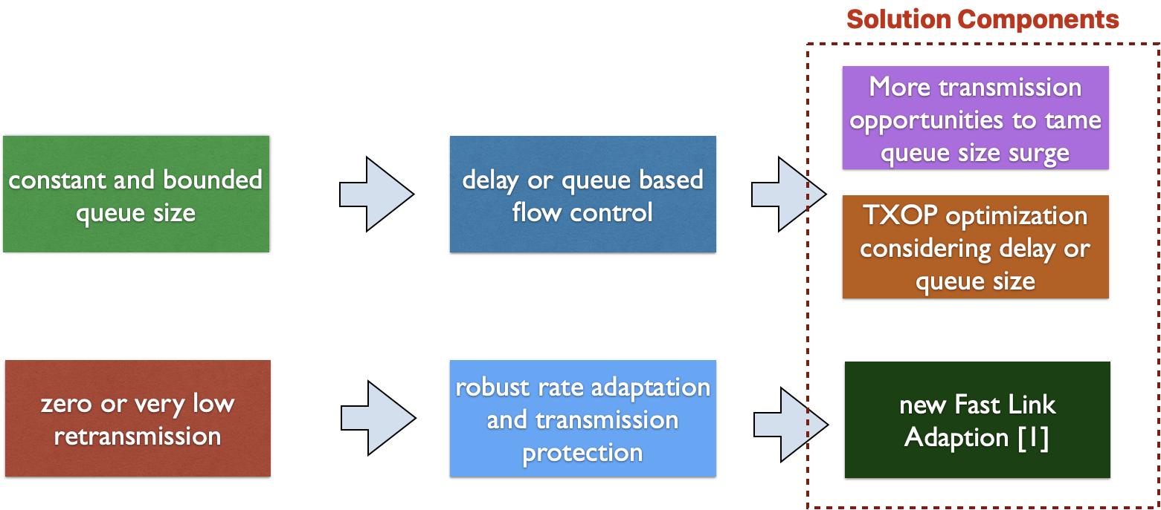
Low Latency for Flows Means

Slide 5
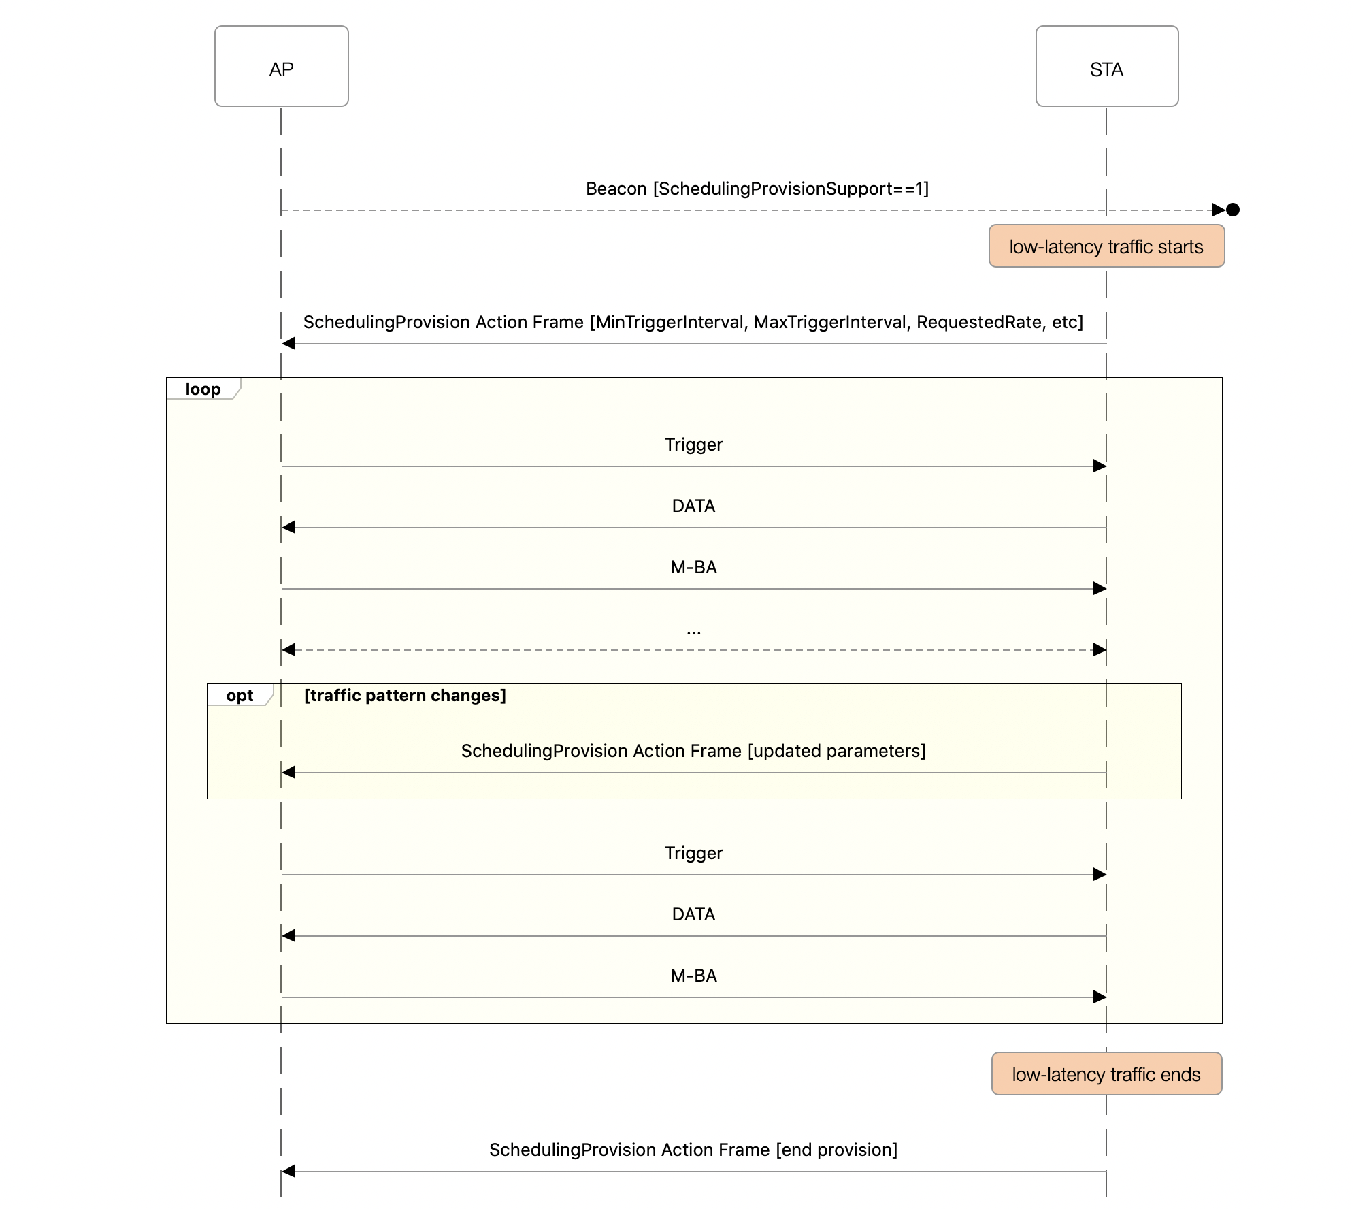
How to Get More Transmission Opportunities
Scheduling Info Provision
  More transmission opportunities: suggestion to AP on Trigger frame periodicity
  TXOP Optimization: minimum resource allocation that shall be satisfied

Slide 6
Scheduling Info Provision Operation
When a STA starts low-latency traffic, if the AP supports the scheduling according to STA’s request, the STA could provision AP the desired scheduling info
  The STA does not wait for finishing set up scheduling session before starting traffic
  The AP could use this info to optimize its scheduling
  The action frame that carries the scheduling info should be protected for privacy reasons
If traffic pattern changes, the STA should update the scheduling info
  may include other parameters in the scheduling info: per AC/TID etc
When the STA finishes the low-latency traffic, the STA should notify the supporting AP
  the AP could unilaterally tear it down if no traffic comes from the STA in predefined consecutive intervals

Slide 7

Scheduling Info Provision vs. TSPEC

Slide 8
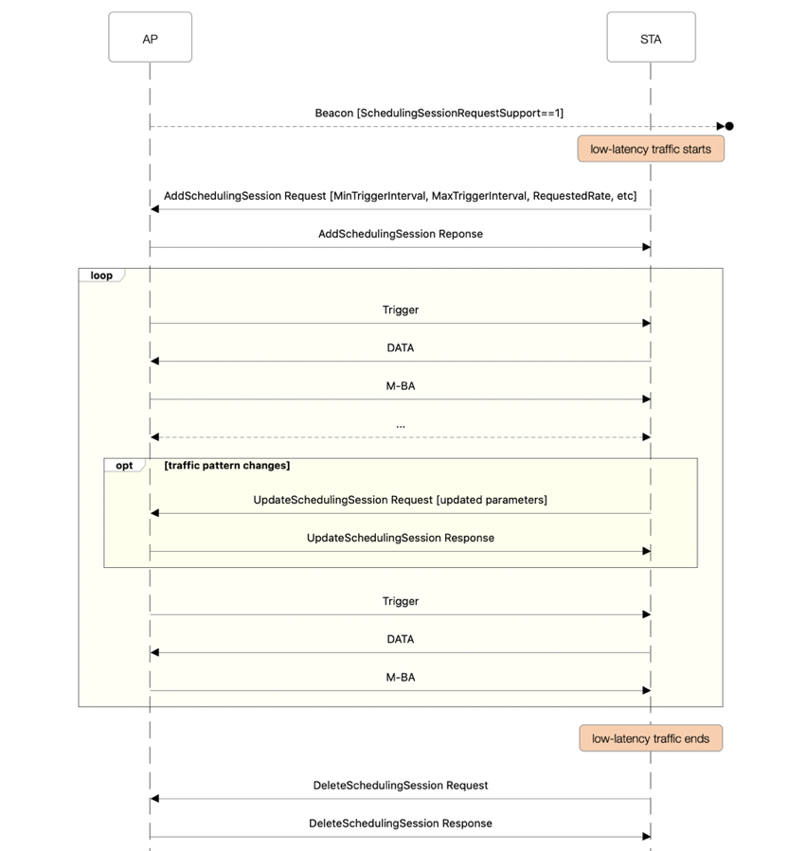
Establish an Explicit Scheduling Session

Slide 9
The Scheduling Session Operation
When a STA starts low-latency traffic, if the AP supports the scheduling session request, the STA could request AP to periodically schedule trigger-based UL transmission
  STA does not wait for finishing set up scheduling session before starting traffic
The STA uses AddSchedulingSession Request/Response frame exchange to confirm with AP its desired scheduling interval and the required resource allocation
  if AP confirms the request, AP should strive to fulfill the request
  if traffic pattern changes, the STA should update the scheduling session requirement
  may include other parameters for the scheduling session: per AC/TID etc
When the STA finishes the low-latency traffic, the STA should tear down the scheduling session
  the AP could unilaterally tear it down if no traffic comes from the STA in predefined consecutive intervals

Slide 10
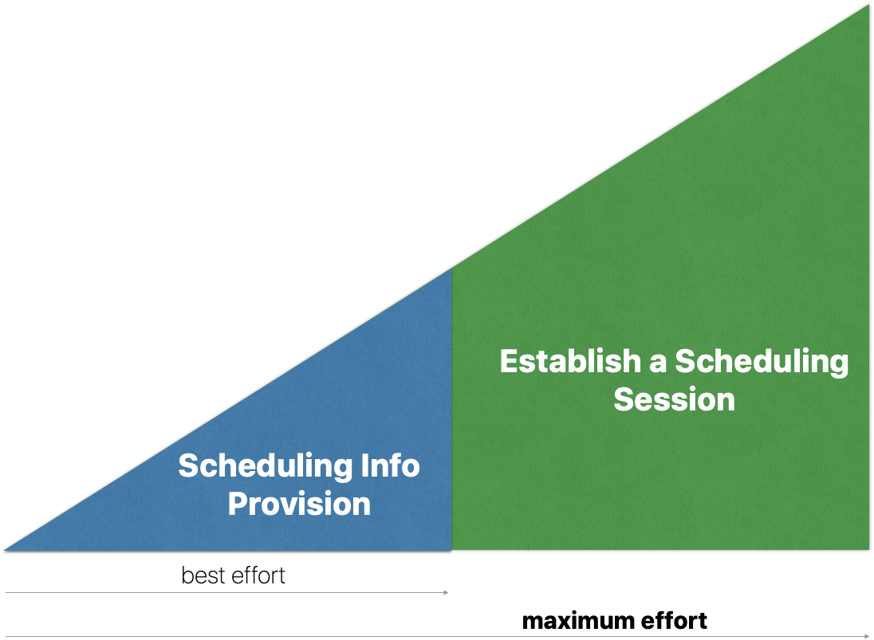
Scheduling Info Provision vs. Establishing a Scheduling Session

Slide 11
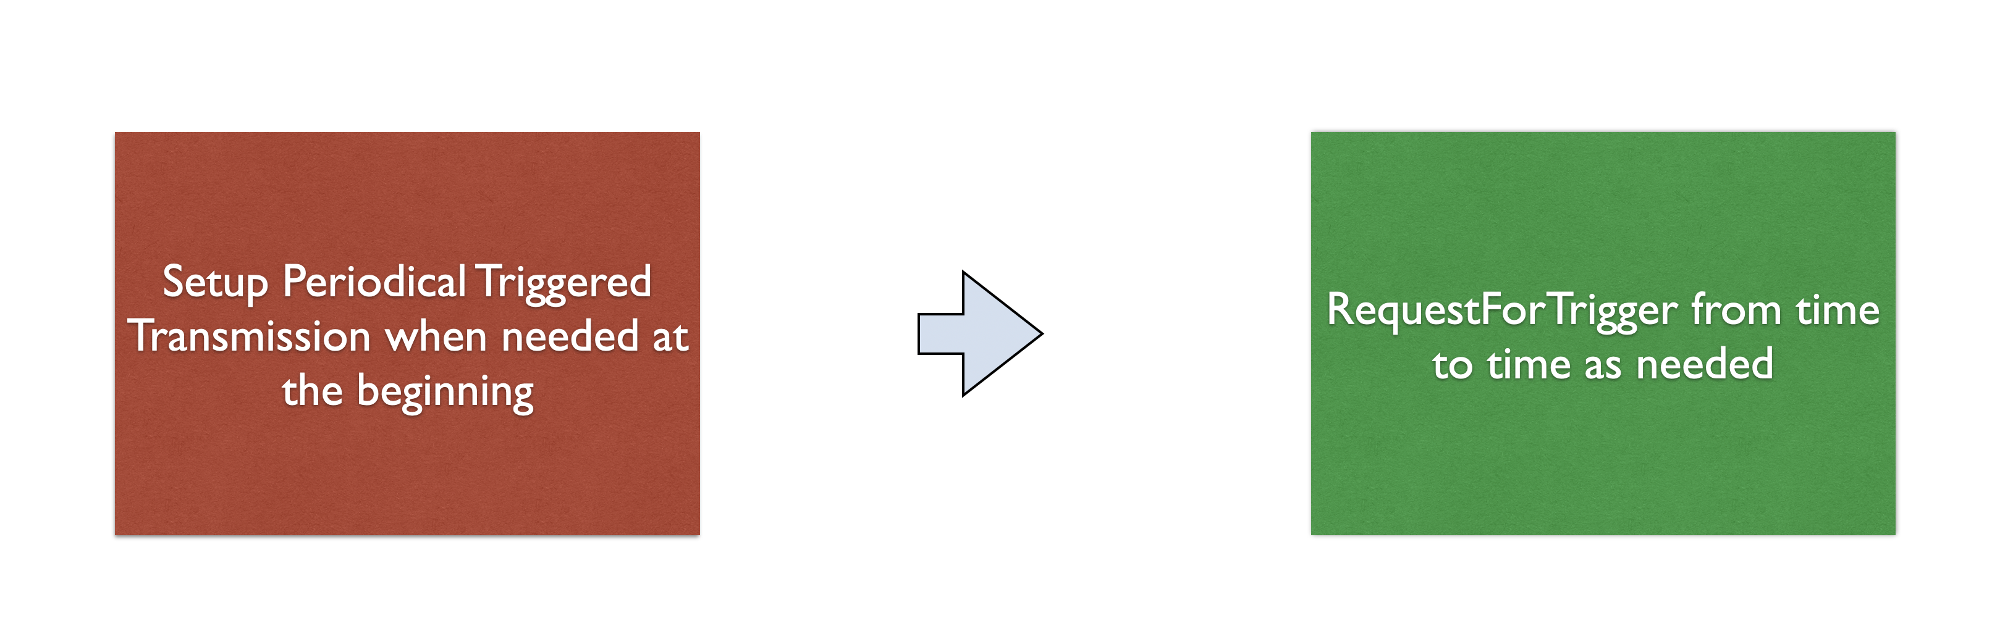
More TX Opportunities at Demand

Slide 12
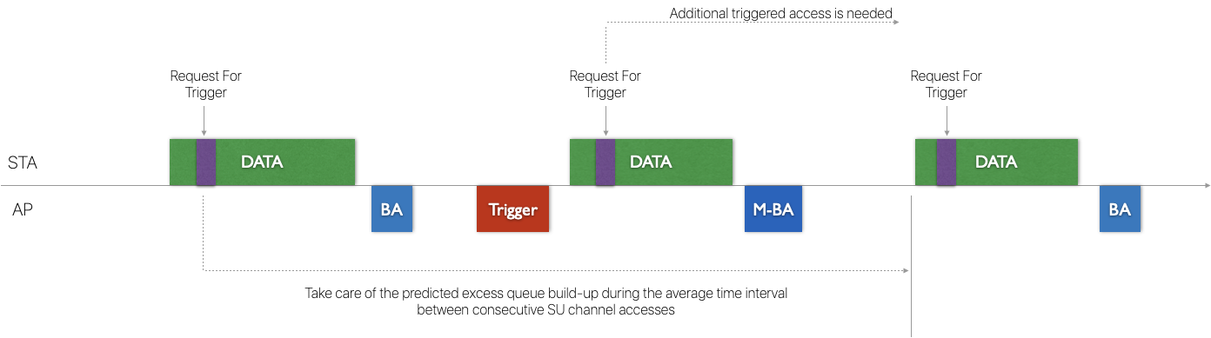
How to Get More Transmission Opportunities
Preferably, a new A-Control “Request For Trigger” is signaled to the AP including
  More transmission opportunities: suggestion on Trigger frame’s deadline, which should be earlier than tolerable queuing delay
  TXOP Optimization: minimum queue reduction to maintain bounded queue size such that trigger frame’s resource allocation shall satisfy
May design a new Control or Management Frame, aggregated with the Data frame

Slide 13
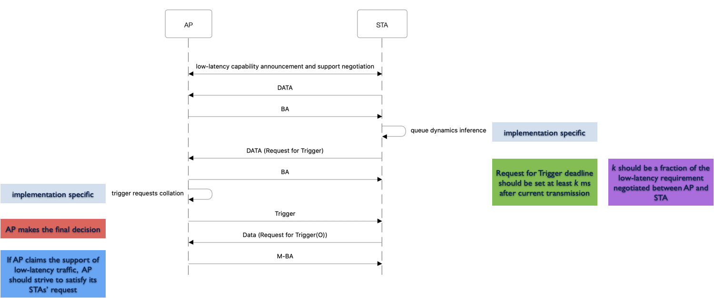
How it Works

Slide 14
Odds and Ends
By default, Request For Trigger is only for AC_VO queue
  low latency requirement shall not be for all queues
  assignment: in the same TXOP, all A-Control subfields in the A-MPDUs have the same setting, or only the A-Control subfield in the last A-MPDU has it set
  update and cancellation: In the next TXOP, if AP receives no Request For Trigger (or update), the previous received Request For Trigger should be cancelled if a corresponding Trigger frame has not been sent
Low Latency flow requirement negotiation
  put some restriction on Request For Trigger to avoid abuse
  Ex: how frequent Request For Trigger can be issued
  can extend to other access categories
  Ex: whether AC_VI queue can use Request For Trigger
Optionally, MU-EDCA[VO].ECWMIN/MAX ≈ EDCA[VO].ECWMIN/MAX
  in other words, AC_VO queue should NOT defer SU access significantly if UL MU transmission is successful unless otherwise specified
  combining both SU and MU channel access, hopefully, the number of channel access at least (1+x) times on average

Slide 15
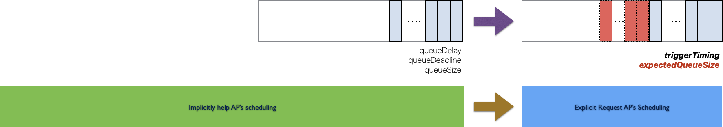
Buffer Status Report vs. Request For Trigger

Slide 16
Summary
In this submission, the following methods are discussed to get STA more transmission opportunities to meet the low latency requirement
  Scheduling Info Provision from STA to AP
  Establish Scheduling Session between STA and AP
  Request For Trigger signaled by the STA to AP

Slide 17
Straw Poll 1
Do you agree to define a robust ”Scheduling Info Provision” Action Frame for a STA to provide AP its desired scheduling information?
Y
N
A

Slide 18
Straw Poll 2
Do you agree to include the following parameters in ”Scheduling Info Provision” Action Frame:
  min trigger interval
  max trigger interval
  min resource allocation
Y
N
A

Slide 19
Straw Poll 3
Do you agree to define a procedure between AP and STA to establish a scheduling session such that the AP shall fulfill the scheduling request during the session if AP accepts the scheduling session request?
Y
N
A

Slide 20
Straw Poll 4
Do you agree to define a ”Request For Trigger” of A-Control subfield for the purpose of get a STA more transmission opportunities in a timely manner?
Y
N
A

Slide 21
Straw Poll 5
Do you agree to include the following parameters in ”Request For Trigger” A-Control Subfield:
  trigger timing
  expected queue size
Y
N
A

Slide 22
Reference
[1] Yet Another Fast Link Adaptation Attempt, DCN: 11-20-1005-01-00be-yet-another-fast-link-adaptation-attempt

