Slide 1
Discussion on methods for synchronous ML operations
Date: August 2020

Slide 2
Introduction
non-STR device
Leakage from TX on link1 cause STA of the same MLD to detect medium as BUSY on link 2
Under such considerations
Concurrent UL/Link aggregation in UL is difficult
Non-AP MLD still benefit from latency gain
DL aggregation may require special treatment for optimal performance

Slide 3
Considerations for UL aggregation
Why do we need it?
To fix/improve UL performance by enabling UL aggregation at non-STR device
Although it is mainly needed for massive/saturated UL case, i.e. limited application
Sync access typically is not frequent
Numerous contributions show that sync access (i.e. medium available on more than one link at a time) is a function of network load.
Chances for sync access are small in a busy network
Sync access would only work and provide throughput increase in a non-congested environment
If we to design a mode for UL link aggregation at non-STR devices, it:
need to work for both congested and non-congested environments and be network independent
need to follow existing regulations
need to be fair to legacy devices as well as STR MLD STAs.
not to violate/break existing EDCA mechanism
naturally extend existing EDCA mechanism w/o adding new mode of operation

Slide 4
Overview of proposals/ideas
There are multiple proposals for link aggregation for both STR and non-STR devices
Primary/Secondary concept. Contention on “primary/anchor” link + PIFS ED check on secondary
Independent contention on both links + PIFS ED check. The winning link “invite” the other link into sync transmission if the other link is IDLE for PIFS
Independent contention on both links
+ PIFS ED check + NAV check
+ PIFS ED + NAV + “add truncated slots back”
+ Medium IDLE with slots truncation + “add truncated slots back” + “link alternation”
AP assisted UL aggregation. STA send a frame to solicit TF on two links. PIFS ED check used on AP side might be used
AP initiated UL aggregation with PPDU end alignment to later send TF for UL
PIFS seems to be in favor as a very simple option to use
despite associated problems

Slide 5
Problem(s) statement(s)
Independent EDCA operation on each link
To get most of ML benefits we need treat each link as an independent link
Each link have its own load and its own interference picture
Each STA of a non-STR MLD is in sync with other STAs operating on that links (i.e. CCA, NAV, etc).
To not PIFS or not to PIFS – that is a regulatory question.
Coexistence/fairness with legacy/STR MLD devices require special attention
It is clear that PIFS access brings unfairness to other devices
New rules need to be introduced to address fairness in most cases
A STA of non-STR MLD does not hear a STA!
deafness caused by TX on another link may require some special handling
No blindness recovery mechanisms currently agreed/defined
PIFS-initiated TX disrupt EDCA “synchronization” of an invited link
Each successful TX on a link reset CW. PIFS access would unfairly shorten existing recovery process on a link
PIFS approach unfairly shorten channel access time regardless of network state on that link
In case of unequal link load, more loaded/congested link may end up transmitting mostly because of invitations from less loaded link and not because own EDCA process

Slide 6
Proposal 0 (PIFS)
PIFS based approach:
Perform contention on both links.
The winning link can trigger transmission on another link if medium of another link is IDLE for PIFS (ED check)
Does not solve the unfairness issue since STA still gets more channel access than using regular EDCA.
Advance ahead entire backoff sequence
Does not take into account interference/congestion/NAV of invited links
In presence of many non-STR devices can easily lead to double collision
BUSY
Back-off
SIFS
CTS
6GHz
STA
7
6
5
AIFSN
4
3
2
1
0
RTS
A-MPDU
Invite
BUSY
SIFS
CTS
5GHz
AIFSN
STA
9
8
7
6
5
RTS
A-MPDU
Transmit if PIFS IDLE

Slide 7
Proposal 1 (ePIFS)
Enhanced PIFS:
Perform contention on both links. The winning link can trigger transmission on another link if
medium of another link is IDLE for PIFS (ED check) and NAV not set
Credit based system to promote fairness – at next backoff add slots to the invited link
Fairer as it add “truncated slots” back to the counter of invited link
This only “advance” one current contention but not the following ones.
Issues:
NAV check might be a problem
Non-STR STA naturally suffer from deafness and may not have up-to-date NAV information
Still does not address unequal load problem
Lightly loaded link 1 can have multiple opportunities to invite link 2 using PIFS access giving unfair advantage over other devices operating on link 2
Link which is add slots back to counter may be over excessively punished in case of consecutive invites. Link “alternation” or some other mechanism may be required to avoid this problem
6GHz
TX BUSY
Back-off
SIFS
CTS
STA
7
6
5
4
3
2
1
0
RTS
A-MPDU
Invite
5GHz
BUSY
SIFS
CTS
STA
9
8
7
6
5
4
3
2
RTS
A-MPDU
Transmit if PIFS IDLE and NAV not set

Slide 8
Proposal 2 (Wait Slot)
Each STA of an MLD follows regular EDCA mechanism on each link independently.
A STA can perform synchronous PPDU transmission if BO on both links reaches zero
the STA on link 1 may hold the BO counter at zero value until BO of link 2 reaches zero
while waiting for link 2, STA on link 1 continue monitoring medium state of link 1
after EDCA count down procedure is completed on both links and medium on both links is IDLE MDL can transmit synchronously on that links
Certainly fair to legacy STAs and EHT STAs on both link.
Does not promote channel access of any STA of the MLD of any link
Keep NAV/CCA/contention synchronization with other devices on any link intact
Flexible
STA on link 1 may choose to wait for link 2 if BO of a STA on link 2 is near completion and/or channel on link 1 is not expected to change.
STA may decide to proceed with transmission w/o waiting the other link
does not get penalized in advance for choosing larger BO window (i.e. do not chose BO for both links at the same time)
BUSY
Back-off
SIFS
CTS
6GHz
STA
7
6
5
4
3
2
1
0
0
0
RTS
A-MPDU
BUSY
Back-off
SIFS
CTS
5GHz
3
2
1
0
STA
9
8
7
6
5
4
RTS
A-MPDU

Slide 9
Proposal 2 (Wait Slot) cont.
There may be issue if medium on one of the link became busy
Multiple STAs in a BSS may hold their BO count at the zero value
At next contention they may transmit simultaneously resulting in collisions.
Following option address this problem
Case 1: When link 1 becomes busy, and link 1 is waiting at BO equal to zero, link 1 shall not transmit and shall draw a new random number without modifying the CW (internal collision)
Case 2: When link 2 becomes busy, and link 1 is waiting at BO equal to zero, link 1 shall not transmit and shall draw a new random number without modifying the CW (internal collision)
Case 1
Case 2
6GHz/Link 1
BUSY
Back-off
BUSY
Internal collision
TXOP
STA
6
5
4
3
2
1
0
0
New BO
6
5
4
3
2
1
0
7
6
5
4
3
2
1
0
Internal collision
New BO
5GHz/Link 2
BUSY
Back-off
TXOP
BUSY
STA
9
8
7
6
5
4
3
2
1
0
9
8
7
6
5
4
3

Slide 10
Simulation results unequal link load
1 AP, 1 STA, 1x1x80, MCS11
Full buffer in UL direction
RTS ON, AMPDU = 256 frames
Added interference:
Link 1 has 1 OBSS
Link 2 has 1-8 OBSSes
OBSS consist of 1 AP/1 STA with 6Mbps load in both directions
15Kb chunk of data arrive every 20ms (fragmented in 1.5k frames)
OBSS STA/AP deliver data using MCS0
Random OBSS TXOP size between 0.5ms and 5ms for every transmission
A single 15Kb chunk require ~3.7-4ms for complete delivery

Slide 11
TXOP initiation on a link
STA of a non-STR device has limited ability to initiate TXOP of link
upon completion of contention on link 1 it check status of link 2
link 2 might be performing some actions that can be affected by leakage such as receive or expect to receive response frame
Link 1 allowed to initiate TXOP if status of link 2 is
SLOT (i.e. in backoff)
PIFS IDLE
PIFS + NAV not set
RX
If STA on link 2 is not an intended receiver of ongoing reception
Otherwise Link 1 cannot initiate TXOP

Slide 12
Throughput comparison
 |  |  | SYNC modes |  |  | Delta vs ASYNC , async=100% |  |  | %
Load, airtime | # BSS on a link 2 | Async, Mbps | ePIFS, Mbps | PIFS, Mbps | Wait, Mbps | vs ePIFS | vs PIFS | vs Wait | Wait vs ePIFS
0% | 0 | 553.9 | 1087.6 | 1094.9 | 1091.2 | 96.3 | 97.7 | 97.0 | -0.3
20 | 1 | 477.5 | 600.0 | 609.4 | 578.6 | 25.7 | 27.6 | 21.2 | 3.7
40 | 2 | 354.7 | 371.3 | 399.1 | 369.9 | 4.7 | 12.5 | 4.3 | 0.4
60 | 3 | 337.0 | 363.1 | 389.9 | 350.3 | 7.7 | 15.7 | 3.9 | 3.7
80 | 4 | 336.4 | 361.8 | 380.9 | 352.5 | 7.5 | 13.2 | 4.8 | 2.6
100 | 5 | 333.2 | 356.1 | 376.5 | 349.9 | 6.9 | 13.0 | 5.0 | 1.8
120 | 6 | 331.4 | 353.8 | 372.6 | 346.1 | 6.8 | 12.4 | 4.4 | 2.2
140 | 7 | 322.6 | 355.7 | 369.0 | 342.5 | 10.3 | 14.4 | 6.2 | 3.9
160 | 8 | 331.6 | 341.6 | 374.5 | 340.5 | 3.0 | 12.9 | 2.7 | 0.3
For low load case performance of SYNC modes is
nearly identical
And significantly higher than Async mode of operation
When network became congested all schemes converge to single link like performance of with Async channel access
Expect to see non-STR STA throughput performance numbers close to Async access in majority of use cases

Slide 13
Attempts for synchronization
 |  | Load, airtime = 0% |  | Load, airtime = 20% |  | Load, airtime = 100%
 |  | Sync | Async | Sync | Async | Sync | Async
ePIFS | Link 1 | 784 | 2 | 301 | 463 | 11 | 35
 | Link 2 | 1084 | 3 | 331 | 464 | 79 | 1072
PIFS | Link 1 | 954 | 2 | 297 | 509 | 44 | 191
 | Link 2 | 923 | 4 | 308 | 487 | 88 | 1006
WAIT | Link 1 | 976 | 2 | 244 | 587 | 18 | 138
 | Link 2 | 883 | 3 | 247 | 558 | 20 | 1098
Async mean # of unsuccessful invitations for concurrent transmission, recorded at "invited" side
Sync mean # of successful invitations for concurrent transmission, recorded at "invited" side
% of sync transmission
load, airtime | ePIFS | PIFS | WAIT
0 | 99.7 | 99.7 | 99.7
20 | 39.2 | 37.8 | 27.3
40 | 11.9 | 13.6 | 5.3
60 | 10.3 | 12.7 | 3.7
80 | 10.1 | 11.8 | 3.8
100 | 9.1 | 10.9 | 3.8
120 | 9.2 | 9.9 | 3.1
140 | 10.3 | 9.7 | 3.6
160 | 8.9 | 11.0 | 2.9
With minor load there is a good chance of concurrent synchronous transmissions on two links
As network load increase chances dropping to ~10% for PIFS based access and ~3-5% for WAIT access

Slide 14
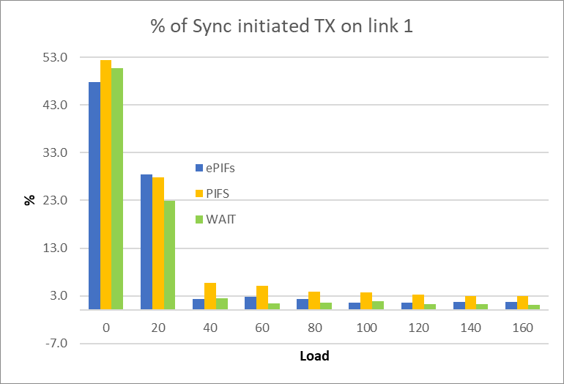
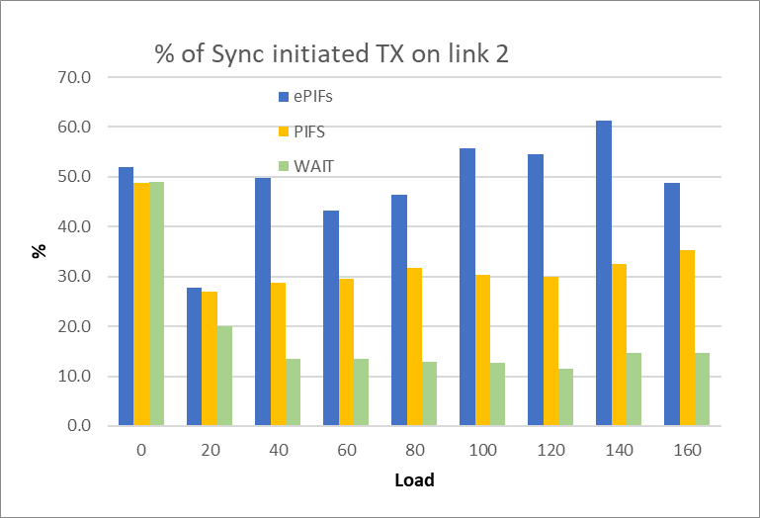
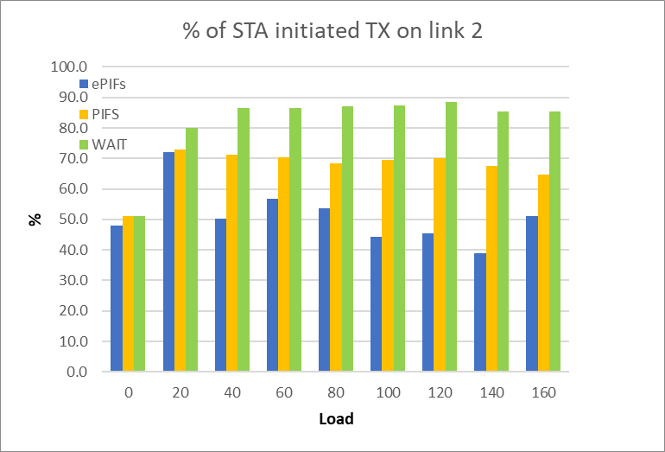
Fairness issues of medium access on Link 2
*SYNC initiated transmission – transmission that started because of “invitation from the other link”
**STA/SELF initiated transmission - transmission that started because of winning contention on the link
In non-congested case WAIT and PIFS modes have similar number of SYNC-initiated TXOPs
In congested cases about 50% of transmissions on link 2 are SYNC-initiated in PIFS case
Link 1 (less congested) simply trigger/initiate TXOP on link 2 (more congested)
Half of initiated TXOP happens regardless of EDCA state on link 2
PIFS-based access create disbalance in access between links

Slide 15
Summary
In a non congested environment all solutions work equally well
PIFS access looks attractive but comes with inherent defects.
Most of PIFS-based variants does not provide fairness
Some variations of PIFS-based access can improve fairness to other devices but does not address unequal load/congestion problem
PIFS based methods disrupt regular EDCA operations on a link
More importantly, subject to regulatory constraints
With minimal changes we can introduce a mechanism which utilize existing standard EDCA process for sync cannel access
Does not require regulatory changes
Keep EDCA operation of legacy and STR MLD devices intact
Keep fairness to other devices
Address (i.e. does not require anything) issue of unequal link load
Enable alignment of UL transmissions in a fair way.

Slide 16
Generalization for all use cases
Wait proposal (as well as other proposals for sync access) initially targeted problems of sync UL aggregation of non-STR device as non-STR non-AP MLD naturally suffer from cross interference require aid to improve its performance
But it can be generalized for any use cases including
STR AP MLD to non-STR STA
STR AP would need a mechanism for efficient DL operation with non-STR STA (as receiver is a non-STR device) and may benefit from concurrent reception
non-STR AP to non-STR STA.
non-STR AP would need a mechanism to synchronize DL transmission for efficient communications (as it is non-STR device)
STR AP to STR STA
In certain cases even STR device would want to perform synchronized transmission. Example: STA on link1 may send 64 frames (out of 64 possible) . If STA on link 2 finish contention of link 2 before reception of BA on link 1 it will not be able send anything since it reached BA scoreboard limit.
Generalization would enable use cases above at no cost and
Reduce spec complexity – no need to describe rules for separate type of devices
Enable unified channel access mechanism as existing EDCA
Help to avoid discussion on devices classification and when they entitled to use “Regular EDCA” or EDCA + WAIT access”
Enhance STR devices capabilities and improve performance in certain use cases

Slide 17
SP
An MLD that intends to align the start time of the PPDUs sent on more than one link shall ensure that EDCA count down procedure is completed on all the links
Note: An MLD is the sole originator of an intended sync transmission
Note: Whether STR MLD can use this mechanism is TBD

Slide 18
SP1’
A non-STR MLD that intends to align the start time of the PPDUs sent on more than one link shall ensure that EDCA count down procedure is completed on all the links
Note: An MLD is the sole originator of an intended sync transmission
Note: Whether to extend this mechanism to STR MLD is TBD

Slide 19
SP2
Do you agree to extend mechanism proposed in SP1 to STR MLD use case?

Slide 20
Backup

Slide 21
Illustration of unfairness of PIFS

