Slide 1
Discussion on methods for synchronous ML operations
Date: August 2020

Slide 2
Abstract
Review of various UL aggregation proposals.
Propose to propose a simpler proposal.
Simulation showtime

Slide 3
Introduction
non-STR device
  Leakage from TX on link1 cause STA of the same MLD to detect medium as BUSY on link 2
Under such considerations
  Concurrent UL/Link aggregation in UL is difficult
  Non-AP MLD still benefit from latency gain
  DL aggregation may require special treatment for optimal performance

Slide 4
Overview of proposals/ideas
There are multiple proposals for link aggregation for both STR and non-STR devices
  Primary/Secondary concept. Contention on “primary/anchor” link + PIFS ED check on secondary
  Independent contention on both links + PIFS ED check. The winning link “invite” the other link into sync transmission if the other link is IDLE for PIFS
  Independent contention on both links + PIFS ED check + NAV check
  Independent contention on both links + PIFS ED + NAV + slots adjustment. The invited link add truncated slots back at the next contention
  AP assisted UL aggregation. STA send a frame to solicit TF on two links. PIFS ED check used on AP side
  AP initiated UL aggregation. AP use PPDU end alignment to later trigger UL on two links at the same time
PIFS seems to be in favor as a very simple option to use
  despite associated problems

Slide 5
Problem(s) statement(s)
Independent EDCA operation on each link
  To get most of ML benefits we need treat each link as an independent link
  Each link have its own load and its own interference picture
  Each STA of a non-STR MLD is in sync with other devices operating on that links (i.e. CCA, NAV, etc).
To not PIFS or not to PIFS – that is a regulatory question.
Coexistence with legacy/STR MLD devices is not properly studied
  Although it is clear that PIFS access brings unfairness to other devices
A STA of non-STR MLD does not hear a STA!
  deafness caused by TX on another link may require some special handling
PIFS-initiated TX disrupt EDCA “synchronization” of an invited link
  Each successful TX on a link reset CW. PIFS access would unfairly shorten existing recovery process on a link
  PIFS approach unfairly shorten channel access time regardless of network state on that link
  In case of unequal link load, more loaded/congested link may end up transmitting mostly because of invitations from less loaded link and not because own EDCA process

Slide 6
Considerations for UL aggregation
Why we need it?
  To fix/improve UL performance by enabling UL aggregation at non-STR device
  Although it is mainly needed for massive/saturated UL case, i.e. limited application
Sync access typically is not frequent
  Numerous simulation results shows that sync access (i.e. medium available on more than one link at a time) is a function of network load.
  Chances for sync access is small in busy network
  Sync access would only provide performance increase work in a non-congested environment
If we to design a mode for UL link aggregation at non-STR devices, it:
  need to work for both congested and non-congested environments and be network independent
  need to follow existing regulations
  need to be fair to legacy devices as well as STR MLD STAs.
  not to violate/break existing EDCA mechanism
  naturally extend existing EDCA mechanism w/o adding new mode of operation

Slide 7
Solutions

Slide 8
Proposal 0 (PIFS)
PIFS based approach:
  Perform contention on both links.
  The winning link can trigger transmission on another link if medium of another link is IDLE for PIFS (ED check)
    Does not solve the unfairness issue since STA still gets more channel access than using regular EDCA.
    Advance ahead entire backoff sequence
    Does not take into account interference/congestion on invited links
    In presence of many non-STR devices can easily lead to double collision
AP
BUSY
Back-off
SIFS
CTS
6GHz
STA
7
6
5
4
3
2
1
0
RTS
A-MPDU
Invite
AP
BUSY
SIFS
CTS
5GHz
STA
9
8
7
6
5
4
3
2
RTS
A-MPDU
Transmit if PIFS IDLE

Slide 9
Proposal 1 (ePIFS)
Enhanced PIFS:
  Perform contention on both links. The winning link can trigger transmission on another link if
    medium of another link is IDLE for PIFS (ED check) and NAV not set
    Credit based system to promote fairness
      At next backoff add slots to the invited link
  Fairer as it add “boosted slots” back to the counter of invited link
    This only “advance” one current contention but not the following ones.
Issues:
  NAV check might be a problem
    Non-STR STA naturally suffer from deafness and may not have up-to-date NAV information
  Still does not address unequal load problem
    Lightly loaded link 1 can have multiple opportunities to invite link 2 using PIFS access giving unfair advantage over other devices operating on link 2
    Link which is forced to increase backoff counter may be over excessively punished in case of consecutive invites. Link “alternation” may be required to avoid this problem
6GHz
AP
BUSY
Back-off
SIFS
CTS
STA
7
6
5
4
3
2
1
0
RTS
A-MPDU
Invite
5GHz
AP
BUSY
SIFS
CTS
STA
9
8
7
6
5
4
3
2
RTS
A-MPDU
Transmit if PIFS IDLE and NAV not set

Slide 10
Proposal 2 (Sync Slot)
Following successful transmission, both STAs sets backoff count to same value either min or max of two links.
  Not fair to other STAs if the number = MIN of two links
  Not fair to itself if number = MAX of two links.
More favorable solution
  Does not rely of blind PIFS ED check
  Mostly reuses baseline EDCA.
  More fair to others
In congested environment STA may hurt itself in some occasions due to interruption by other STAs
Require same sync start time which may not be available
AP
Back-off
SIFS
CTS
6GHz
STA
5
4
3
2
1
0
RTS
A-MPDU
Backoff counters of STAs in the MLD are set to the common value.
AP
Back-off
SIFS
CTS
5GHz
5
4
3
2
1
0
RTS
A-MPDU
STA

Slide 11
Proposal 3 (Wait Slot)
Each STA of an MLD follows regular EDCA mechanism on each link independently.
A STA can perform synchronous PPDU transmission if BO on both links reaches zero
  the STA on one link 1 may hold the BO counter at some value until BO counter on link 2 reaches same value
  After that STA continue BO count down on both links
Certainly fair to legacy STAs and EHT STAs on both link.
  Does not promote channel access of any STA of the MLD of any link
  Keep NAV/CCA/contention synchronization with other devices intact
Flexible
  STA on one link 1 may choose to wait for link 2 if BO of a STA on link 2 is near completion and/or channel on link 1 is not expected to change.
  STA may decide to proceed with transmission w/o waiting the other link
  does not get penalized in advance for choosing larger BO window (i.e. do not chose BO for both links at the same time)
  As a generalization of proposal 2, STA on link 1 instead of holding may increase its BO at any time to align BO across links
AP
BUSY
Back-off
SIFS
CTS
6GHz
STA
7
6
5
4
3
2
1
1
1
0
RTS
A-MPDU
AP
BUSY
Back-off
SIFS
CTS
5GHz
3
2
1
0
STA
9
8
7
6
5
4
RTS
A-MPDU

Slide 12
Proposal 3 (Wait Slot) cont.
There may be issue with Wait slot if medium on a waiting link became busy
  Multiple STAs in a BSS may hold their BO count at the same value (e.g. at zero) so at next contention may transmit simultaneously resulting in collisions.
Following options may be considered to resolve this:
  Option 1. (no holding BO at zero):
    If a link 1 reaches BO equal zero, it may be re-loaded with the current BO count of the link 2 if link 2 is idle.
    If link 1 reaches BO equal zero, and link 2 is busy, then link 1 shall either transmit or draw a new random number without modifying the CW.
  Option 2 (generalized Option 1):
    At any time, if both links are idle, the link with the smaller BO count may be re-loaded with the BO count of the link with the larger BO count.
    If link 1reaches BO equal zero, and link 2 is busy, then link 1 shall either transmit or draw a new random number without modifying the CW or re-load with link 2 BO count.
  Option 3 (hold BO at zero):
    When link 2 becomes busy, and link 1 is waiting at 0: link 1 shall not transmit and shall draw a new random number without modifying the CW (internal collision)
    When link 1 becomes busy, and link 1 is waiting at 0: link 1 shall not transmit and shall draw a new random number without modifying the CW (internal collision)

Slide 13
Simulation results unequal link load
1 AP, 1 STA, 1x1x80, MCS11
Full buffer in UL direction
RTS ON, AMPDU = 256 frames
Added interference:
  Link 1 has 1 OBSS
  Link 2 has 1-8 OBSSes
  OBSS consist of 1 AP/1 STA with 6Mbps load in both directions
    15Kb chunk of data arrive every 20ms (fragmented in 1.5k frames)
    OBSS STA/AP deliver data using MCS0
    Random OBSS TXOP size between 0.5ms and 5ms for every transmission
    A single 15Kb chunk require ~3.7-4ms for complete delivery

Slide 14
TXOP initiation on a link
Non-STR device upon completion of contention on link 1 check status of link 2
Link 1 allowed to initiate TXOP if status of link 2 is
  IDLE
  SLOT (i.e. in backoff)
  PIFS
  PIFS + NAV not set
  RX
    If STA on link 2 is not an intended receiver of ongoing reception
Otherwise Link 1 cannot initiate TXOP

Slide 15
Throughput comparison
 |  |  |  |  |  | Delta vs ASYNC , async=100% |  |  | %
Load, airtime | # BSS | Async, Mbps | ePIFS, Mbps | PIFS, Mbps | Wait, Mbps | vs ePIFS | vs PIFS | vs Wait | Wait vs ePIFS
0% | 0 | 553.9 | 1087.6 | 1094.9 | 1091.2 | 96.3 | 97.7 | 97.0 | -0.3
20 | 1 | 477.5 | 600.0 | 609.4 | 578.6 | 25.7 | 27.6 | 21.2 | 3.7
40 | 2 | 354.7 | 371.3 | 399.1 | 369.9 | 4.7 | 12.5 | 4.3 | 0.4
60 | 3 | 337.0 | 363.1 | 389.9 | 350.3 | 7.7 | 15.7 | 3.9 | 3.7
80 | 4 | 336.4 | 361.8 | 380.9 | 352.5 | 7.5 | 13.2 | 4.8 | 2.6
100 | 5 | 333.2 | 356.1 | 376.5 | 349.9 | 6.9 | 13.0 | 5.0 | 1.8
120 | 6 | 331.4 | 353.8 | 372.6 | 346.1 | 6.8 | 12.4 | 4.4 | 2.2
140 | 7 | 322.6 | 355.7 | 369.0 | 342.5 | 10.3 | 14.4 | 6.2 | 3.9
160 | 8 | 331.6 | 341.6 | 374.5 | 340.5 | 3.0 | 12.9 | 2.7 | 0.3
For low load case performance of Sync modes is nearly identical
  And significantly higher than Async mode of operation
When network became congested all schemes converge to 1-link like performance of regular Async channel access
Expect to see non-STR STA throughput performance numbers close to Async access in majority of use cases

Slide 16
Attempts for synchronization
 |  | Load, airtime = 0% |  | Load, airtime = 20% |  | Load, airtime = 100%
 |  | Sync | Async | Sync | Async | Sync | Async
ePIFS | Link 1 | 784 | 2 | 301 | 463 | 11 | 35
 | Link 2 | 1084 | 3 | 331 | 464 | 79 | 1072
PIFS | Link 1 | 954 | 2 | 297 | 509 | 44 | 191
 | Link 2 | 923 | 4 | 308 | 487 | 88 | 1006
WAIT | Link 1 | 976 | 2 | 244 | 587 | 18 | 138
 | Link 2 | 883 | 3 | 247 | 558 | 20 | 1098
% of sync transmission
load, airtime | ePIFS | PIFS | WAIT
0 | 99.7 | 99.7 | 99.7
20 | 39.2 | 37.8 | 27.3
40 | 11.9 | 13.6 | 5.3
60 | 10.3 | 12.7 | 3.7
80 | 10.1 | 11.8 | 3.8
100 | 9.1 | 10.9 | 3.8
120 | 9.2 | 9.9 | 3.1
140 | 10.3 | 9.7 | 3.6
160 | 8.9 | 11.0 | 2.9
With minor load there is a good chance of concurrent synchronous transmissions on two links
As network load increase chances dropping to ~10% for PIFS based access and ~3-5% for WAIT access
Async mean # of unsuccessful invitations for concurrent transmission, recorded at "invited" side
Sync mean # of successful invitations for concurrent transmission, recorded at "invited" side

Slide 17
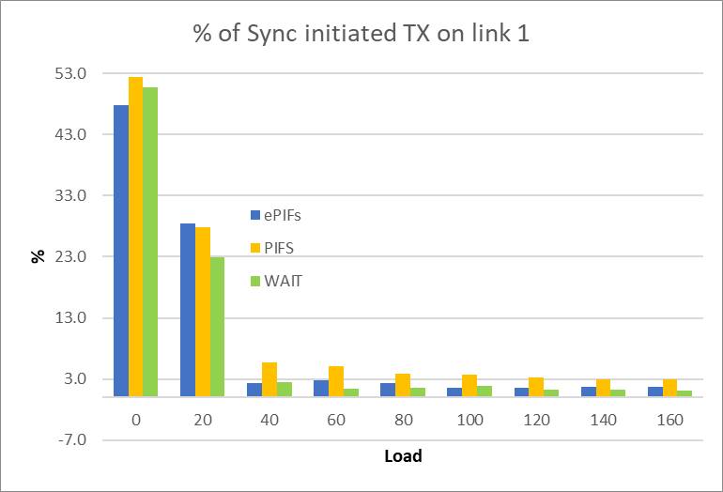
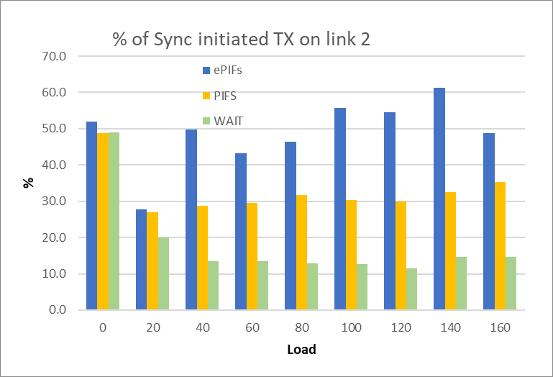
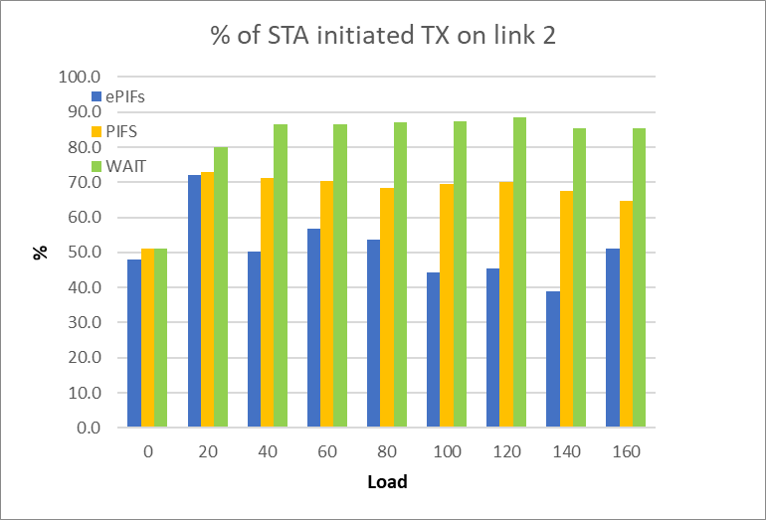
Fairness of medium access on Link 2
In non-congested case WAIT and PIFS-based modes have similar number of SYNC-initiated TXOPs
In more congested case with PIFS-access about 50% or more of transmissions on link 2 are SYNC-initiated.
  Link 1 (less congested) simply trigger/initiate TXOP on link 2 (more congested)
  Half of initiated TXOP happens regardless of EDCA state on link 2
Both PIFS and ePIFS access create disbalance in access between links

Slide 18
Summary
In non congested environment all solutions work equally well
PIFS access looks attractive but comes with inherent defects.
  Most of PIFS-based variants neither provide fairness
  Some variations of PIFS-based access can improve fairness to other devices but does not address unequal load/congestion problem
  All PIFS based methods disrupt regular EDCA operations on a link
  All are subject to regulatory constraints
With minimal changes we can introduce a mechanism which utilize existing standard EDCA process for sync cannel access
  Does not require regulatory changes
  Keep EDCA operation of legacy and STR MLD devices intact
  Keep fairness to other devices
  Address (i.e. does not require anything) issue of unequal link load
  Enable alignment of UL transmissions in a fair way.

Slide 19
SP
Do you support that in 11be a STA MLD that intends to align the start of PPDU transmissions on more than one link can only do so when BO counters for the corresponding EDCAF on that links reach zero value or if there are no BO

Slide 20
Backup

Slide 21
Illustration of unfairness of PIFS

