Slide 1
Discussion on methods for synchronous ML operations
Date: 2020-07-03
Authors:

Slide 2
Abstract
Review of various UL aggregation proposals.
Propose to propose a simpler proposal.
Simulation showtime

Slide 3
Introduction
non-STR device
  Leakage from TX on link1 cause STA of the same MLD to detect medium as BUSY on link 2
Under such considerations
  Concurrent UL/Link aggregation in UL is difficult
  Non-AP MLD still benefit from latency gain
  DL aggregation may require special treatment for optimal performance

Slide 4
Problem(s) statement(s)
There are multiple proposals for link aggregation for both STR and non-STR devices
  With Primary/Secondary channel. Contention on Primary and PIFS ED check on secondary
  With independent contention on both links and PIFS access. The winning link does PIFS ED on another link
  Using independent contention and PIFS access with NAV check
  Using independent contention and PIFS access with NAV check and slots adjustment
  AP assisted UL aggregation. STA send TF frame to solicit TF on two links. PIFS may be involved
  AP initiated UL aggregation. AP use PPDU end alignment to later trigger UL on two links at the same time
  TBD contention and PIFS access with TBD fix
  PIFS seems to be in favor as a very efficient and simple option to use despite the following:
To not PIFS or not to PIFS – that is a regulatory question.
Coexistence with legacy devices / STR MLD devices is not studied

Slide 5
Problem(s) statement(s)
Independent EDCA operation
  To get most of ML benefits we treat each link as an independent link for communication
  Each link have it’s own load and it’s own interference picture
  Each link is in sync with other devices operating on that link (i.e. CCA, NAV, etc). PIFS access disrupt this synchronization
  Each successful transmission on a link reset CW value to MIN. So PIFS-initiated transmission from another link unfairly shorten existing recovery process
  Each PIFS initiated transmission unfairly shorten channel access time regardless of network state on that link
A STA of non-STR STA does not hear a STA !
  deafness from another link may require some special handling
All these need to be addressed for “Combined Channel Access/Link aggregation on non-STR device” mode which is designed:
  Primarily in an attempt to just to fix/enable UL aggregation at non-STR device
  And very likely only needed for massive/saturated UL case

Slide 6
In an urgent need for UL aggregation
Performance/timeline considerations
Sync access typically is not frequent
  Sync access (i.e. medium available for both or more links at the same time) is a function of network load.
  Chances for sync access is small in a congested network
If we to design a mode to enable UL link aggregation at non-STR devices
  it need to work for both congested and non-congested environments.
  be network independent
  need to follow existing regulations
  be fair to legacy devices as well as STR MLD STAs.
  not violate/break existing EDCA mechanism

Slide 7
Solution
Next, we present potential solutions that are proposed by others in offline and IEEE discussions.
We also present our preferred solution in slide 11 and further enhancements to it in slide 17.

Slide 8
Option 0 (PIFS)
PIFS based approach:
  Perform contention on both links.
  The winning link can trigger transmission on another link if medium of another link is IDLE for PIFS (ED check)
    Does not solve the unfairness issue since STA still gets more channel access than using regular EDCA.
    Advance ahead entire backoff sequence
    Does not take into account interference/congestion on invited links
    In presence of many non-STR devices can easily lead to double collision
STA MLD’s backoff
Link2
UL A-MPDU1
DL BA1
UL A-MPDU3
Link1
UL A-MPDU2
DL BA2
UL A-MPDU4
Transmit if PIFS IDLE

Slide 9
Option 1 (ePIFS)
Enhanced PIFS:
  Perform contention on both links. The winning link can trigger transmission on another link if
    medium of another link is IDLE for PIFS (ED check) and NAV not set
  Invited link shall modify it’s backoff counter by some rule, for example, by doubling existing counter or by adding number of slots it took winning link to count down to zero
  More fair as it add “boosted slots” back to the counter of invited link
    This only “advance” one current contention but not the following ones.
  NAV check might be a problem
    Non-STR STA naturally suffer from deafness and may not have up-to-date NAV information
  Still does not address unequal load problem
    Lightly loaded link 1 can have multiple opportunities to invite the other link 2 using PIFS access giving unfair advantage over other devices operating on that link 2
    Link which is forced to increase backoff counter may be over excessively punished in case of consecutive invites
    Link “alternation” may be introduced as solution
STA MLD’s backoff being 0
Link2
UL A-MPDU1
DL BA1
UL A-MPDU3
Transmit if PIFS idle + No NAV set even if backoff countdown is not zero
Link1
UL A-MPDU2
DL BA2
UL A-MPDU4

Slide 10
Option 2 (Sync Slot)
Following successful transmission, both STAs sets backoff count to same value either min or max of two links.
  Not fair to other STAs if the number = MIN of two links
  Not fair to itself if number = MAX of two links.
More favorable solution
  Does not rely of blind PIFS ED check
  Mostly reuses baseline EDCA.
  More fair to others
In congested environment STA may hurt itself in some occasions due to interruption by other STAs
Require same sync start time which may not be available
AP
Back-off
SIFS
CTS
6GHz
STA
5
4
3
2
1
0
RTS
A-MPDU
Backoff counters of STAs in the MLD are set to the common value.
AP
Back-off
SIFS
CTS
5GHz
5
4
3
2
1
0
RTS
A-MPDU
STA

Slide 11
Proposal (Wait Slot)
Each STA of an MLD follows regular EDCA mechanism on each link independently.
A STA can perform synchronous PPDU transmission if backoff counters on both links reaches zero
  the STA on one link may hold the backoff counter at some value until backoff counter on another link reaches same value
  After that STA continue backoff count down on both links
Certainly fair to other legacy STAs and EHT STAs in both link.
  Does not promote channel access of any STA of the MLD of any link
  Keep NAV/CCA/contention synchronization with other devices intact
Flexible
  STA may use this if backoff of other link is near completion and/or channel is not expected to change.
  as STA on one may decide to proceed with transmission w/o waiting the other link
  does not get penalized in advance for choosing larger backoff window (i.e. do not chose backoff for both links at the same time)
  As a generalization of option 2, STA on link 1 instead of holding may increase its backoff at any time to align backoffs across links
Further optimization possible (see slide 17).
6GHz
AP
Transmission to other STA
Back-off
SIFS
CTS
STA
7
6
5
4
3
2
1
1
1
0
RTS
A-MPDU
5GHz
AP
Transmission to other STA
Back-off
SIFS
CTS
STA
9
8
7
6
5
4
3
2
1
0
RTS
A-MPDU
Notes:
If medium got occupied while STA on link 1 was waiting for link2 it may subtract number of idle slots spent holding backoff at X from the next backoff counter value

Slide 12
Simulation results unequal link load
1 AP, 1 STA, 1x1x80, MCS11
Full buffer in UL direction
RTS ON, AMPDU = 256 frames
Added interference:
  Link 1 has 1 OBSS
  Link 2 has 1-8 OBSSes
    OBSS consist of 1 AP/1 STA with 6Mbps load in both directions
    15Kb chunk of data arrive every 20ms (fragmented in 1.5k frames)
    OBSS STA/AP deliver data using MCS0
    Random OBSS TXOP size between 0.5ms and 5ms for every transmission
    A single 15Kb chunk require ~3.7-4ms for complete delivery

Slide 13
TXOP initiation on a link
Non-STR device upon completion of contention on link 1 check status of link 2
Link 1 allowed to initiate TXOP if status of link 2 is
  IDLE
  SLOT (i.e. in backoff)
  PIFS
  PIFS + NAV not set
  RX
    If STA on link 2 is not an intended receiver of ongoing reception
Otherwise Link 1 cannot initiate TXOP

Slide 14
Throughput comparison
 |  |  |  |  |  | Delta vs ASYNC , async=100% |  |  | %
Load, airtime | # BSS | Async, Mbps | ePIFS, Mbps | PIFS, Mbps | Wait, Mbps | vs ePIFS | vs PIFS | vs Wait | Wait vs ePIFS
0% | 0 | 553.9 | 1087.6 | 1094.9 | 1091.2 | 96.3 | 97.7 | 97.0 | -0.3
20 | 1 | 477.5 | 600.0 | 609.4 | 578.6 | 25.7 | 27.6 | 21.2 | 3.7
40 | 2 | 354.7 | 371.3 | 399.1 | 369.9 | 4.7 | 12.5 | 4.3 | 0.4
60 | 3 | 337.0 | 363.1 | 389.9 | 350.3 | 7.7 | 15.7 | 3.9 | 3.7
80 | 4 | 336.4 | 361.8 | 380.9 | 352.5 | 7.5 | 13.2 | 4.8 | 2.6
100 | 5 | 333.2 | 356.1 | 376.5 | 349.9 | 6.9 | 13.0 | 5.0 | 1.8
120 | 6 | 331.4 | 353.8 | 372.6 | 346.1 | 6.8 | 12.4 | 4.4 | 2.2
140 | 7 | 322.6 | 355.7 | 369.0 | 342.5 | 10.3 | 14.4 | 6.2 | 3.9
160 | 8 | 331.6 | 341.6 | 374.5 | 340.5 | 3.0 | 12.9 | 2.7 | 0.3
For low load case performance is nearly identical
If network became congested all schemes converge to 1-link like performance of regular Async channel access
Async access – rulezzz in majority of use cases

Slide 15
Attempts for synchronization
 |  | Load, airtime = 0% |  | Load, airtime = 20% |  | Load, airtime = 100%
 |  | Sync | Async | Sync | Async | Sync | Async
ePIFS | Link 1 | 784 | 2 | 301 | 463 | 11 | 35
 | Link 2 | 1084 | 3 | 331 | 464 | 79 | 1072
PIFS | Link 1 | 954 | 2 | 297 | 509 | 44 | 191
 | Link 2 | 923 | 4 | 308 | 487 | 88 | 1006
WAIT | Link 1 | 976 | 2 | 244 | 587 | 18 | 138
 | Link 2 | 883 | 3 | 247 | 558 | 20 | 1098
% of sync transmission
load, airtime | ePIFS | PIFS | WAIT
0 | 99.7 | 99.7 | 99.7
20 | 39.2 | 37.8 | 27.3
40 | 11.9 | 13.6 | 5.3
60 | 10.3 | 12.7 | 3.7
80 | 10.1 | 11.8 | 3.8
100 | 9.1 | 10.9 | 3.8
120 | 9.2 | 9.9 | 3.1
140 | 10.3 | 9.7 | 3.6
160 | 8.9 | 11.0 | 2.9
With zero/light load a there is a good chance of concurrent synchronous transmissions on two links
As network load increase chances dropping to ~10% for PIFS based access and ~3-5% for WAIT access
Async mean # of unsuccessful invitations for concurrent transmission, recorded at "invited" side
Sync mean # of successful invitations for concurrent transmission, recorded at "invited" side

Slide 16
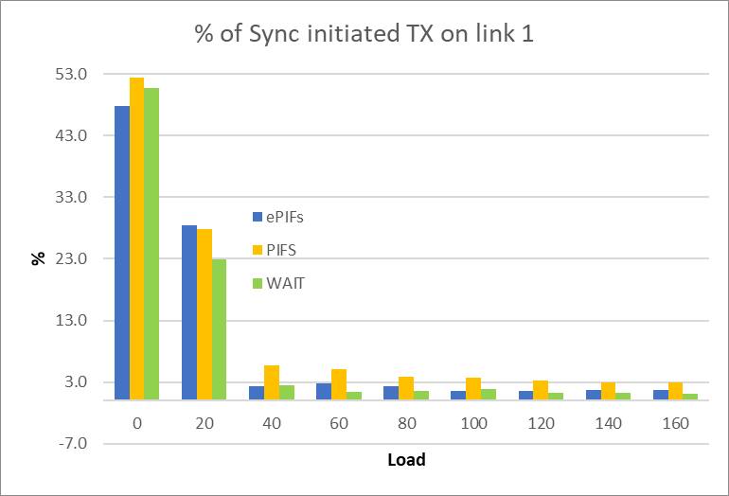
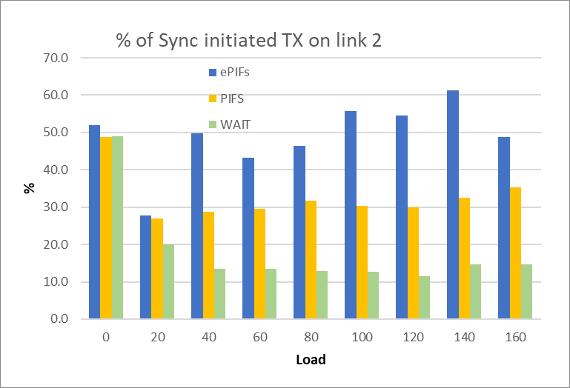
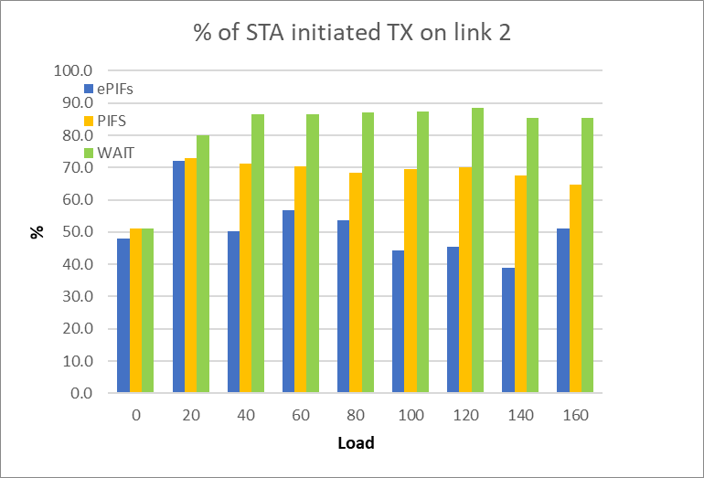
Fairness of medium access on Link 2
Both PIFS and ePIFS access create significant disbalance in access between links
In non-congested case WAIT, PIFS and ePIFS provide similar number of SYNC-initiated TXOPs
In more congested case with ePIFS-access about 50% or more of transmissions on link 2 are SYNC-initiated.
  Link 1 (less congested) simply trigger/initiate TXOP on link 2 (more congested)
  Half of initiated TXOP happens regardless of EDCA state on link 2

Slide 17
Enhancement to wait slot
There may be issue with Wait slot if multiple STAs hold their backoff count to zero and then simultaneously transmit resulting in collisions.
Following options to enhance the wait slot mechanism may be considered to resolve this:
  Option 1(no holding BO at zero):
    If a link reaches BO equal zero, it may be re-loaded with the current BO count of the other link if the other link is idle.
    If linkA reaches BO equal zero, and linkB is busy, then link A shall either transmit or draw a new random number without modifying the CW.
  Option 2 (generalized Option 1):
    At any time, if both links are idle, the link with the smaller BO count may be re-loaded with the BO count of the link with the larger BO count.
    If linkA reaches BO equal zero, and linkB is busy, then linkA shall either transmit or draw a new random number without modifying the CW or re-load with linkB BO count.
  Option 3 (hold BO at zero):
    When linkB becomes busy, and linkA is waiting at 0: linkA shall not transmit and shall draw a new random number without modifying the CW (internal collision)
    When linkA becomes busy, and linkA is waiting at 0: linkA shall not transmit and shall draw a new random number without modifying the CW (internal collision)

Slide 18
Summary
In non congested environment all solutions work equally well
PIFS access looks attractive but comes with inherent defects.
  Most of PIFS-based variants neither provide fairness nor address issues of unequal link load/congestion
  Some variations of PIFS-based access can improve fairness to other devices STA but still does not address unequal load/congestion problem
  All PIFS based methods disrupt regular EDCA operations on a link
  All are subject to regulatory constraints
With minimal changes we introduce a mechanism which utilize existing standard EDCA mechanism
  Does not require regulatory changes
  Keep EDCA operation of legacy and STR MLD devices intact
  Keep fairness to other devices
  Address (i.e. does not require anything) issue of unequal link load
  Enable alignment of UL transmissions in a fair way.

Slide 19
Straw Poll
Do you support that in 11be a STA that intends to align the start of PPDU transmissions on more than one link may hold its backoff counter of one link to match it to the one on another link to achieve synchronous count down process with the goal of reaching zero on both links at the same time
  Exact method to decide when to modify slot counter is implementation dependent

Slide 20
Backup

Slide 21
Illustration of unfairness of PIFS

