Slide 1
Channel Access for STR AP MLD with non-STR non-AP MLD
Date: 2020-07-01
Authors:
Name | Company | Address | Phone | Email
Liangxiao Xin | Sony Corporation |  |  | Liangxiao.Xin@sony.com
Mohamed Abouelseoud |  |  |  | Mohamed.Abouelseoud@sony.com
Yusuke Tanaka |  |  |  | Yusuke.YT.Tanaka@sony.com
Kosuke Aio |  |  |  | Kosuke.Aio@sony.com
Yongho Seok | MediaTek |  |  | Yongho.Seok@mediatek.com

Slide 2
Introduction
STR AP MLD and non-STR non-AP MLD are expected to be supported in R1[1]
For STR AP MLD and non-STR non-AP MLD:
  Non-STR MLD is not able to receive on one link while transmitting on another link simultaneously due to the in-device coexistence interference
  It is not decided yet how STR AP MLD contends the channel and reserves the TXOP on multiple links [2-9]
  There are fairness issues regarding channel access among STR AP MLD and non-STR non-AP MLD that is needed to be discussed.
In this presentation, we discuss channel access and reservation for STR AP MLD and non-STR non-AP MLD

Slide 3
Motivation
Problem 1: How to launch transmission on multi-link?
  Synchronized channel access on multiple links is attractive and easily can enable PPDU alignment but difficult to achieve.
  Asynchronized channel access on multiple links is more practical but needs extra work to enable PPDU alignment
Problem 2: How to end transmission on multi-link?
  There is no restriction on TXOP reservation on multiple links
  When STR AP MLD and non-STR non-AP MLD coexists, channel access fairness issues can prevent non-STR non-AP MLD from accessing the channel
We propose to enable flexible channel access and TXOP reservation restriction in cases of STR AP MLD and non-STR non-AP MLD
  STR AP MLD is flexible to start transmitting on multiple links at the same/different time depending on the channel condition
  When accessing a new link, STR AP MLD should limit its TXOP reservation on the new link such that it does not exceed any active TXOPs on other links

Slide 4
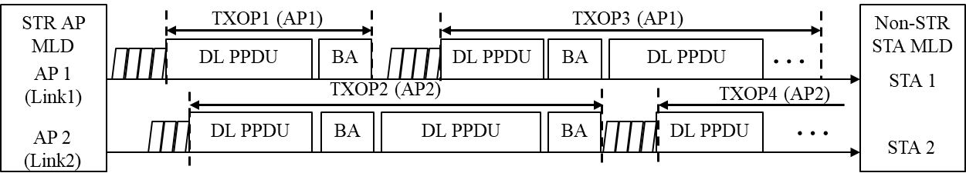
Problem1: Fairness issue discussion
Non-STR MLD can’t gain channel access on multi-link when STR MLD always occupies at least one link. (as shown in the figure)
  STR AP MLD has higher chance to gain channel access on one link when it occupies another link (Non-STR MLD are not competing)
  STR AP MLD will have an advantage of reserving consecutive overlapping TXOPs on multiple links and blocking other non-STR MLD STAs from accessing the channel
Non-STR non-AP MLD should have fair chance to access the channel

Slide 5
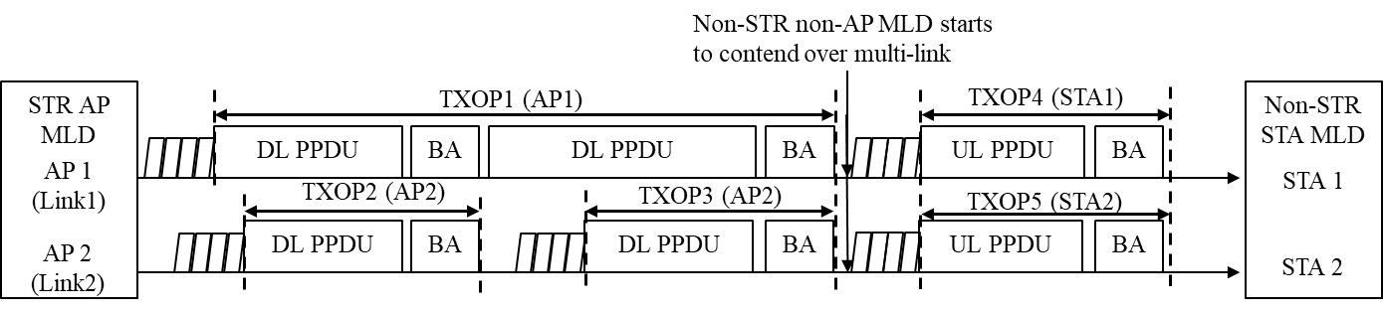
Proposed solution
We propose to add restriction on the STR AP MLD reserving TXOPs with non-STR non-AP MLD.
  When accessing a new link, STR AP MLD should limit its TXOP reservation on the new link such that it does not exceed any active TXOPs on other links
Example:
  TXOP2 and TXOP3 do not exceed TXOP1.
  When TXOP1 and TXOP3 end at the same time, non-STR non-AP MLD can immediately contend over both links.

Slide 6
Problem 2: Multi-link channel Access
JMPC has been discussed for synchronized channel access [9]
  Contend for medium, access to the medium on another link by doing ED for PIFS time
  Has regulatory restriction, chances to join medium are not high and has fairness issues
We propose using same random backoff number initialization for the ML channel access
  AP MLD sets the random backoff counters of an AC in multiple links to one value using the same random number generator
  The count down on each link is running at the same time independently
  The EDCA backoff countdown procedure on each link is independent

Slide 7
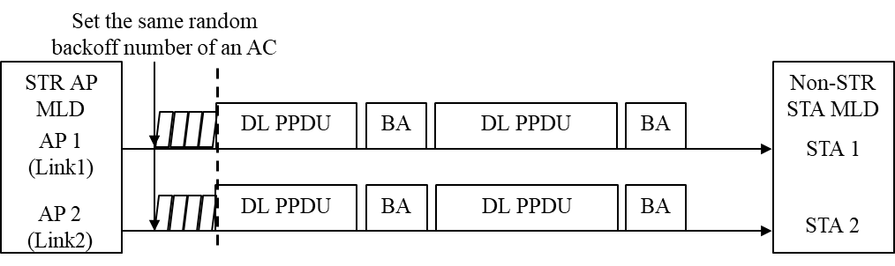
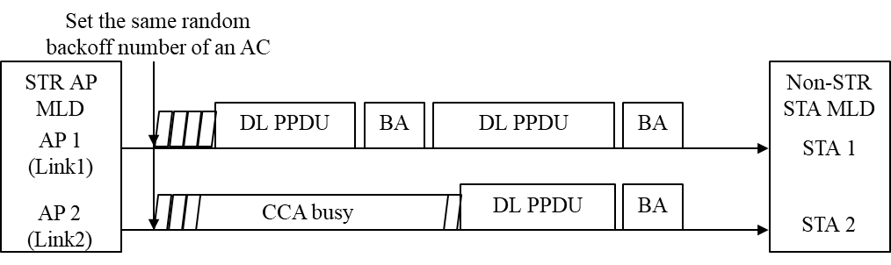
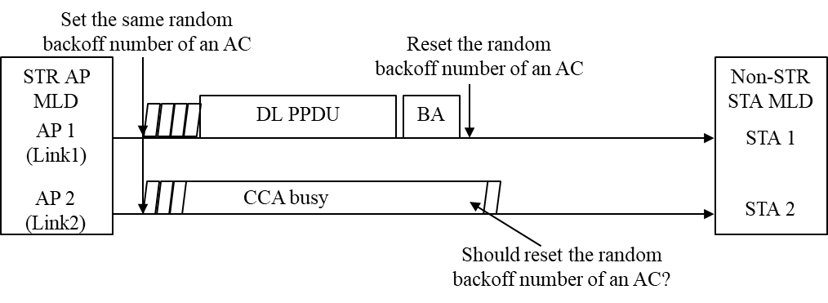
Examples of proposed solution
Example 1: When the two links are idle (no CCA busy), the backoff on Link 1 and 2 count down to zero at the same time
Example 2: When Link 2 experience CCA busy during count down, the backoff on Link 1 and 2 count down to zero at the different times
Example 3: If Link 2 failed to access the channel till the end of the active TXOP on link 1, the backoff timer of Link 2 may be reset ( to avoid fairness issues and make synchronized access easier)

Slide 8
Benefits of same random backoff number
The same random backoff number initialization enables the AP MLD to have easier channel access on multiple links depending on the channel condition
  STR AP MLD has higher chance to gain access on multiple links at the same time when the channels are less busy
  STR AP MLD is also allowed to gain access on multiple links at different times depending on channel conditions
The same random backoff number initialization does not violate any EDCA rule. There should be no fairness issues between the AP MLD and other devices (including legacy devices) accessing these links
There might be few updates needed to the current EDCA mechanism
  How to setup the contention window is TBD
  CW update could be the same as in the current standard
  The same random backoff number initialization may be used when CWs of an AC on multiple links are the same.

Slide 9
Summary
In this presentation, in order to enable fair and dynamic channel access for an STR AP MLD that communicates with a non-STR non-AP MLD, we propose:
  STR AP MLD should limit its TXOP reservation on a new link such that it does not exceed any active TXOPs on other links
  STR AP MLD uses the same backoff number to contend the channel access on multiple links and independently count down on each link

Slide 10
SP1
Do you agree to add the following to 11be R1 SFD:
  11be defines a mechanism to solve the following fairness issue in case of channel access between STR MLD and NSTR MLD
    Fairness issue: the NSTR non-AP MLD does not gain channel access on any link of one of its NSTR link pairs for a long time because the STR AP MLD always occupies at least one link of the NSTR link pair to transmit DL QoS Data frames to the NSTR MLD
    The solution is TBD

Slide 11
SP2
Do you support to include the following in SFD?
  An MLD STA may initialize the random back-off counter in multiple links to one value using the same random number generator when the CW of those links are same. The count down on those links is independent and depends on the channel condition

Slide 12
References
[1] 11-20/0566r20: Compendium of straw polls and potential changes to the Specification Framework Document
[2] 11-20/0275r2: MLO: Need for sync PPDUs
[3] 11-19/1305r4: Synchronous Multi-Link Operation
[4] 11-20/0106r4: Follow up of discussion on multi-link operation
with leakage on non-AP MLD
[5] 11-20/0026r6: MLO: Sync PPDUs
[6] 11-20/0291r1: MLO asynchronize and synchronize operation discussions
[7] 11-20/0433r5: PPDU alignment in STR constrained multi-link
[8] 11-20/0081r2: MLO Synchronous Transmission
[9] 11-20/0455r2: Asynchronous multi-link operation for non-STR STA

