Slide 1
Cyclic Shift Values for pre-NGV modulated fields
Date: 2020-07-30
Authors:

Slide 2
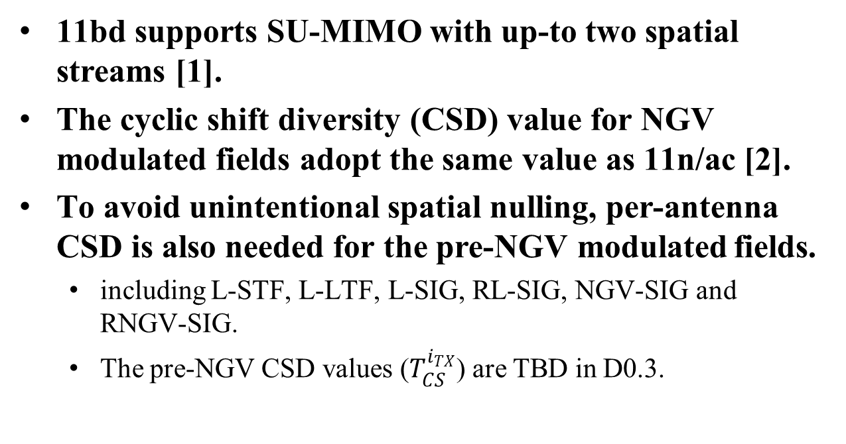
Introduction
11bd supports SU-MIMO with up-to two spatial streams [1].
The cyclic shift diversity (CSD) value for NGV modulated fields adopt the same value as 11n/ac [2].
To avoid unintentional spatial nulling, per-antenna CSD is also needed for the pre-NGV modulated fields.
  including L-STF, L-LTF, L-SIG, RL-SIG, NGV-SIG and RNGV-SIG.
  The pre-NGV CSD values ($T_{CS}^{i_{TX}}$) are TBD in D0.3.

Slide 3
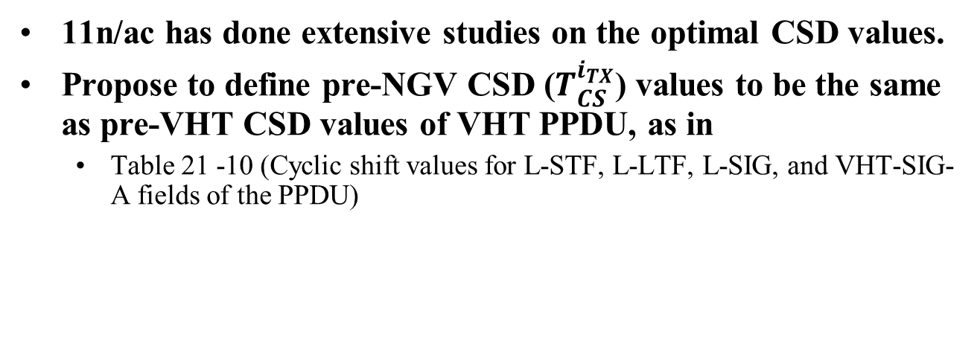
Pre-NGV CSD Values
11n/ac has done extensive studies on the optimal CSD values.
Propose to define pre-NGV CSD ($T_{CS}^{i_{TX}}$) values to be the same as pre-VHT CSD values of VHT PPDU, as in
  Table 21 -10 (Cyclic shift values for L-STF, L-LTF, L-SIG, and VHT-SIG-A fields of the PPDU)

Slide 4
Reference
[1] Rui Cao and etc., “NGV MIMO Simulations”, 11-19/1070r0
[2] Prashant Sharma and etc., “Cyclic Shift Values for NGV”, 11-20/0888r0

Slide 5
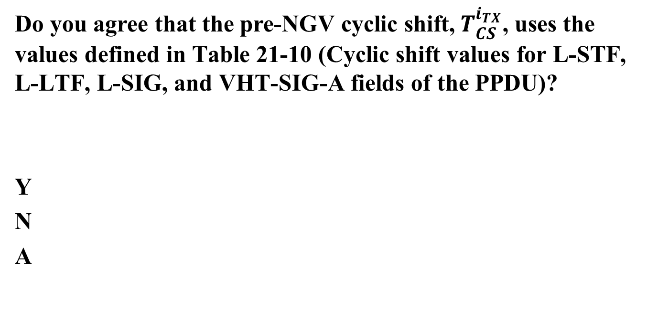
Straw Poll
Do you agree that the pre-NGV cyclic shift,$T_{CS}^{i_{TX}}$, uses the values defined in Table 21-10 (Cyclic shift values for L-STF, L-LTF, L-SIG, and VHT-SIG-A fields of the PPDU)?
Y
N
A

