Slide 1
Cyclic Shift Values for pre-NGV modulated fields
Date: 2020-06-30
Authors:

Slide 2
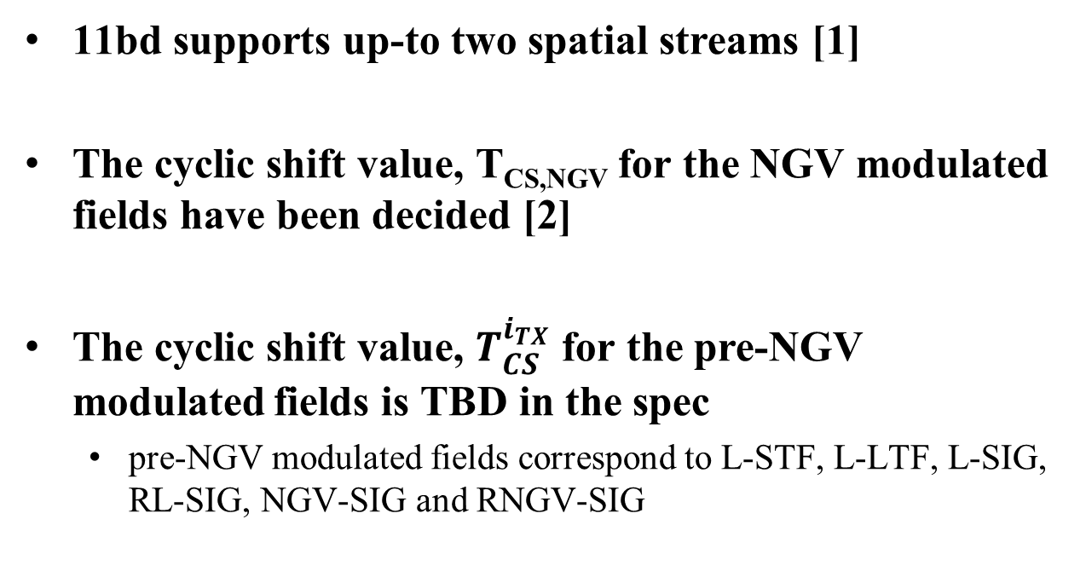
Introduction
11bd supports up-to two spatial streams [1]
The cyclic shift value, T_{CS,NGV} for the NGV modulated fields have been decided [2]
The cyclic shift value, $T_{CS}^{i_{TX}}$ for the pre-NGV modulated fields is TBD in the spec
  pre-NGV modulated fields correspond to L-STF, L-LTF, L-SIG, RL-SIG, NGV-SIG and RNGV-SIG

Slide 3
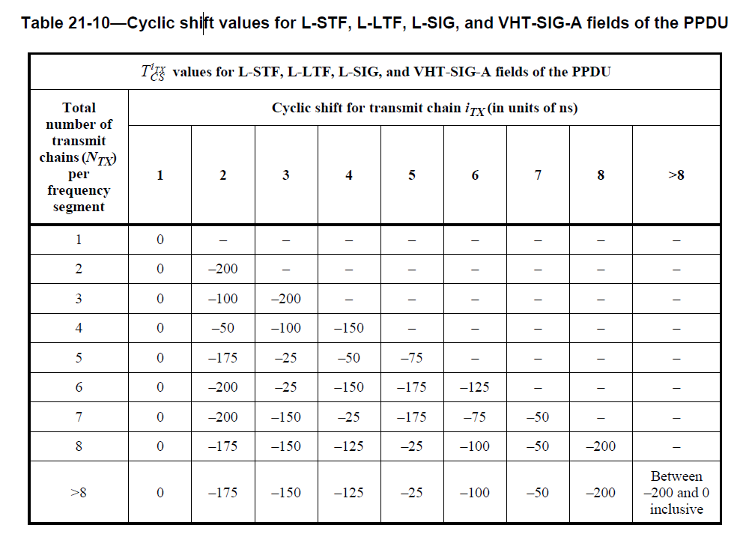
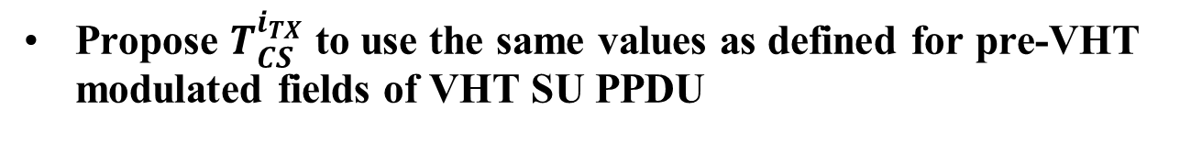
Cyclic Shift for pre-NGV modulated fields
Propose $T_{CS}^{i_{TX}}$ to use the same values as defined for pre-VHT modulated fields of VHT SU PPDU
  Table 21 -10 (Cyclic shift values for L-STF, L-LTF, L-SIG, and VHT-SIG-A fields of the PPDU)
  Only use rows corresponding to N_{TX} = 1 and 2

Slide 4
Reference
[1] Rui Cao and etc., “NGV MIMO Simulations”, 11-19/1070r0
[2] Prashant Sharma and etc., “Cyclic Shift Values for NGV”, 11-20/0888r0

Slide 5
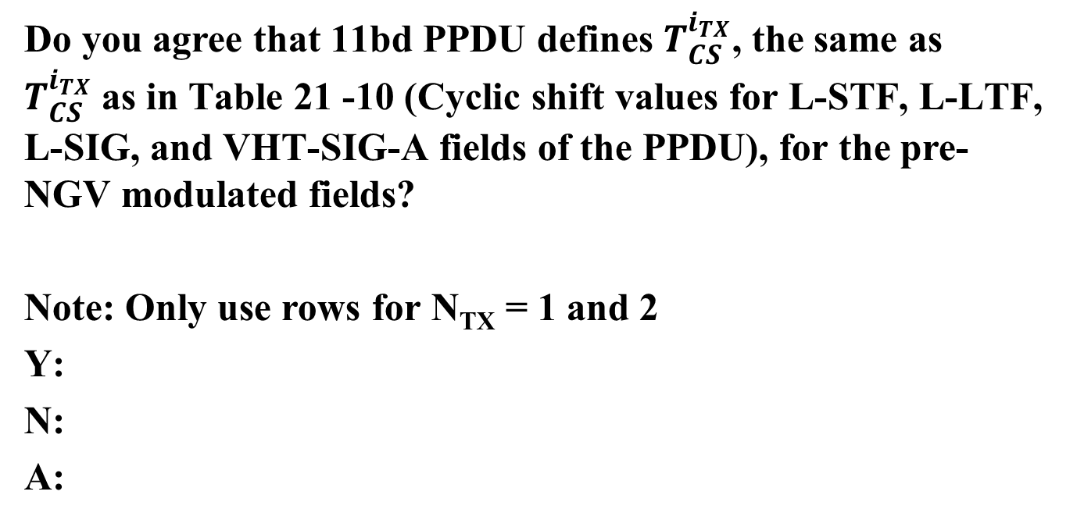
Straw Poll 1
Do you agree that 11bd PPDU defines $T_{CS}^{i_{TX}}$, the same as $T_{CS}^{i_{TX}}$as in Table 21 -10 (Cyclic shift values for L-STF, L-LTF, L-SIG, and VHT-SIG-A fields of the PPDU), for the pre-NGV modulated fields?
Note: Only use rows for N_{TX} = 1 and 2
Y:
N:
A:

