Slide 1
Multi-RU indication in RU allocation subfield
Date: 2020-06-24
Authors:
Name | Affiliations | Address | Phone | email
Ross Jian Yu | Huawei |  |  | ross.yujian@huawei.com
Mengshi Hu | Huawei
Ming Gan | Huawei

Slide 2
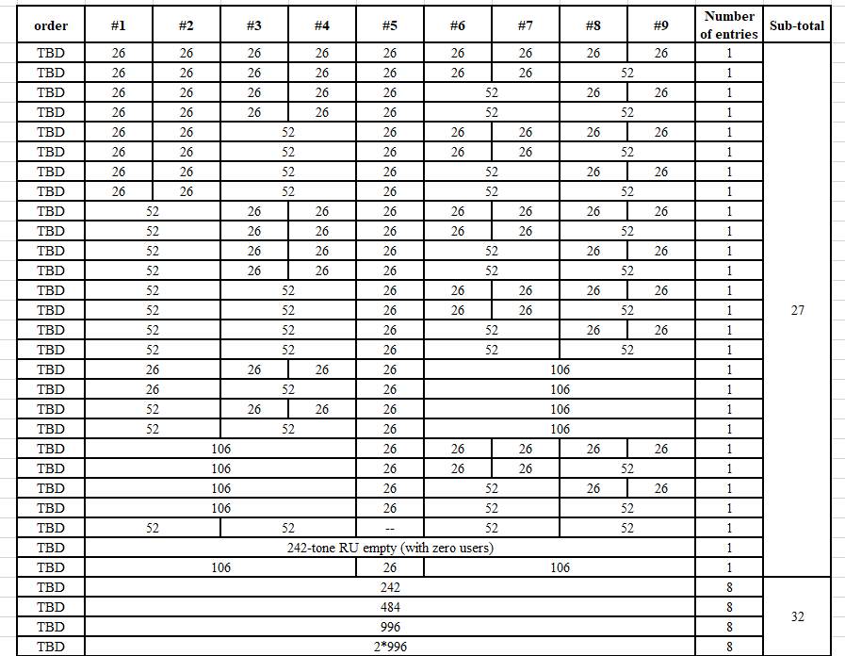
Introduction and recap
Summarizing all the passed SPs regarding RU allocation table, we have the following table so far:
Table – Part I

Slide 3
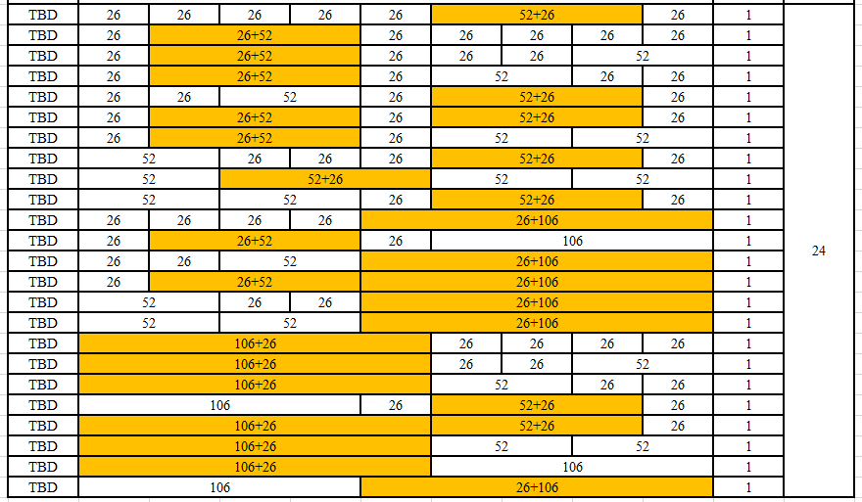
Introduction and recap
Summarizing all the passed SPs regarding RU allocation table, we have the following table so far:
Table – Part II
83 entries so far

Slide 4
Introduction and recap
The following entries are missing in the baseline table:
  How to indicate zero user field cases for 484-tone RU, 996-tone RU, 2*996-tone RU
  Large MRU (484+242-tone RU, 996+484-tone RU, 2*996+484-tone RU, 3*996-tone RU, 3*996+484-tone RU) indication
    Including zero user field cases
In this contribution, we give a comparison of different methods regarding the above two cases. Moreover, we also talk about a special case about the case where 240MHz is composed of two groups of 996+484-tone RU.

Slide 5
Zero user field cases indication
The possible solutions include:
According to the above analysis, Opt1 is preferred with several advantages and only 3 entries additional overhead .
Options | Pro | Con
Opt1: follow 11ax, besides 242(0), also include 484(0), 996(0), 2*996(0) in the table (preferred) | Can clearly indicate the RU size, position/number of pilot, even one of the two content channel is wrongly decoded One or multiple 242(0) clearly indicates empty RUs, not for MU-MIMO case | 4 entries instead of 1 entry Not a very big overhead
Opt2: only has 242(0) | 1 entry instead of 4 entries | 242(0) doesn’t tell you the exact RU size, position/number of pilot, need to check the RU allocation subfield with 1~8 user fields

Slide 6
Multi-RU indication (Opt A)
The following multi-RU combinations are supported:
  484+242-tone RU, 996+484-tone RU, 2*996+484-tone RU, 3*996-tone RU, 3*996+484-tone RU
The possible solutions include:
  OptA: absolute frequency method [1-4], list all the possible combinations of the MRU within an 80/160/240/320Mhz transmission.
  OptA: for zero user field case, can indicate through
    Opt A1: one entry for each MRU combination
    Opt A2: by counting multiple 242(0)
    Opt A3: by counting each single RU (0) within a MRU
26 or 0 entries
TBD | 242(1)+484(2) | 8
TBD | 242(2)+484(2) | 8
TBD | 484(1)+242(4) | 8
TBD | 484(1)+242(3) | 8
TBD | 484(1)+996(2) | 8
TBD | 484(2)+996(2) | 8
TBD | 996(1)+484(4) | 8
TBD | 996(1)+484(3) | 8
TBD | 484(1)+996(2)+996(3) | 8
TBD | 484(2)+996(2)+996(3) | 8
TBD | 996(1)+484(3)+996(3) | 8
TBD | 996(1)+484(4)+996(3) | 8
TBD | 996(1)+996(2)+484(5) | 8
TBD | 996(1)+996(2)+484(6) | 8
TBD | 996(1)+996(2)+996(3) | 8
TBD | 996(1)+996(2)+996(4) | 8
TBD | 996(1)+996(3)+996(4) | 8
TBD | 996(2)+996(3)+996(4) | 8
TBD | 484(1)+996(2)+996(3)+996(4) | 8
TBD | 484(2)+996(2)+996(3)+996(4) | 8
TBD | 996(1)+484(3)+996(3)+996(4) | 8
TBD | 996(1)+484(4)+996(3)+996(4) | 8
TBD | 996(1)+996(2)+484(5)+996(4) | 8
TBD | 996(1)+996(2)+484(6)+996(4) | 8
TBD | 996(1)+996(2)+996(3)+484(7) | 8
TBD | 996(1)+996(2)+996(3)+484(8) | 8
26*8=208 entries

Slide 7
Multi-RU indication(Opt B)
The possible solutions include (cont’d):
  OptB: 8 or 9 entries for each MRU combinations [2]
    Since we assume all the RU allocation subfields exist for non-compression mode for the baseline mode, the Rx can check which RU allocation subfields are indicated as a MRU entry. For example, within one 80MHz, there are 4 RU allocation subfields. The Rx can check which 3 out of 4 RU allocation subfields indicate MRU entry, and thus know the exact location of this MRU.
  OptB: for zero user field case, can indicate through
    Opt B1: one entry for each MRU combination
    Opt B2: by counting multiple 242(0)
    Opt B3: by counting each single RU (0) within a MRU
5 or 0 entries
TBD | 484+242 | 8
TBD | 996+484 | 8
TBD | 996+996+484 | 8
TBD | 996+996+996 | 8
TBD | 996+996+996+484 | 8
5*8=40 entries

Slide 8
Multi-RU indication (Opt C)
The possible solutions include (cont’d):
  OptC: 9 entries for all the MRU combinations
    Similar as OptB, since we assume all the RU allocation subfields exist for non-compression mode , the baseline mode, the Rx can check which RU allocation subfields are indicated as a MRU entry.
    By checking how many RU allocation subfields within each 80MHz are indicated as one of the 9 entries, the Rx can identify the MRU patterns (both sizes and locations).
Overhead comparison:
TBD | Belongs to an MRU; contributes zero User fields to the User Specific field in the same EHT-SIG content channel as this RU Allocation subfield | 1
TBD | Belongs to an MRU; contributes 1~8 User fields to the User Specific field in the same EHT-SIG content channel as this RU Allocation subfield | 8
Options | MRU Overhead | Total Overhead
OptA | 234 or 208 | Max 320, 9 bit
OptB | 45 or 40 | Max 131, 8 bit
OptC (preferred) | 9 | Max 95, 7bit
Existing entries which passed SPs: 83, additional SRU zero user field entries 0 or 3

Slide 9
Opt C Examples (OFDMA cases)
3 out of 4 RU allocation subfields indicate MRU entry
White part means non-large-MRU, can be either small MRU, single RU, empty RU
80 MHz
484+242, 4 cases
MRU
MRU
MRU
242-tone
3 out of 4
0 out of 4
484+242, 8 cases
MRU
MRU
MRU
160 MHz
3 out of 4
3 out of 4
(484+242) + (484+242), 16 cases
MRU
MRU
MRU
MRU
MRU
MRU
4 out of 4
2 out of 4
996+484, 4 cases
MRU
MRU
MRU
MRU
MRU
MRU
Table Number of MRU indication within each 80MHz segment and MRU combinations
BW | 1st 80MHz | 2nd 80Mhz | MRU combinations
160 | 3 | 0 | 484+242
 | 3 | 3 | (484+242) + (484+242)
 | 4 | 2 | 996+484
Order can change for 1st and 2nd 80MHz

Slide 10
Opt C Examples (OFDMA cases)
3 out of 4
0 out of 4
240 MHz
484+242,
4+4+4=12 cases
MRU
MRU
MRU
0 out of 4
3 out of 4
3 out of 4
(484+242) + (484+242), 3*4*4=48 cases
MRU
MRU
MRU
MRU
MRU
MRU
0 out of 4
3 out of 4
3 out of 4
(484+242) + (484+242) + (484+242),
4*4*4=64 cases
MRU
MRU
MRU
MRU
MRU
MRU
3 out of 4
MRU
MRU
MRU

Slide 11
Opt C Examples (OFDMA cases)
4 out of 4
2 out of 4
996+484,
4+4=8 cases
MRU
MRU
MRU
MRU
MRU
MRU
0 out of 4
Discussion 1:
Assuming 1st 80+2nd 80 or 2nd 80+3rd 80 can both support 996+484, then 8 cases
Assuming only one of the two above cases can support 996+484, 4 cases, which one can be indicated by MAC (e.g., beacon frame) or defined by the spec (e.g., primary or secondary 160MHz w/o punctured 80MHz)
Passed motion: For the OFDMA transmission in contiguous 240 MHz, for one STA large size RU aggregation is allowed only within 160 MHz which is composed of two adjacent 80 MHz channels.
4 out of 4
2 out of 4
(996+484) + (484+242), 2*4*4=32 cases
MRU
MRU
MRU
MRU
MRU
MRU
3 out of 4
MRU
MRU
MRU
Discussion 2:
Assuming 1st 80+2nd 80 or 2nd 80+3rd 80 can both support (996+484), then 32 cases
Assuming only one of the two above cases can support (996+484), 16 cases

Slide 12
Opt C Examples (OFDMA cases)
240 MHz
4 out of 4
4 out of 4
2*996+484,
MRU
MRU
MRU
MRU
MRU
MRU
MRU
MRU
2 out of 4
MRU
MRU
Discussion3:
Assuming 2*996 must be contiguous, then 4 cases
Assuming 2*996 can also be non-contiguous, 6 cases
4 out of 4
4 out of 4
(996+484)+(996+484)
MRU
MRU
MRU
MRU
MRU
MRU
MRU
MRU
4 out of 4
MRU
MRU
MRU
MRU
Discussion4:
Is this supported? Equally split 240MHz into two parts seem to be a good option for scheduling, propose to allow this and mandate it has to be left 120MHz + right 120MHz.
Under this assumption: 1 case.

Slide 13
Opt C Examples (OFDMA cases)
Table Number of MRU indication within each 80MHz segment and MRU combinations
BW | 1st 80MHz | 2nd 80Mhz | 3rd 80MHz | MRU combinations
240 | 3 | 0 | 0 | 484+242
 | 3 | 3 | 0 | (484+242) + (484+242)
 | 3 | 3 | 3 | (484+242) + (484+242) + (484+242)
 | 4 | 2 | 0 | 996+484
 | 4 | 2 | 3 | (996+484) + (484+242)
 | 4 | 4 | 2 | 2*996+484
 | 4 | 4 | 4 | (996+484)+(996+484)
Order can change between three 80MHz segments

Slide 14
Opt C Examples (OFDMA cases)
3 out of 4
0 out of 4
320 MHz
484+242,
4+4+4+4=16 cases
MRU
MRU
MRU
0 out of 4
0 out of 4
3 out of 4
3 out of 4
(484+242) + (484+242), 6*4*4=96 cases
MRU
MRU
MRU
MRU
MRU
MRU
0 out of 4
0 out of 4
3 out of 4
3 out of 4
(484+242) + (484+242) + (484+242),
4*4*4*4=256 cases
MRU
MRU
MRU
MRU
MRU
MRU
3 out of 4
0 out of 4
MRU
MRU
MRU
3 out of 4
3 out of 4
(484+242) + (484+242) + (484+242) + (484+242),
4*4*4*4=256 cases
MRU
MRU
MRU
MRU
MRU
MRU
3 out of 4
3 out of 4
MRU
MRU
MRU
MRU
MRU
MRU
4 out of 4
2 out of 4
996+484,
4+4=8 cases
MRU
MRU
MRU
MRU
MRU
MRU
0 out of 4
0 out of 4

Slide 15
Opt C Examples (OFDMA cases)
320 MHz
4 out of 4
2 out of 4
(996+484) + (484+242), 2*4*8=64 cases
MRU
MRU
MRU
MRU
MRU
MRU
3 out of 4
0 out of 4
MRU
MRU
MRU
4 out of 4
2 out of 4
(996+484) + (484+242) + (484+242), 2*4*16=128 cases
MRU
MRU
MRU
MRU
MRU
MRU
3 out of 4
3 out of 4
MRU
MRU
MRU
MRU
MRU
MRU
4 out of 4
2 out of 4
(996+484) + (996+484), 4*4=16 cases
MRU
MRU
MRU
MRU
MRU
MRU
4 out of 4
2 out of 4
MRU
MRU
MRU
MRU
MRU
MRU
4 out of 4
4 out of 4
MRU
MRU
MRU
MRU
MRU
MRU
MRU
MRU
3*996+484,
4 out of 4
2 out of 4
Discussion 5:
3*996 must be contiguous: 4 cases
Can be non-contiguous: 8 cases
MRU
MRU
MRU
MRU
MRU
MRU
4 out of 4
4 out of 4
MRU
MRU
MRU
MRU
MRU
MRU
MRU
MRU
3*996, 4 cases
4 out of 4
0 out of 4
MRU
MRU
MRU
MRU

Slide 16
Opt C Examples (OFDMA cases)
Table Number of MRU indication within each 80MHz segment and MRU combinations
BW | 1st 80MHz | 2nd 80Mhz | 3rd 80MHz | 4th 80MHz | MRU combinations
320 | 3 | 0 | 0 | 0 | 484+242
 | 3 | 3 | 0 | 0 | (484+242) + (484+242)
 | 3 | 3 | 3 | 0 | (484+242) + (484+242) + (484+242)
 | 3 | 3 | 3 | 3 | (484+242) + (484+242) + (484+242) + (484+242)
 | 4 | 2 | 0 | 0 | 996+484
 | 4 | 2 | 3 | 0 | (996+484) + (484+242)
 | 4 | 2 | 3 | 3 | (996+484) + (484+242) + (484+242)
 | 4 | 2 | 4 | 2 | (996+484) + (996+484)
 | 4 | 4 | 4 | 0 | 3*996
 | 4 | 4 | 4 | 2 | 3*996+484
Order can change between four 80MHz segments

Slide 17
Summary
The contribution discussed the following parts:
  Indication of zero user field case for single RU:
    Opt1: follow 11ax, besides 242(0), also include 484(0), 996(0), 2*996(0) in the table (preferred)
    Opt2: only has 242(0)
  Indication of large Multi-RU
    Opt A: absolute frequency method
    Opt B: 8 or 9 entries for each MRU combinations
    Opt C (preferred): 9 entries for all MRU combinations
  5 Discussions regarding applicable scenarios regarding 996+484, 2*996+484, 3*996+484
    Applicable scenario of 996+484 within 240MHz: one 160MHz or either one of two 160MHz
    Applicable scenario of 2*996+484 within 240MHz: 2*996 be contiguous or not
    Applicable scenario of 3*996+484 within 320MHz: 3*996 be contiguous or not

Slide 18
Straw Poll #1
Do you agree to add the following rows to the RU Allocation table?
  484-tone RU; contributes zero User fields to the User Specific field in the same EHT-SIG content channel as this RU Allocation subfield
    Note: multi-RU is TBD
  996-tone RU; contributes zero User fields to the User Specific field in the same EHT-SIG content channel as this RU Allocation subfield
TBD | 484-tone RU; contributes zero User fields to the User Specific field in the same EHT-SIG content channel as this RU Allocation subfield | 1
TBD | 996-tone RU; contributes zero User fields to the User Specific field in the same EHT-SIG content channel as this RU Allocation subfield | 1

Slide 19
Straw Poll #2
Do you agree that for large multi-RU, 9 entries will be used to indicate: belongs to an MRU, contributes 0~8 User fields to the User Specific field in the same EHT-SIG content channel as this RU Allocation subfield?
  Compressed modes are TBD.
  Yes/No/Abstain
TBD | Belongs to an MRU; contributes zero User fields to the User Specific field in the same EHT-SIG content channel as this RU Allocation subfield | 1
TBD | Belongs to an MRU; contributes 1~8 User fields to the User Specific field in the same EHT-SIG content channel as this RU Allocation subfield | 8

Slide 20
Straw Poll #3
Do you agree that
  996+484 is not supported in two contiguous 80 MHz segments that cross two 160MHz channels

Slide 21
Straw Poll #4
Which option do you prefer for RU 2*996+484 in a 240MHz OFDMA transmission?
  Opt1: Assuming 2*996 must be contiguous, then 4 cases
  Opt2: Assuming 2*996 can also be non-contiguous, 6 cases
  Abs
  Note: not for SFD

Slide 22
Straw Poll #5
Which option do you prefer for RU 3*996+484 in a 320MHz OFDMA transmission?
  Opt1: Assuming 3*996 must be contiguous, then 4 cases
  Opt2: Assuming 3*996 can also be non-contiguous, 8 cases
  Abs
  Note: not for SFD

Slide 23
Straw Poll #6
Do you agree that the following MRU combination is supported and the only supported mode when two groups of RU996+484 exist in an 240 MHz OFDMA transmission:
  (996+484) + (484+996), from lowest frequency to highest frequency

Slide 24
References
https://mentor.ieee.org/802.11/dcn/20/11-20-0798-00-00be-signaling-of-ru-allocation-follow-up.pptx, Dongguk Lim, LG
https://mentor.ieee.org/802.11/dcn/20/11-20-0798-03-00be-signaling-of-ru-allocation-follow-up.pptx, Dongguk Lim, LG
https://mentor.ieee.org/802.11/dcn/20/11-20-0578-00-00be-on-ru-allocation-singling-in-eht-sig.pptx, Jianhan Liu, Mediatek
https://mentor.ieee.org/802.11/dcn/20/11-20-0373-01-00be-ru-allocation-subfield-design-for-multi-ru-support.pptx, Myeongjin Kim, Samsung
https://mentor.ieee.org/802.11/dcn/20/11-20-0609-05-00be-further-discussion-on-ru-allocation-subfield-in-eht-sig.pptx, Ross Jian Yu, Huawei
https://mentor.ieee.org/802.11/dcn/20/11-20-0400-00-00be-multi-ru-combination-and-signaling-for-ofdma-transmission.pptx, Mengshi Hu, Huawei

