Slide 1
1x EHT-LTF sequence

Slide 2
Introduction
I suggested 1/2/4x EHT-LTF sequences for 320MHz PPDU[1]. But it has some concerns that
it’s based on 1 stream, but many members want to consider multi-stream, too.
in 1x EHT-LTF, it’s better to consider RU sizes for non-OFDMA transmission as 11ax [2].
in 2x/4x EHT-LTF, the suggested sequences based on HE-LTF sequences didn’t catch BPSK data’s PAPRs.
Therefore I’d like to discuss 1x, 2x and 4x EHT-LTF sequences, separately.
Here I focus on 1x EHT-LTF sequence with multi-stream in non-OFDMA transmission.

Slide 3
1x EHT-LTF sequences
There are two options
Option1: 320MHz 1x EHT-LTF sequences are used for 320MHz non-OFDMA transmission and 240MHz non-OFDMA transmission together. That means, 3*996, 3*996+484, 4*996 RUs as well as 2*996, 2*996+484 RUs are considered.
Option2: 320MHz 1x EHT-LTF sequences are used for 320MHz non-OFDMA transmission only. That means, 3*996, 3*996+484, 4*996 RUs are considered.
If we choose option2, we need to define 240MHz 1x EHT-LTF sequence, too.
1x EHT-LTF sequence for 320MHz PPDU
EHTLTF_{320MHz_1x} = {LTF_{80MHz_lower1_1x}, 23 zeros, LTF_{80MHz_upper1_1x}, 23 zeros, LTF_{80MHz_lower2_1x}, 23 zeros, LTF_{80MHz_upper2_1x}}
LTF_{80MHz_lower1_1x} = {s(1)*LTF_{80MHz_left_1x}, 0, s(2)*LTF_{80MHz_right_1x}}
LTF_{80MHz_upper1_1x} = {s(3)*LTF_{80MHz_left_1x}, 0, s(4)*LTF_{80MHz_right_1x}}
LTF_{80MHz_lower2_1x} = {s(5)*LTF_{80MHz_left_1x}, 0, s(6)*LTF_{80MHz_right_1x}}
LTF_{80MHz_upper2_1x} = {s(7)*LTF_{80MHz_left_1x}, 0, s(8)*LTF_{80MHz_right_1x}}
s(1)~s(8)= [1 1 1 1 -1 -1 -1 -1] for option1, and [1 -1 1 1 1 1 -1 -1] for option2

Slide 4
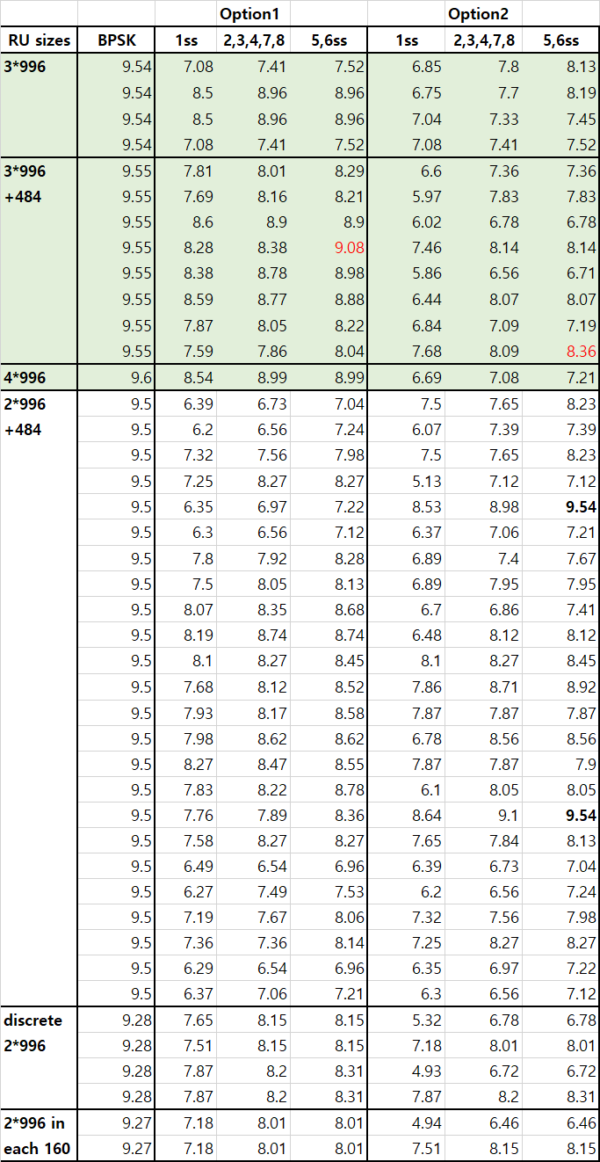
PAPR performance (1/2)
There are PAPR table of 1x EHT-LTF sequence for 320MHz transmission with multi-stream.
For 320MHz transmission (green area), all sequences have under BPSK median’s PAPRs.
But the worst PAPR of option 2 is lowest.
For both of 240 and 320MHz transmission, only option 1’s PAPRs are under BPSK median’s.
The bold PAPR values in option2 shows over BPSK median’s.
[NOTE] PAPR table of 1x EHT-LTF for 160+160MHz transmission is in Appendix.

Slide 5
PAPR performance (2/2)
Based on the PAPR performance,
If we define a 1x EHT-LTF sequence for 320MHz and 240MHz transmission, the worst PAPR (option1) is 9.08dB in 3*996+484 RU. And all PAPRs are under BPSK median’s.
Or if we define two 1x EHT-LTF sequences, peak PAPR (option2) in 320MHz transmission is 8.36dB among RU sizes of option2. But we need another sequence for 240MHz transmission, and the worst PAPR is 9.08dB (The structure and sequence are in Appendix).
PAPRs of option1 are somewhat higher than option2 among 3*996, 3*996+484, 4*996 RUs, but all PAPRs are below BPSK median’s. Therefore we slightly prefer a unified solution(option1).

Slide 6
Conclusion
In this contribution, I suggest 1x EHT-LTF sequences for 320MHz transmission with two options.
Option1: A unified 1x EHT-LTF sequence for both of 320MHz transmission and 240MHz transmission.
The all PAPRs with multi-streams are below BPSK median's PAPRs.
Option2: Two sequences for 320MHz transmission and 240MHz transmission, respectively.
It shows slightly lower PAPRs than option 1.
We may choose a option if 240MHz channelization or transmission is defined [2]. But now we can consider option1 regardless the decision because the PAPRs of option 1 are under data meidan’s in all RU sizes.

Slide 7
Reference
[1] IEEE802.11-20/0825r1, “EHT-LTF sequences in new tone plan”
[2] IEEE802.11-20/0960r1, “Consideration on 240MHz”

Slide 8
Straw poll 1
Do you support to make 1x EHT-LTF sequence by reusing HE-LTF sequences as below in 320MHz BW PPDU of 11be?
LTF_{80MHz_left_1x} and LTF_{80MHz_right_1x}
The coefficient of the sequences are changed in 11be.
Y/N/Abs

Slide 9
Straw poll 2
Do you agree to add the below text in 11be SFD?
In a 320MHz transmission using 1x EHT-LTF, the 1x EHT-LTF sequence is given as below.
EHTLTF_{-2036,2036}= {LTF_{80MHz_1st_1x}, 0, 0, 0, 0, 0, 0, 0, 0, 0, 0, 0, 0, 0, 0, 0, 0, 0, 0, 0, 0, 0, 0, 0, LTF_{80MHz_2nd_1x}, 0, 0, 0, 0, 0, 0, 0, 0, 0, 0, 0, 0, 0, 0, 0, 0, 0, 0, 0, 0, 0, 0, 0, LTF_{80MHz_3rd_1x}, 0, 0, 0, 0, 0, 0, 0, 0, 0, 0, 0, 0, 0, 0, 0, 0, 0, 0, 0, 0, 0, 0, 0, LTF_{80MHz_4th_1x}}
LTF_{80MHz_1st_1x} = { LTF_{80MHz_left_1x}, 0, LTF_{80MHz_right_1x}}
LTF_{80MHz_2nd_1x} = { LTF_{80MHz_left_1x}, 0, LTF_{80MHz_right_1x}}
LTF_{80MHz_3rd_1x} = { -LTF_{80MHz_left_1x}, 0, -LTF_{80MHz_right_1x}}
LTF_{80MHz_4th_1x} = { -LTF_{80MHz_left_1x}, 0, -LTF_{80MHz_right_1x}}
LTF_{80MHz_left_1x} and LTF_{80MHz_right_1x} are used as it is in 11ax.
Y/N/Abs

Slide 10
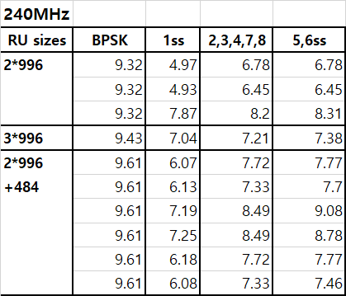
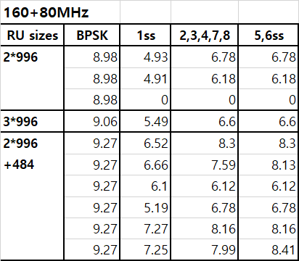
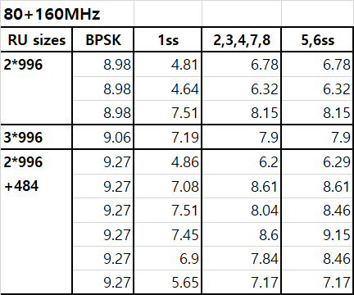
Appendix
1x EHT-LTF sequence for 240MHz transmission
EHTLTF_{240MHz_1x} = {LTF_{80MHz_lower1_1x}, 23 zeros, LTF_{80MHz_upper1_1x}, 23 zeros, LTF_{80MHz_lower2_1x}}
LTF_{80MHz_lower1_1x} = {s(1)*LTF_{80MHz_left_1x}, 0, s(2)*LTF_{80MHz_right_1x}}
LTF_{80MHz_upper1_1x} = {s(3)*LTF_{80MHz_left_1x}, 0, s(4)*LTF_{80MHz_right_1x}}
LTF_{80MHz_lower2_1x} = {s(5)*LTF_{80MHz_left_1x}, 0, s(6)*LTF_{80MHz_right_1x}}
s(1)~s(6)= [1 1 -1 1 -1 -1]
PAPR table

Slide 11
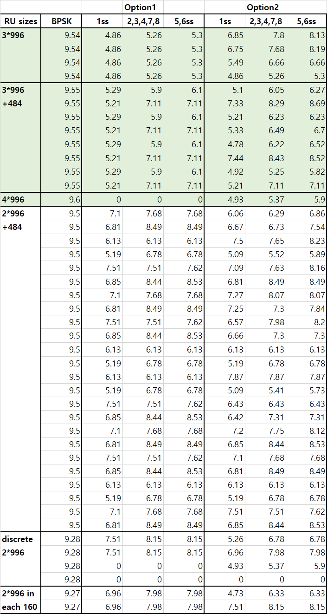
Appendix
PAPR table in 160+160MHz
Most of PAPRs are lower than the PAPRs of 320MHz transmission.
And all PAPRs are under the BPSK median’s.

