Slide 1
Partial Bandwidth Feedback for Multi-RU
Date: 2020-07-01
Authors:

Slide 2
Introduction
802.11be shall supports that
  Wideband band and noncontiguous spectrum utilization
  Large size RU combination assigned to a single STA [1].
  Maximum 16 spatial stream
Feedback overhead is significantly increased, compared to 11ax [2]
In order to reduce feedback overhead, the partial BW feedback is adopted in 11ax as an optional feature
  Partial BW feedback
    By choosing [RU Start Index, RU End Index] to cover the allocated RU only, feedback overhead can be reduced compared with full BW feedback
In this slide, we show a modified signaling for partial BW feedback for multi-RU combination in 802.11be

Slide 3
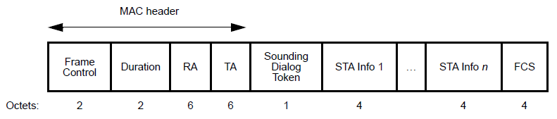
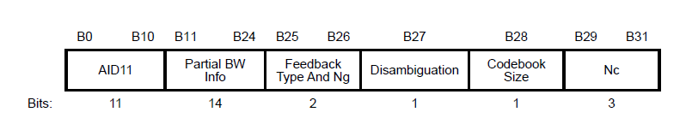

Recap: HE NDPA Structure (1)
Partial BW Info
  AP signals RU Start Index (the first 26-tone RU) and RU End Index (the last 26-tone RU) for feedback
  STA feedbacks channel state information (CSI) in the tones between RU Start Index and RU End Index
  STA Info field: 4 byte

Slide 4
Recap: HE NDPA Structure (2)
Sounding Dialog Token
  Ranging and HE subfields in Sounding Dialog Token
    VHT NDPA: These two bits are reserved
    HE NDPA: The second bit is used to distinguish HE and VHT NDPA
  VHT STA regards all NDPA as VHT NDPA, while HE STA regards it as HE NDPA if the HE subfield is set to 1
Disambiguation
  Disambiguation is set to 1 to prevent a VHT STA from wrongly identifying its AID in the HE, which is positioned in B(27) in STA Info field.
Ranging | HE/VHT | Description
Reserved | Reserved | VHT NDPA
Reserved | 1 | HE NDPA
1 | 0 | Ranging NDPA
1 | 1 | Reserved

Slide 5
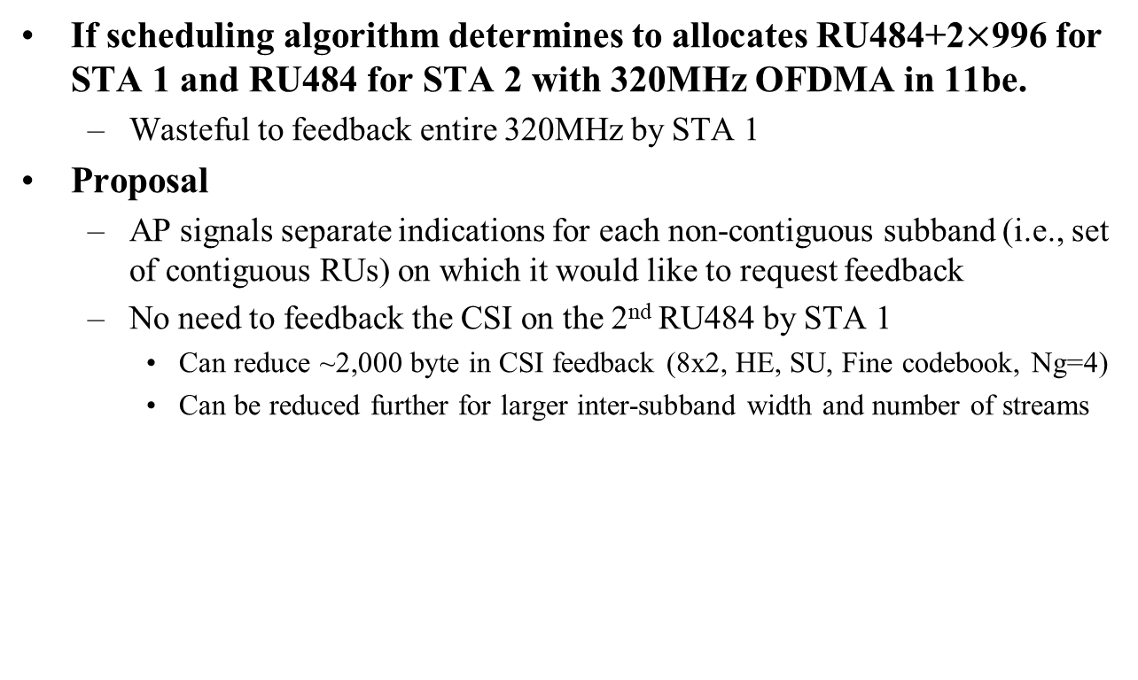
Motivation
If scheduling algorithm determines to allocates RU484+2$×$996 for STA 1 and RU484 for STA 2 with 320MHz OFDMA in 11be.
  Wasteful to feedback entire 320MHz by STA 1
Proposal
  AP signals separate indications for each non-contiguous subband (i.e., set of contiguous RUs) on which it would like to request feedback
  No need to feedback the CSI on the 2nd RU484 by STA 1
    Can reduce ~2,000 byte in CSI feedback (8x2, HE, SU, Fine codebook, Ng=4)
    Can be reduced further for larger inter-subband width and number of streams
 | Partial BW Info
 | RU26 Start Index | RU26 End Index
STA Info 1 | 0 | 107
STA Info 2 | 18 | 35
Feedback by STA 2
484
484
996
996
RU index
0 …
18 … 35
…
… 107
Feedback by STA 1

Slide 6
EHT NDPA Update (1)
Based on the HE NDPA, EHT NDPA can be designed by updating following fields:
  Disambiguation
    Disambiguation is set to 1 to prevent a VHT STA from wrongly identifying its AID in the HE/EHT NDPA, which will be positioned in
    B(16*n+11) for n=1,2… (i.e., B(27), B(43), B(59),…)
  N_{c}
    3bit → 4bit (for 16 spatial streams support)
  Partial BW Info subfield
    14bit → 8bit (Granularity is reduced from 26-tone RU to 242-tone RU [4][5])
    Applicable for Option 1 and Option 2 in slide 9 and slide 10, respectively

Slide 7
EHT NDPA Update (2)
Candidate I
Sounding Dialog Token
  Under discussion for three candidates [5],[6],[7]
  We propose to multiplex EHT and EHT+
  Candidate I
    STA Info field can have 2*n bytes
    No aggregated sounding
  Candidate II
    STA Info field can have 4*n bytes
    Need HE/EHT differentiation bits [5]
    Possible for HE/EHT/EHT+ aggregated sounding
  Candidate III
    STA Info field can have 4*n bytes
    Possible for EHT/EHT+ aggregated sounding
Ranging | HE/VHT | Description
0 | 0 | VHT, EHT, EHT+ NDPA
0 | 1 | HE NDPA
1 | 0 | Ranging NDPA
1 | 1 | Reserved
Candidate II
Ranging | HE/VHT | Description
0 | 0 | VHT NDPA
0 | 1 | HE, EHT, EHT+ NDPA
1 | 0 | Ranging NDPA
1 | 1 | Reserved
Candidate III
Ranging | HE/VHT | Description
0 | 0 | VHT NDPA
0 | 1 | HE NDPA
1 | 0 | Ranging NDPA
1 | 1 | EHT, EHT+ NDPA
Note: EHT+: the amendments after EHT

Slide 8
EHT NDPA Update (3)
NDPA Version field (3bit) - Proposal
  Better identification than just using Sounding Dialog Token and Disambiguation for future 802.11 coexistence
  Identify the exact NDPA version starting with 802.11be
  Description of 3 bit version information is same as 3 bit version information in U-SIG.
How to indicate NDPA Version
  Option A: Including version information in each STA Info field
  Option B: Including version information in a Common Info field
    Special AID11: Indicate to a Common Info field by using the reserved AID values. ex) [2008 ~ 2046]
    After a Common Info field, one or more STA Info fields corresponding to the version follow
    Note: Special AID11 value itself may indicate the NDPA version, without using the version information field
EHT and EHT+ can be multiplexed in a single NDPA

Slide 9
Option 1: One Partial BW Info Subfields
Similar to 11ax, Partial BW Info subfield indicates [RU Start Index, RU End Index]
  Granularity: 242-tone RU
  Partial BW Info: 8 bits
NDPA Version: Option A (Included in each STA Info field)
  Option B (Included in a Common Info field) is also possible
STA Info field: 4 bytes
Pros:
  The size of STA Info field is 4 bytes as 11ax
Cons:
  Cannot indicate the non-contiguous subbands
Frame Control | Duration | RA | TA | Sounding Dialog Token | STA Info 1 | …. | STA Info n | FCS
Octets: 2 | 2 | 6 | 6 | 1 | 4 |  | 4 | 4
B0 B10 | B11 B13 | B14 | B15 B22 | B23 B24 | B25 B26 | B27 | B28 B31
AID11 (11) | NDPA Version (3) | Reserved (1) | Partial BW Info (8) | Codebook Size (2) | Feedback Type And Ng (2) | Disambiguation (1) | Nc (4)

Slide 10
Option 2: Two Partial BW Info Subfields
Each Partial BW Info subfield indicates [RU Start Index, RU End Index] corresponding to each non-contiguous subband respectively.
  Granularity: 242-tone RU
  Partial BW Info: 16 bits
NDPA Version: Option A (Included in each STA Info)
STA Info field: 6 bytes
Pros:
  Can indicate the non-contiguous subbands
Cons:
  Partial BW Info 2 (8 bits) is overhead when non-contiguous subbands don’t exist
Frame Control | Duration | RA | TA | Sounding Dialog Token | STA Info 1 | …. | STA Info n | FCS
Octets: 2 | 2 | 6 | 6 | 1 | 6 |  | 6 | 4
B0 B10 | B11 B18 | B19 B26 | B27 | B28 B37 | B38 B40 | B41 B42 | B43 | B44 B47
AID11 (11) | Partial BW Info 1 (8) | Partial BW Info 2 (8) | Disambiguation (1) | Feedback Type And Ng (2) Codebook Size (2) Nc (4) | NDPA Version (3) | Reserved (2) | Disambiguation (1) | Reserved (4)

Slide 11
Option 3: Reuse the RU Allocation Subfield
In [3], proposed 9-bit RU Allocation subfield for Trigger frame to indicate the multi-RU combinations in EHT.
  Reduced 7-bit RU Allocation subfield when minimum allocated RU is 242-tone RU
NDPA Version: Option B (Included in a Common Info field)
  Option A (Included in each STA Info field) is also possible
STA Info field: 4 bytes
Pros:
  The size of STA Info field is 4 bytes as 11ax
  Can indicate the non-contiguous subbands
Cons:
  Less flexibility in representation
B0 B10 | B11 B13 | B14 B15
AID11 (11) | NDPA Version (3) | Reserved (2)
Frame Control | Duration | RA | TA | Sounding Dialog Token | Common Info | EHT STA Info 1 | …. | EHT STA Info n | Common Info | EHT+ STA Info 1 | … | EHT+ STA Info n | FCS
Octets: 2 | 2 | 6 | 6 | 1 | 2 | 4 |  | 4 |  | 2n | 2n | 2n | 4
B0 B10 | B11 B13 | B14 B22 | B23 B24 | B25 B26 | B27 | B28 B31
AID11 (11) | Reserved (3) | RU allocation subfield (9) | Codebook Size (2) | Feedback Type And Ng (2) | Disambiguation (1) | Nc (4)

Slide 12
Summary
We proposed three Partial BW Info design methods for EHT
  Option 1: One Partial BW Info subfield in a STA Info field
  Option 2: Two Partial BW Info subfields in a STA Info field
  Option 3: Reuse the RU allocation subfield
We also proposed two NDPA identification methods for EHT
  Option A: Including version information in each STA Info field
  Option B: Including version information in a Common Info field

Slide 13
SP 1
Do you agree to design the EHT NDPA frame based on the VHT/HE NDPA frame?
  Y / N / Abstain

Slide 14
SP 2
Do you support to design EHT NDPA frame with considering EHT+ for forward compatibility?
  Note: EHT+ is the amendments after EHT.
  Y / N / Abstain

Slide 15
SP 3
For the indication of EHT+, which option do you support in a Ranging and HE subfields of Sounding Dialog Token field?
  Candidate I / Candidate II / Candidate III / Abstain
Candidate I
Ranging | HE/VHT | Description
0 | 0 | VHT, EHT, EHT+ NDPA
0 | 1 | HE NDPA
1 | 0 | Ranging NDPA
1 | 1 | Reserved
Candidate II
Candidate III
Ranging | HE/VHT | Description
0 | 0 | VHT NDPA
0 | 1 | HE, EHT, EHT+ NDPA
1 | 0 | Ranging NDPA
1 | 1 | Reserved
Ranging | HE/VHT | Description
0 | 0 | VHT NDPA
0 | 1 | HE NDPA
1 | 0 | Ranging NDPA
1 | 1 | EHT, EHT+ NDPA

Slide 16
SP 4
For the indication of the partial BW information, which option do you support in NDPA frame?
  Option 1
    One Partial BW Info subfield in a STA Info field
    Bit size of Partial BW Info subfield is TBD
  Option 2
    Two Partial BW Info subfields in a STA Info field
    Bit size of Partial BW Info subfield is TBD
  Option 3
    Reuse the RU allocation subfield
    Bit size of RU allocation subfield is TBD
  Abstain

Slide 17
SP 5
Do you support to include 3-bit version information in EHT NDPA frame?
  Note: Description of 3-bit version information is same as 3-bit version information in U-SIG.
  Y / N / Abstain

Slide 18
SP 6
For the inclusion of 3-bit version information in NDPA, which option do you support?
  Option A: Including version information in each STA Info field
  Option B: Including version information in a Common Info field

Slide 19
Reference
[1] 802.11-20/0566r23, Specification Framework for TGbe.
[2] 802.11-19/0828r4, Feedback Overhead Analysis for 16 Spatial Stream MIMO
[3] 802.11-20/0828r0, RU Allocation Subfield Design for EHT Trigger Frame
[4] 802.11-20/1161r0, EHT Punctured NDP and Partial Bandwidth feedback
[5] 802.11-20/1015r1, EHT NDPA Frame Design Discussion
[6] 802.11-20/1435r1, EHT NDPA frame design
[7] 802.11-20/1436r0, NDPA and MIMO Control Field Design for EHT

