Slide 1
Partial Bandwidth Feedback for Multi-RU
Date: 2020-07-01
Authors:

Slide 2
Introduction
802.11be shall supports that
  Wideband band and noncontiguous spectrum utilization
  Large size RU combination assigned to a single STA [1].
  Maximum 16 spatial stream
Feedback overhead is significantly increased, compared to 11ax [2]
In order to reduce feedback overhead, the partial BW feedback is adopted in 11ax as an optional feature
  Partial BW feedback
    By choosing [RU Start Index, RU End Index] to cover the allocated RU only, feedback overhead can be reduced compared with full BW feedback
In this slide, we show a modified signaling for partial BW feedback for multi-RU combination in 802.11be

Slide 3
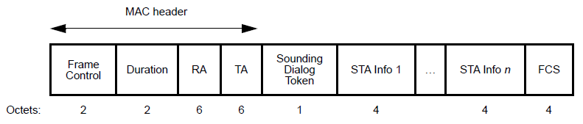
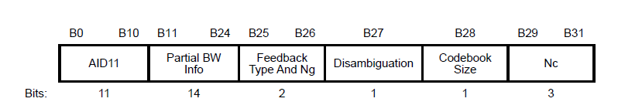

Recap: HE NDPA Structure (1)
Partial BW Info
  AP signals RU Start Index (the first 26-tone RU) and RU End Index (the last 26-tone RU) for feedback
  STA feedbacks channel state information (CSI) in the tones between RU Start Index and RU End Index
  STA Info subfield: 4 byte

Slide 4
Recap: HE NDPA Structure (2)
Sounding Dialog Token
  Ranging and HE subfield in Sounding Dialog Token
    VHT NDPA: These two bits are reserved
    HE NDPA: The second bit is used to distinguish HE and VHT NDPA
  VHT STA regards all NDPA as VHT NDPA, while HE STA regards it as HE NDPA if the HE subfield is set to 1
Disambiguation
  Disambiguation is set to 1 to prevent a VHT STA from wrongly identifying its AID in the HE, which is positioned in B(27) in STA Info field.
Ranging | HE/VHT | Description
0 | 1 | VHT
0 | 1 | HE NDPA
1 | 0 | Ranging NDPA
1 | 1 | Reserved

Slide 5
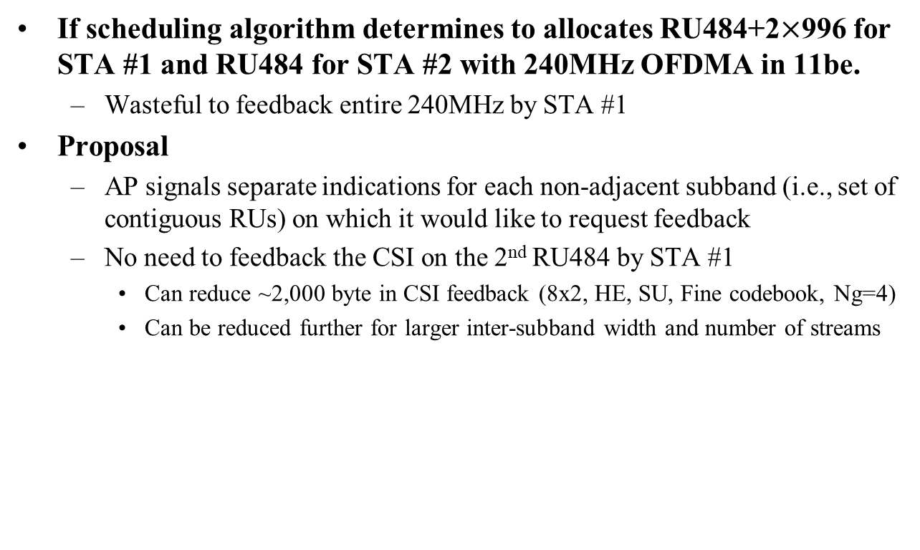
Motivation
If scheduling algorithm determines to allocates RU484+2$×$996 for STA #1 and RU484 for STA #2 with 240MHz OFDMA in 11be.
  Wasteful to feedback entire 240MHz by STA #1
Proposal
  AP signals separate indications for each non-adjacent subband (i.e., set of contiguous RUs) on which it would like to request feedback
  No need to feedback the CSI on the 2nd RU484 by STA #1
    Can reduce ~2,000 byte in CSI feedback (8x2, HE, SU, Fine codebook, Ng=4)
    Can be reduced further for larger inter-subband width and number of streams
 | Partial BW Info
 | RU26 Start Index | RU26 End Index
STA Info 1 | 0 | 111
STA Info 2 | 18 | 35
Feedback by STA #2
484
484
996
996
RU index
0 …
18 … 35
…
… 111
Feedback by STA #1

Slide 6
EHT NDPA Update
Based on the HE NDPA, EHT NDPA can be designed by updating following subfields:
  Disambiguation
    Disambiguation is set to 1 to prevent a VHT STA from wrongly identifying its AID in the HE/EHT NDPA, which will be positioned in
    B(16*n+11) for n=1,2… (i.e., B(27), B(43), B(59),…)
  N_{c}
    3bit → 4bit (for 16 spatial streams support)
  Partial BW Info subfield
    14bit → 8bit (Granularity is reduced from 26-tone RU to 242-tone RU [4][5])
    Applicable for Option #1 and Option #2 in slide 9 and slide 10, respectively

Slide 7
EHT NDPA Identification (1)
Identifications for VHT, HE, EHT and EHT+ NDPA
  Propose to set two bits (Ranging and HE subfield) in Sounding Dialog Token as below
    0: VHT, EHT, EHT+ NDPA
    1: HE NDPA
    2: Ranging NDPA
    3: Reserved
  VHT STA
    Regards all NDPA as VHT NDPA
    Disambiguation bit prevents a VHT STA from wrongly identifying its AID in the HE, EHT, and EHT+ NDPA
  HE STA
    Regards as HE NDPA if the HE subfield is set to 1
  EHT and EHT+ NDPA
    Regards as EHT and EHT+ NDPA as long as the Ranging and HE subfield is set to 00 and Disambiguation bit is set to 1
Ranging | HE/VHT | Description
0 | 0 | VHT, EHT, EHT+ NDPA
0 | 1 | HE NDPA
1 | 0 | Ranging NDPA
1 | 1 | Reserved
Note: EHT+: the amendments after EHT

Slide 8
EHT NDPA Identification (2)
NDPA Version field (3bit)
  Identify the exact NDPA version starting with 802.11be
  Description of 3 bit version information is same as 3 bit version information in U-SIG.
    Better identification than just using Sounding Dialog Token and Disambiguation for future 802.11 coexistence
Option #A: Including version information in each STA Info
Option #B: Including version information in Common Info
  AID11: Indicate to Common Info field by using the reserved AID values.
    ex) [2008 ~ 2046]
EHT and EHT+ can be multiplexed in a single NDPA

Slide 9
Option #1: One Partial BW Info Subfields
Similar to 11ax, Partial BW Info subfield indicates [RU Start Index, RU End Index]
  Granularity: 242-tone RU
  Partial BW Info: 8 bits
NDPA Identification: Option #A / Option #B
STA Info subfield: 4 bytes
  1 bit is reserved in the STA Info subfield (cf. 4 bits are reserved for Option #B)
Pros:
  The size of STA Info field is 4 bytes as 11ax
Cons:
  Cannot indicate the non-adjacent subbands
Frame Control | Duration | RA | TA | Sounding Dialog Token | STA Info 1 | …. | STA Info n | FCS
Octets: 2 | 2 | 6 | 6 | 1 | 4 |  | 4 | 4
B0 B10 | B11 B13 | B14 | B15 B22 | B23 B24 | B25 B26 | B27 | B28 B31
AID11 (11) | NDPA Version (3) | Reserved (1) | Partial BW Info (8) | Codebook Size (2) | Feedback Type And Ng (2) | Disambiguation (1) | Nc (4)

Slide 10
Option #2: Two Partial BW Info Subfields
Each Partial BW Info subfield indicates [RU Start Index, RU End Index] corresponding to each non-adjacent subband respectively.
  Granularity: 242-tone RU
  Partial BW Info: 16 bits
NDPA Identification: Option #A
STA Info subfield: 6 bytes
  2 bits are reserved in the STA Info subfield
Pros:
  Can indicate the non-adjacent subbands
Cons:
  Partial BW Info #2 (8 bits) is overhead when non-adjacent subbands don’t exist
Frame Control | Duration | RA | TA | Sounding Dialog Token | STA Info 1 | …. | STA Info n | FCS
Octets: 2 | 2 | 6 | 6 | 1 | 6 |  | 6 | 4
B0 B10 | B11 B18 | B19 B26 | B27 | B28 B37 | B38 B40 | B41 B42 | B43 | B44 B47
AID11 (11) | Partial BW Info #1 (8) | Partial BW Info #2 (8) | Disambiguation (1) | Feedback Type And Ng (2) Codebook Size (2) Nc (4) | NDPA Version (3) | Reserved (2) | Disambiguation (1) | Reserved (4)

Slide 11
Option #3: Reuse the RU Allocation Subfield
In [3], proposed 9-bit RU Allocation subfield for Trigger frame to indicate the multi-RU combinations in EHT.
NDPA Identification: Option #A / Option #B
STA Info subfield: 4 bytes
  3 bits are reserved in the STA Info subfield (cf. No reserved bit for Option #A)
Pros:
  Minimum granularity: 26-tone RU
  The size of STA Info field is 4 bytes as 11ax
Cons:
  Less flexibility in representation
B0 B10 | B11 B13 | B14 B15
AID11 (11) | NDPA Version (3) | Reserved (2)
Frame Control | Duration | RA | TA | Sounding Dialog Token | Common Info | EHT STA Info 1 | …. | EHT STA Info n | Common Info | EHT+ STA Info 1 | … | EHT+ STA Info n | FCS
Octets: 2 | 2 | 6 | 6 | 1 | 2 | 4 |  | 4 |  | 2n | 2n | 2n | 4
B0 B10 | B11 B13 | B14 B22 | B23 B24 | B25 B26 | B27 | B28 B31
AID11 (11) | Reserved (3) | RU allocation subfield (9) | Codebook Size (2) | Feedback Type And Ng (2) | Disambiguation (1) | Nc (4)

Slide 12
EHT MIMO Control Field Update (1)
Based on the HE MIMO control field, EHT MIMO control field can be designed by updating following subfields:
  N_{c}, N_{r}
    3bit → 4bit (for 16 spatial streams support)
  BW
    2bit → 3bit (for 320MHz support)
  Partial BW Info subfield
    14bit → 8bit (Granularity is reduced from 26-tone RU to 242-tone RU [4][5])
    Applicable for Option #1 and Option #2 in slide 13
  Disallowed Subchannel Bitmap
    0 or 8bit → 0 or 16bit (for 320MHz support)
Nc | Nr | BW | Grouping | Codebook Information | Feedback Type | Remaining Feedback Segments | First Feedback Segment | …
Bit: 4 | 4 | 3 | 2 | 2 | 2 | 3 | 1

Slide 13
EHT MIMO Control Field Update (2)
EHT MIMO Control field format
  For Option #1
  For Option #2
    [2nd RU Start Index, 2nd RU End Index] are present if the 2nd RU Start-End Index Present is equal to 1
  For Option #3
… | RU Start Index | RU End Index | Sounding Dialog Token Number | Disallowed Subchannel Bitmap Present | Reserved | Disallowed Subchannel Bitmap
Bit: | 4 | 4 | 6 | 1 | 3 | 0 or 16
… | RU Start Index | RU End Index | Sounding Dialog Token Number | Disallowed Subchannel Bitmap Present | 2nd RU Start-End Index Present | Reserved | Disallowed Subchannel Bitmap | 2nd RU Start Index | 2nd RU End Index
Bit: | 4 | 4 | 6 | 1 | 1 | 3 | 0 or 16 | 0 or 4 | 0 or 4
… | RU Allocation Subfield | Sounding Dialog Token Number | Disallowed Subchannel Bitmap Present | Reserved | Disallowed Subchannel Bitmap
Bit: | 9 | 6 | 1 | 3 | 0 or 16

Slide 14
Summary
We proposed two Partial BW Info design methods for EHT
  Option #1: Two STA Info subfields for one STA
  Option #2: Use the RU allocation subfield
We also proposed two NDPA identification methods for EHT
  Option #A: Including version information in each STA Info.
  Option #B: Including version information in a Common Info

Slide 15
SP #1
Do you agree to design the EHT NDPA frame based on the VHT/HE NDPA frame?
  Y / N / Abstain

Slide 16
SP #2
Do you agree to design the EHT MIMO control field based on the VHT/HE MIMO control field?
  Y / N / Abstain

Slide 17
SP #3
For the indication of the partial BW feedback, which option do you support in NDPA frame and MIMO Control Field?
  Option #1
    One Partial BW Info Subfield in a STA Info subfields
  Option #2
    Two Partial BW Info Subfields in a STA Info subfields
  Option #3
    Reuse the RU allocation subfield

Slide 18
SP #4
Do you support to include 3 bit version information in EHT NDPA frame?
  Note: Description of 3 bit version information is same as 3 bit version information in U-SIG.
  Y / N / Abstain

Slide 19
SP #5
For the inclusion of 3 bit version information in NDPA, which option do you support?
  Option #A
    Including version information in each STA Info.
  Option #B
    Including version information in a common Info.

Slide 20
SP #6
Do you support to set the Ranging and HE subfield of Sounding Dialog Token for EHT NDPA frame as below ?
  Note: EHT+ means the amendments after EHT
  Y / N / Abstain
Ranging | HE/VHT | Description
0 | 0 | VHT, EHT, EHT+
0 | 1 | HE NDPA
1 | 0 | Ranging NDPA
1 | 1 | Reserved

Slide 21
Reference
[1] 802.11-20/0566r23, Specification Framework for TGbe.
[2] 802.11-19/0828r4, Feedback Overhead Analysis for 16 Spatial Stream MIMO
[3] 802.11-20/0828r0, RU Allocation Subfield Design for EHT Trigger Frame
[4] 802.11-20/1161r0, EHT Punctured NDP and Partial Bandwidth feedback
[5] 802.11-20/1015r1, EHT NDPA Frame Design Discussion

