Slide 1
Partial Bandwidth Feedback for Multi-RU
Date: 2020-07-01
Authors:

Slide 2
Introduction
802.11be shall supports that
  Wideband band and noncontiguous spectrum utilization
  Large size RU combination assigned to a single STA [1].
  Maximum 16 spatial stream
Feedback overhead is significantly increased, compared to 11ax [2]
In order to reduce feedback overhead, the partial BW feedback is adopted in 11ax as an optional feature
  Partial BW feedback
    By choosing [RU Start Index, RU End Index] to cover the allocated RU only, feedback overhead can be reduced compared with full BW feedback
In this slide, we show a modified signaling for partial BW feedback for multi-RU combination in 802.11be

Slide 3
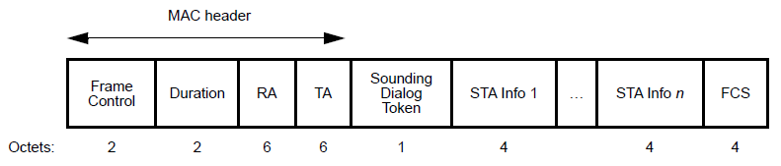
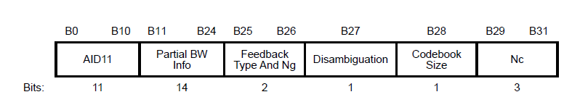

Recap: HE NDP Announcement Frame
AP signals the partial BW info subfield in NDPA
  AP signals RU Start Index (the first 26-tone RU) and RU End Index (the last 26-tone RU) for feedback
  STA feedbacks channel information (CSI) in the tones between RU Start Index and RU End Index
  STA Info subfield: 4 byte

Slide 4
Update for EHT NDPA
Based on the HE NDPA, EHT NDPA can be designed by updating following subfields:
  Ranging and HE subfield in Sounding Dialog Token
    0: VHT, EHT, EHT+ (EHT+: the amendments after EHT)
    1: HE
    2: Ranging NDPA, 3: Reserved
  Disambiguation
    Disambiguation subfield is set to 1 to prevent a VHT STA from wrongly identifying its AID in the HE/EHT NDPA, which will be positioned in
    B(16*n+11) for n=1,2… (i.e., B(27), B(43), B(59),…)
  N_{c}
    3bit → 4bit (for 16 spatial streams support)
  Partial BW Info subfield
    14bit → 16bit (for 320MHz support)
    Applicable only for option #1 in slide 6
Ranging | HE/VHT | Description
0 | 0 | VHT, EHT, EHT+ NDPA
0 | 1 | HE NDPA
1 | 0 | Ranging NDPA
1 | 1 | Reserved

Slide 5
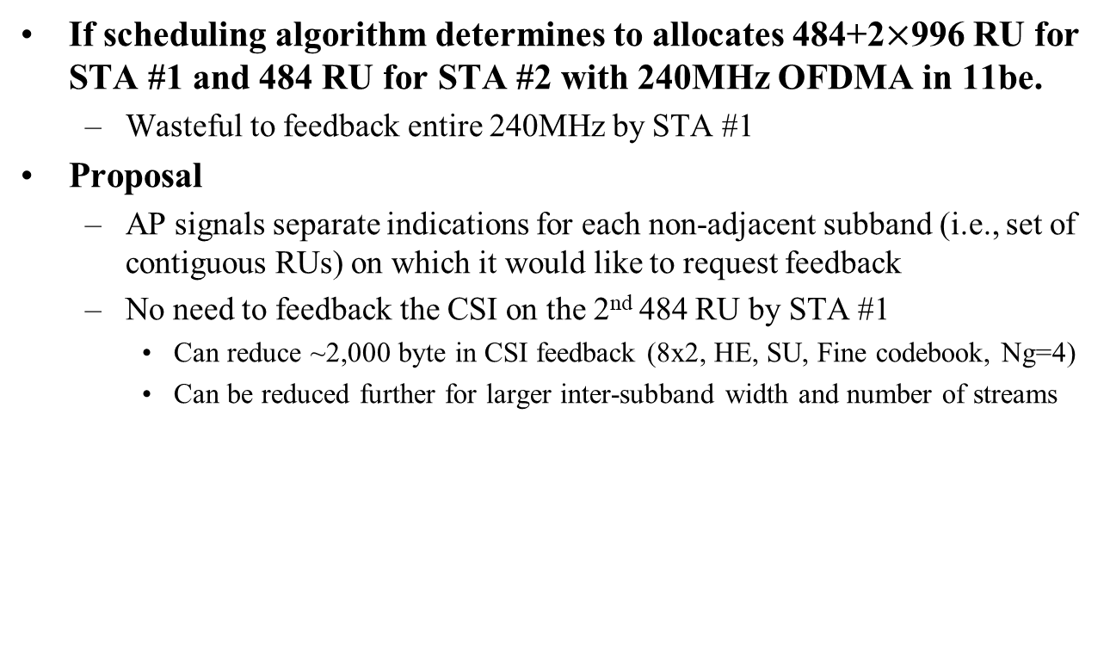
Partial BW feedback for Multi-RU: Motivation
If scheduling algorithm determines to allocates 484+2$×$996 RU for STA #1 and 484 RU for STA #2 with 240MHz OFDMA in 11be.
  Wasteful to feedback entire 240MHz by STA #1
Proposal
  AP signals separate indications for each non-adjacent subband (i.e., set of contiguous RUs) on which it would like to request feedback
  No need to feedback the CSI on the 2nd 484 RU by STA #1
    Can reduce ~2,000 byte in CSI feedback (8x2, HE, SU, Fine codebook, Ng=4)
    Can be reduced further for larger inter-subband width and number of streams
 | Partial BW Info
 | RU Start Index | RU End Index
STA Info 1 | 0 | 111
STA Info 2 | 18 | 35
Feedback by STA #2
484
484
996
996
RU index
0 …
18 … 35
…
… 111
Feedback by STA #1

Slide 6
Partial BW feedback for Multi-RU: Option #1
Duplicated STA Info subfield for one STA
  Each Partial BW Info subfield indicates [RU Start Index, RU End Index] corresponding to each non-adjacent subband respectively.
  NDPA Version field (3bit)
    Identify the exact NDPA version starting with 802.11be
  STA Info subfield: 6 byte
B0 B10 | B11 B26 | B27 | B28 B37 | B38 B40 | B41 B42 | B43 | B44 B47
AID11 (11) | Partial BW Info #1 (16) | Disambiguation (1) | Feedback Type And Ng (2) Codebook Size (2) Nc (4) | NDPA Version (3) | Reserved (2) | Disambiguation (1) | Reserved (4)
Frame Control | Duration | RA | TA | Sounding Dialog Token | STA Info 1 | …. | STA Info n | STA Info n | FCS
Octets: 2 | 2 | 6 | 6 | 1 | 6 |  | 6 | 6 | 4
B0 B10 | B11 B26 | B27 | B28 B37 | B38 B40 | B41 B42 | B43 | B44 B47
AID11 (11) | Partial BW Info #2 (16) | Disambiguation (1) | Feedback Type And Ng (2) Codebook Size (2) Nc (4) | NDPA Version (3) | Reserved (2) | Disambiguation (1) | Reserved (4)

Slide 7
Partial BW feedback for Multi-RU: Option #2
Use the RU allocation map
  “RU allocation subfield” along with bandwidth information can identify the size and the location of the RU, for which the beamformer is requesting feedback
    In [3], proposed the 9-bit RU Allocation subfield for Trigger frame to indicate the multi-RU combinations in EHT.
    Provide a table mapping the allocated RU to subcarrier indices [S, E]
  NDPA Version field (3bit)
    Identify the exact NDPA version starting with 802.11be
  STA Info subfield: 4 byte
Frame Control | Duration | RA | TA | Sounding Dialog Token | STA Info 1 | …. | STA Info n | FCS
Octets: 2 | 2 | 6 | 6 | 1 | 4 |  | 4 | 4
B0 B10 | B11 B13 | B14 B22 | B23 B24 | B25 B26 | B27 | B28 B31
AID11 (11) | NDPA Version (3) | RU allocation subfield (9) | Codebook Size (2) | Feedback Type And Ng (2) | Disambiguation (1) | Nc (4)

Slide 8
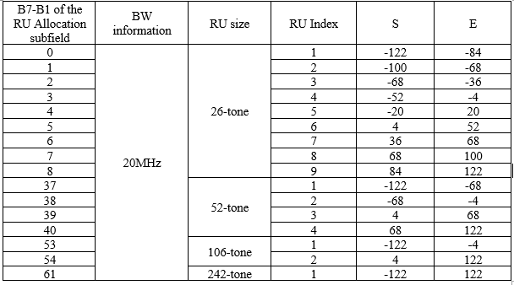
Example of the Mapping Table for Option #2
A table for mapping allocated RU to subcarrier indices [S, E]
  The table can be made separately according to the grouping size (N_{g})
  Detailed implementation of the table is TBD
[Arrangement of RU Index]

Slide 9
Update for EHT MIMO Control Field
Based on the HE MIMO control field, EHT MIMO control field can be designed by updating following subfields:
  N_{c}, N_{r}
    3bit → 4bit (for 16 spatial streams support)
  BW
    0: 20MHz, 1: 40MHz, 2: 80MHz, 3: 160MHz, 4: 320MHz
    2bit → 3bit
  Partial BW Info subfield
    14bit → 16bit (for 320MHz support)
    Applicable only for option #1 in slide 10
  Disallowed Subchannel Bitmap
    0 or 8bit → 0 or 16bit (for 320MHz support)

Slide 10
Update for MIMO Control Field
EHT MIMO Control field format
  For Option #1
    [2nd RU Start Index, 2nd RU End Index] are present if the 2nd RU Start-End Index Present is equal to 1
    Size of EHT MIMO Control field: 6 or 8 or 10 byte
  For Option #2
    Size of EHT MIMO Control Field: 5 or 7 byte
Nc | Nr | BW | Grouping | Codebook Information | Feedback Type | Remaining Feedback Segments | First Feedback Segment | …
Bit: 4 | 4 | 3 | 2 | 2 | 2 | 3 | 1
RU Start Index | RU End Index | Sounding Dialog Token Number | Disallowed Subchannel Bitmap Present | 2nd RU Start-End Index Present | Reserved | Disallowed Subchannel Bitmap | 2nd RU Start Index | 2nd RU End Index
Bit: 8 | 8 | 6 | 1 | 1 | 3 | 0 or 16 | 0 or 8 | 0 or 8
RU Allocation Subfield | Sounding Dialog Token Number | Disallowed Subchannel Bitmap Present | Reserved | Disallowed Subchannel Bitmap
Bit: 9 | 6 | 1 | 3 | 0 or 16

Slide 11
Summary
In this slide, we proposed a modified signaling for the partial BW feedback to reduce feedback overhead in multi-RU combination
  Option #1
    Duplicated STA Info subfield for one STA
    STA Info subfield: 6 byte or 12 byte
  Option #2
    Use the RU allocation subfield
    STA Info subfield: 4 byte

Slide 12
Reference
[1] 802.11-20/0566r23, Specification Framework for TGbe.
[2] 802.11-19/0828r4, Feedback Overhead Analysis for 16 Spatial Stream MIMO
[3] 802.11-20/0828r0, RU Allocation Subfield Design for EHT Trigger Frame

Slide 13
SP #1
Do you agree to design the EHT NDPA frame based on the VHT/HE NDPA frame with following modifications?
  Other modifications are TBD
    Ranging and HE subfield in Sounding Dialog Token
    N_{c} : 4bit
    NDPA Version: 3bit
      Identify the exact NDPA version starting with 802.11be
  Y / N / Abstain
  Y / N / Abstain
Ranging | HE/VHT | Description
0 | 0 | VHT, EHT, EHT+ NDPA
0 | 1 | HE NDPA
1 | 0 | Ranging NDPA
1 | 1 | Reserved

Slide 14
SP #2
Do you agree to design the EHT MIMO control field based on the VHT/HE MIMO control field with following modifications?
  Other modifications are TBD
  EHT MIMO control field
    N_{c} : 4bit
    N_{r} : 4bit
    BW: 3bit
      0: 20MHz, 1: 40MHz, 2: 80MHz, 3: 160MHz, 4: 320MHz
    Disallowed Subchannel Bitmap: 0 or 16bit
  Y / N / Abstain
  Y / N / Abstain

Slide 15
SP #3
For the indication of the partial BW feedback, which option do you support in NDP Announcement frame and MIMO Control Field?
  Option #1
    Support duplicated STA Info subfield for one STA
    STA Info subfield: 6 byte or 12 byte
  Option #2
    Use the RU allocation subfield
    STA Info subfield: 4 byte

Slide 16
Appendices

Slide 17
Example of Option #1
If scheduling algorithm determines to allocates 484+2$×$996 RU for STA #1 and 484 RU for STA #2 with 240MHz OFDMA in 11be
 | Partial BW Info #1 |  | Partial BW Info #2
 | RU Start Index | RU End Index | RU Start Index | RU End Index
STA Info 1 | 0 | 17 | 36 | 111
STA Info 2 | 18 | 35 | - | -
484
484
996
996
RU index
0 … 17
18 … 35
36 …
… 111
Feedback by STA #1
Feedback by STA #2
Feedback by STA #1

Slide 18

Example of Option #2
If scheduling algorithm determines to allocates 484+2$×$996 RU for STA #1 and 484 RU for STA #2 with 240MHz OFDMA in 11be
  See [3] for the value of RU allocation subfield
 | RU allocation subfield [X8-X0]
STA Info 1 | 001010111
STA Info 2 | 001000001
484
484
996
996
RU index
0 … 17
18 … 35
36 …
… 111
Feedback by STA #1
Feedback by STA #2
Feedback by STA #1

