Slide 1
All TIDs mapped to All Links
Date: 2020-08-13
Authors:

Slide 2
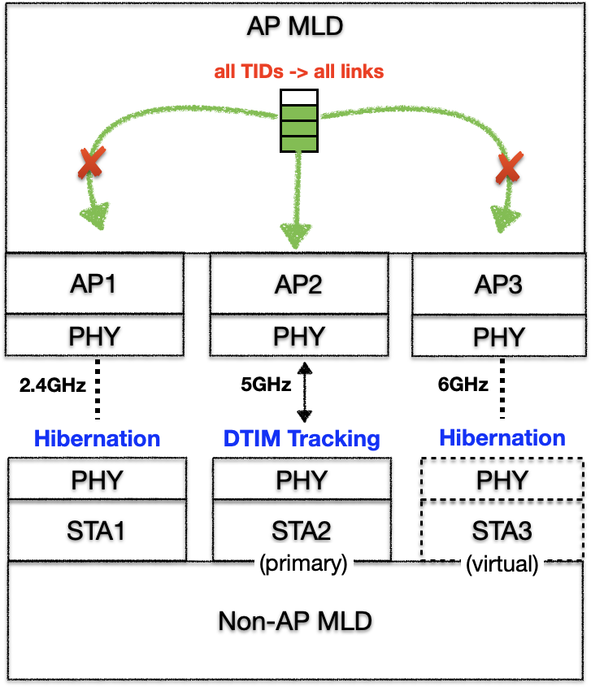
Motivation
A non-AP MLD may request to map all TIDs (both DL and UL) to all links.
The non-AP MLD may only use one of the STAs, e.g. STA2 in the example, to track DTIM beacons and maintain low power communication with the AP MLD.
  The STA can be called the primary STA, for the sake of explanation.
The non-AP MLD puts other STAs, e.g. STA1 and STA3 in the example, in a special low power mode, called hibernation mode.
Whenever needed, the non-AP MLD shall be able to:
  Transition (slow) its primary STA to a different link; or
  Switch (fast) its primary STA to a different link

Slide 3
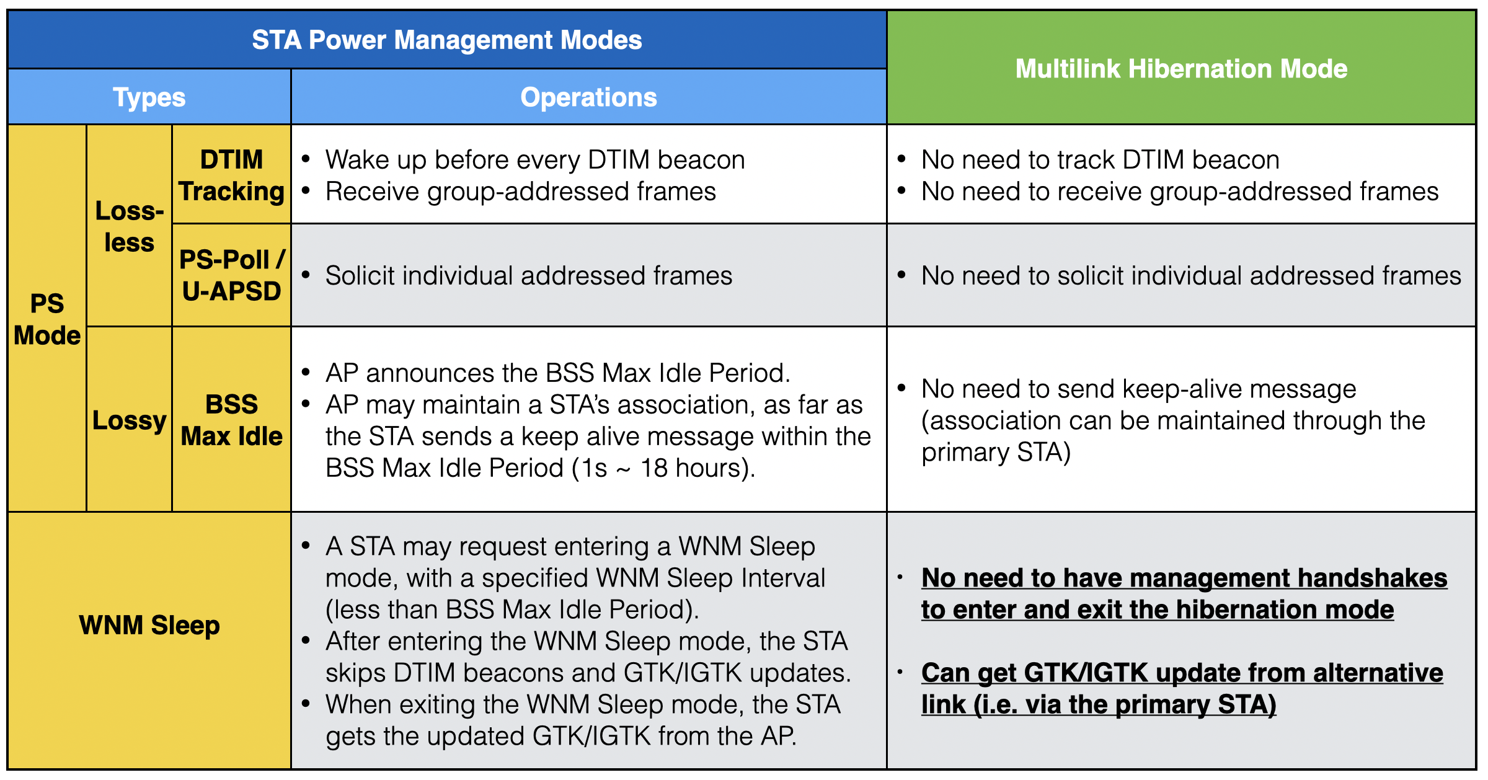
Hibernation vs. Power Saving

Slide 4
How to enter/exit the hibernation mode?
During the ML Setup, a non-AP MLD may indicate one or more of its STAs enter the hibernation mode.
  After the ML Setup, the AP MLD may immediately send frames to the non-AP MLD via STA(s) in active mode, but shall not send frames to the non-AP MLD via STA(s) in hibernation mode.
A non-AP MLD may choose to transition (slow) a primary STA to a different link, by:
  Indicating the new primary STA exiting the hibernation mode
    The new primary STA just needs to send a PS-Poll or U-APSD trigger frame to its associated AP to exit the hibernation mode
  Indicating the old primary STA entering the hibernation mode
    Existing power management schemes can be used??

Slide 5
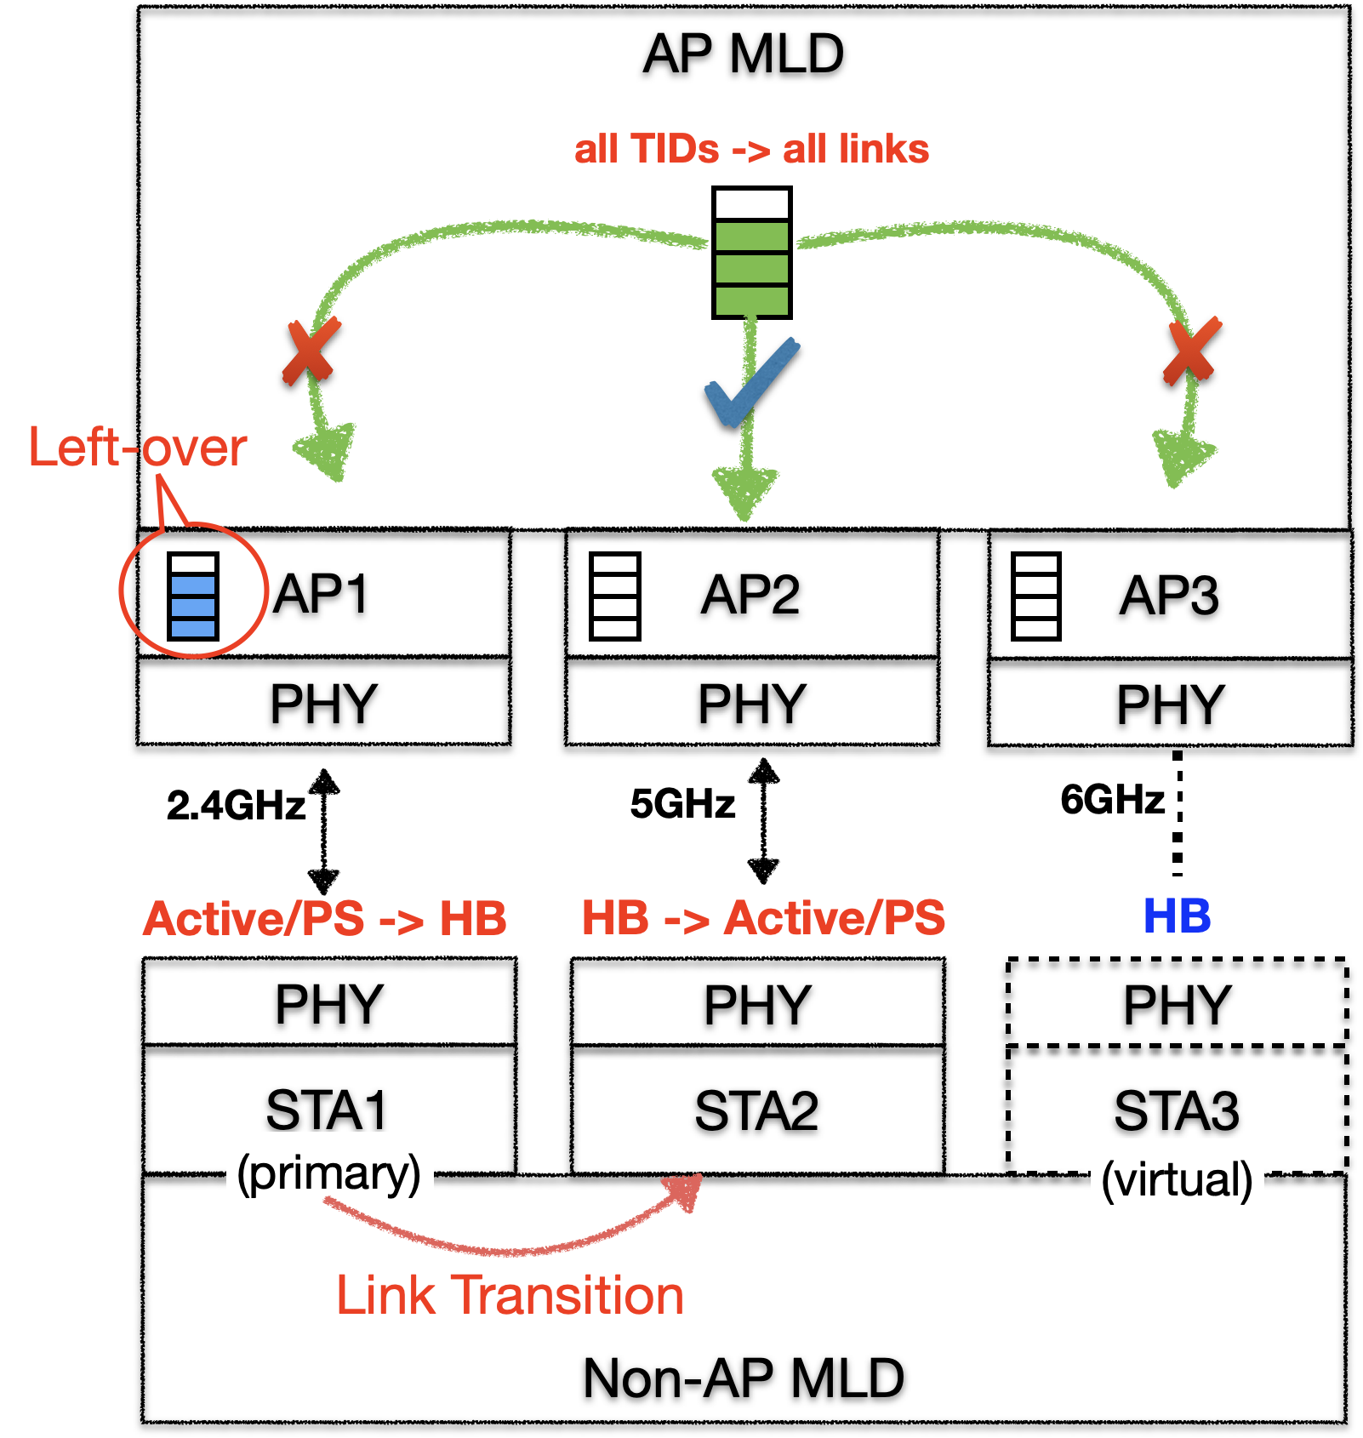
Link Transition
STA2 may send a PS-Poll or U-APSD trigger frame to AP2 to exit the hibernation mode
STA1, if in Active mode, shall enter PS mode first, i.e. by sending a frame to AP1 with PM=1, and AP1 shall immediately stop transmitting to STA1
However, AP1 may still have some “left-over” BUs pulled down to lower MAC, waiting for STA1’s PS-Poll or U-APSD trigger
STA1 may continue transmitting PS-Poll or U-APSD trigger to AP1 to collect the “left-over” BUs, until it receives a frame with More Data field set to “0”
However, AP1 may never set More Data field to “0” if there is continuous data flowing from upper layer.
How does STA1 indicate it wants to enter the hibernation mode and request AP1 to complete the left-over BUs without pulling down more BUs?

Slide 6
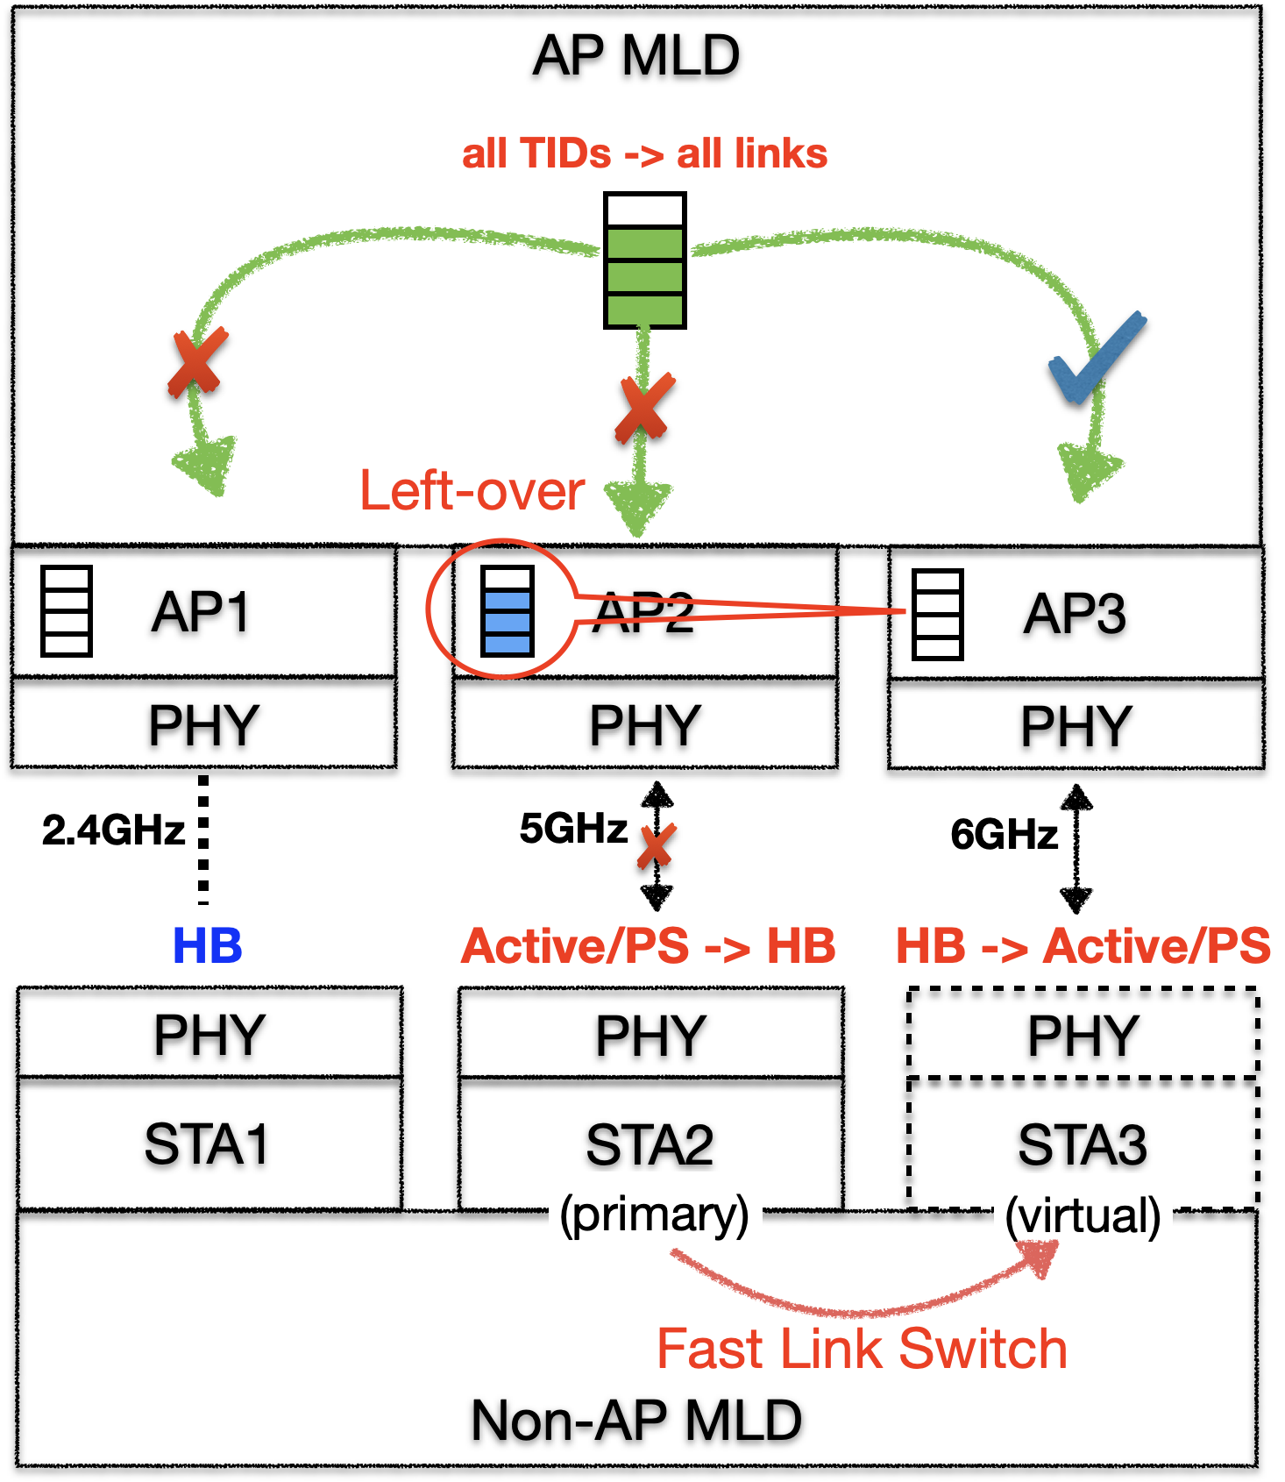
Fast Link Switch
Fast Link Switch vs. Link Transition
  Link Transition:
    The old link can still be used to convey left-over packets.
  Fast Link Switch:
    The old link may become immediately unavailable.
    The left-over packets (esp. low-latency ones) cannot wait the old link to become available again.
A new signaling is needed for STA3 to request:
  AP MLD to stop buffering new packets to AP2
  AP MLD to: 1) transfer the left-over packets from AP2 to AP3, or 2) rebuffer those packets to AP3;
  AP MLD to start transmitting packets to STA3
Propose to define a new A-Control field for the fast link switch signaling

Slide 7
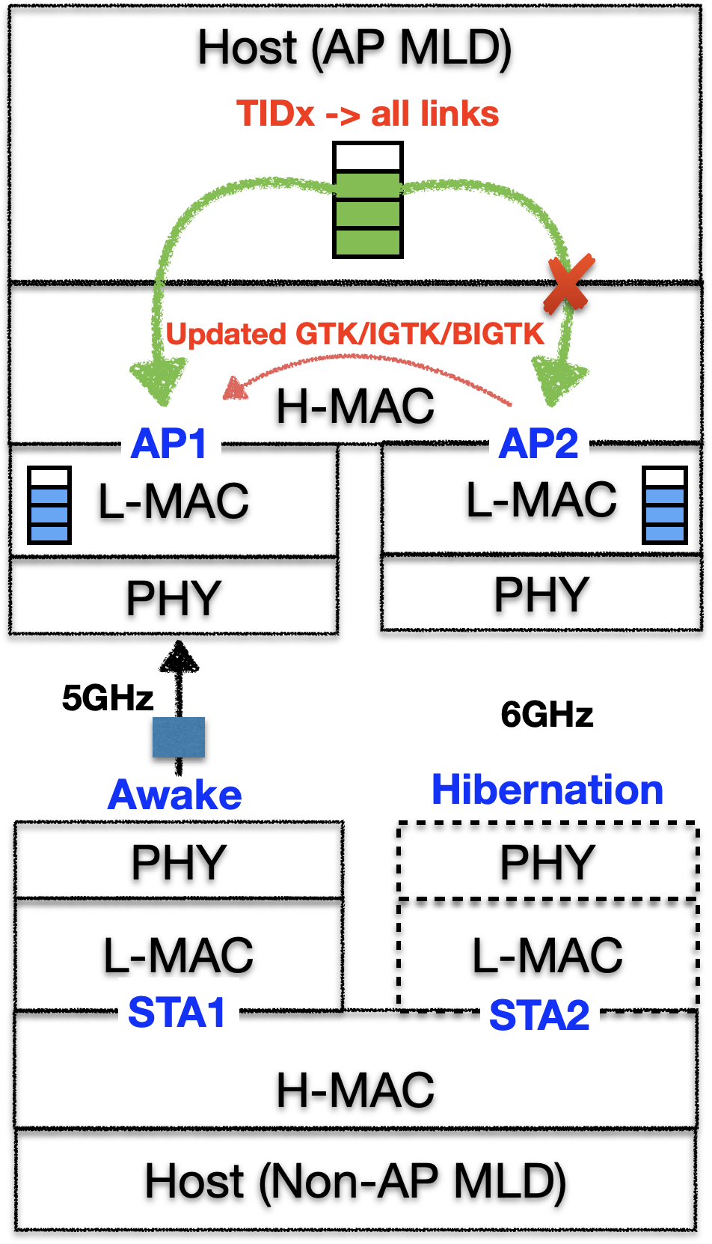
GTK/IGTK/BIGTK Update
When one AP of an AP MLD needs to update its GTK/IGTK/BIGTK, the AP MLD shall be able to convey the new GTK/IGTK/BIGTK to any awake STA of an associated Non-AP MLD, which may operate on a different link from the AP that updates its GTK/IGTK/BIGTK.
The same rule should apply to other unicast BSS operation update, if any.

Slide 8
Summary
A non-AP MLD may request to map all TIDs (both DL and UL) to all links, but, normally, it may rely on a single primary STA to maintain low power operation.
  The non-AP MLD may put other STAs in a hibernation mode.
  Whenever needed, the non-AP MLD may transition (slow) or switch (fast) the primary STA to a different link.
New signals are needed for a non-AP MLD to indicate:
  Entering / exiting the hibernation mode
  Transitioning a primary STA to a different link
  Switching a primary STA to a different link

Slide 9
SP1
Do you support the following multilink hibernation mode indication in R1:
  During the Multi-Link Setup, a non-AP MLD may indicate one or more of its STAs enter the multilink hibernation mode.

Slide 10
SP2
Do you support to define new signaling(s) in R1 to facilitate an AP MLD to deliver “left-over” BUs to a Non-AP MLD during link transition and/or fast link switch?

Slide 11
SP3
Do you support the following multi-link scheme in R1:
  When one AP of an AP MLD needs to update its GTK/IGTK/BIGTK, the AP MLD shall be able to convey the new GTK/IGTK/BIGTK to any awake STA of an associated Non-AP MLD, which may operate on a different link from the AP that updates its GTK/IGTK/BIGTK.

