Slide 1
Channel Access for Constrained MLD
Date: 2020-06-20
Authors:
Name | Affiliations | Address | Phone | Email
Yiqing Li | Huawei | Shenzhen, China |  | liyiqing3@Huawei.com
Yunbo Li
Ming Gan
Yuchen Guo
Guogang Huang
Yifan Zhou
Meihong Zhang

Slide 2
Introduction
Terminology
  NSTR link pair
  A STA is NSTR limited if all of the following conditions are true:
    the STA is affiliated with an MLD that has at least one NSTR link pair
    the STA has received the RTS on a link that is a member of one or more of the MLD’s NSTR link pairs
    a STA of the MLD is a TXOP holder or TXOP responder on one of the other links that is a member of at least one of the NSTR link pairs of which the link on which the RTS was received is a member
Different channel access mechanisms were proposed to synchronize PPDUs for constrained MLD
  Fully synchronization transmission
    Opt 1: single primary link EDCA + other secondary links do PIFS access
    Opt 2: multiple primary links EDCA + primary links can also do PIFS access
      This option has fairness issues (detail explanation is in the next page)
      Opt 2.1: multiple primary link + PIFS access + fairness compensation
    Opt 3: multiple primary links EDCA + links waiting until all links reaching 0
  End time aligned transmission
    Opt 4: Independent Access on each link
In this contribution, we discuss the channel access mechanisms for constrained MLD in order to guarantee the fairness.

Slide 3
Recap: Fairness Issues for Fully Synchronized Transmission
Fairness Issues: for fully synchronized transmission, allowing full backoff on one link and PIFS access on another link provides more channel access opportunities for constrained MLD than that for legacy devices.
Different Synchronized Transmission Channel Access methods regarding fairness have been proposed.
  Opt.1: Remain backoff counter threshold for limiting PIFS access along with PD/NAV check [1]
  Opt.2: Toggle full backoff link [2]
  Opt.3: Store the remain backoff counter for PIFS access. The suspended backoff counter value is added in the next EDCA transmission [2][3].
Fairness issues are not the first time to be discussed in IEEE 802.11 spec.

Slide 4
Recap: MU EDCA for fairness issues in 802.11ax
Fairness Issues in 802.11ax: HE STAs have more channel access opportunities due to the trigger based channel access methods besides EDCA than legacy STAs.
  Similar with what we have for fully sync. transmission as MLDs acquiring more channel access chances than legacy devices due to PIFS access besides EDCA.
Solutions already in 802.11ax: To define MU EDCA parameters for non-AP HE STA that receives a Basic Trigger frame that contains a User Info field addressed to the STA. (See Section 26.2.7 in Draft P802.11ax_D7.0)
  The HE STA shall update its CWmin[AC], CWmax[AC], AIFSN[AC] and MUEDCATimer[AC] state variables.
For now, we can follow the direction of MU EDCA channel access mechanisms to propose the fairness compensation methods for PIFS access.

Slide 5
Proposal 1: Fairness Compensation Methods for PIFS access - non-STR EDCA Parameters set
Based on what we have in 802.11ax as MU EDCA channel access mechanism, we propose to define a new EDCA parameters set and a new timer which can be named as non-STR EDCA Parameters set and PIFSAccessTimer[AC].
Each link performs Independent EDCA. If backoff on one link completes for sync. transmission and PIFS check passes on other links, all these links change the EDCA parameters set to non-STR EDCA parameters set for the next transmission during PIFSAccessTimer[AC].
  PIFSAccessTimer[AC] as the time of applying non-STR EDCA parameters set
  E.g., Once the STA 1 has full backoff and STA 2 has used the PIFS access, during the PIFSAccessTimer[AC], non-STR EDCA parameters set is applied for both STA 1 and STA 2 for the next transmission.

Slide 6
Proposal 1: Fairness Compensation Methods for PIFS access - non-STR EDCA Parameters set (Cont.)
Discussion about PIFSAccessTimer[AC]
  Each link has its own PIFSAccessTimer[AC] value?
    PIFSAccessTimer[AC] is link based (Preferred).
    PIFSAccessTimer[AC] is MLD based.
  About the decreasing rule
    The timer decreases by time regardless of the channel state, aligned with MUEDCATimer[AC] (Preferred).
    The timer decreases when the channel is idle, same as the backoff counter.
  If one link is still in back off when its PIFSAccessTimer[AC] reaches 0, the device can change back to EDCA parameters set while remaining the ongoing backoff counter value.
  If one link applies PIFS access during PIFSAccessTimer[AC], its PIFSAccessTimer[AC] will be refreshed.
    The link which completes backoff procedure resulting in other links PIFS accessing should set up PIFSAccessTimer[AC] or refresh it if the timer is non-zero.
  AP can broadcast its non-STR EDCA Parameters set and PIFSAccessTimer[AC] in beacon frames or in probe response/request
    Both non-STR EDCA Parameters set and PIFSAccessTimer[AC] can have default values.

Slide 7
Proposal 2: Fairness Compensation Methods for PIFS access – DisallowTimer
In order to limit the PIFS access behaviors, we propose to define a new timer which can be named as DisallowTimer[AC].
  Simpler and cleaner than proposal 1.
Each link performs Independent EDCA. If one link applied PIFS access for the last sync. transmission, set a DisallowTimer[AC] during which PIFS access in not allowed on this link.
  DisallowTimer[AC] can have default values. Additionally, it can be set and broadcasted by AP in beacons or Probe response/request.
  The timer decreases by time regardless of the channel state or decreases when the channel is idle
The link can do PIFS access when DisallowTimer[AC] value reaches 0.

Slide 8
Simulation Analysis
Simulation Parameters | Value
BSS number | 1
STA number in each BSS | 10 (4 NSTR STA MLD with 2 STAs in each MLD and 2 single link STAs)
BSS area | 15m*15m
Links | Two links with 5GHz and 6GHz
Traffic Direction | UL
Packet size | 1500 Bytes
MCS | 9
NSS | 2
AMPDU aggregation number | 256
PPDU Max length | 5.46ms
Bandwidth | 80MHz
Channel Access Protocol | 11ax EDCA

Slide 9
Simulated Schemes
PIFS Access
  Each link performs Independent EDCA. If the backoff counter on one link reaches 0, PIFS access can be applied on other links.
PIFS B
  Store the remain backoff counter for PIFS access. The suspended backoff counter value is added in the next EDCA transmission
Independent EDCA Access
PIFS EDCA Access
 | EDCA Parameters Set | non-STR EDCA Parameters set
CWmax | 1023 | 1023
CWmin | 15 | 31
AIFS | 43us | 79us

Slide 10
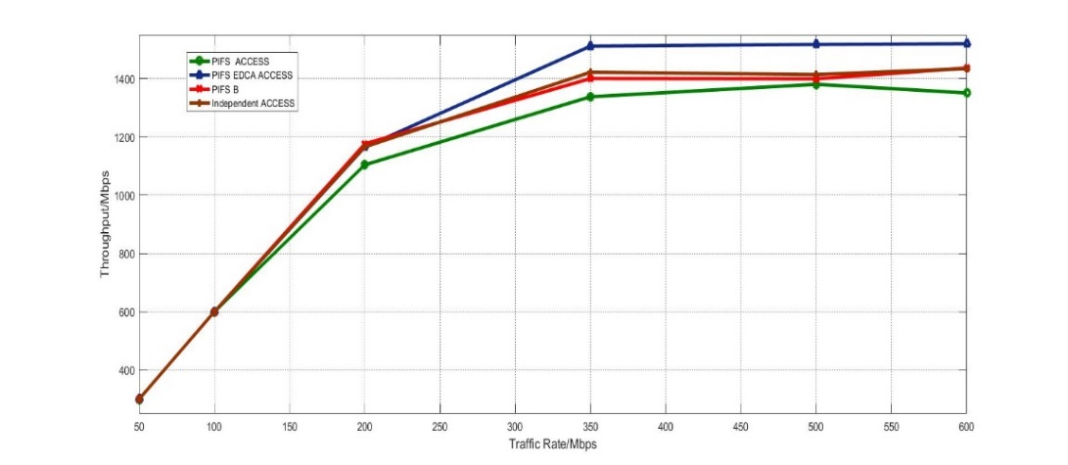
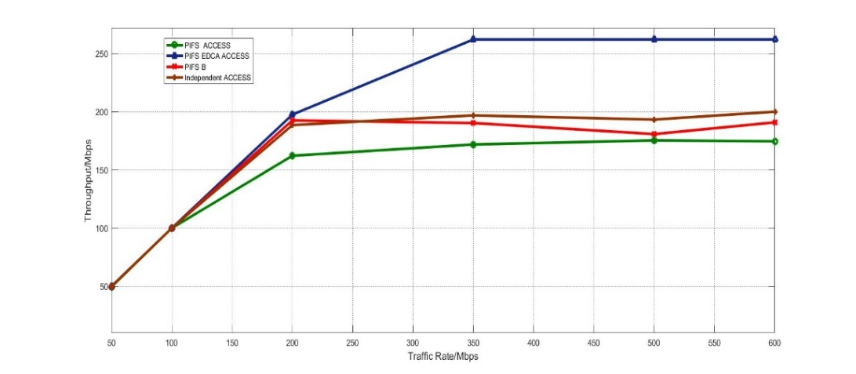
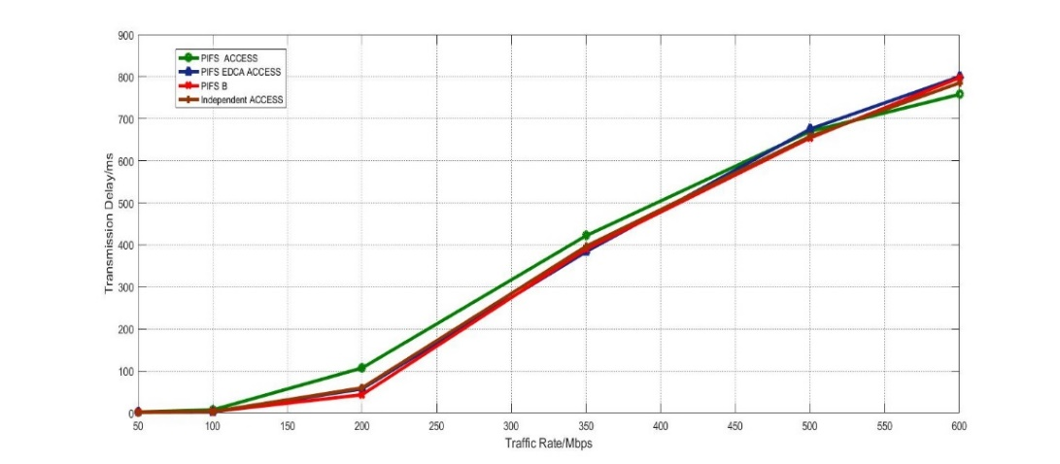
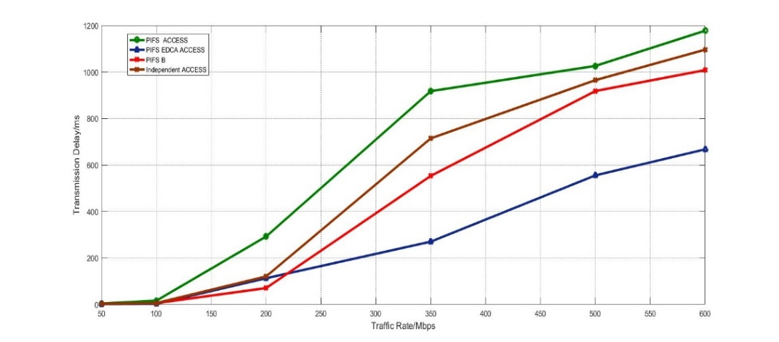
Throughputs and Transmission Delay Comparison
Average Throughput with increasing traffic rate within the BSS
Average Throughput with increasing traffic rate among the legacy STAs
Average Transmission Delay with increasing traffic rate within the BSS
Average Transmission Delay with increasing traffic rate among the legacy STAs
PIFS EDCA Access scheme have gains on legacy performance over throughputs (~20%) and transmission delay (~40%) compared with other schemes.

Slide 11
Summary
For 802.11ax, MU EDCA parameters are defined to solve the fairness issues that HE STAs acquiring more channel access opportunities than legacy STAs.
Following this direction, to deal with similar fairness issues in fully synchronized transmission for constrained MLD, we propose to define a non-STR EDCA parameters set and a PIFSAccessTimer[AC].
  If backoff on one link completes for sync. transmission and PIFS check passes on other links, all these links change to non-STR EDCA parameters set for the next transmission during PIFSAccessTimer[AC].
As another simpler and cleaner option, we propose to define a DisallowTimer to limit the PIFS access behaviors during which PIFS access is not allowed on that link.

Slide 12
Reference
[1] IEEE802.11-20/26r6, “MLO: Sync PPDUs”
[2] IEEE802.11-20/487r5, “Multiple Link Operation Follow Up”
[3] IEEE802.11-20/638r0, “STR AP Sync. PPDU Transmission”

