Slide 1
RU allocation subfield in EHT-SIG Follow up II
Date: 2020-06-19
Authors:
Name | Affiliations | Address | Phone | email
Ross Jian Yu | Huawei |  |  | ross.yujian@huawei.com
Mengshi Hu | Huawei
Ming Gan | Huawei

Slide 2
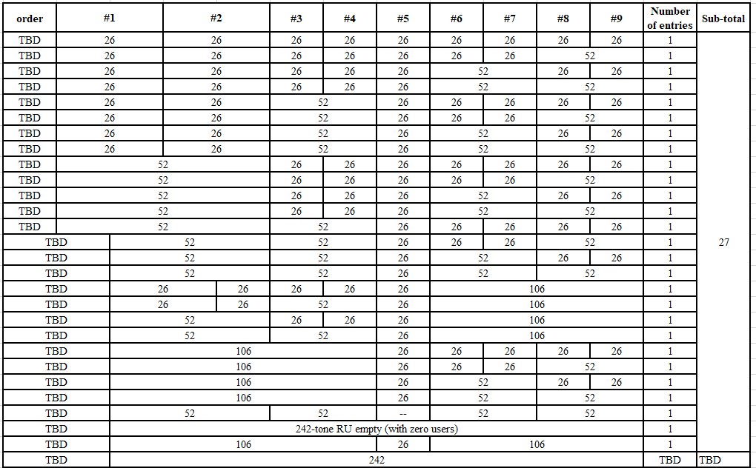
Introduction and recap
The following SPs have been passed as a baseline RU allocation table [1]:
Do you agree that the mapping from the TBD-bit RU Allocation subfield to the RU assignment, contains the following entries?
The RUs highlighted in orange means combination.
Other entries TBD
Compressed mode TBD
Note: Not all the 106+26-tone and 52+26 tone MRU are applicable when PPDU BW is greater than or equal to 80 MHz.
[37/0/8/2]
Table – Part I

Slide 3
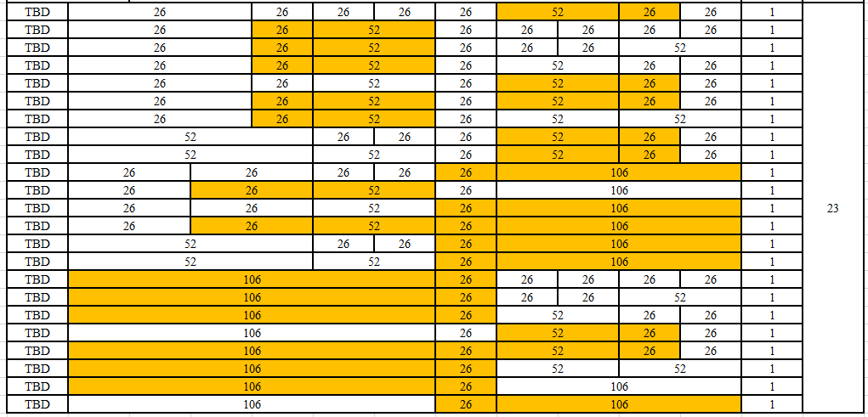
Introduction and recap
The following SPs have been passed as a baseline RU allocation table [1]:
Do you agree that the mapping from the TBD-bit RU Allocation subfield to the RU assignment, contains the following entries?
The RUs highlighted in orange means combination.
Other entries TBD
Compressed mode TBD
Note: Not all the 106+26-tone and 52+26 tone MRU are applicable when PPDU BW is greater than or equal to 80 MHz.
[37/0/8/2]
Table – Part II

Slide 4
Introduction and recap
The following SPs have also been passed [3]:
Do you agree that for non-compressed mode, each RU Allocation subfield in an EHT-SIG content channel corresponding to a 20 MHz frequency segment indicates the RU assignment, including the size of the RU(s) and their placement in the frequency domain, to be used in the EHT modulated fields of the EHT PPDU sent to multiple users in the frequency domain, also indicates information needed to compute the number of users allocated to each RU? [41Y/0N/15A]
This contribution further discusses the following parts:
Discussion on the definition of compressed modes and non-compressed modes, an overhead analysis is given
Focus on the non-compressed mode, and talk about the missing entries

Slide 5
Mode designs categories
For EHT PPDU sent to multiple users, we divide the mode designs proposed so far into the following categories:
Non-compressed OFDMA mode (11be baseline method, similar as 11ax)：
Used for OFDMA with RUs of all sizes
MU-MIMO is considered
RU Allocation subfield in the common field indicates the RU assignment information with granularity of 20MHz
N*RU Allocation subfield in one CC, where N=1 for 20/40MHz, 2 for 80MHz, 4 for 160MHz, 8 for 320MHz – needed for non-SST scenarios.
Enable similar function as 11ax, e.g., mixed of small and big RUs, enable mixed OFDMA+MU-MIMO
Compressed mode 1
No RU allocation subfield, used for full BW MU-MIMO [5], non-punctured and punctured cases can be merged or seen as two separate compressed modes
or further extend to if the transmission of the STAs of one parking segment is non-OFDMA[4]
Compressed mode X
Large size RU OFDMA mode [5] – compressed compared with baseline mode
N*RU Allocation subfield, where N=2 for 80MHz/160MHz/320MHz [3]
Variable RU allocation subfield with header bits [6]

Slide 6
Overhead comparison
Below is an overhead analysis of between different modes, given the overhead saving, it would still be OK if EHT-SIG only supports baseline and compressed mode 1.
Saving user field is more important. One user field is 22 bits, with half CRC+Tail considered, would be 27 bits.
SST helps the most regarding saving overhead
BW | Baseline | Compressed mode 1 | Large size RU OFDMA mode | N*RU Allocation subfield, where N=2 for BW>=80MHz | Variable RU allocation subfield with header bits
80 | 2*L_{RA} bits | 3^{NOTE1} | L_{RA} | 2*L_{RA} | (1-2)*L_{RA}+4^{NOTE2}
160 | 4*L_{RA} | 3 | 2*L_{RA} | 2*L_{RA} | (1-4)*L_{RA}+8
240 | 6*L_{RA} | 3 | 2*L_{RA} | 2*L_{RA} | (1-6)*L_{RA}+12
320 | 8*L_{RA} | 3 | 2*L_{RA} | 2*L_{RA} | (1-8)*L_{RA}+16
CRC+Tail | 10 | 10 | 10 | 10 | 10
overhead saving |  | 13, 29, 45 61 bits | 8, 16, 32, 48 | 0, 16, 32, 48 | Max 4, 16, 28, 40
L_{RA}=7/8/9 bits, take 8 bits as an example
Note 1: puncture info 3 bits as an example, or 0 if whole puncture info in U-SIG
Note 2: variable header bits needed

Slide 7
Non-compressed OFDMA mode
Encourage the group to consider the signaling of the baseline method first. And then further consider if the indication needs further optimization.
The non-compressed is to ensure the scheduler can cover different scenarios
Industry - IoT scenarios - OFDMA
Residential/Enterprise – versatile traffic, mixed of small and big RUs for OFDMA, will also need MU-MIMO if the number of users is big
In order to have a full non-compressed table, the following cases are missing in the baseline table:
MU-MIMO indication in single big RU which was presented in 11ax, propose to simply follow 11ax
in the RU allocation table, 9 entries per RU size will be used to indicate: contributes 0~8 User fields to the User Specific field in the same EHT-SIG content channel as this RU Allocation subfield
MU-MIMO indication in 2*996-tone RU, propose to simply follow 11ax
Large MRU indication, including MU-MIMO indication, may need further discussion.

Slide 8
Summary
This contribution discusses the categorization of the non-compressed mode, and talks about the designs assuming no compression at all, i.e., the baseline method.
An overhead analysis of different EHT-SIG mode is given. Non-compressed OFDMA mode and compressed mode 1 seem to be enough, but I am open for further discussion on how many modes the group wants to support.
Encourage the group to consider the signaling of the baseline method first. And then further consider if the indication needs further optimization.

Slide 9
Straw Poll #1
Do you agree that for RU242, in the RU allocation table, 8 entries per RU size will be used to indicate: contributes 1~8 User fields to the User Specific field in the same EHT-SIG content channel as this RU Allocation subfield?
Make the following change in the baseline table in the SFD
Compressed modes are TBD.
Yes/No/Abstain
TBD | 242 | TBD 8

Slide 10
Straw Poll #2
Do you agree that for RU484 or RU996, in the RU allocation table, 8 entries per RU size will be used to indicate: contributes 1~8 User fields to the User Specific field in the same EHT-SIG content channel as this RU Allocation subfield?
Add the following entries in the baseline table in the SFD
Compressed modes are TBD.
Yes/No/Abstain
TBD | 484 | 8
TBD | 996 | 8

Slide 11
Straw Poll #3
Do you agree that for RU 2*996, in the RU allocation table, 8 entries per RU size will be used to indicate: contributes 1~8 User fields to the User Specific field in the same EHT-SIG content channel as this RU Allocation subfield?
Add the following entries in the baseline table in the SFD
Compressed modes are TBD.
Yes/No/Abstain
TBD | 2*996 | 8

Slide 12
References
https://mentor.ieee.org/802.11/dcn/20/11-20-0566-28-00be-compendium-of-straw-polls-and-potential-changes-to-the-specification-framework-document.docx (Edward Au, Huawei)
https://mentor.ieee.org/802.11/dcn/20/11-20-0773-02-00be-bcc-interleaver-parameters-for-multiple-ru.pptx (Ross Jian Yu, Huawei)
https://mentor.ieee.org/802.11/dcn/20/11-20-0839-01-00be-management-of-ru-allocation-field.pptx (Dongguk Lim, LGE)
https://mentor.ieee.org/802.11/dcn/20/11-20-0783-01-00be-eht-sig-compression-format.pptx (Ross Jian Yu, Huawei)
https://mentor.ieee.org/802.11/dcn/20/11-20-0829-01-00be-eht-sig-structure-for-multi-user-support.pptx (Myeongjin Kim, Samsung)
https://mentor.ieee.org/802.11/dcn/20/11-20-0578-00-00be-on-ru-allocation-singling-in-eht-sig.pptx (Jianhan Liu, Mediatek)

