Slide 1
Multi-TID ML BA Negotiation Scheme
Date: 2020-06-06
Authors:

Slide 2
Introduction
Baseline block ack sessions are negotiated on a per-TID basis
  Start after successful exchanges of ADDBA Request/ADDBA Response
  TXer indicates parameter preferences, RXer has the final say on them
EHT will increase the achievable throughput due to
  Increase of BW to 320 MHz, SSs to 16, QAM constellation to 4K,
  Introduction of multi-link operation, etc.
Will lead to a richer parameter exchange during negotiation
  Expected buffer size increments to 1024 or even beyond that
  Expected mapping of TIDs (BA sessions) to different links, etc.
Which will increase management level signaling for these purposes
  We propose to reduce such overhead while increasing flexibility of the negotiation process

Slide 3
Background
STA 1
ADDBA Request
Ack
STA 2
Ack
ADDBA Response
BA negotiation is performed with two action frames
  ADDBA Request and ADDBA Response exchanges (handshake)
  Each frame contains BA session parameters desired by the originator STA and the parameters agreed to (if accepted) by the recipient STA
One handshake is required for each BA setup (tuple consisting of <RA, TA, TID>)
  There can be up to 16 BA sessions between two peer devices
    One per TID per direction
      E.g., <STA, AP, TID0-TID7> and <AP, STA, TID0-TID7>
  Each requires one set of ADDBA Request/ADDBA Response exchanges
    4-frames per handshake (including ACK)
  More frame exchanges are needed if/when re-negotiations is needed

Slide 4
Considerations for EHT
In this contribution, we propose the following enhancements to the protocols
  Enable BA setup during association phase
  Enable multi-TID BA session negotiations
  Enable TID to link mapping while negotiating BA sessions
  Accelerate the negotiation process in case of disagreements
Reducing the number of over-the-air management frames for
  (Re-)Negotiating block-ack sessions and TID-to-link mapping agreements
Reducing the start time of BA sessions being in place
  Today BA sessions are negotiated immediately and independently after association
  Our proposal enables this to be done during association for multi TIDs and links with a single handshake
    Can help quickly resume data session in roaming scenarios

Slide 5
Proposal
Create a container (most likely an IE) for carrying the following information:
  One or more BlockAck Session Parameter Sets. Which consist of:
    BlockAck Action (to differentiate ADDBA Request/Response)
    Dialog Token
      Not necessary if element is carried in Action frames since Action frame can carry this field
    BlockAck Parameter Set (note that the TID is included here)
    Parameters related to BlockAck negotiation for each TID
      BlockAck Timeout, Starting Seq Number, ADDBA Extension, status code etc
  One or more TID-to-Link Mapping Parameter Sets
    To indicate the link(s) where a TID maps on to
IE expected to carries sub-elements to provide a flexible structure
  The amount of information carried would depend on the number of BA session (TID/direction) and/or TID to link mapping being established or updated
  Expect a control field with fields to signal the operation and number of TIDs
  Optional subelements expected to carry BA parameter set and link information per TID per direction

Slide 6
BA negotiation during association phase
Include ADDBA Parameter Set element to Association Request frame
  With list of TIDs for which a BA setup request is being sent
    Plus their BA parameters and TID-to-link mapping
  The Assoc Req frame can also include default BA parameter set and TID mapping for the reverse direction
    Equivalent to a non-AP MLD’s preferred set if it were to respond to an ADDBA Request from the AP MLD
    helps quickly converge to a mutually agreeable set and reduces further exchange of frames.
Include ADDBA Parameter Set element to Association Response
  Same as above

Slide 7
BA negotiation after association phase
Extend existing ADDBA frames to carry the new IE
  To signal BA setup for more than one TID
  Provide TID mapping for more than one TID
  Existing ADDBA framework can still be used for establishing or re-negotiating BA setup for a single TID
Benefit, single ADDBA exchange (4 frames) can establish or update the BA setup or TID mapping (or both) for more than one TID
Content similar to that exchanged during Assoc Req/Resp.

Slide 8
Additional considerations
Signaling to indicate support for TID-mapping
  default mapping if either MLD doesn’t supporting TID mapping
    1 bit in EHT Cap
Signaling to indicate ‘acceptance’ of default parameter
  Eliminates an explicit frame confirming the ADDBA Request for the reverse direction
    1 bit in ADDBA Response sent for the forward direction
Reason code(s) to indicate failure of the setup for a TID or disinterest to participate in setup
  ML setup can be successful while BA setup or TID mapping for one or more TID was a failure
  Rejection may be since the other MLD is not interested or ready for proactive setup for a particular TID.

Slide 9
Summary
In this contribution, we propose a mechanism to extend the existing BA setup mechanism to more than one TID.
  Include TID to link mapping as part of the BA setup
  Further extend the mechanism to reverse direction
Propose to allow BA setup performed during (re)association (ML setup).
  Cuts down the delay in getting to the data session
    can help roaming scenarios

Slide 10
SP #1
Do you agree to have a bit in EHT Capabilities element to indicate if the transmitting MLD supports TID-to-link mapping or not?
  NOTE: the MLDs use default mapping if either MLD doesn’t supporting TID mapping
  Y:
  N:
  A:

Slide 11
SP #2
Do you support that ADDBA Request / ADDBA Response frames extended to perform TID-to-link mapping negotiation?
  Y:
  N:
  A:

Slide 12
SP #3
Do you support to extend the existing ADDBA frame exchange to perform one or more of:
  BA negotiation for more than one TID
  TID-to-link negotiation for more than one TID
  NOTE: Exact signaling (e.g., defining an IE structure to carry information of other TIDs) is TBD
  Y:
  N:
  A:

Slide 13
SP #4
Do you support to add a mechanism in Association Request / Association Response frame exchange to perform BA setup negotiation for one or more TIDs?
  Y:
  N:
  A:

Slide 14
SP #5
Do you support to add a mechanism in Association Request / Association Response frame exchange to perform TID-to-link mapping negotiation for one or more TIDs?
  Y:
  N:
  A:

Slide 15
SP #6
Do you support to add a mechanism by which an MLD can proactively indicate for each TID the following?
  its default BA parameter set for the reverse direction
  its default link-mapping for the reverse direction
  Y:
  N:
  A:

Slide 16
SP #7
Do you support to add a signaling mechanism by which an MLD can indicate for each TID for each setup (BA or TID-mapping) the following?
  Acceptance of default parameters advertised by initiating MLD in it a preceding Request frame
  Unwillingness to participate in a setup proactive initiated by a peer MLD
  Y:
  N:
  A:

Slide 17
Appendix

Slide 18
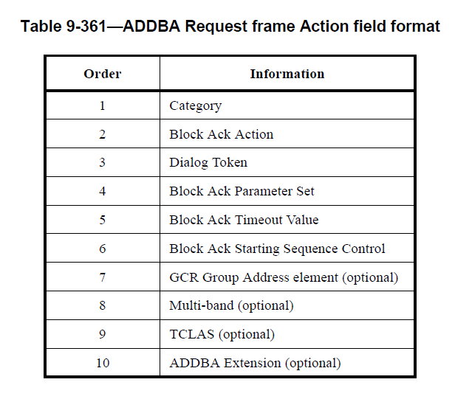
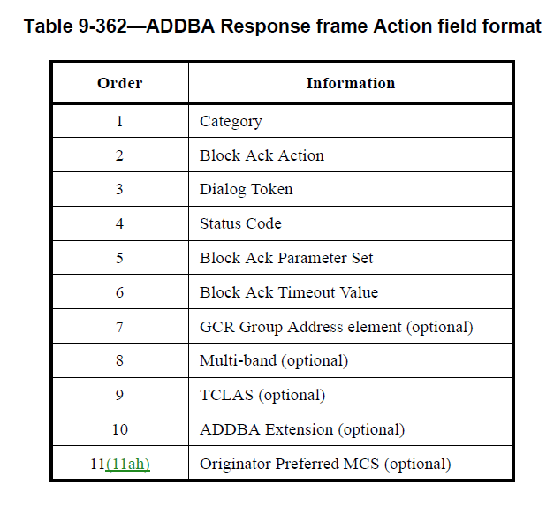
Contents of ADDBA Req/Resp frames

