Slide 1
Multilink Traffic Stream (TS) Operation
Date: 2020-06-29
Authors:

Slide 2
Single Link TS Operation Overview
Traffic Stream (TS) is established between SMEs by using ADDTS request and response frames
MSDUs within a TS should be delivered subject to the QoS parameter values provided to the MAC in a particular TSPEC.
TSPEC is a result of negotiation, based on actual requirements from one or more applications as well as actual MAC and PHY capabilities
MAC entities determine the TSPEC applicable for delivery of MSDUs belonging to a particular TS using the priority parameter provided with those MSDUs at the MAC SAP.
TSPEC is accountable to enable scheduling and admission control for MAC data services
Admission control can be applied to both EDCA and HCCA;
Traffic Classification (TCLAS) is used to associate a Layer-2 traffic stream to a higher layer application, or a category of applications
TID (8-15) = TSID comes from the ‘priority’ parameter at the MAC-SAP along with an MSDU；

Slide 3
.11 Amendments on TS Operation
Firstly introduced by 802.11e
In support of Fast BSS transition by 802.11r
In support of Service Provider Interface (SSPN) and Expedited Bandwidth Request (EBR) by 802.11u
U-APSD Coexistence by 802.11v
Higher layer stream ID and AP-initiated ADDTS by 802.11aa
DMG extensions by 802.11ad for SP allocation
In support of MU transmission by 802.11ax

Slide 4
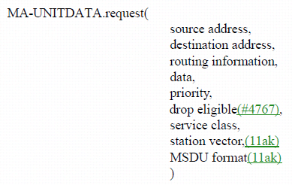
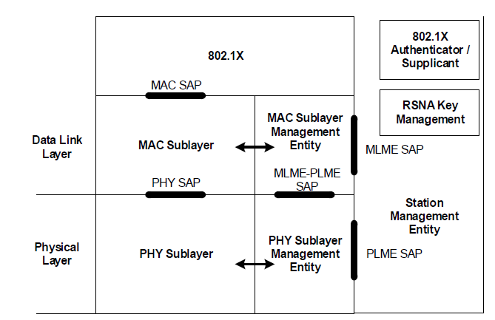
QoS Architecture
The priority parameter specifies the requested priority of the data unit transfer.
The drop eligible parameter provides guidance on whether this request can be discarded in preference to other requests when there are insufficient resources in a STA.
Priority parameter carried by TID
priority(TID)=0-7, interpreted as UP
priority(TID)=8-15, provided as TSID, UP can be found in TSPEC (TS info subfield)
MAC data service
TSPEC element {
Element ID,
Length,
TS info,
Nominal MSDU size,
Max MSDU size,
Min service interval,
Max service interval,
Inactivity Interval,
Suspension interval,
Service start time,
Min data rate,
Mean data rate,
Peak data rate,
Burst size,
Delay bound,
Min PHY rate,
Surplus bandwidth allowance,
Medium time,
DMG attributes
}
TS info{
Traffic type,
TSID,
Direction,
Access policy,
Aggregation,
APSD,
User priority,
TS info ACK policy,
Schedule,
Reserved,
}
TS management primitive

Slide 5
MLD QoS Architecture
Regarding a single MAC-SAP
A common description about the higher layer data streams, for both traffic characteristics and QoS requirements;
One data stream associates with one TS setup, re-using ADDTS REQ/RES;
MLD level admission control policy (for both EDCA and HCCA);
Regarding multiple links
Per-link resource reservation (allocation/schedule);
Per-link channel access mechanism;
Follow TID-to-Link mapping principles;

Slide 6
TSPEC is Neither Scalable Nor Flexible
TS setup is basically a procedure to exchange and negotiate TSPEC between MAC entities
Basic TSPEC element contains the set of parameters that define the characteristics and QoS expectations of a traffic flow, in the context of a particular STA.
Basic TSPEC is optional when DMG TSPEC is present in ADDTS request and response
DMG TSPEC element contains the set of parameters needed to create or modify an airtime allocation.
Basic TSPEC
Schedule (Allocation) info
DMG TSPEC

Slide 7
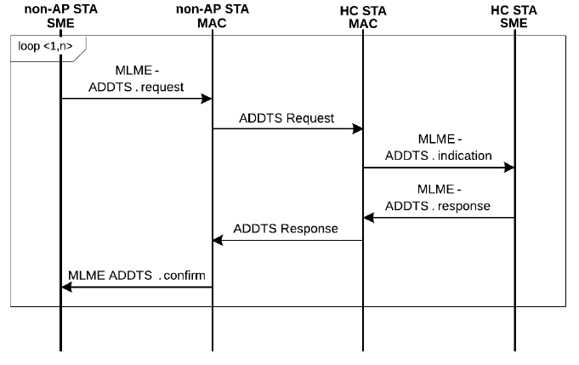
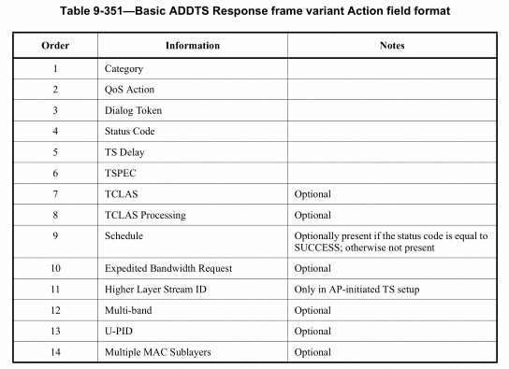
Basic TS Setup
STA initiated setup:
Basic ADDTS request/response
HC co-located with AP
Requested TSPEC
Admitted TSPEC (medium time & schedule)

Slide 8
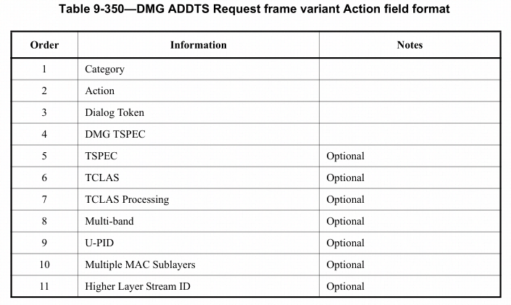
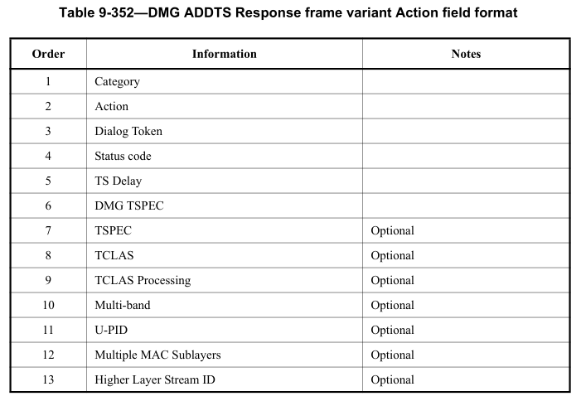
DMG TS Setup
STA initiated setup:
DMG ADDTS request/response
HC co-located with AP
Requested Allocation
DMG
DMG
Admitted Allocation

Slide 9
Multi-link TS Setup (1)
Non-AP MLD is built with full protocol stack, thus can have more information about the higher layer
Non-AP MLD should coordinate with AP MLD for more efficient use of the resources, with regards to the traffic characteristics and QoS requirements
Similar to other layer management functions, it is preferred to have a single TS setup between MLDs among multiple links.
ADDTS information exchange can be re-used on one selected link (maybe same as other management frame handshake)
Schedule/Allocation are established on the one or more links
Admission control policy should be implemented at MLD level
A flexible and scalable TSPEC variant for multilink shall be defined
Separate the common specification for traffic characteristics, associated with MAC-SAP and per-link schedule/allocation based on individual link capabilities.
Similar idea is also considered in [1]

Slide 10
Multi-link TS Setup (2)
Non-AP MLD
AP MLD
SME
STA1
STA2
STA1
STA2
SME
Option 1
ML ADDTS Req
w/ one TSPEC
{ML-TSPEC(STA1, STA2) }
{ML-TSPEC(STA1-Sch, STA2-Sch)}
ML ADDTS Res
Re-design TSPEC for multilink
Option 2
ML ADDTS Req
w/ multiple TSPEC
{ML-TSPEC(STA1), ML-TSPEC(STA2)}
{ML-TSPEC(STA1-Sch), ML-TSPEC(STA2-Sch)}
ML ADDTS Res
Re-use TSPEC for multilink

Slide 11
Considerations on Other ADDTS Action Fields
Action Fields | Attributes | Basic ADDTS request | Basic ADDTS response | Note | Suggested Revision for Multi-link
TSPEC | Mandatory | Y | Y | Interface between MAC and higher layer | Shall
TCLAS (+ processing) | Optional | Y | Y | Higher layer related | May not
Intra AC priority | Optional | Y | --
Higher layer stream ID | Only in AP initiated TS setup | Y | Y
U-PID | Optional | Y | Y
U-APSD coexistence | Optional | Y | -- | Specific to APSD | May
EBR | Optional | Y | Y | Specific to emergency service | May
Multi-band | Optional | Y | Y | DMG extensions | No need
Multiple MAC sublayer | Optional | Y | Y
TS delay | Mandatory | -- | Y | Delay for another retry | No need
Schedule | Optionally present if SUCCESS | -- | Y | Specifies the schedule information, service start time, SI, etc. | Should

Slide 12
11be Passed Motions
802.11be defines multi-link operation to better utilize the frequency band to enable high throughput low latency data transmission
Directional TID-to-link mapping mechanism allows the transmission of a specific TID to be carried on multiple links
By default, after the multi-link setup, all TIDs are mapped to all setup links.
The multi-link setup may include the TID-to-link mapping negotiation.
A single BA agreement is established between MLDs for a TID to be transmitted over one or more links
Setup BA agreement by using ADDBA request and response frames

Slide 13
Summary
TS operation shall be able to utilize the multilink capabilities provided by 11be
A consistent framework for multilink management is required regarding TS operation
A single TS is established between MLDs for a TSID to be transmitted over one or more links
TS setup procedure shall be re-using ADDTS request and response frames
Successfully established TS triggers BA agreement to be setup on the same links
T(S)ID-to-link mapping rules
Following the same rules defined for TID-to-link mapping
A TS can be setup on any available links subject to admission control policy
TS setup may update the TID-to-link mapping
Admission control should take into account the total capabilities of all available links

Slide 14
SP#1
Do you agree that a TS setup is required to transmit QoS Data frames with TID = 8~15 for 11be MLD?

Slide 15
SP#2
Do you agree that a single TS that is negotiated between two MLDs for a TID equal to 8~15 that may be transmitted over one or more links?

Slide 16
SP#3
Do you agree to use ADDTS Request and Response, TSPEC or their variants to setup or update a TS for the 11be MLD?

Slide 17
SP#4
Do you support to define the admission control policy to be implemented at the MLD level?

Slide 18
Reference
20-0418r1, Low latency service in 802.11be
20-0408r4, Prioritized EDCA Channel Access Over Latency Sensitive Links in MLO
20-0566r30, Compendium of straw polls and potential changes to the Specification Framework Document

