Slide 1
Group addressed frames delivery for MLO Follow UP
Date: 2020-07-20
Authors:

Slide 2
Background
There are two kinds of buffered BUs at the AP, one is individual addressed BUs and the other is group addressed BUs
Regarding individual addressed BU, its delivery follows the TIM baseline
  The non-AP MLD is assigned by one AID only
  In the TIM element, one bit corresponding to a non-AP MLD’s AID indicates if there is buffered individual addressed BUs for this non-AP MLD
  Further optimization is needed, such link bitmap to indicate on which link the non-AP MLD should receive this buffer
Meanwhile group addressed BUs delivery was also discussed in a few contributions [1]-[4]
  It is agreed that each AP in an AP MLD shall independently transmit all bufferable group addressed Management frames after every DTIM beacon
In this contributions, we provide further discussion for group addressed BUs delivery

Slide 3
Group addressed BUs delivery
The AP in the AP MLD shall transmit all buffered group addressed MMPDU BUs immediately after every DTIM beacon except for the following case
  A TWT scheduling AP shall schedule all buffered group addressed BU during the broadcast TWT SPs located within the beacon interval that follows the DTIM Beacon frame in the non-trigger enabled unannounced Broadcast TWT SP
AP 1
Link 1
AP1
DTIM B
Group BU 1
STA 1
STA1
AP 2
AP2
DTIM B
Group BU 2
STA 2
Link 2
STA2
AP 3
Link 3
AP3
DTIM B
Group BU 3
STA 3
Configured link
Legacy STA
STA 3

Slide 4
Group addressed BUs delivery
TIM element provides group addressed BU delivery notification at the AP side
  Bit 0 of the Bitmap Control field of the TIM element contains the traffic indication virtual bitmap bit associated with AID 0.
  This bit is set to 1 in TIM elements with the DTIM Count field set to 0 when one or more group addressed MSDUs/MMPDUs are buffered at the AP
If the AP in a Multiple BSSID set, TIM element also provides the group addressed BU delivery notification at the nontransmitted BSSID side
  The bits 1 to (2^{n} – 1) of the Partial Virtual Bitmap field of the TIM element are used to indicate that one or more group addressed frames are buffered for each AP corresponding to a nontransmitted BSSID
  The AIDs from 1 to (2^{n} – 1) are not allocated to a STA such that to avoid the collision with individual addressed BU notification

Slide 5
Group addressed BUs delivery for MLO
Group addressed BU delivery notification in one frame is also needed for each AP in the AP MLD
  To ensure that each STA within the Non-AP MLD can receive the group addressed Management frames from its associated AP in the AP MLD, an AP needs to indicate if other APs in the same AP MLD have buffered BUs
  To avoid the “miss” and “duplicate” group addressed Data frame problem as mentioned in [5], an AP needs to indicate if other APs in the same AP MLD have buffered BUs
Note-It does not apply to single radio MLD
AP 1
Link 1
AP1
DTIM B
Group BU 1
STA 1
STA1
AP 2
AP2
DTIM B
STA 2
Link 3
STA 2
STA MLD has group BU on link 1
Configured link
Reception

Slide 6
Group addressed BUs delivery for MLO
Moreover, this notification is also needed for the other APs in the AP MLDs to which an AP that is in the same multiple BSSID set as the transmitting AP is affiliated to, similar to the CSN and eCSA mechanisms.
It is straightforward for an AP in an AP MLD to provide group addressed BU delivery notification for each AP in the AP MLD by using a bitmap
However, it requires additional field or element in the Beacon frame.
Hence, we propose to reuse TIM baseline to provide such notification, like individual addressed BU
  For the transmitting AP in the AP MLD, reuse Bit 0 of the Bitmap Control field of the TIM element
  For other APs in the AP MLD, reuse the bits of the Partial Virtual Bitmap field of the TIM element like non-transmitted BSSID

Slide 7
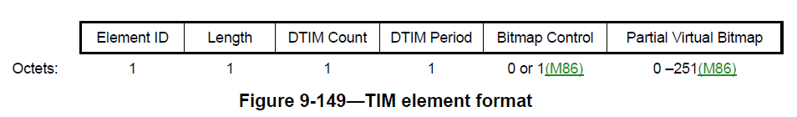
Group addressed BUs delivery for MLO
Since each bit of the Partial Virtual Bitmap field of the TIM element correspond to an AID in the AID space, each AP in the AP MLD shall be assigned by an AID
  Opt 1: Assign an unique AID to each AP in an AP MLD explicitly
  The unique AIDs will be broadcasted through the frame
  Opt 2: Assign an unique AID to each AP in an AP MLD implicitly
  Assign some contiguous unique AIDs to each AP in the MLD implicitly like non-transmitted BSSIDs, but in the order of Link ID
  The starting point can be either AID 1 or the AID after the last AID assigned to nontransmitted BSSIDs

Slide 8
Summary
To help each STA within the non-AP MLD maintain its own basic BSS operation, we propose that an AP within an AP MLD shall provide the group addressed BU delivery notification for each AP in the AP MLD
  One way is additional notification bitmap
  The other way is to reuse TIM baseline

Slide 9
References
[1] IEEE 802.11-19/1988r0 Power save for Multi-link
[2] IEEE 802.11-20/0488r0 Multi-link Group Addressed Data Delivery
[3] IEEE 802.11-20/0442r2 MLA: Group addressed frames delivery
[4] IEEE 802.11-20/0661r4 Group addressed frames delivery for MLO
[5] IEEE 802.11-20/0903r0 Multi-link Group Addressed Data Frame Delivery Follow up

Slide 10
SP 1
Do you support that in R1, an AP affiliated with an AP MLD shall indicate if other APs in the same AP MLD has buffered group addressed frames by using the existing TIM element?
  If the AP is not part of multiple BSSID set or if the AP is part of a multiple BSSID set and is a transmitted BSSID, then the indication is in DTIM Beacon sent by the AP and is based on the latest information about the other APs that it has when the AP schedules the DTIM beacon
  if the AP is a non-transmitted BSSID in a multiple BSSID set, then the indication is in DTIM Beacon sent by the transmitted BSSID of the same multiple BSSID set as the AP and is based on the latest information about the other APs that the transmitted BSSID has when it schedules the DTIM beacon

Slide 11
SP 2
Do you agree that in R1, if an indication of buffered group addressed frames about an AP in an AP MLD is received by a non-AP MLD, the STA in the non-AP MLD that is associated with that AP and decides to stay awake to receive group addressed BUs shall elect to receive all group addressed frames

Slide 12
SP 2A
Do you agree that in R1, if an indication of buffered group addressed frames about an AP in an AP MLD is received by a non-AP MLD, the STA in the non-AP MLD that is associated with that AP and stays awake to receive group addressed BUs shall elect to receive all group addressed frames

Slide 13
SP 3
Do you agree to add to the SFD for R1 that an AP shall use contiguous bits of the Partial Virtual Bitmap field of the TIM element after the last bit for nontransmitted BSSID (if any) to indicate group addressed BU information in the DTIM beacon it sends for the other APs in the AP MLDs to which the AP is affiliated to or to which an AP that is in the same multiple BSSID set as the AP is affiliated to?

Slide 14
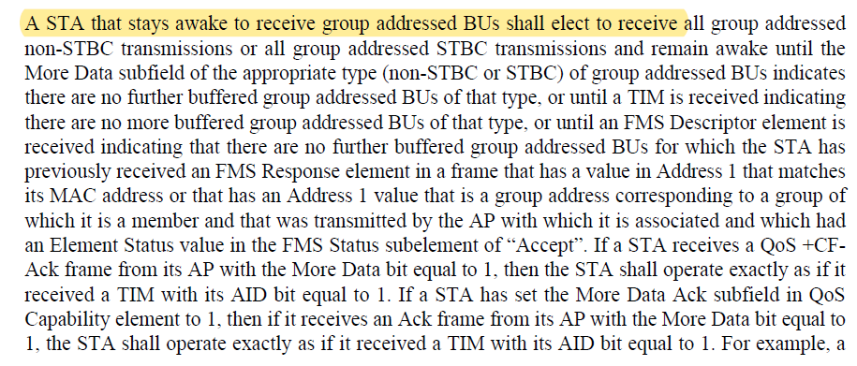
APPENDIX

