Slide 1
Wireless Broadband Alliance Sensing Activities: Home Monitoring Use-Case, KPIs Being Evaluated
Date: 2020-06-26
Authors:

Slide 2
Abstract
This contribution proposes a list of KPIs for Home Monitoring Use-Case

Slide 3
Outline
Brief History within WBA
Generic Wi-Fi Sensing Systems
Comparison to Other Wi-Fi Services
Home Monitoring Use-Case
  KPIs Being Evaluated
Usage of Existing MAC/PHY Standards
Challenges Faced
  References

Slide 4
Brief History within WBA
A workgroup specific to Wi-Fi Sensing discussions was officially formed January 2019
First output of group was a whitepaper introducing the technology along with business opportunities
https://wballiance.com/wba-wi-fi-sensing/
The group has started a second phase project, focused on application layer topics surrounding testing for a Home-Monitoring use-case.
https://wballiance.com/wba-wi-fi-sensing/

Slide 5
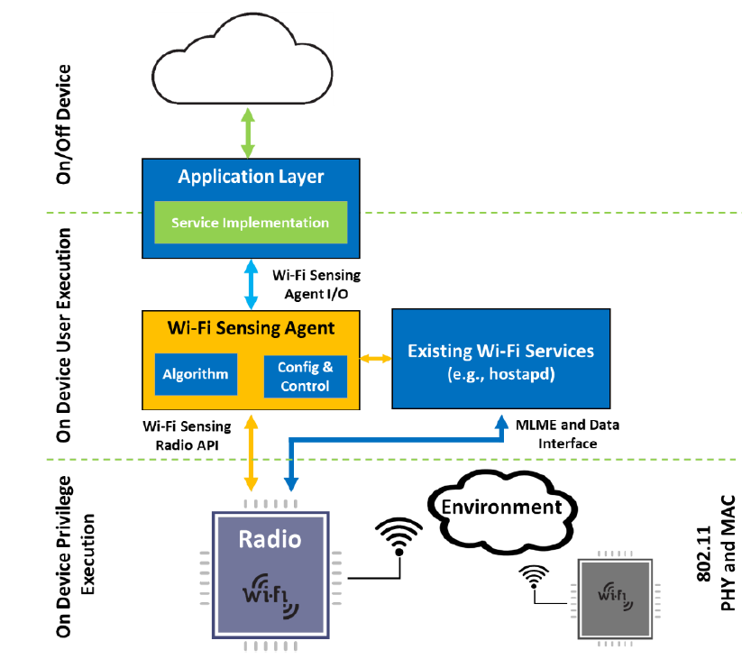
Generic Wi-Fi Sensing Systems
Uses for Sensing is very broad [1]-[5]
  Home Monitoring (Motion Detection)
  Health-Care and Monitoring
  Gesture Detection (smart control)
  Many Others …
Sensing occurs above MAC/PHY [6]
  PHY data (CSI) is extracted from radio
  Processed by algorithm within an agent
  Agent output enables application/service
Works along side existing services
  Agent may be added to AP, or STA
[1] WBA Wi-Fi Sensing Whitepaper

Slide 6
Comparison to Other Wi-Fi Services
Wi-Fi Sensing is just a new type of service
As an example, compare Hotspot 2.0 to Home-Monitoring
  Both provide service to end user (automatic roaming vs home insight)
  Both reside in an agent above the MAC/PHY layer (hostapd vs sensing agent)
  Both extend 802.11 base components (discovery/association vs channel estimation)
Difference is Wi-Fi Sensing is still emerging …
  Hotspot 2.0 benefits from standardization (802.11u – discovery features, 802.11i – WPA2)
  Hotspot 2.0 uses defined information elements for data exchange (WFA Defined)

Slide 7
Home Monitoring Use-Case
Algorithm designed to detect motion in home (2.4G / 5G / 6G)
  Extra features such as localization are also present
  Enhancements to filter false detections from pets / shadows / moving objects
Output typically sent to cloud, and accessible via mobile app
Many useful features can be derived from motion
  Alerts/alarm when unexpected motion detected in house
  Historical data
  Interaction with other IoT devices
Technology provides many benefits
  Does not require LoS (PIR sensors and cameras)
  Privacy concerns (cameras)
  Algorithms to minimize potential false detections

Slide 8
KPIs Being Evaluated
Base Motion Sensing Performance Metrics
  Characterization of algorithm’s ability to minimize false-detects and maximize correct-detections
Sensing Latency Delay and Decay
  Measurement of time for algorithm’s prediction to match reality
Sensing Stationary/Static Environment
  Long term stability in environment where there is no motion
Motion Resolution
  Ability to detect small vs large vs fast vs slow human motion
Floor Coverage and Surface Area
  Coverage of entire environment with a given number of devices

Slide 9
KPIs Being Evaluated
Sensing Location Accuracy
  Ability of algorithm to determine physical location of motion
Sensing With Interference
  Reduction in sensitivity due to electrical, mechanical, or network load interference
Network Performance
  Measurement of network resources utilized for Sensing
Computation Resources
  Evaluation of CPU/memory resource requirements to implement Agent

Slide 10
Usage of Existing MAC/PHY Standards
Eliciting measurement from another STA
  Various mechanisms in existing standard used for this purpose
    Null-Data frame transmission and ACK response
      LTS in ACK used to provide CSI
      Pro: Protocol contained in MAC layer
      Con: Limitation is ACKs are legacy and MIMO CSI not possible
    Existing application data traffic
      Relies on data communication, or application layer data transmission
      Pro: MIMO CSI is possible
      Con: Solution spans many layers (up to application layer)
      Con: Higher overhead and less deterministic behaviour

Slide 11
Challenges Faced
No standardized protocol for eliciting measurements
  Periodic measurements generally performed
    Air time efficiency, regular scheduled intervals
  MIMO or Legacy CSI
  Need to ensure static configuration for transmission (beamforming)
Device participation and capability exchange
  Not every device will want to participate (e.g., battery operated)
No common radio API and interface among chipsets
  Results in duplication of code that could be made common

Slide 12
References
[1]. https://wballiance.com/wba-wi-fi-sensing/
[2] Wi-Fi sensing: Usages, requirements, technical feasibility and standards gaps IEEE 802.11-19/1293r0
  [3] 802.11 Sensing: Applications, Feasibility, Standardization, IEEE 802.11-19/1626r0
  [4] Wi-Fi Sensing Application: Multipath Enhanced Device free Localization, IEEE 802.11-19/1580r0
  [5] Wi-Fi Sensing: Technical Feasibility, Standardization Gaps, IEEE 802.11-17/1803r0
  [6] WLAN Sensing Definitions, IEEE 802.11-20/0807r1

