Slide 1
Triggered P2P for 11be Release 1
Date: 2019-08-23
Authors:

Slide 2
Abstract
Propose a simple/low-complexity Triggered P2P scheme to be used for 11be R1.

Slide 3
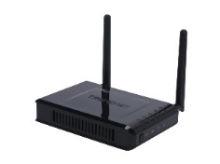
Introduction
Direct Link transmission => A Direct Link Scheduled (“DLS”) STA communicates directly with another Direct Link Peer STA (“DLP”).
Benefits of Direct Link (“DiL”) transmission [1] :
high throughput because lower number of transmissions
low latency due to one hop communication.
Use-case of interest:
Miracast streaming from laptop to monitor.
VR applications
Wireless file transfer from phone to printer.
AP
DiL-A
TXOP
DLS STA
SIFS
Data
DLP STA
SIFS
Ack
Slide 3

Slide 4
Trigger based DiL sequence benefits
A DiL transmission sequence initiated by a TF transmission has following benefits.
Increases the chances of either AP or the DiL STA wins a TXOP for DiL transmissions when both contend simultaneously.
Better medium management at AP as it can serve more than just one DiL STA in a TXOP.
Submission 1117r1 (appendix) mentions some inefficiency of QTP to support Direct link:
Legacy STA not prevented from channel access.
AP is not aware of actual resource requests at STA during the QTP period. The initial configuration of schedules may be stale => medium inefficiency.

Slide 5
Possible Topologies
Case 1
ESS
Case 2
AP in the ceiling
of an office
AP in the ceiling
of an office
DLP
STA
(wireless monitor)
DLS
STA (laptop)
DLS
STA (laptop)
DLP
STA
(wireless monitor)
Both STAs associated
to same AP.
[Optional]
Another AP in the ESS
Only one STA associated
to the Triggering AP.
: AP
: Non-AP STA
Notes:
Case 3 is same as general Multi-AP.

Slide 6
Basic Triggered P2P sequence
AP transmits a TF allocating remaining portion of TXOP to STA.
Special signaling needed; may be a bit.
Peer STA responds with Ack (in TB PPDU) if it wants to use the allocation.
Peer STA uses the allocation for any purpose including peer-to-peer communication.
TXOP owned by AP
TF from AP for P2P (Allocate T1)
Ack from peer STA
Data from peer STA to other peer
Ack to peer STA from other peer
T1

Slide 7
Summary
Discussed challenges with Triggered P2P operation.

Slide 8
References
11-18-1481-01-0eht-technology-for-EHT
11-18-2009-06-0rta-rta-report-draft

Slide 9
Backup slides

Slide 10
1117r1: Direct Link issues with 11ax amendments
Direct link provides high “interferences” to the AP
Direct link traffic carries large amount of data
Large video transmission for VR, or video streaming.
Direct link traffic often requires low latency thus frequently accesses the medium.
Interactive applications (VR, visio conferences, etc.)
Direct link cannot be efficiently scheduled by an AP today
AP cannot trigger the sending of direct link data, so fine scheduling is not possible.
Direct link only relies on EDCA.
Multi User OFDMA doesn’t support Direct link traffic.
Quiet time period mechanism is not incentive enough
Every station with direct link traffic will contend on the same period. Even if this period has been negotiated by a STA, the quiet time period is open for all direct link stations
Other stations with uplink data may also contend during this period (Quiet time period is just intended to give a better priority of medium access for direct link traffic).
No specific protection against legacy stations.

Slide 11
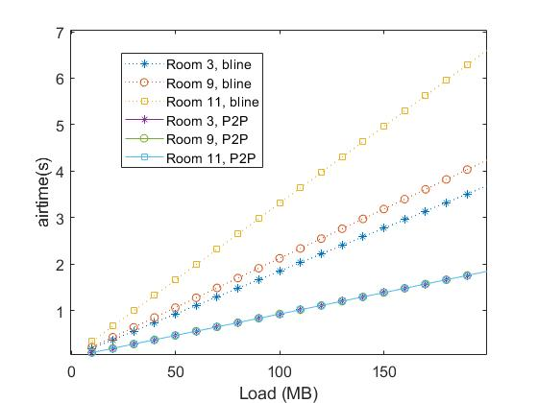
Motivation
P2P communication can significantly reduce the load on the BSS and simultaneously the latency by a one-hop communication.
About 70% reduction in
latency/airtime possible in
the two floor home scenario
by using P2P communication among users in the same room.

