Slide 1
Backward compatible EHT trigger frame
Date: 2020-06-01
Authors:

Slide 2
Background
In 802.11ax, trigger frame was proposed to solicit the uplink MU PPDU (HE TB PPDU)
  Synchronize the stating time of all the uplink sub-PPDUs
  Align the ending time of all the uplink sub-PPDUs
  Provide the transmission parameters for each uplink sub-PPDU, e.g., RU allocation, MCS
802.11 be introduces new bandwidth, new stream number
  All of these new factors may change the trigger frame
In this contribution, we discuss a possible backward compatible EHT trigger frame design

Slide 3
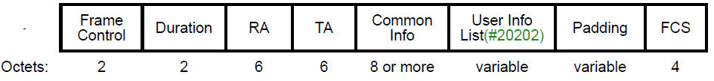
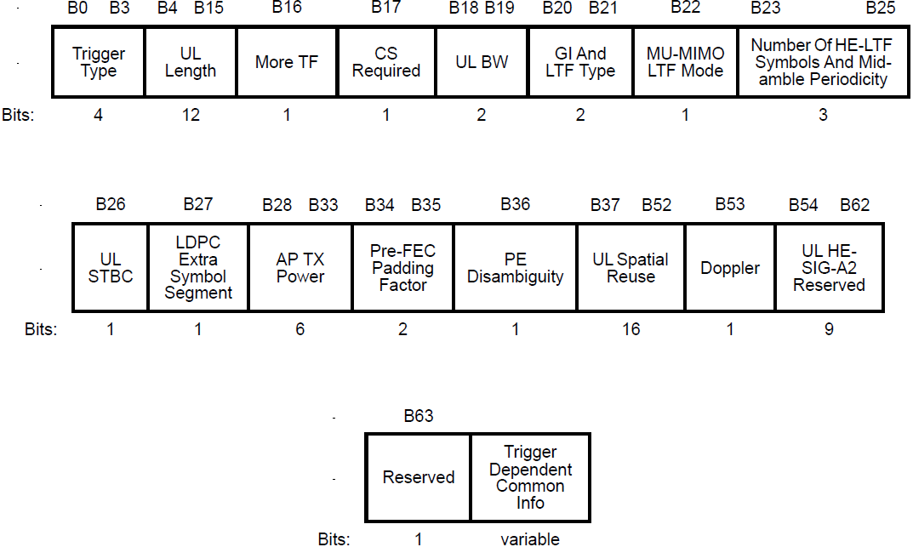
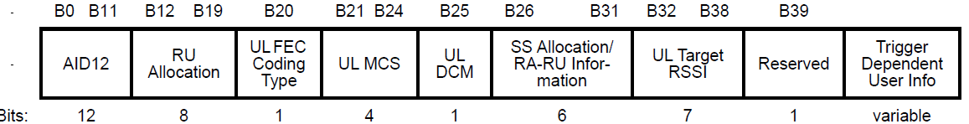
Recap
HE trigger frame is shown as below
  Common Info field and a list of User Info fields

Slide 4
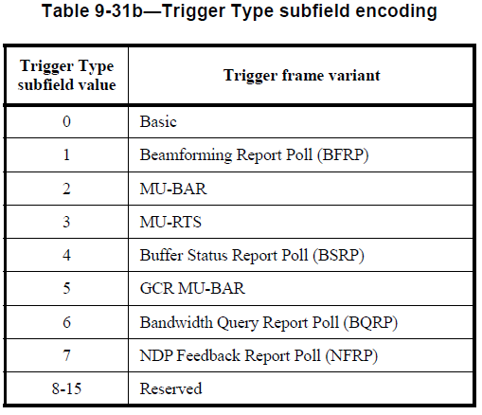
Backward compatible
In 802.11ax, we already have the following trigger types
For the same trigger function, it is better to reuse the exiting trigger types
  No need to add the new trigger types just because of new bandwidth and new stream number
  Can be used to solicit the mixed UL PPDU from HE STA and EHT STA
  We will discuss the backward compatible design from
  Common Info field in the trigger frame
  User Info field in the trigger frame

Slide 5
Common Info field in trigger frame
The following subfields in the Common Info field need extension because of the new features in EHT
  UL Bandwidth
  Number of EHT-LTF Symbols And Midamble Periodicity extension
  UL Spatial Reuse…
The following fields may be added to the Common Info field for the mixed transmission
  EHT/HE indication per segment, like 80 MHz
  Puncture info
  All of the above fields could be put in a special User Info field，like special STA Info field of puncture info in NDP announcement frame
  Transparent to HE STA
  Or we can reuse reserve bits in the Common Info field
  But some of them may already be used for implementation
  The reserved bits may not be enough

Slide 6
User Info field in trigger frame
The following subfields in the User Info field may be impacted by the new features in EHT
  RU allocation subfield
  SS allocation subfield
  However, there is only one reserved bit in User Info field. From the philosophy of design, it is better to keep it.
  We propose to have a special User Info field to divide the User Info fields into two categories
  Keep the existing 8-bit RU allocation subfield, and add MRU mode and large RUs to 7-bit table (refer to appendix)
  RU allocation subfield in the 1st part indicates a RU within or larger than primary160 MHz
  RU allocation subfield in the 2nd part indicates a RU within or larger than second 160 MHz
User Info 1
User Info 2
…
User Info X
Special User Info
User Info X+1
User Info X+2
…
User Info X+n
The first part, the assigned RU is within or larger than primary 160 MHz
The second part, the assigned RU is within or larger than secondary 160 MHz

Slide 7
Summary
We propose a backward compatible EHT trigger frame by adding a special User Info field
  No need double the existing trigger types
  Can be used to solicit UL mixed PPDU transmission from HE STA and EHT STA

Slide 8
References
[1] 11-20-0416-00-00be-mru-signaling-in-trigger-frame
[2] 11-20-0413-01-00be-discussion-on-eht-trigger-based-ul-mu

Slide 9
SP 1
Do you agree that the Trigger frame can be used to solicit the TB PPDU from both the HE STA(s) and EHT STA(s)?

Slide 10
SP 2
Do you agree to keep the same length of the User Info filed with at least one reserved bit in the Trigger frame as the HE Trigger frame in R1?

Slide 11
SP 2’
Do you agree to keep the lengths of all the User Info fields same in the Trigger frame for a given trigger type in R1?

Slide 12
SP 3
Do you agree to optionally include a special User Info starting with a special AID in the Trigger frame in R1?

Slide 13
SP 4
Do you agree to include an EHT/HE indication per 80 MHz in the common part of the Trigger Frame , indicating to the EHT STA whether to transmit an HE or EHT TB PPDU in R1?

Slide 14
SP 5
Do you agree to have one unified RU allocation table for the RU allocation field in the User Info field of the Trigger frame in R1?

Slide 15
Appendix 1
B8-B2 | Description | Number of entries
0-36 | 26-tone RU in 80MHz | 37 (18 is reserved)
37-52 | 52-tone RU in 80MHz | 16
53-60 | 106-tone RU in 80MHz | 8
61-64 | 242-tone RU in 80MHz | 4
65-66 | 484-tone RU in 80MHz | 2
67 | 996-tone RU in 80MHz | 1
68 | 2*996-tone RU | 1 (can be either 160MHz full BW or one kind of large M-RU)
69-84 | Small M-RU | 16
85-124 | Large M-RU | 40
125 | 4*996-tone RU | 1
…

Slide 16
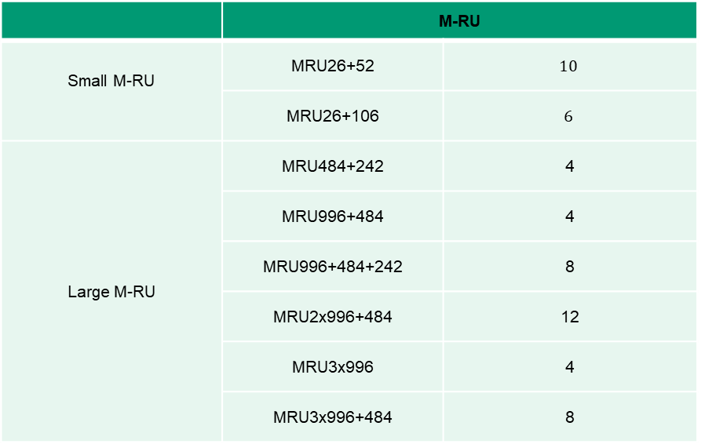
Appendix 2
 | M-RU
Small M-RU | MRU26+52 | $$10$$
 | MRU26+106 | $$6$$
Large M-RU | MRU484+242 | 4
 | MRU996+484 | 4
 | MRU996+484+242 | 8
 | MRU2x996+484 | 12
 | MRU3x996 | 4
 | MRU3x996+484 | 8

