Slide 1
Pilot subcarriers considering new tone plan

Slide 2
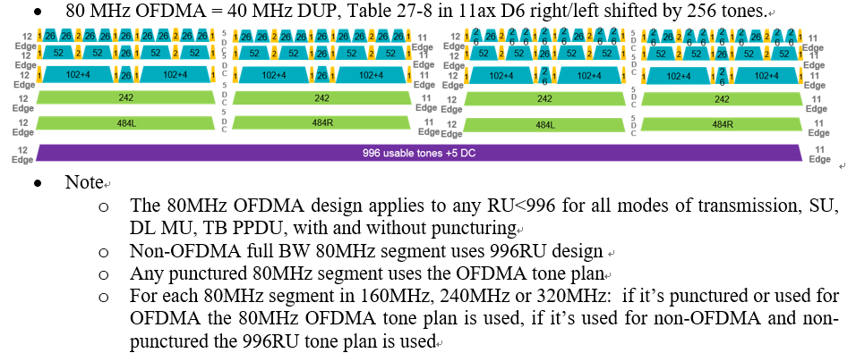
Background
The new tone plan was passed [1].
Here I’d like to check the pilot subcarriers for the new tone plan.
  The RU location is changed from [-258:-17, 17:258] to [-253:-12, 12:253] in 80MHz segment. And the location of pilot subcarriers may not be suitable in the below cases.
    26/52/106/242/484-tone RUs (some RU location is changed)
    n*996-tone RUs (n>=1) (the RU location is not changed)
    RU combinations

Slide 3
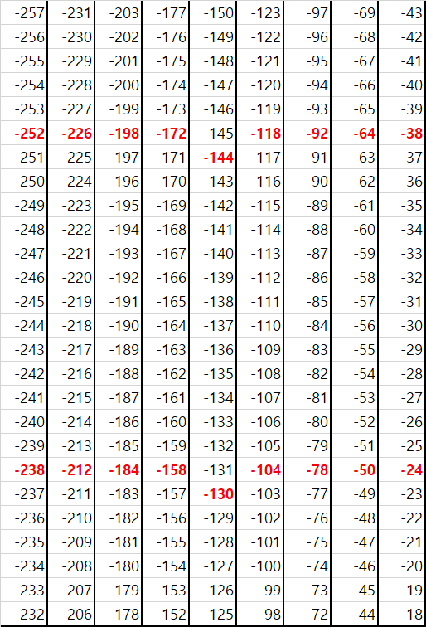
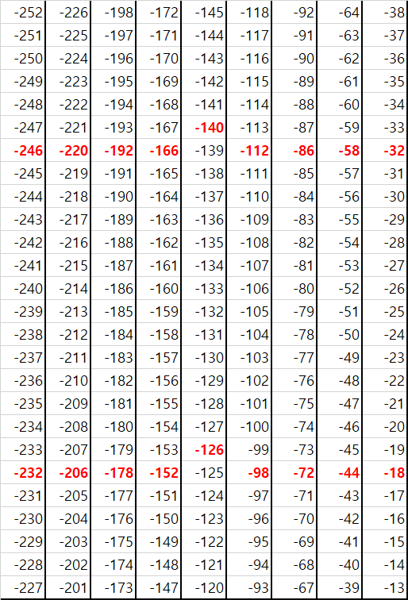
Pilot indices for under 996RUs (1/3)
There are data and pilot subcarriers in some 26 RUs of old/new tone plan.
  The 11ax pilot subcarriers were decided in (6 or 7) and (20 or 21) index with even tone among 26-tone RU[2]. So we also consider the 11be pilot subcarriers in new tone plan as red color in the below right figure.
  Also it’s simple because the pilots are generated by repeating the pilot subcarriers in 40MHz.
26RUs in [-258:-17] of old tone plan
26RUs in [-253:-12] of new tone plan

Slide 4
Pilot indices for under 996RUs (2/3)
There are pilot indices for under 996RUs in 20/40MHz of 11ax
  In 20MHz
  In 40MHz
We can reuse that in 11be because of no change of tone plan in 20/40MHz.
26-tone RU | {-116, -102}, {-90, -76}, {-62, -48}, {-36, -22}, {-10, 10}, {22, 36}, {48, 62}, {76, 90}, {102, 116}
52-tone RU | {-116, -102, -90, -76}, {-62, -48, -36, -22}, {22, 36, 48, 62}, {76, 90, 102, 116}
106-tone RU | {-116, -90, -48, -22}, {22, 48, 90, 116}
242-tone RU | {-116, -90, -48, -22, 22, 48, 90, 116}
26-tone RU | {-238, -224}, {-212, -198}, {-184, -170}, {-158, -144}, {-130, -116}, {-104, -90}, {-78, -64}, {-50, -36}, {-24, -10}, {10, 24}, {36, 50}, {64, 78}, {90, 104}, {116, 130}, {144, 158}, {170,184}, {198, 212}, {224, 238}
52-tone RU | {-238, -224, -212, -198}, {-184, -170, -158, -144}, {-104, -90, -78, -64}, {-50, -36, -24, -10}, {10, 24, 36, 50}, {64, 78, 90, 104}, {144, 158, 170,184}, {198, 212, 224, 238}
106-tone RU | {-238, -212, -170, -144}, {-104, -78, -36, -10}, {10, 36, 78, 104}, {144, 170, 212, 238}
242-tone RU | {-238, -212, -170, -144, -104, -78, -36, -10}, {10, 36, 78, 104, 144, 170, 212, 238}
484-tone RU | {-238, -212, -170, -144, -104, -78, -36, -10, 10, 36, 78, 104, 144, 170, 212, 238}

Slide 5
Pilot indices for under 996RUs (3/3)
And we can use the below pilot indices for under 996RUs in 80/160/320 MHz for 11be.
  in a OFDMA/non-OFDMA 80MHz EHT PPDU
    [Pilot indices in 40MHz]-256, [Pilot indices in 40MHz]+256
  in a OFDMA/non-OFDA 160MHz EHT PPDU
    [Pilot indices in 80MHz]-512, [Pilot indices in 80MHz]+512
  in a OFDMA/non-OFDMA 320MHz EHT PPDU
    [Pilot indices in 160MHz]-1024, [Pilot indices in 160MHz]+1024

Slide 6
Pilot indices for RU combinations
In case of Small/Large RU combinations [3], pilot subcarriers includes the pilots in each RU. For example,
  In 26+52RU, 2 pilots of 26RU and 4 pilots of 52RU (total 6)
  In 996+484RU: 16 pilots of 996RU and 16 pilots of 484RU (total 32)
  Actually it’s already agreed in the discussion of LDPC mapper.[4]

Slide 7
Pilot indices for n*996RUs (n≥1) (1/2)
Subcarriers of 996RU are not changed in[-500:-3 3:500]. So we can consider two options to decide pilot subcarriers for n*996RUs.
  Option1: We can use pilot subcarriers as it is in 11ax, but the alignment of pilot subcarriers with 26/52/106/242/484-tone RU is broken.
  Option2: We can change pilot subcarriers to be aligned with other RUs.
  As a reference, we check the PAPR performance of LTF sequences and option1 has lower PAPR in 80/160MHz. Please see the next page. But option2 is easy to set pilot subcarriers same with other RUs.
  The two options have pros and cons. So we need to discuss it.
996-tone RU | {-468, -400, -334, -266, -226, -158, -92, -24, 24, 92, 158, 226, 266, 334, 400, 468}
996-tone RU | {-468, -400, -334, -266, -220, -152, -86, -18, 18, 86, 152, 220, 266, 334, 400, 468}

Slide 8
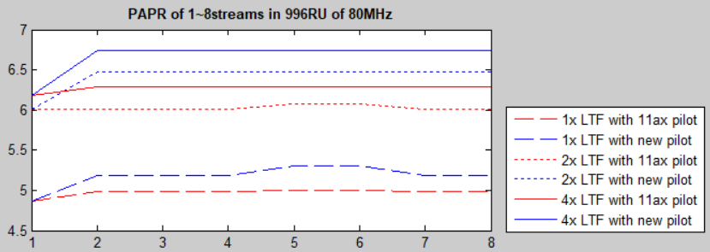
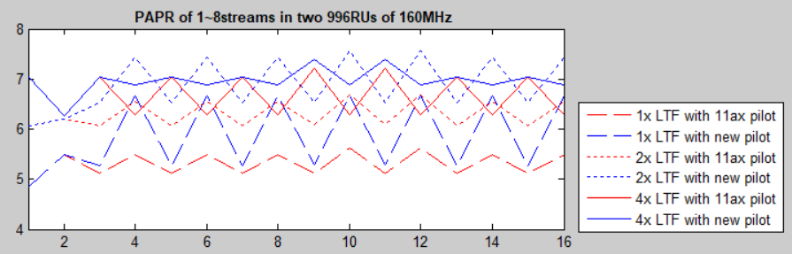
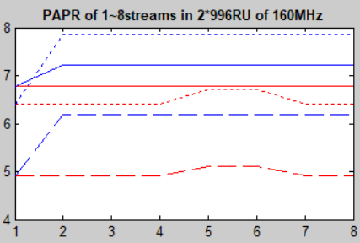
Pilot indices for n*996RUs (n≥1) (2/2)
PAPRs per stream(1~8streams) in 80MHz
  In all cases, LTF sequences with 11ax pilot subcarriers has about 0.1~0.5dB lower PAPRs with new pilots.
PAPRs per stream of two 996RUs in the left figure and of 2*996RU in the right figure in 160MHz
  It has the same trend.

Slide 9
Conclusion
In this slide, the location of pilot subcarriers of 11be is considered.
  For under 996RUs, pilot subcarriers is better to be shifted.
  For RU combinations, pilot subcarriers of each RU are used as it is.
  And for n*996RUs (n≥1), we can consider two options to use as it is or shifted pilots.

Slide 10
Reference
[1] IEEE802.11-20/0566r21, “Compendium of straw polls and potential changes to the Specification Framework Document”
[2] IEEE802.11-15/0819r1, “11ax OFDMA Tone Plan Leftover Tones and Pilot Structure”
[3] IEEE802.11-19/1262r9, “Specification Framework for Tgbe”
[4] IEEE802.11-20/0394r1, “Thoughts on RU Aggregation and Interleaving”

Slide 11
Straw poll 1
Do you support to reuse pilot subcarriers of 11ax in 20/40MHz PPDU of 11be?
  Y/N/Abs

Slide 12
Straw poll 2
Do you support the below pilot indices for 26/52/106/242/484RU in 80/160/320MHz PPDU of 11be?
  in a OFDMA/non-OFDMA 80MHz EHT PPDU
    [Pilot indices in 40MHz]-256, [Pilot indices in 40MHz]+256
  in a OFDMA/non-OFDA 160MHz EHT PPDU
    [Pilot indices in 80MHz]-512, [Pilot indices in 80MHz]+512
  in a OFDMA/non-OFDMA 320MHz EHT PPDU
    [Pilot indices in 160MHz]-1024, [Pilot indices in 160MHz]+1024
  Y/N/Abs

Slide 13
Straw poll 3
Do you support that pilot subcarriers for small/large RU combinations includes the pilot subcarriers of each RU?
  Y/N/Abs

Slide 14
Straw poll 4
Which one do you prefer as the pilot subcarriers for n*996RUs (n≥1) in 80/160/320MHz PPDU of 11be?
  Option1: Pilot subcarriers as it is in 11ax.
  Option2: Pilot subcarriers to be changed with other RUs as SP1.
  Other:
  Abs:

Slide 15
Straw poll 5
(If option 1 of SP4 is supported,)
Do you support to use the below pilot indices for n*996RUs (n ≥ 1) in 11be?
  In a OFDMA/non-OFDMA 80MHz EHT PPDU
    Pilot indices of 996-tone RU: P₉₉₆ = {-468, -400, -334, -266, -226, -158, -92, -24, 24, 92, 158, 226, 266, 334, 400, 468}
  In a OFDMA/non-OFDMA 160MHz EHT PPDU
    Pilot indices of 996-tone RU: {P₉₉₆ -512}, {P₉₉₆ + 512}
    Pilot indices of 2*996-tone RU: {P₉₉₆ -512, P₉₉₆ + 512}
  In a OFDMA/non-OFDMA 320MHz EHT PPDU
    Pilot indices of 996-tone RU: {P₉₉₆ -1536}, {P₉₉₆ -512}, {P₉₉₆ + 512}, {P₉₉₆ + 1536}
    Pilot indices of 2*996-tone RU: {P₉₉₆ -1536, P₉₉₆ -512}, {P₉₉₆ + 512, P₉₉₆ + 1536}
    Pilot indices of 4*996-tone RU: {P₉₉₆ -1536, P₉₉₆ -512, P₉₉₆ + 512, P₉₉₆ + 1536}

Slide 16
Straw poll 6
(If option 2 of SP4 is supported,)
Do you support to use the below pilot indices for n*996RUs (n ≥ 1) in 11be?
  In a OFDMA/non-OFDMA 80MHz EHT PPDU
    Pilot indices of 996-tone RU: P₉₉₆ = {-468, -400, -334, -266, -220, -152, -86, -18, 18, 86, 152, 220, 266, 334, 400, 468}
  In a OFDMA/non-OFDMA 160MHz EHT PPDU
    Pilot indices of 996-tone RU: {P₉₉₆ -512}, {P₉₉₆ + 512}
    Pilot indices of 2*996-tone RU: {P₉₉₆ -512, P₉₉₆ + 512}
  In a OFDMA/non-OFDMA 320MHz EHT PPDU
    Pilot indices of 996-tone RU: {P₉₉₆ -1536}, {P₉₉₆ -512}, {P₉₉₆ + 512}, {P₉₉₆ + 1536}
    Pilot indices of 2*996-tone RU: {P₉₉₆ -1536, P₉₉₆ -512}, {P₉₉₆ + 512, P₉₉₆ + 1536}
    Pilot indices of 4*996-tone RU: {P₉₉₆ -1536, P₉₉₆ -512, P₉₉₆ + 512, P₉₉₆ + 1536}

